Slide 1
NOxTech NOx Reduction Technology
Technology Highlights
Over $23 MM invested
    Cummins & DOE
Successful diesel application
    2.8 MW Diesel IC Engine
    Operating since 1995 @ 96%
Enron holds exclusive license
    All utility boiler applications
    50% partner w/ Mitsui-Babcock
1 MW lab-scale demo
    Mitsui-Babcock (MB) test rig
    On-going tests positive
20 MW scale test
    MB test rig – Sept 2001
    Address scale-up issues
200 MW full scale demo
    TVA – Nov/Dec 2001
Technology Process
Gas-phase, autocatalytic process
  Inject hydrocarbon
    Natural gas, propane or diesel
    1%-3% of boiler heat input
  Inject ammonia
  Chemical reaction:
    Reduces NOx by 80%-90%
    Minimal ammonia slip (<2ppm)
    Reduces CO &Unburned Carbon
Increases fuel flexibility
No impact on plant output
Shorter installation cycle
Reduced site restrictions

Slide 2
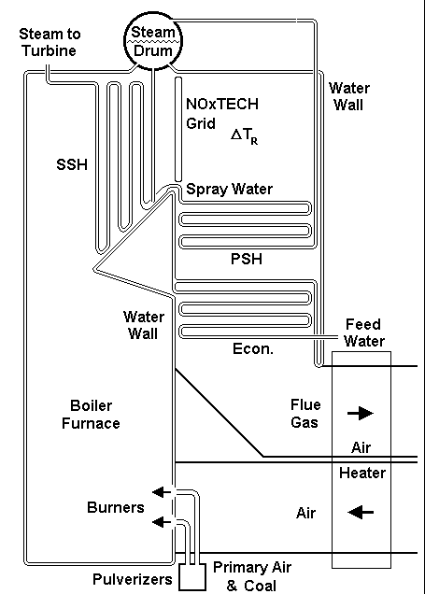
Typical System Installation
NOxTech Grid
Injects Gas
Injects Ammonia
Installed at ideal temp
Exhaust gas containing
NO_{X} and O₂
Hydrocarbons
(natural gas or diesel)
Reactants
(ammonia or urea)
Autocatalytic Process
Autoignition & Autothermal Heating
(temps of 1400 to 1750º F)
Generating NH₃ and/or HNCO
NO_{X} & CO removal
Depletion of NH₃
Treated exhaust gas
Low NO_{X}, CO & UBC
Minimal NH₃Slip
By products: CO₂, H₂0 & N₂

