Slide 1
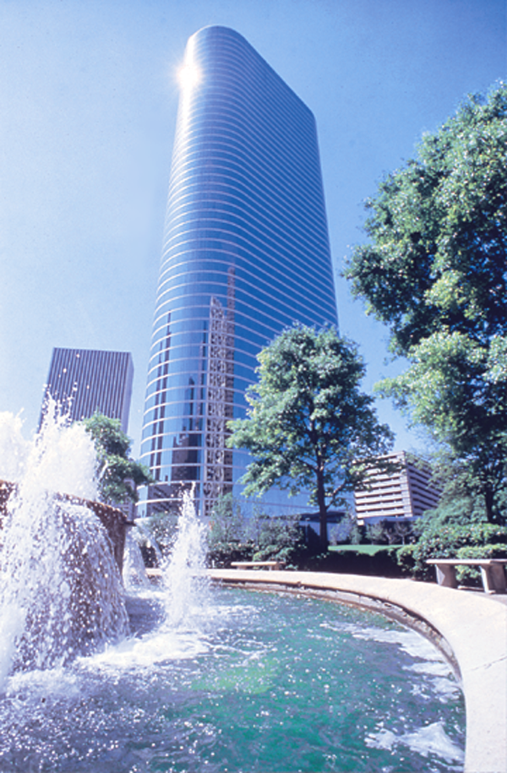

The What and Why of Enron
Dr. Kenneth L. Lay
Chairman
Leadership in Dynamic Organizations
Johnson Graduate School of Management
Cornell University
Ithaca, New York
March 28, 2001
®

Slide 2
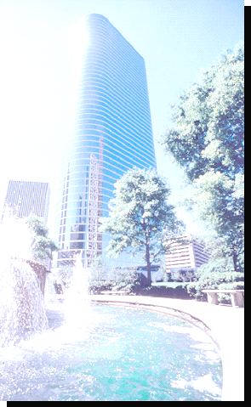
The Transformation of Enron
Enron Today
Power Trading
Natural Gas Trading
Powerplant Construction
Weather Derivatives
Pulp & Paper Derivatives
Broadband Services
Energy Outsourcing
Gas Transportation Services
e-Commerce Initiatives
Enron 1985
Natural Gas Transmission
Exploration & Production
$2 Billion Market Cap
$50 Billion Market Cap

Slide 3
Income Contribution to Enron of
New Businesses
(Estimated Percent of Net Income)
5%
40%
75%
$226M
$453M
$893M
1989
1994
1999
New
Natural Gas Pipelines and E&P

Slide 4
New Business Lines at Enron
Wholesale Gas
Customization
Wholesale
Power
Customization
Premium
Broadband
Services
New Power
Company
Energy
Outsourcing
EnronOnline
Azurix
(Water)
Enron
Net Works
Xcelerator

Slide 5
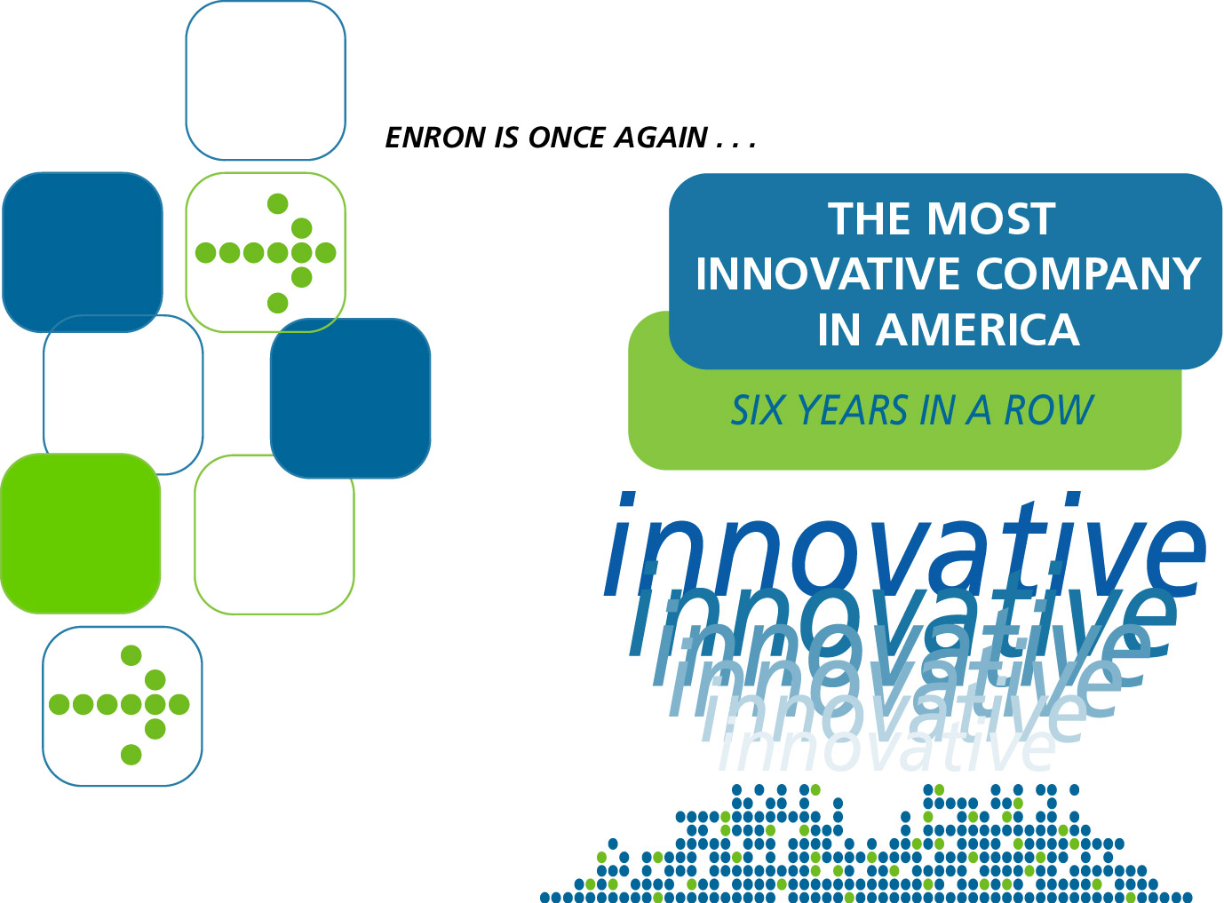



Fortune Magazine, February 2001

Slide 6

Market Making Evolution

Slide 7
Open Access: U.S.
Wholesale Gas
(1985- )
Expanding Scope: Market Making
Gas Pipelines
Open Access: U.S.
Wholesale Power
(1994- )
Open Access: Europe
Whol. Gas and Power
(1995- )
Energy Outsourcing
(1997- )
Niche Assets;
Niche Services
Niche Assets;
Niche Services
Online Trading
(1999- )
Premium Bandwidth
Services
(1999- )

Slide 8
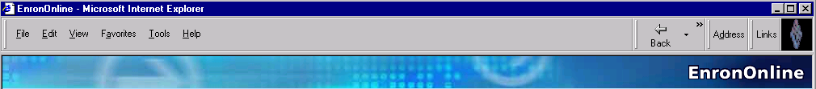
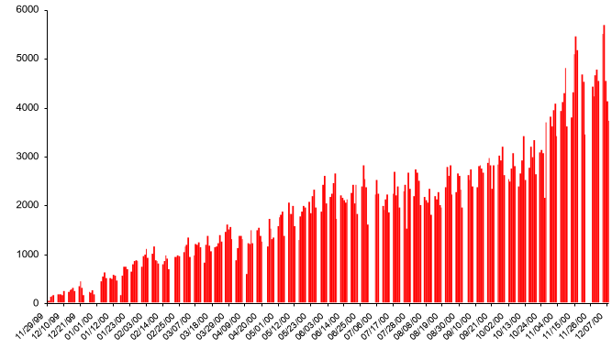
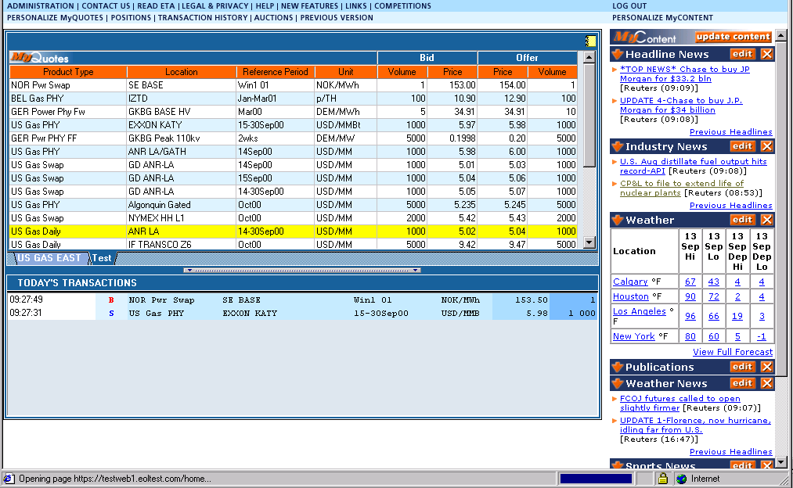
EnronOnline
Instantaneous Market Making
Growth of Daily Transactions
1999
2000
2001
Free, reliable transaction system with Enron as principal

Slide 9
EnronOnline Product Slate
1999 - 4Q
March 2001
Natural Gas
  U.S.
  Canada
Power
  U.S.
  Nordic
Coal
Pulp & Paper
Plastics
Natural Gas
  U.K.
  Belgium
  Argentina
  Canada
Power
  U.K.
  Germany
  Holland
  Switzerland
  Australia
Coal
  Europe
  U.S.
  International
Options
  Continental power options
  Nuclear outage knock-in call options
  US & UK gas options
Bandwidth
Weather
  U.S.
  Europe
  Japan
  Australia
Emissions Credits
Crude & Refined Products
Petrochemicals
Plastics
LPG
Steel
Pulp & Paper
Metals
  U.S.
  U.K.
  Japan
  Asia
Seafreight
Lumber
Auctions
  Emissions
  EnBank Virtual
  Storage
Pipeline Capacity
Auction
Credit Derivatives
Aluminum
  Japan
  Holland
  Spain
  Austria
  Nordic Pool
  Canada

Slide 10
The “How” and “Why” of Enron
Culture

Slide 11
The Economics Paradox
Central Order Without Central Planning
“The problem of a rational economic order is determined precisely by the fact that knowledge never exists in concentrated or integrated form but solely as the dispersed bits of incomplete and frequently contradictory knowledge which all the separate individuals possess.”
“The economic problem of society is. . . the utilization of knowledge which is not given to anyone in its totality.”
- F. A. Hayek (1944)

Slide 12
Economic Organization: Tight and Loose
Tight Rules
Ownership title
Rule of law
Legal institutions
Loose Rules
Market prices
Asset redeployment
Market structure

Slide 13
The Management Paradox
How can innovation and progress occur without a detailed blueprint and precise workforce instructions?

Slide 14
Management Strategy: Tight and Loose
Tight Controls
Financial accounting
Risk management
Performance reviews
Legal obligations
Loose Controls
Organization
Creativity/new business ideas
Work schedules
Working environment
  Dress code
  Floor design
Providers of equipment/services

Slide 15
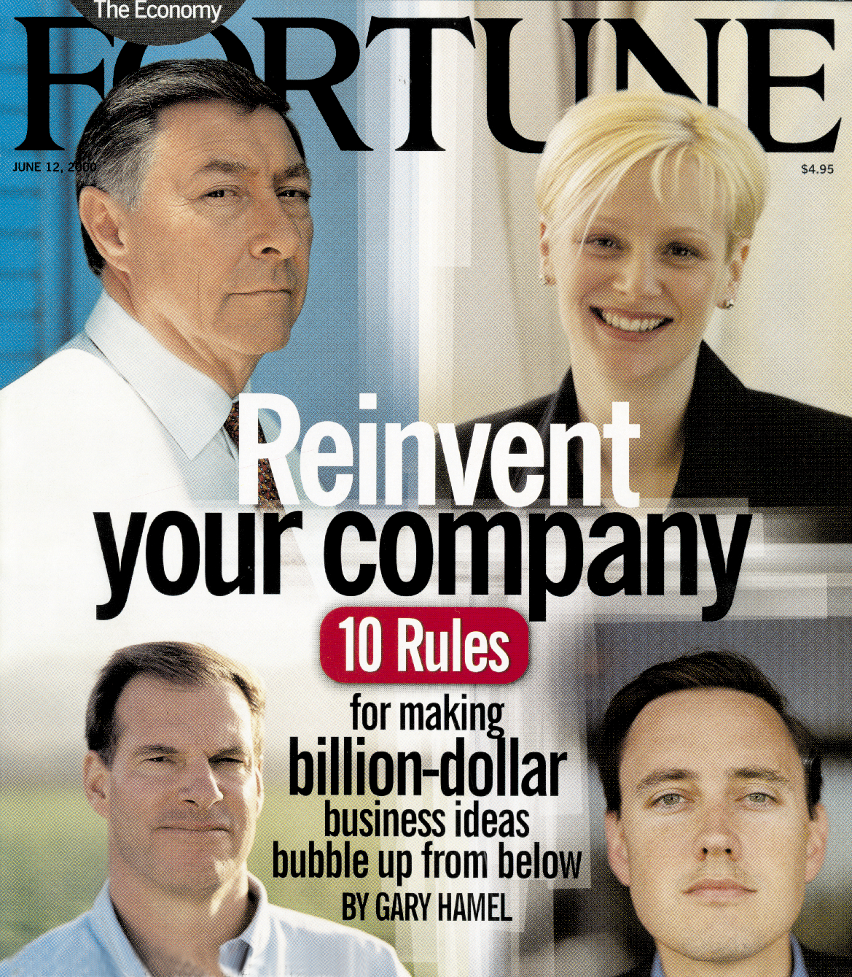
Build a Culture - Build a Company

Slide 16
Fourth Vision
“Set Unreasonable Expectations”
- Gary Hamel
Become the World’s
Leading Company
(2001- )
Third Vision
Become the World’s
Leading Energy
Company
(1995-2000)
Second Vision
Become the World’s
First Natural Gas Major
(1990-95)
First Vision
Become the Premier Integrated Natural Gas Company in North America
(1986-89)
© 2001 RB-UofH-0101-<number>

Slide 17
“Stretch Your Business Definition”
Traditional Model
Asset intensive
Vertically integrated
Geographically dominant
Commodity-price dependent
Hierarchical
New Model
Knowledge intensive
Network integrator
Online reach
Differentiation dependent
Entrepreneurial

Slide 18
Enron Intellectual and IT Capital
Analyst/Associate – New Hires
IT Expenditures ($ million)
530
$522
443
440
$358
$291
265
209
$105
$128
$62
1997
1998
1999
2000
2001E
1996
1997
1998
1999
2000
2001E

Slide 19
“Pay Your Innovators Well -- Really Well”
Base salary and benefits: industry average
Bonus: pay for performance
Equity: company ownership/long term
“[Enron] has created a custom-made compensation scheme that gives the startup team an outsized stake in the new venture’s success. It is not unusual for a young team member to end up with $1 million in Enron stock for helping to build a new business.”
- Gary Hamel, Fortune

Slide 20
“Create a Cause, Not a Business”
“Creating Innovative and Efficient Energy Solutions for Growing Economies and a Better Environment Worldwide”
- Part of 3rd Vision--To Become
the World’s Leading Energy Company

Slide 21
“Make Like a Cell - Divide and Divide”
Divide Within Businesses
Enron North America
(from 4 to 29 profit centers -1998)
Divide From Businesses
EnronOnline
(from Enron North America -1999)
New Power Company
(from Enron Energy Services - 2000)
Enron Networks
(from Enron North America - 2000)
Divide When Creating Businesses
Enron Broadband Services
(9 profit centers - 2000)

Slide 22
A New Integration Model. . .
Integration
High transaction costs;
“do it yourself”
Horizontal
(scale)
Vertical
(scope)
“Virtual” Integration
Low transaction costs;
“shop and bundle”

Slide 23
“Open Up the Market for Talent”
“Offer an Open Market for Capital”
“Lower the Risks of Experimentation”
“Design an Open Market for Ideas”
Meritocracy
“Listen to New Voices”

Slide 24
The Challenge of Tomorrow—Reinvent!
“Somewhere out there is a bullet with your company’s name on it. Somewhere out there
is a competitor, unborn and unknown, that will render your strategy obsolete. You can’t dodge
the bullet—you’re going to have to shoot first. You’re going to have to out-innovate the innovators.”
Gary Hamel, Leading the Revolution

Slide 25


