Slide 1
Williams Gas Pipeline
Western Frontier Pipeline
Enron North America Corp.
November 2000

Slide 2
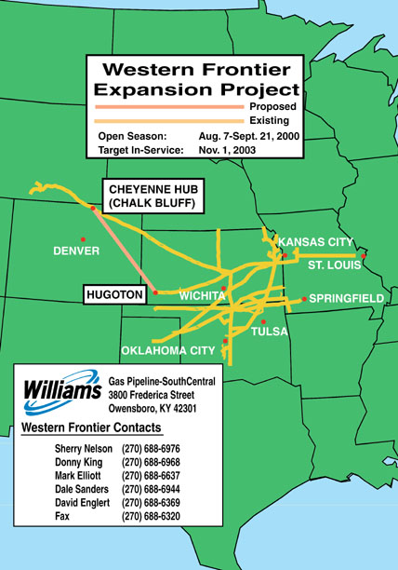
Western Frontier Pipeline
Insert map

Slide 3
Western Frontier Pipeline
Extremely Successful Open Season
  Expressions of Interest Exceeded Project Requirements
  Valuable Customer Input Utilized in Project Analysis
  Designed Project based on Customer Needs
  Senior Management Supports Next Phase
    Initiate Project Expenditures
    Project Design Activities
    Binding Agreements
    Binding Open Season

Slide 4
Western Frontier Pipeline
Customer Requirements
  Cost Effective - Transportation and Fuel
  Market Liquidity & Flexibility
  Storage Access
  Ease of Use (Nominations & Scheduling)
  Rate Design Creativity

Slide 5
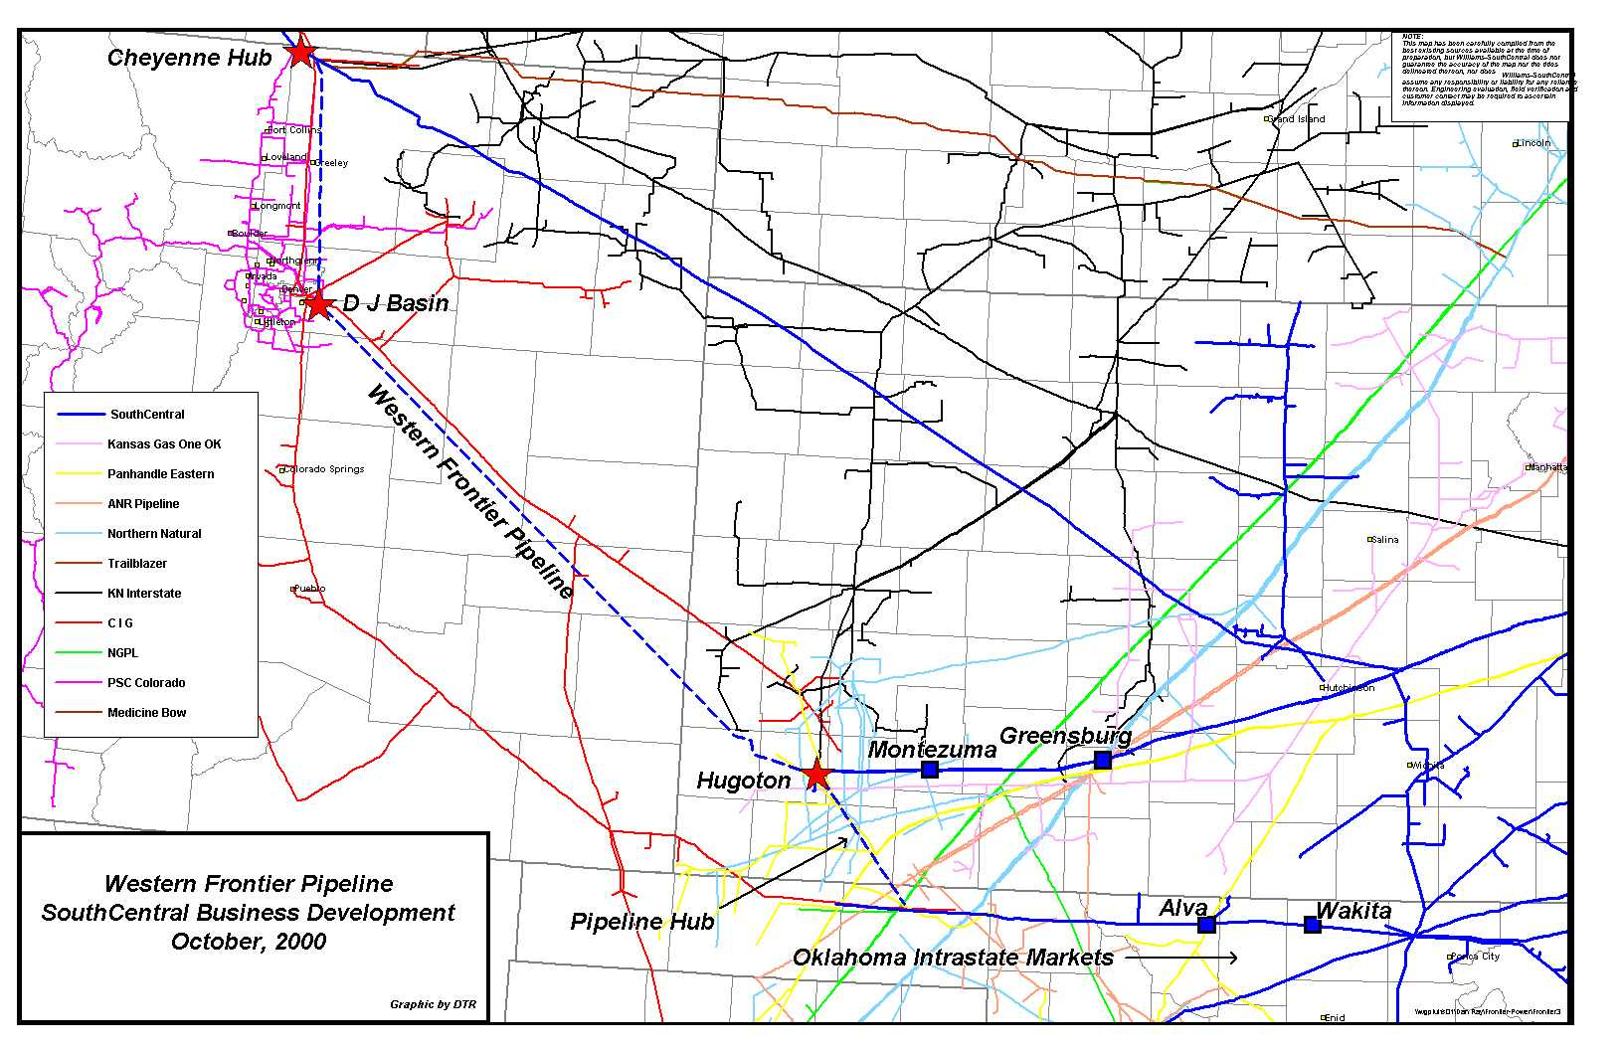
Western Frontier Pipeline
Insert map

Slide 6
Western Frontier Pipeline
Western Frontier Pipeline Project Refined
  Route Cheyenne Hub/DJ Basin/Hugoton, KS/Oklahoma
  Maximize Efficiency of Facilities
    400 Mile 30” Diameter Pipeline
    Higher MAOP and Operating Pressure
  Minimize Horsepower Requirement
    13,000 HP Proposed @ Cheyenne Hub
  Maximize Market Opportunity
  Basin Flexibility

Slide 7
Western Frontier Pipeline
Minimize Fuel and Transportation Cost
  100% LF Rates from Cheyenne Hub to:
    Hugoton - $0.25 per Dth
    Pipeline Hub Including Central’s OK System - $0.30 per Dth
    Rate Negotiable for Central System Market Access
  Fuel Anticipated at Less Than 1%
  Minimum Term Requirement - 10 Years

Slide 8
Western Frontier Pipeline
Market Liquidity
  Pipeline Hub
    Northern Natural (NNG)
    Pan Handle Eastern (PEPL)
    ANR
    Natural Gas Pipeline of America (NGPL)
  Williams System Markets
  Oklahoma Intrastates (TransOk, Enogex, ONG)
  Potential Markets along Western Frontier Pipeline

Slide 9
Western Frontier Pipeline
Flexibility
  Transport to Western Frontier Markets or Hugoton Interconnect at Lower Rate
  Transport on Pipeline Hub to Off-System Market & Central’s Oklahoma System
  Negotiable Rate on Williams Central System
  Seamless Transportation Service on Williams
  Future Expansion
    Denver and Front Range Markets
    Western Frontier Mainline
    Williams Central System Markets

Slide 10
Western Frontier Pipeline
Storage Opportunities
  Mid-Continent Location
    Central’s System Storage Capacity 42 Bcf
    Third Party Storage - Manchester Storage
  Development of Kiowa Storage
    Salt Dome Storage
    5 Bcf Capacity Proposed
    High Injection and Deliverability Rates

Slide 11
Western Frontier Pipeline
Ease of Use
  Total Focus on Customer
  Williams 1Line System (Scheduling & Nominations)
  Seamless Transportation to Any Off-System or Williams Markets

Slide 12
Western Frontier Pipeline
Williams Current Risk Exposure
    Investment in Up-Front Manpower and Expenses
    Environmental and Regulatory Risks
    Construction Risks
    Assuming All Risk Beyond First 10 Years of Project

Slide 13
Western Frontier Pipeline
Project Critical Dates
  Precedent Agreements in Place by November 15, 2000
  Binding Open Season
    Begins December 1, 2000
    Ends December 15, 2000
  FERC Project Filing July 15, 2001
  In-Service Date of November 1, 2003

Slide 14
Western Frontier Pipeline
QUESTIONS?

