Slide 1
Western Electricity and Gas Markets Update: Implication for Price and Portfolio Controls
Confidential Draft Outline
Not for Release

Slide 2
Significant Price Mitigation is Already in Place
FERC’s April 26 Order is now in effect, which sets a proxy market clearing price (MCP) at the average border price of gas x the marginal heat rate in California, Plus emissions costs and $2 for O&M
Proxy MCP around $108/MWh.
Mitigation occurs during Stage 1/2/3 and CAISO has called emergencies on several days since the order went into effect.

Slide 3
Although Summer Will Be Tight, the Market is Already Turning
Term market prices are falling reflecting fundamentals which are responding to:
  Higher CA retail rates (finally) going into effect 6/1/01
  Load shedding in PNW (?)
  New generation additions coming on line (See next slide)

Slide 4
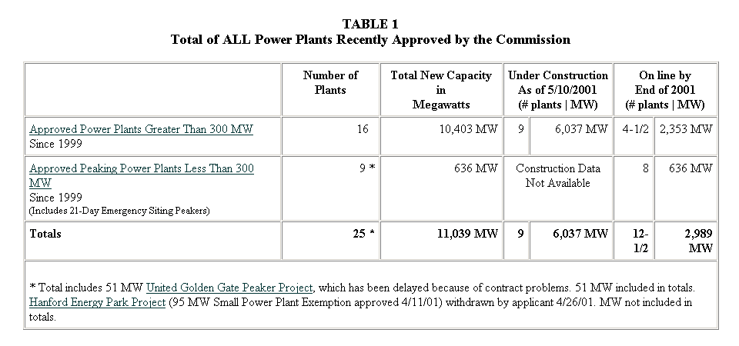
California Energy Commission

Slide 8
Although California is still net short, that is not the rule for the West
The majority of operating capacity in the west is dedicated to native load.
Only ~15% of the U.S. West’s installed capacity (19,711* MW in CA and 4,159* MW outside of California) is “merchant” and potentially subject to a forward contracting requirement. *(2000 WSCC Information Summary)
Even merchant generators sell forward reflecting need to hedge risks of capital intensive projects
DWR has forward contracted a significant amount of merchant generation including new generation

Slide 9
Mandated Price Controls or Portfolio Requirements Are Unnecessary
Any price controls signal higher demand and uncertainty to the investment community—both act to raise prices
Any mandated requirement to forward contract is unnecessary given the strong backwardation in the current curve (how about we say…given the response of the market)?
  By the time a “Just and reasonable” cost for a 18-month contract is set via FERC proceedings, the price will undoubtedly be out of line with the market

