Slide 1
West Gas Origination
Denver, Colorado September 9/10, 2001
Market Area Overview
“What’s going on between 5,000 and 10,000 ft?”

Slide 2
I. Price Perspective

Slide 3
A Return to Normalcy?
Long Term (25 Yr) Perspective
In January 1976, the monthly average price was $.54
The September 2001 NYMEX contract closed at $2.295
The median price for the period is $1.85.
The maximum is $8.06, and was reached in January 2001
Medium Term (5yr) Perspective
In September 1996, the monthly average price was $1.85
This is 24% lower than the September 2001 NYMEX contract close.
At $2.295 the September contract is equal to the 5 year median monthly price.

Slide 4

Historical Statistics

Slide 5
II. Supply Trends

Slide 6
U.S. Rig Counts
Record Levels of Drilling Activity
8/30/01 total gas rig count of 1,030
Activity is tapering off from the 7/13/01 high of 1,068
Gulf rigs are down 14% from their highs
1999
2000
2001

Slide 7
U.S. Supply Update
But, Moderate U.S. Supply Growth
U.S. Supply growth increased from 53.4 Bcf/d in Q2 to 53.5 Bcf/d in Q3 – A .2% increase
Represents a marked slowdown from Q3’s 2% production growth
On a year-on-year basis, U.S. production is up 2% from 2000Q3

Slide 8
Canadian Rig Counts
Record Levels of Canadian Activity
Most recent data indicates 328 active rigs at the end of August
This is off 43% from the year-to-date high of 539 rigs in January 2001
Similar constraints as those found in the U.S. market
1999
2000
2001

Slide 9
Canadian Supply Update
Continued Robust Canadian Growth
Canadian production increased from 11.2 in Q1 to 11.8 Bcf/d in Q2 – a 3.9% increase
Year-on-year, Canadian production increased 13.8%
Exploratory drilling is on the rise

Slide 10
Canadian Imports
Importance of Canadian Supply
U.S. market is highly dependent on Canadian supply
Over 56% of Canadian gas is exported to the U.S.
Year to date, Canadian imports have increased an average of 8% relative to last year
9.22% CAGR in Canadian Imports

Slide 11
III. Demand Trends

Slide 12
U.S. Cooling Degree Days
Non-Eventful Summer Weather
Across the United States, there have been 6.3% more CDDs than normal
On a year-on-year basis, the heat seems even less significant, with .8% more CDDs in 2001 versus 2000

Slide 13
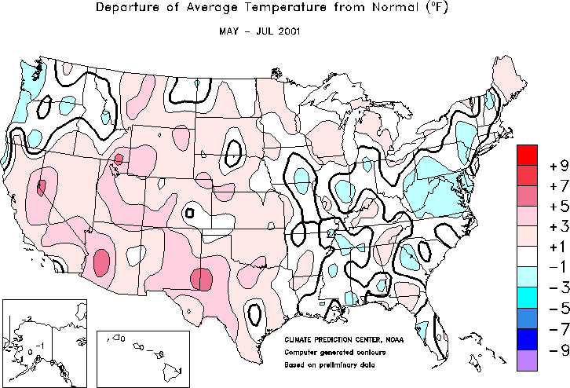

Moderate Summer Weather
Notes:
http://www.cpc.ncep.noaa.gov/products/analysis_monitoring/regional_monitoring/usa.html#seasonal

Slide 14
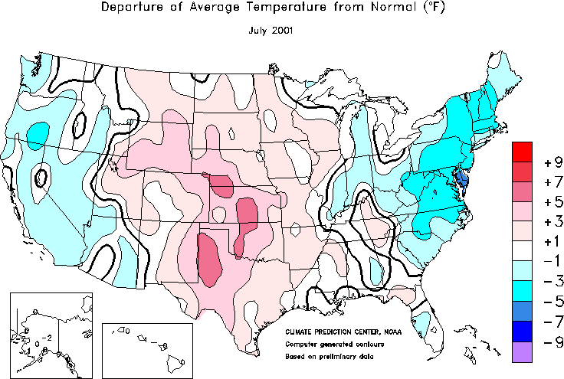
Weakening Western Weather Pattern
Notes:
http://www.cpc.ncep.noaa.gov/products/analysis_monitoring/regional_monitoring/usa.html#seasonal

Slide 15
Gross Domestic Product
The Economy is the Story
Torpid economic growth is affecting gas consumption
U.S. GDP grew .2% in real terms during the second quarter of 2001
This was the lowest growth in 8 years
On a year on year basis this was the lowest growth since 1980Q2
The deceleration in real GDP growth is largely due to decreases in exports and private inventory investment.

Slide 16
Industrial Growth
Contracting Industrial Growth
Total industrial production contracted .1% in July. On an annual basis it contracted 4.2%
This is the tenth consecutive monthly decline
The manufacturing component was relatively flat month on month. On an annual basis it contracted 3.87%
There is significant slackness in U.S. industrial capacity
Capacity utilization for total industry was 77%
This is more than 5 percentage points below the 1967-2000 average

Slide 17
U.S. Electric Power Use
1999
2000
2001

Slide 18
Western Power Demand Reduction
The Demand Story
Demand decrease of 8% relative to July 2000
Average retail price increase of approximately 25%
Cooler weather
Increased public awareness and conservation efforts
Curtailed production
Changed production schedules

Slide 19
Regional Demand Reduction
Conservation Has Been Key
In the PNW over 1,700 average MWs of industrial load have come off line to date
In California, demand is about 10% lower than expected
Rockies/SW conservation reached 5% in June
2000
2001

Slide 20
WSCC Generation by Fuel Type
Gas and Hydro Have Born the Brunt
Gas fired generation is expected to decline by 10.3% in 2001Q3
Hydro generation is expected to decline by 18% in 2001Q3
Nuclear will increase by 1.3%, Other by 1.2%, and Coal by .8%
2000
2001
Notes:
Source: CERA

Slide 21
Declining Western Consumption by Sector
2000
2001

Slide 22
IV. Storage

Slide 23
U.S. Storage Overview
The Rapid Pace Continues
Strong storage levels reflective of weak fundamentals
Unprecedented level of injections have been a critical factor in market declines
As of September 2, the year-over-year storage surplus was 386 Bcf
8 weeks left in injection season
High probability of reaching 11/5/98 storage high of 3,094 Bcf

Slide 24
Western U.S. Storage Levels
Strong Western Storage
Despite a slow start, storage is now in year-on-year surplus
As of 9/2/01 storage levels stand at 418 Bcf
On a year-on-year basis, this is 28 Bcf over the previous record set in 1999
This is also 51 Bcf over the 6-year average
Going into the withdrawal season, the West may also beat a record 435 Bcf (11/5/98)

Slide 25
Canadian Storage Overview
Approaching a New High
Year-Over-Year Storage Surplus now at 12.4 Bcf
Significantly off from a season high of 36.6 Bcf in July
14.7 Bcf/w average injection rate for year is 2.7 Bcf/w over the 5-year average
At this rate, Canada will easily hit the five year high for going into the withdrawal season

Slide 26
V. Conclusion

Slide 27
The Bottom Line
Weakening fundamentals continue to pressure gas prices across the country
Gas supply, though on the upswing, is not the primary driver of the bearish environment
Similarly, unremarkable summer weather has not sparked demand
The weak economy combined with successful conservation efforts are key drivers in driving down demand and prices
The resulting rapid pace of injections has set the stage for record inventories going into the withdrawal season

Slide 28
VI. Rockies Fundamentals

Slide 29

Western U.S. Gas Grid
Northern Border
PGT
WBI
Northwest
Big Horn Basin
Powder River Basin
To
Chicago
Wind River Basin
Green River Basin
KN
CIG
Overthrust
WIC
Trailblazer
Uinta Basin
Piceance Basin
DJ Basin
NGPL
Kern
Paradox Basin
Northwest
CIG
Raton Basin
El Paso
San Juan Basin
= Glenrock
= Cheyenne/Rockport
= OPAL
El Paso
Permian Basin
<number>

Slide 30
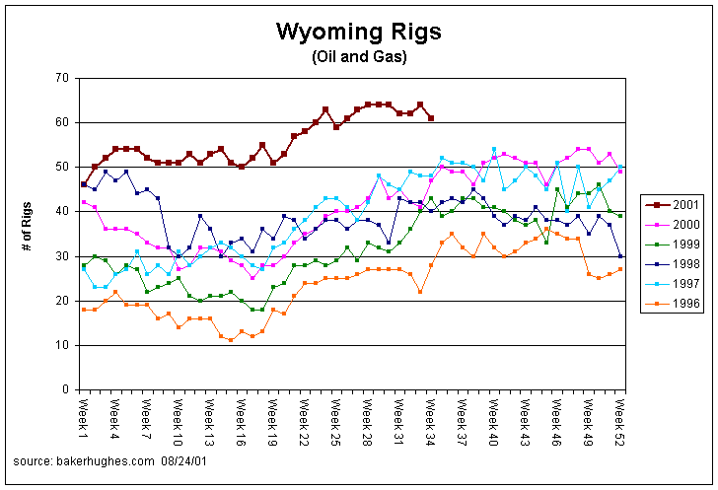
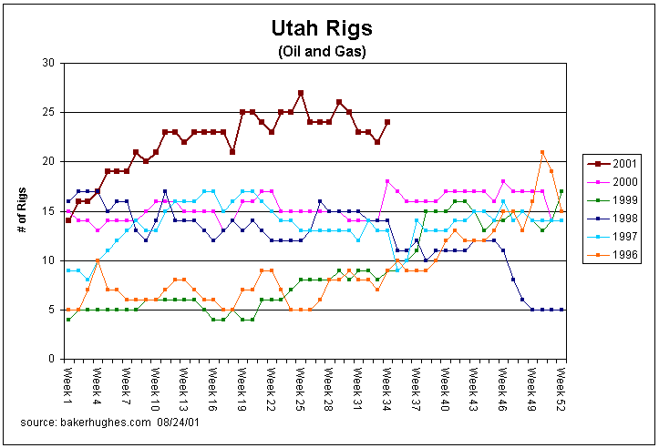
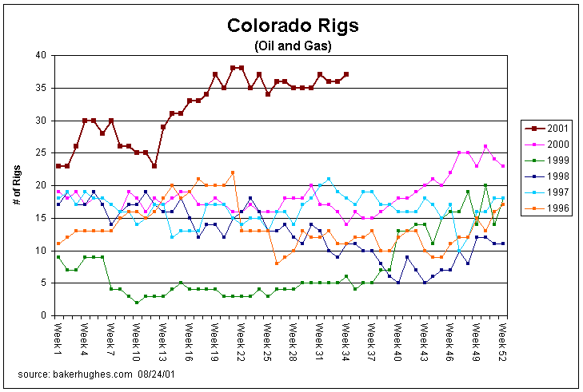
Rig Counts are Up
Drilling is continuing at the highest pace in over a decade despite the infrastructure constraints that have appeared over the last year.
Note: Powder River Basin CBM rigs are excluded from the Baker-Hughes Wyoming rig count due the shallow nature of the CBM wells
<number>

Slide 31
Historical Rockies Overview
Historical CIG Basis
Surging volumes from the Powder River, Wind River, and Green River Basins have led to major constraints due to insufficient Rockies take-away capacity.
The Rockies market has also been characterized by frequent lateral constraints, leading to deep discounts to index for Powder River, Piceance, and Wind River supply.
Five-Year Historical Average:
$(0.48)
Historical Monthly Volatility:
83%
Regional summer gas demand is more than a Bcf per day less than the regional winter demand, which causes greater price weakness during the summers as gas-on-gas competition for capacity out of the Rocky Mountain region is increased.
These micro and macro transportation constraints, combined with the Rockies’ substantial summer/winter demand swing, has led to greatly increased price volatility that is expected to continue in the near term.
An Index price environment of $2-$2.25 must be maintained in order to promote drilling activity.
<number>

Slide 32
Rockies Resource Base
The entire Rocky Mountain region has an estimated reserve base of just over 172 Tcf made up of 30 – 40 Tcf of proven reserves, with the rest being undiscovered.
The Rocky Mountain Region is approximately 16% depleted, as compared to the rest of the entire U.S. gas producing regions which are depleted by approximately 50%.
The region has also accounted for 4% of past domestic production and is estimated to have over 21% of remaining U.S. gas supply
The life of the remaining gas supplies in the Rocky Mountains is 95 years at current export levels. Assuming anticipated pipeline expansions of 1.7 Bcf, the life span decreases to 61 years compared to the remaining U.S gas supplies of 34 years
Current pipeline expansions account for 1.7 Bcf, of which only 1.4 Bcf will be true export capacity
<number>

Slide 33
Rockies Basin Forecast

Slide 34
Rockies Basin Forecast

Slide 35
Pipeline Expansions
Intra-Rockies Expansions:
Questar Mainline 104:
Nov ‘01
270,000 MMBtu/d
Western Uinta to Salt Lake & Kern
WIC/Medicine Bow:
Dec ’01
+276,000 MMBtu/d, ramping up to 556,000 MMBtu/d by late 2003
Glenrock to Cheyenne
WIC/Overthrust:
+200,000 MMBtu/d
Backhaul from Cheyenne to Opal
Northern Border
PGT
WBI
Northwest
WBI:
Nov ’02
100,000 MMBtu/d
Northwest:
Nov ’03
175,000 MMBtu/d
KN
CIG
Overthrust
WIC
Trailblazer
Trailblazer:
June ’02
225,000 MMBtu/d
Kern:
May ’03
900,000 MMBtu/d
Kern
NGPL
Northwest
CIG
El Paso
= Glenrock
= Cheyenne/Rockport
= OPAL
El Paso
<number>

Slide 36
Cheyenne Take-Away
Maximum (Winter) Take-Away Capacity
Now: 1.82 Bcf/d
After Trailblazer Expansion: 2.05 Bcf/d
Note: Summer take-away capacity is roughly 0.5 Bcf/d less than the winter levels due to reduced Front Range demand and CIG’s maximum Mid-Continent deliverability of 360 MMcfd.
KN:
120 MMcfd
Cheyenne
Trailblazer:
700 MMcfd
925 MMcfd in June 2002
CIG:
600 MMcfd
(Actual CIG deliverability could be less than 600 MMcfd, depending on the magnitude of Front Range demand , due to CIG’s Mid-Continent take-away capacity of 360 Mcfd)
PSCO:
400 MMcfd
(Actual PSCO deliverability is dependant on Front Range demand)

Slide 37
San Juan Effect
Any declines in the San Juan Basin will free up southern take-away capacity out of the Rockies, constrained only by the existing 400 MMcfd slack capacity currently on NWPL and Transcolorado
Historical Growth Rate (since 1999): 2%
Projected 5-Year Growth Rate: -5%

Slide 38
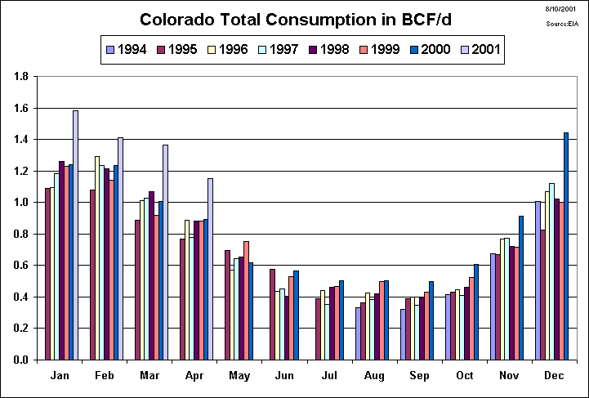
Colorado Demand
<number>

Slide 39
What’s Driving Colorado’s Load Growth?
<number>

Slide 40
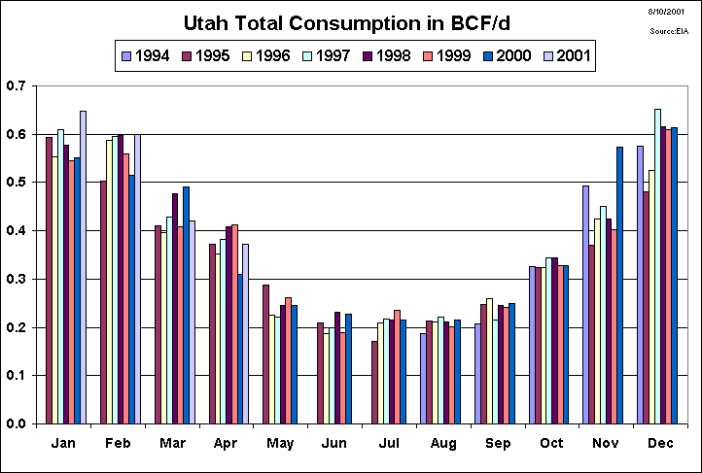
Utah Demand
<number>

Slide 41
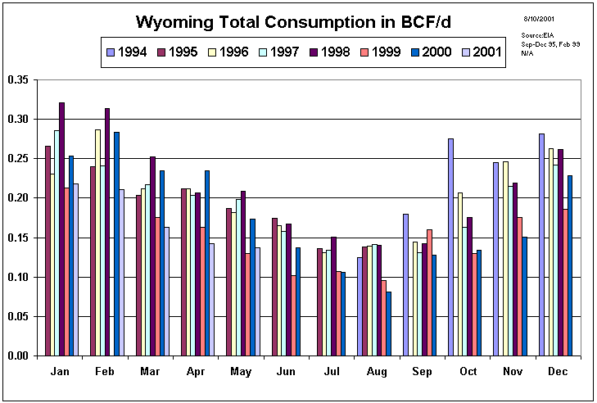
Wyoming Demand
<number>

Slide 42
Rockies’ New Gas-Fired Generation
Incremental power generation brought on-line in the last year:
Project Manager Plant Name Capacity Run Time *Gas Usage
El Paso Manchief 265 MW 50% 28,620 Dth/d
PSCo Ft St Vrain 250 MW 50% 27,000 Dth/d
Black Hills Fountain V 240 MW 50% 25,920 Dth/d
PSCo Valmont 11 MW 50% 1,188 Dth/d
Incremental power generation under construction:
Project Manager Plant Name Capacity Run Time *Gas Usage
CSU / El Paso Nixon 480 MW 70% 72,576 Dth/d
TSGT Big Sandy 140 MW 30% 9,072 Dth/d
TSGT` Brighton 140 MW 30% 9,072 Dth/d
Platte River Rawhide 210 MW 30% 13,608 Dth/d
Black Hills N Simpson 40 MW 30% 2,592 Dth/d
* Gas usage calculated using a 9,000 heat rate
<number>

Slide 43
Summary of New Generation in the West

Slide 44
The Impact of Market Heat Rate on Gas Demand in the WSCC
Current
Market HR
MW
(Bars)
MMBtu
(Line)

Slide 45
Macro Rockies 5 Year Forecast
Pricing for summer 2002 is somewhat uncertain. Forecasts indicate a slight long position leading up to the June Trailblazer expansion; however, early storage injections could potentially accommodate the over-supply
Depending on the extent of San Juan declines, Summer 2003 could also exhibit price weakness leading up to the 900 MMcfd Kern expansion
Following the 2003 Kern expansion, the Rockies should demonstrate relative price strength, as supply growth will likely take a minimum of 2 to 3 years to fill the 900 MMcfd
Supply/Demand Balance without San Juan Declines
NWPL Expansion
Kern Expansion
Trailblazer Expansion
Supply/Demand Balance with San Juan Declines
Note: Rockies supply has only grown by 800 MMcfd over the last six years, implying a potential long period of over capacity following the the total 1,400 MMcfd of expansions (Trailblazer, Kern, NWPL)
<number>

Slide 46
Summer 2002
As winter demand falls, Rockies supply growth is expected to be halted by constraints until the 225 MMcfd Trailblazer expansion in June
Unconstrained forecasts indicate a potential net long position of more than 100 MMcfd just prior to the expansion, which potentially could be alleviated by early storage injections
Following the June expansion, pricing will depend on the extent of storage acceleration, if any, and the supply response time lag. In other words, how quickly will gas be turned on and/or diverted from storage?
In the weeks and months following the Trailblazer expansion, the spread between NWPL and CIG could tighten until the supply response fills the new capacity
Macro Rockies Supply/Demand Balance
Indication of potential price weakness
<number>

Slide 47
Summer 2003: Pre-Kern Expansion
Leading up to the Kern expansion, the potential for price weakness depends on San Juan declines
If San Juan declines do not occur, the Rockies could be in a significant net long position
However, CERA is predicting San Juan declines of over 250 MMcfd by 2003, which would open up space for Rockies gas through the San Juan triangle
Given the uncertainty of supply forecasts two years out, the supply/demand picture prior to the Kern expansion is somewhat cloudy
Supply/Demand Balance without San Juan Declines
Supply/Demand Balance with San Juan Declines
<number>

Slide 48
Kern 2003
The strongest conclusion of our fundamental analysis is that the Rockies will be in huge net short position following the Kern expansion
It will most likely take 2-3 years minimum for Rockies supply growth to “catch up” with the 900 MMcfd expansion
During this period of excess take-away capacity, prices would be expected to exhibit significant strength as the Rockies basis returns to an unconstrained level
Bottom Line:
Regardless of your view of Rockies supply potential, 900 MMcfd of supply cannot be turned on in a matter of days or weeks. The cumulative increase in the Rockies supply over the last six years has been less the Kern expansion.
Supply/Demand Balance without San Juan Declines
Supply will not jump up on day one.
The supply increase will be gradual.
Supply/Demand Balance with San Juan Declines
<number>

Slide 49
Historical NWPL Rockies Basis
Constrained Period
Unconstrained Period
Constrained Period
During the unconstrained period from Jan 98 through Apr 00, the average Rockies basis was:
Winter $(0.17)
Summer $(0.32)
All-In Average $(0.25)
The total of 1.4 Bcfd of expansions over the next two years would be expected to return the Rockies basis to these historical levels, if not tighter.
This “blip” was from a NYMEX jump, rather than a Rockies fixed price shock
WIC, Trailblazer, &
Pony Express expansions:
Approx. 400 MMcfd
<number>

