Slide 1

West Coast LNG Projects
Progress Report on Feasibility Analysis
for Managerial Decision in November 2001
October 17, 2001
<date/time>

Slide 2
Presentation Objectives
Identify Feasibility Stage Deliverables for EEOS Tasking Letter(s)
Review Current Issues
FSRU
PNW Pipeline System Take-away Technical/Commercial Analysis

Slide 3
Feasibility Stage Objective
Develop Project Concepts and Strategies in Support of EGM Managerial Decision Whether to:
Proceed with West Coast LNG Terminal Development
California: FSRU
PNW: Land-Based Terminal in OR/WA
Begin Discussions with Asian LNG Producers and Major Gas Buyers (LNG Supply, Potential Partnership)
Time Frame for Completion of Feasibility:
Mid- to Late November 2001

Slide 4
FSRU, Long Beach, CA

Slide 5
Feasibility Stage Deliverables - FSRU
Gas Market Report/SoCal Report
DSA Final Report by Merlin/Oceanic
Permitting/Regulatory Report by ERM
Gas Interchangeability Report
LPG Issue Resolution (Extraction or “Producer” Solution)
Tax Report
Project Schedule
Project Technical Definition/Scope of Work
Revised Cost Estimate (Capex, Opex)
Economics Model

Slide 6
Current Issues
New Technology Risk
Mitigation:
DSA
Cooperation with Moss Maritime and a World-Class Shipyard
Partnership with LNG Producer
Contractual Coverage of FM
Permitting/Regulatory Process/ NGOs
Awaiting ERM Report on:
Permitting Process
Costs/Cash Outflows
Schedule
Owner Deliverables
Fatal Flaws/Road Blocks

Slide 7
Pacific North West

Slide 8
Feasibility Stage Deliverables - PNW
Gas P/L System Technical and Commercial Review
Northwest Pipeline Corporation’s Position
Confirm Enron Review’s Conclusions
Would Finding a PNW Terminal Partner Help?
If LNG Terminal is Found Viable:
Permitting/Regulatory Report for OR and WA
Gas Interchangeability Report
LPG Issue Resolution (Extraction or “Producer” Solution)
Tax Report
Project Schedule
Project Technical Definition/Scope of Work
Revised Cost Estimate (Capex, Opex)
Economics Model

Slide 9
Current Issues
Pipeline System Take-away Technical and Commercial Review
Pipeline Capacities, Gas Flows & Constraints
Expansions
Pricing
Critical Issues
Discussions with Northwest Pipeline Necessary
Meeting set up with Kirk Morgan, NW Pipeline Business Development Group, in Salt Lake City on Nov. 26

Slide 10
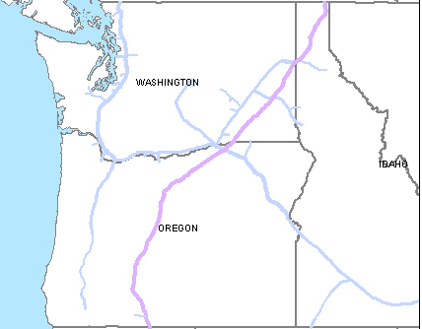

PNW Pipeline Diameter
30”
(36”)
42” ~ 36”
16”
16”
30”
8”
20”
12”
26”
10”
6”
30”
10”
26”
26”
26”
20”
30” ~ 22”
16”
20”
10”
42” ~ 36”

Slide 11
Physical Gas Flow in Northwest Pipeline
Sumas
Capa: 1085 MDth/day
Chehalis
Capa: 700 MDth/day
Availability: 212 MDth/day
Stanfield
Capa: 640 MDth/day
Availability: 250 MDth/day
Washougal
Capa: 416 MDth/day
Availability: 85 MDth/day
Roosevelt
Capa: 500 MDth/day
Availability: 94 MDth/day
Gas Flow
Gas Input
Bottle Neck

Slide 12
Gas Flows & Available Capacity
Best Tie-in Point & Available Capacity

Slide 13
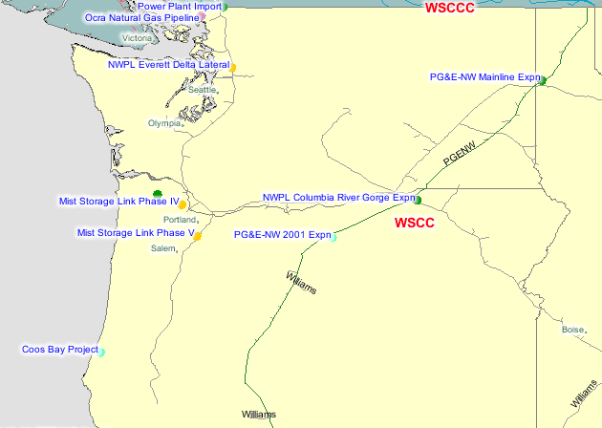
PNW Pipeline Expansions
Evergreen Expansion
Sumas~Chehalis
28 Miles (36”)
250 MMCFD
2003/6 Services
Washington Lateral
400 MMCFD
2004/1 Services
Chehalis
Gorge Expansion
50 MMCFD
2003/11 Services
32 Miles (24”)
2002/11 Services
20 Miles (24”)
2004/11 Services
21 Miles (42”)
200 MMCFD
2002/7 Services
21 Miles (42”)
130 MMCFD
2003 Services
65 Miles
Capa. & Service open - unknown

Slide 14
Pricing in Northwest Pipeline System
Transportation Costs to Local System***
NYMEX*
Basis for Sumas**
U$4.00
U$0.04
U$0.30~0.35
Trading Price
Total Costs to the Utility
* Average Forward Curve (Forward Pricing: 2002~2024)
** Basis for Sumas (Forward Pricing: 2002~2024) -
Max: +43 Cents, Min: -51 Cents, Average: 4 Cents
*** Transportation Costs to Local System: Postage Stamp System,
annually set, adjusted if necessary. (30 ~ 35 cents range)
Note: Stanfield is trading slightly higher than Sumas.

Slide 15
Historical Gas Prices
U$/mmbtu

Slide 16
Forward Gas Curve at 10/11/01
U$/mmbtu

Slide 17
Northwest Pipeline Issues
Available Capacity:
Only 200MMcf/d at Chehalis
498 MMcf/d at Roosevelt
High Subscription Rate (Load Factor of 83%)
Bi-directional Pipeline
Combination of Physical and Displacement Capacity to Meet Firm Contract Commitments
Physically, 73% of Natural Gas on Northwest Pipeline Is From Canada (through Sumas or Stanfield)
Key Constraint Points: Chehalis & Roosevelt
Should We Limit Ourselves to a Merchant Gas Sale Only?
Part Gas-Driven and Part Power-Driven Deal

Slide 18
Conclusions
Sumas/Stanfield Basis Differentials Not Favorable
Northwest Pipeline Tariff System (Postage Stamp Rate of 30 - 35 cents) Prevents us from Realizing Transportation Premium on Sales into Gas Grid
The Same Price Position if We Tied in at Sumas
Enron to Hold Discussions with Northwest Pipeline
Consider Partnership with Northwest Natural Gas Co.?
Include the PNW Terminal Option in Enron’s Presentations to LNG Suppliers (Together with Reasons for Abandoning Baja California Option)
FSRU Is a Clear Favorite at This Point
Enron to Keep the PNW Terminal Option under Study

Slide 19
Northwest Pipeline Discussion Points
Balancing the NW Pipeline System
Physical Flows and Constraints
Trading Point Pricing and Transportation Charges
Backhaul Rates (?)
Planned Expansions and Implications for Basis and Tariff
Capacity Subscriptions
Active Pipeline Segmentation
System’s Demand Seasonality and Peaking Issues
Outlook for Gas-Fired Power Generation
Enron’s PNW LNG Terminal Idea
Possible Tie-in Points

Slide 20
Should Enron Look for a PNW Partner?
Consider Offering Partnership in the PNW Terminal
Northwest Pipeline Corporation, subsidiary of The Williams Companies
Facilitated Access to Northwest Pipeline System
Underground Storage at Jackson Prairie (18 Bcf)
Northwest Natural Gas Company (OR/WA Utility)
Access to Existing and Future Northwest Natural Gas Customers – 352 MMcf/d
Port Westward, Longview
Underground Storage at Mist (50 Bcf)
Advantages for Potential Partners
Diversified Gas Supply Source (mainly Northwest Natural)
Flexibility in Managing Gas Flow from P/L System’s Central Point (Northwest Pipeline Corp.)
Expansion of LNG Network, Opening up Pacific Basin (Williams)

Slide 21
Post-Feasibility Stage – FSRU & PNW
LNG Supply Procurement
Beginning of Discussions with Potential Suppliers: Early December 2001
Shipping Plan: Early 2002
Identifying Terminal Partners
LNG Producers and Major LNG Buyers
Beginning of Discussions: Early December 2001
Defining Project Structure
Preliminary Financing Plan: Mid-2002

Slide 22
Appendix: Preliminary Project Economics
(Unit: U$/MMBtu)
NYMEX * 4.00
Sumas Basis 0.04
Potential Premium** 0.30
Shipping (0.70)~(1.25)
Terminal Costs (0.47)
Losses (0.15)~(0.23)
Enron Margin (0.10)
Potential Netback 1.99~2.62
* Average Forward Curve (Forward Pricing: 2002~2024)
** Non-Gas Grid Sales Only

