Slide 1
California Gas Utility Demand
Number of
Customers
Throughput
(Bcf)
Company Name
State
Southern California Gas
Pacific Gas & Electric
San Diego Gas & Electric
Next Largest LDC’s in the US
Nicor Gas
Columbia Gas Distribution
Brooklyn Union
CA
CA
CA
IL
OH/PA
NY
4,864,772
3,914,130
729,508
1,898,034
1,884,641
1,642,752
802.0
745.8
132.4
469.9
418.8
308.9
Data Source:

Slide 2
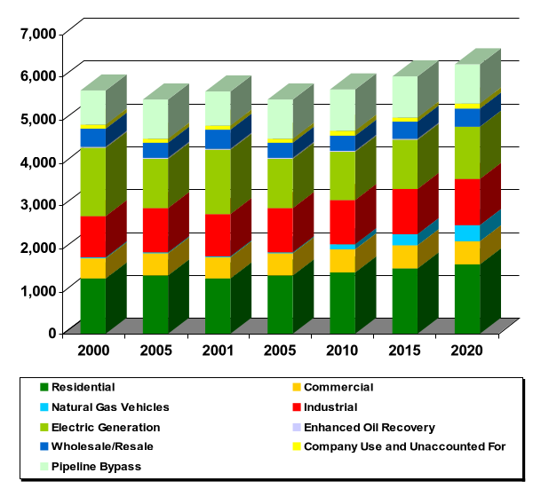
Total California Gas Demand Forecast
Interstate Pipeline Capacity
to California
MMcf/day
PGT
Kern
Transwestern
El Paso
1,885
700
1,050
3,490
7,165

Slide 3
New Gas Fired Generation Additions
2001 - 2004
for California, Idaho & Oregon
High Probability:
Medium Probability:
Year
MW
MMBtu/d
MW
MMBtu/d
2001
2002
2003
2004
Total
3,151
2,440
720
0
6,311
560,186
439,200
129,600
0
1,128,976
400
2,010
1,200
2,100
5,710
62,400
361,800
216,000
378,000
1,018,200

Slide 4
Western North American Natural Gas Pipelines
Western Canadian
SedimentaryBasin
1999 Avg. Flows to Border
1 ANG
2 El Paso
3 Kern River
4 Mojave
5 Northwest
6 NOVA
7 Paiute
8 PG&E Redwood path
9 PG&E GT-NW
10 SoCalGas
11 SDG&E
12 Transwestern
13 Tuscarora
California Production
Total
1,608
621
391
1,705
765
989
6,079
1
6
5
Coleman
Kingsgate
Stanfield
5
9
Malin
5
Rocky Mountain Basin
13
7
3
8
San Juan Basin
4
2
Andarko Basin
10
Topock
11
Blythe
12
Variable Charges to
Border
PGT $.189
El Paso - SJ $.204
El Paso - Perm $.226
TW - SJ $.245
TW - Perm $.235
Kern $.131
Historical Supply:
2
2
Permian Basin
Calif. Prod.
El Paso
Transwestern
PG&E GT- NW
Kern
Mojave
Others
1998
852
1,558
812
1,709
638
324
(32)
5,860
1997
766
1,526
539
1,690
635
300
53
5,509
1996
761
1,425
386
1,656
644
295
143
5,310
Volumes stated in MMcf/d

Slide 5
History of Capacity Turnback in the West Through 1999
Pipeline
Turnback
Settlement
Response
Transwestern
(0.95 Bcf/d capacity
to California)
SoCal - 457,281 MMBtu/d
as of 11/1/96
Sharing the Risk ($513 million)
11/96 - 10/97 = 50% TW
11/97 - 10/01 = 75% TW
11/01 - 10/06 = 100% TW
TW reduced pressure on the
mainline eliminating 140,000
MMBtu/ of capacity
TW resold 135,000/d under it’s
Phase II San Juan expansion
for terms of 5 years at 25-40%
of max tolls. 100,000/d was sold
for 2 years of 2/98
Remainder has been sold through
short-term Auctions
% at Risk
El Paso
(3.49 Bcf/d capacity
to California)
SoCal - 309,000 MMBtu/d
as of 1/1/96
PG&E - 1,174,200 Mmbtu/d
as of 1/198
Total = 1,483,200
NGC purchased 1,300,000
MMBtu/d of capacity for
2 years out of 1/1/98
- NGC will pay $.12 MMBtu
(40% of max tolls)
reservation
fee
- Transport or pay provision
based on:
50% MDQ in 98
72% MDQ in 99
Sharing the Risk ($1,114 million)
1/96 - 12/06 = 65% EP at risk
Customer’s 35% equals
$254.8 million

Slide 6

Western Region - Major Pipeline Options
®

Slide 7
1997 to 2002 Canadian Natural Gas
Import Changes
(In MMcf/d)
100
423
1,687
NBPL 861
Great Lakes 126
Alliance 700
Maritimes &
Northeast: 245
Portland 178
PGT: 100
Canadian Imports
12 Month Average as of July 1999
Midwest 39%
California 19%
Northeast 25%
Northwest 17%
Net Increase Canadian Imports by 2002:
+2,210 MMcf/d or 28.3% above 1997 imports

