Slide 1

WTI Market Maker
Trading Simulation Model
John Lavorato
Chief Operating Officer, Enron Wholesale Services
Prepared by Zimin Lu, Enron Research

Slide 2
Simulation Procedures
The simulation model has two versions
Version 1 assumes continuous trading, i.e., close - close prices are used Version 2 assumes open-close trading, a more realistic
2

Slide 3
Model Inputs and Outputs
Trading Assumptions
P/L Results
3

Slide 4
Impact Of The Assumptions
Bid / Offer Spread: Higher spread, more profit
Daily Number of Trades: More trades, more profit
Net Open Position Allowed: NOPA does not limit open position intra-day, but limit net open position carried to the next day
The larger NOPA, more volatile the cumulative P/L
4
Volume Per Trade: Amplifies the P/L
Simulation Interval: Total P/L is path dependent, meaning that the P/L depends price history during the simulation

Slide 5
Graphic Output 1
Close price history in the simulation
5

Slide 6
Graphic Output 2
Cumulative P/L in the simulation: shows the volatility of P/L
6

Slide 7
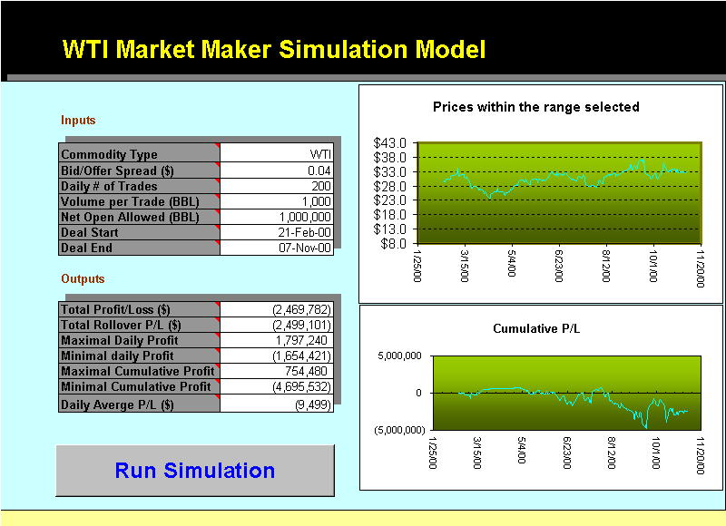
Bid / Offer Spread
Spread = 4 cents, volume per trade=1000 Bbl, NOPA=1,000,000 Bbl Deal tenor= 1 year back from Nov. 7,2000 Number of Trades = 200
7

Slide 8

Bid / Offer Spread
Spread = 4 cents, volume per trade=1000 Bbl, NOPA=1,000,000 Bbl Deal tenor= 1 year back from Nov. 7,2000 Number of Trades = 600
8

Slide 9

Bid / Offer Spread
Spread = 4 cents, volume per trade=1000 Bbl, NOPA=1,000,000 Bbl Deal tenor= 1 year back from Nov. 7,2000 Number of Trades = 1000
9

Slide 10

Bid / Offer Spread
Spread = 6 cents, volume per trade=1000 Bbl, NOPA=1,000,000 Bbl Deal tenor= 1 year back from Nov. 7,2000 Number of Trades = 200
10

Slide 11

Bid / Offer Spread
Spread = 6 cents, volume per trade=1000 Bbl, NOPA=1,000,000 Bbl Deal tenor= 1 year back from Nov. 7,2000 Number of Trades = 600
11

Slide 12

Bid / Offer Spread
Spread = 6 cents, volume per trade=1000 Bbl, NOPA=1,000,000 Bbl Deal tenor= 1 year back from Nov. 7,2000 Number of Trades = 1000
12

Slide 13
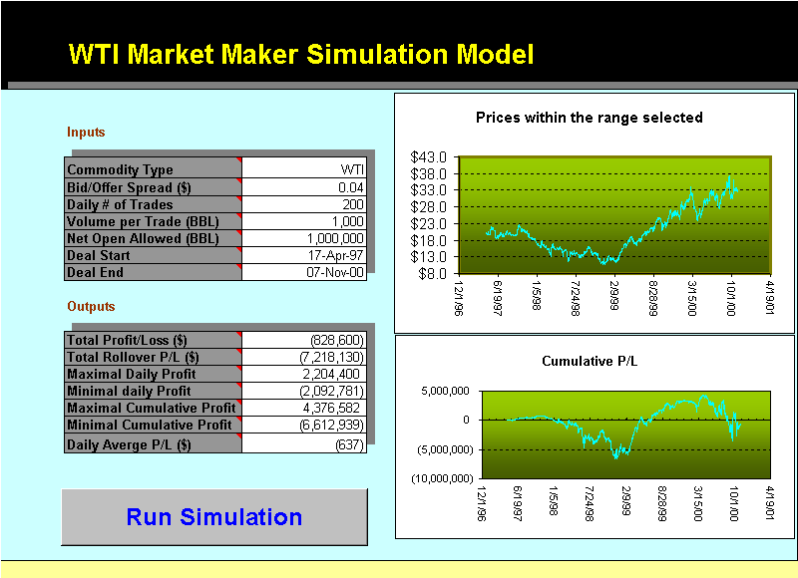
Deal Tenor
Spread = 4 cents, volume per trade=1000 Bbl, NOPA=1,000,000 Bbl, Deal tenor= 5 year back from Nov. 7,2000 Number of Trades = 200, cf. Page 7
13

Slide 14

Deal Tenor
Spread = 4 cents, volume per trade=1000 Bbl, NOPA=1,000,000 Bbl, Deal tenor= 5 year back from Nov. 7,2000 Number of Trades = 600, cf. Page 8
14

Slide 15
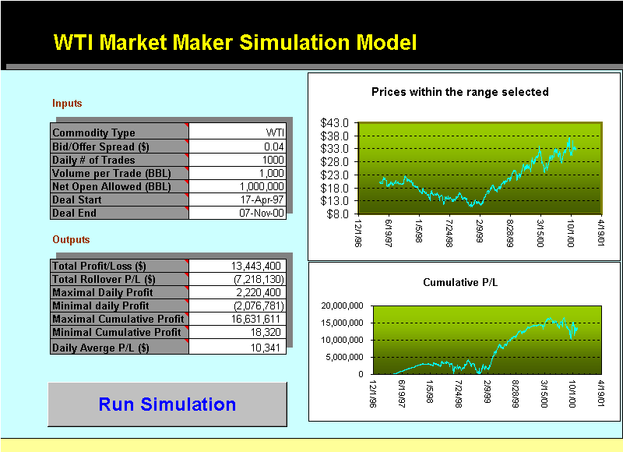
Deal Tenor
Spread = 4 cents, volume per trade=1000 Bbl, NOPA=1,000,000 Bbl, Deal tenor= 5 year back from Nov. 7,2000 Number of Trades = 1000, cf. Page 9
15

Slide 16

Net Open Position Allowed
Spread = 4 cents, volume per trade=1000 Bbl, NOPA=20,000 Bbl, Deal tenor= 1 year back from Nov. 7,2000 Number of Trades = 200, cf. Page 7
16

Slide 17
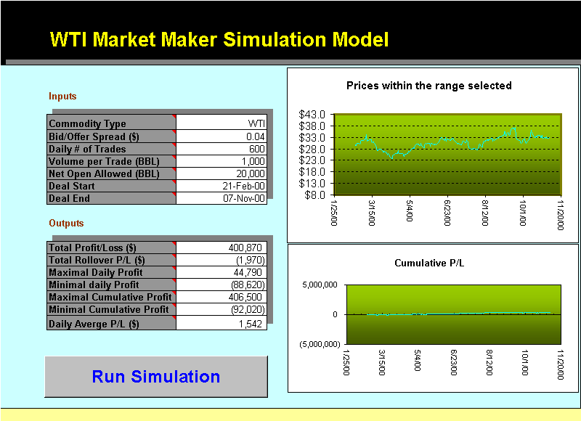
Net Open Position Allowed
Spread = 4 cents, volume per trade=1000 Bbl, NOPA=20,000 Bbl, Deal tenor= 1 year back from Nov. 7,2000 Number of Trades = 600, cf. Page 8
17

Slide 18

Net Open Position Allowed
Spread = 4 cents, volume per trade=1000 Bbl, NOPA=20,000 Bbl, Deal tenor= 1 year back from Nov. 7,2000 Number of Trades = 1000, cf. Page 9
18

Slide 19

Net Open Position Allowed
Spread = 4 cents, volume per trade=1000 Bbl, NOPA=5,000,000 Bbl, Deal tenor= 5 year back from Nov. 7,2000 Number of Trades = 200, cf. Page 13
19

Slide 20

Net Open Position Allowed
Spread = 4 cents, volume per trade=1000 Bbl, NOPA=5,000,000 Bbl, Deal tenor= 5 year back from Nov. 7,2000 Number of Trades = 600, cf. Page 14
20

Slide 21

Net Open Position Allowed
Spread = 4 cents, volume per trade=1000 Bbl, NOPA=5,000,000 Bbl, Deal tenor= 5 year back from Nov. 7,2000 Number of Trades = 1000, cf. Page 15
21

