Slide 1
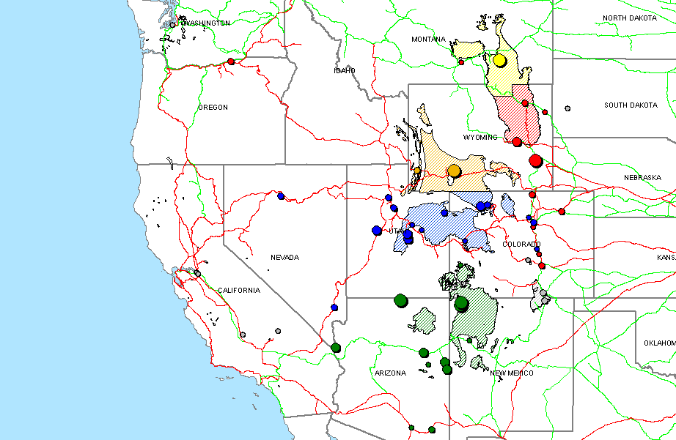
Plants and Mine Supply Regions of WSCC
BNSF
UP
Consumption
O
O
O
O
6330 to 9140
3020 to 6330
1160 to 3020
0 to 1160
Fuel
4 Corners
Central Rockies
Northern PRB
Other
Southern PRB
Southern Wyoming

