Slide 1

Connect your Mobile Employees
Ed Sami
Director, Strategic Accounts
Tel: 650-776-9090
Email: esami@viafone.com

Slide 2


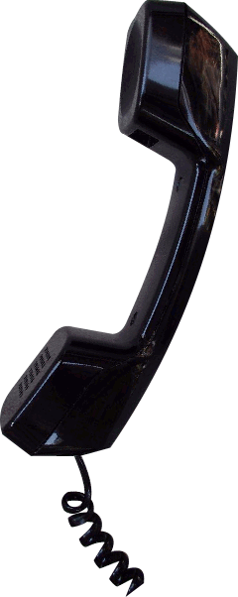
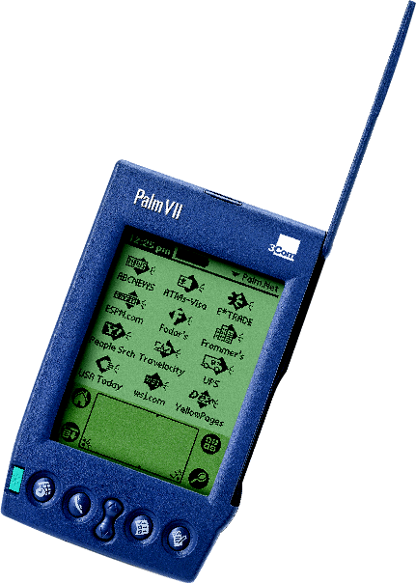
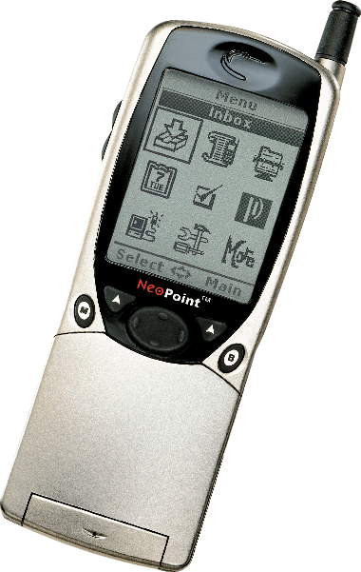

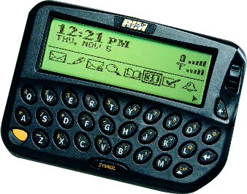
Who Is ViaFone
Connecting Mobile Employees
MOBILE EMPLOYEES
ViaFone
Claims Adjusters
Field Sales
Service Personnel
General Managers
Field Technicians
ViaFone connects mobile employees to enterprise systems to improve overall business performance
Production Managers
CORE ENTERPRISE SYSTEMS
Customer
Relationship
Management
Field
Service
Automation
Supply
Chain
Management
Enterprise
Resource
Planning
Corporate
Intranet
Other data
and apps

Slide 3
Corporate Profile
ViaFone is a mobile application software company that enables enterprises to connect employees to critical business systems
ViaFone OneBridge™ delivers proven mobile applications for voice and wireless data devices
Company
Leadership
$35M raised from premier investors
Offices in San Francisco, New York, Atlanta, Paris
Deployment partners’ presence in 46 countries
100+ Employees
Executives from:
Oracle
Borland
Cisco
Cambridge Technology Partners
BCG
Lucent
Phone.com/Openwave
Customers
Partners
Unmatched production experience including:
Alliances with HP, WebMethods, IBM, Interwoven, TIBCO, Documentum…
System integrator partners include Cap Gemini, DMR, Questra…
Hewlett-Packard
CNET/MySimon
CDNow
Ticketmaster
Nexjet
Undisclosed F500

Slide 4
ROI Opportunities
Sales Forecasting
Efficiency – faster & more efficient transfer of up-to-date information
Increased Revenue – respond faster to leads, company reacts faster to latest situations
Order Management – Sales & Service
Lower Costs – correct ordering, reduced returns
Lower Costs – faster order entry : reduced estimated configurations & buffer inventories
Increased Revenues – commit faster & more accurately – capture more business
Field Service
Lower Costs – more cost effective trouble ticket resolution
Increased Revenues – sell faster response as a service product
Calendar & E-Mail
Lower Costs - More efficient scheduling of meetings & personal efficiency
Lower Costs – faster approvals, alerts, and email responses – workflow

Slide 5
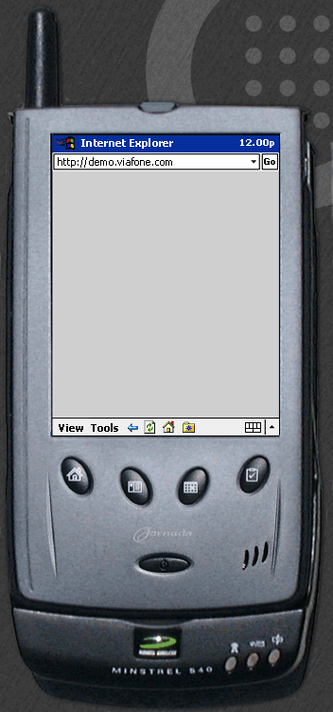
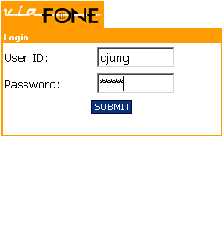
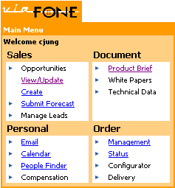
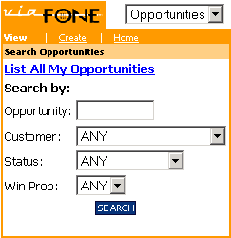
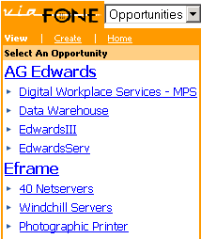
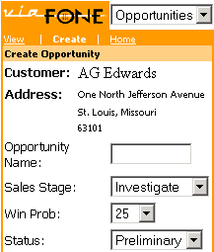
Mobile Sales Forecasting
PLEASE “VIEW – SLIDE SHOW”
Access, review and immediately update the forecast
Give management a clear picture of the forecast
Get company to work quickly, in a coordinated way, on the latest customer situation
Respond quickly to leads – beat the competition

Slide 6


Expected Savings – Sales Forecasting
Sales Team time savings through wireless forecast information entry and alerting
Faster leads transfer, faster ability of salesperson to respond, faster alerting of sales team, leading to win rate increase
Better real-time alert/information for sales management and link to supply-chain
Efficiency
2000 salespeople benefit
10 min per week saved by each rep and manager
17 persons worth of saving = $ 2,600,000 / year
Increased Revenue
Win Rate Increase
0.5 % higher sales of only 500 salespeople with $ 2.5 mill quota
= $ 6,250,000
Contribution Margin : 50% = $3,125,000 / year
Notes:
SALES FORECASTING ACCESS A. SALES TEAM TIME SAVINGS WHEN A SALESPERSON USES THE SYSTEM, HE/SHE SAVES TIME HAVING TO SCHEDULE, PASS INFORMATION, AND THE MANAGER SAVES TIME ATTENDING TO THE SCHEDULING REQUEST, RECEIVING THE INFORMATIOJN ASSUME: SAVE 10 MIN / TRANSACTION SALESPERSON TIME SAVE 10 MIN/ TRANSACTION MANAGER TIME $ 150,000 BURDENED COST PER PERSON, 4 TRANSACTIONS/ MONTH, BY 2000 REPS SAVINGS = $ 2,600,000 / YEAR B. MANUFACTURING TIME & COST SAVED FROM ENTERING FORECAST INFORMATION MORE PROMPTLY EARLIER, AND MORE ACCURATE, ENTRY/CONFIRMATION OF ORDERS DECREASES MANUFACTURING CYCLE TIME, SAVING COSTS
NEED TO ASSESS WHAT PERCENT OF COST IS DUE TO RE-WORK BECAUSE GOODS ARE ALREADY ADVANCED IN THE MANUFACTURING CYCLE, AND HAVE TO BE PULLED APART AND REWORKED. LABOR IS INVOLVED, AND A CERTAIN PERCENT OF THE PARTS ARE WASTED. IN ADDITION, EXCESS INVENTORY IS SAVED (ONE TIME SAVING)
C. INCREASED PROFITS FROM INCREASED WIN RATES
500 SALESPEOPLE WITH $ 2.5 MILL. QUOTA EACH = $ 1250 MILL. SALES
0.5% OF $ 1250 MILL = $ 6.25 MILL.
50% CONTRIBUTION MARGIN GOES STRAIGHT DOWN TO THE NET PROFIT LINE = $ 3.125 MILLION

Slide 7
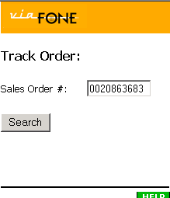
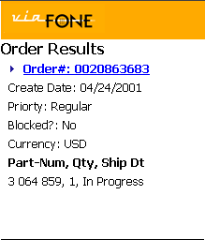
Mobile Service & Sales Order Management
PLEASE “VIEW – SLIDE SHOW”
Track delivery on any wireless device or from any phone
Review status of shipment and revise schedule on the go
Automatic wireless alert to manager if order fulfillment is critical

Slide 8
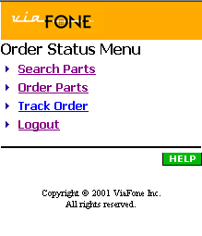
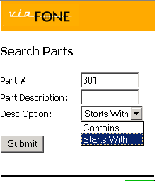
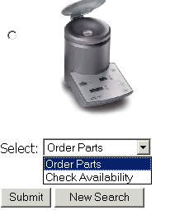
Mobile Part Ordering
PLEASE “VIEW – SLIDE SHOW”
Correct ordering of parts reduces inventory in the field, returns, wastage of inventory in the field
Visual image of part
Order Part while at customer location – improves accuracy of

Slide 9
Expected Savings – Order Management
Manufacturing Time & Cost Savings from prompt and accurate entry of information
Process efficiencies from resolving trouble-tickets
Reduced Costs
1 Day Earlier resolution of trouble-tickets, through correct and earlier parts orders from the field, by 200 field engineers per month
Cost savings = $ 2,500,000 / year
Correct order entry results in 2% fewer returns on 1000 orders, and therefore lower parts wastage
Cost Savings = $ 1,500,000 / year
Reduced manufacturing inventories and re-work costs due to more accurate order entry with current valid part #’s, compatibilities
Increased Revenue
Ability to commit to accurate delivery dates on the spot, and secure earlier delivery dates - capture more business
Notes:
ORDER MANAGEMENT ACCESS
(FIGURES MAY VARY – THIS FORMAT ALLOWS PROMPT CALCULATION OF POTENTIAL ROI)
A. 1 DAY EARLIER RESOLUTION OF TROUBLE TICKETS
200 ENGINEERS X 2 TROUBLE TICKETS/DAY X 250 DAYS = 100,000 TROUBLE TICKETS
ASSUME 50% RESOLVED IMMEDIATELY AND 50% TAKE 4 DAYS AVERAGE
SO 50,000 TROUBLE TICKETS RESOLVED 1 DAY EARLIER
ASSUME 1 HOUR SAVED ON THE SAVED DAY = 50,000 HOURS SAVED = 25 PERSONS WORTH OF SAVING
AT 100,000 BURDENED COST / ENGINEER = $ 2.5 MILL. B. LESS WASTAGE ON RETURNS FROM THE FIELD THE CORRECT PART WAS IDENTIFIED AND ORDERED, AND MULTIPLE PARTS WEREN’T ORDERED JUST TO GET THE RIGHT ONE ASSUME: 2% LOWER RETURN RATE ON THESE ACCURATE ORDERS 10% WASTAGE ON RETURNS
$ 750,000/ORDER X 1000 ORDERS = $ 750 MILL. IMPACTED 2% FEWER RETURNS = $ 15 MILL 10% WASTAGE = $ 1,500,000 PER YEAR SAVED

Slide 10
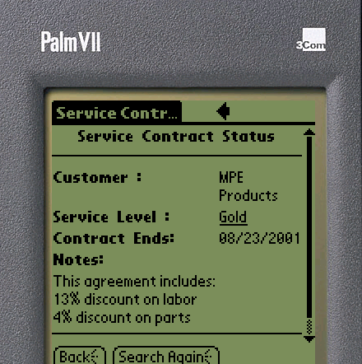
Mobile Field Service
Access service history records in the field
Build accurate service quotes
Query replacement part inventory, order status
Order equipment/parts and receive confirmation immediately

Slide 11
Expected Savings – Service
Prompt response to customer complaints
Re-route most cost-effective engineer to customer site
Allow engineer to access best knowledge base anywhere in company
Process efficiencies from resolving trouble-tickets quickly
Reduced Costs
1 Day Earlier resolution of trouble-tickets, through more prompt response and faster resolution, by 200 field engineers per month
Cost savings = $ 2,500,000 / year
Correct order entry results in 2% fewer returns on 1000 orders, and therefore lower parts wastage
Cost Savings = $ 1,500,000 / year
Reduced manufacturing inventories due to more accurate order entry of replacement parts with current valid part #’s, compatibilities
Increased Revenue
Enhance speed of customer service, and sell as new premium service product
Notes:
Same calculation as order management – these savings are in addition to savings from order management, for the different reasons given

Slide 12
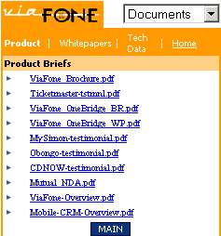
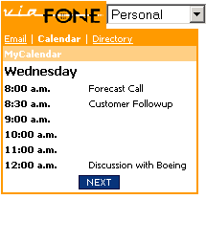
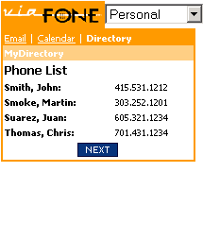
Mobile Email, Documents, Calendar, Directory
PLEASE “VIEW – SLIDE SHOW”
Check current status of your calendar from anywhere
Schedule meetings and conference calls while mobile
Respond to emails – grant approvals without delay – increase efficiency & workflow
Access right person/list of people from directory and initiate emails

Slide 13
Expected Savings – Calendar & Email
Time savings from accessing your up-to-date calendar status
Ability to schedule meetings with other personnel, while mobile, saving time and increasing personal efficiency
Decreased administrative need and costs (e.g “free time”)
More people on time for meetings
Immediate responses to approval requests – reduce follow up costs and costs of delayed decisions
Efficiency
2000 mobile people benefit
10 min. per week saved by each mobile person and a calendar invitee or receiver of approval/email
17 persons worth of saving = $ 2,300,000 / year
Notes:
EMAIL ACCESS TIME SAVINGS – EFFICIENCY (SELF), EFFICIENCY (IMMEDIATE COMMUNICATION TO RECEIVER) TIME SAVED IN BOOTING UP, RESPONDING TO EMAILS IN TIME – REDUCED NEED TO TRY TO LOCATE YOU, FOR YOU TO TALK TO SOMEONE TO BECOME AWARE OF AN ISSUE, FOR YOU TO BRIEF SOMEONE WHAT THE RESPONSE IS, TO REMEMBER TO PROCESS THE ISSUE ONCE YOU ARE SOMEWHERE YOU CAN LOG IN, FOR THE RECEIVER TO FOLLOW UP MANY TIMES BECAUSE YOU CANNOT BE REACHED PROMPTLY, FOR RECEIVER TO FOLLOW UP ON RECEIVING YOUR WRITTEN APPROVAL AFTER YOU’VE CALLED. ASSUME: 5 MIN/ WEEK SAVED PER TRANSACTION BY EACH USER & RECEIVER OF THE EMAIL 2000 PEOPLE USE THE MOBILE EMAIL SYSTEM EVERY DAY
2000 * 10 MIN / WEEK * 52 WEEKS = 8.5 PERSONS OF SAVING
$ 130,000 COST OF PERSON, BURDENED, PER YEAR $ 1,150,000 / YEAR SAVED
CALENDAR ACCESS SAVINGS FROM EFFICIENCY (SELF), EFFICIENCY (KNOWING SCHEDULE OF RECEIVER WHEN NEEDED), NO NEED TO INCUR ADMIN. COSTS OF ASKING SOMEONE TO SCHEDULE SAVINGS FROM ASKING YOUR ASSISTANT TO SCHEDULE, REMEMBERING TO FOLLOW UP ON MEETINGS THAT NEED TO BE SCHEDULED ONCE YOU CAN LOG IN, TRYING TO ORGANIZE YOURSELF TO REMEMBER, COMPLICATIONS FROM NOT PROMPTLY SCHEDULING, FOLLOWING UP WITH CUSTOMER/EMPLOYEE BECAUSE YOU COULD NOT PROMPTLY RESPOND TO THE REQUEST FOR A MEETING 5 MIN/ WEEK SAVED PER TRANSACTION BY EACH SENDER & ATTENDEE OF THE MEETING
ASSUME 2 TOTAL ATTENDEES PER MEETING
2000 PEOPLE USE THE MOBILE CALENDER SYSTEM EVERY DAY
2000 * 10 MIN / WEEK * 52 WEEKS = 8.5 PERSONS OF SAVING
$ 130,000 COST OF PERSON, BURDENED, PER YEAR $ 1,150,000 / YEAR SAVED

Slide 14
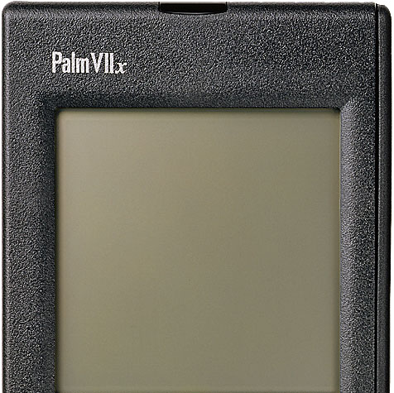
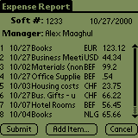
Mobile Time and Expense
Real – time or Disconnected/Sync Examples
Enter Time
Monitor personnel productivity
Bill customers faster by entering time promptly
Enter Expense Report
Review expenses
Add new items
Submit (Information stored on device)

Slide 15
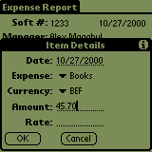
Mobile Expense Reporting
Enter Expense
Example of how to add individual expense item

Slide 16
Expected Savings – Time Entry
Capture billing time accurately
Closely monitor productivity of mobile billable employee
Faster billing to the customer
Efficiency
2000 mobile people benefit
20 min / week additional productivity obtained through better monitoring
17 persons worth of saving = $ 2,300,000 / year
Notes:
B. TIME ENTRY SAVINGS FROM PROMPTLY CAPTURING BILLABLE EMPLOYEE TIME, SAVINGS FROM MORE CLOSELY MONITORING EMPLOYEE PRODUCTIVITY ON REAL TIME BASIS 2000 EMPLOYEES CLOSELY MONITORED GET 20 MIN / WEEK MORE PRODUCTIVITY OUT SAVINGS AT $ 130,000 / EMPLOYEE = $ 2,300,000 / YEAR

Slide 17
Expected Savings – Expense Entry
Reduced administrative burden of entering time for another employee
Reduced rechecking of items, following up, improperly entered/explained items requiring re-doing
Efficiency
2000 mobile people benefit
10 min / week saved
8.5 persons worth of saving = $ 1,100,000 / year
Notes:
EXPENSE ENTRY SAVE TIME ENTERING EXPENSES INSTEAD OF WHEN YOU DON’T REMEMBER EVERYTHING, HAVING SOMEONE ELSE DO THIS ENTRY FOR YOU AND EXPLAINING, RECHECKING TIME FOR AP DEPARTMENT WHEN ITEMS ARE NOT PROPERLY EXPLAINED, FILING/PROCESSING/SUBMITTING/APPROVING TIME SAVED WHEN ELECTRONIC SUBMISSION – PROPERLY EXPLAINED – ARE ENCOURAGED ASSUME: ENTRY & RECHECKING TIME SAVED = 20 MIN/REPORT FILING/PROCESSING/SUBMITTING/APPROVING TIME SAVED = 20 MIN/REPORT 2000 PEOPLE USE THE MOBILE EXPENSE SYSTEM ONCE A MONTH @ $ 130,000 BURDENED COST/EMPLOYEE
$ 1,100,000 SAVED

Slide 18

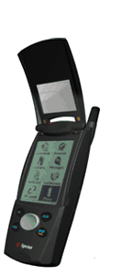
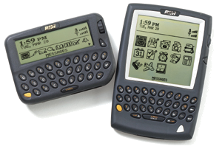

ViaFone Fit in the Wireless Landscape
Voice
CRM
SCM
A
L
L
S
Y
S
T
E
M
S
1
0
0
%
A
C C E S S
Computer
SFA
VOICE
Multi Carriers, Browsers,
&
Device
Platforms
Content
FSA
WAP
Lotus
PIM
PDA
ERP
KM
DATA
eBiz
Pager
?
Future
Devices

Slide 19
Why ViaFone
Any Device can access Any Corporate System
Industry Visionary
First to deliver Voice+Data Solutions
First to provide true back-end integration (not just web scraping)
First to focus on innovative mBusiness Applications
Proven Experience in the Field around mBusiness Applications with F500
Sales, Field Service, and Supply Chain
Certified in 30+ countries (more than 100 devices, 20 carriers/protocols)
Technology Leadership: ViaFone OneBridge
Voice + Data
Offline (synchronization) and Real-Time Access
Seamless Integration With Existing/Legacy Business Systems
Enterprise-Class Security Framework
Most Advanced “Whole” Product NOT Service
Full documentation and APIs
24/7 Customer Service & Support, Professional Training

