Slide 1
Value-at-Risk
Presented by
Tanya Tamarchenko
Enron Research Group
Houston, Texas
6 November 2000

Slide 2
Overview
Enron today
Value-At-Risk: Introduction
Energy Value-At-Risk: Numerical Techniques
Enron’s Value-At-Risk Model
Conclusions

Slide 3
Enron Today
 Combination of physical presence in
the energy markets with expertise in
financial products
 A market-maker in energy derivatives
 Three core businesses
- Cash and physical business
- Risk management
- Finance

Slide 4
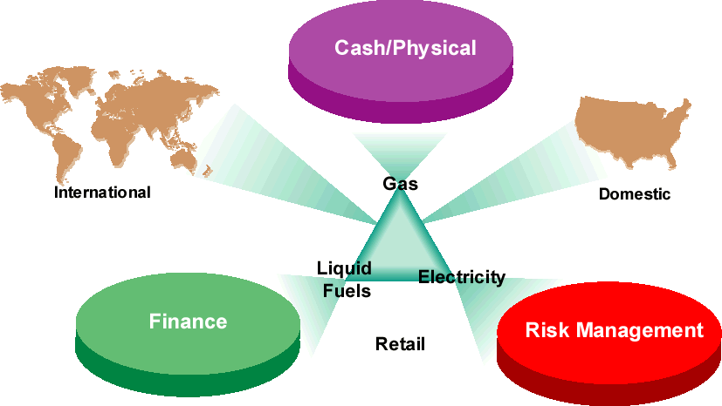
Enron Market Strategies

Slide 5
Enron Today: North America
Marketing Offices
Owned & Leased Capacity
NYMEX Trading
Owned Gas Storage
Leased Storage
Power Plants
In Operation
In Construction
Under Development
Energy Marketing
Activity
Gas
Power
Coal
Leading Provider of Energy in North America
Unparalleled Energy Network and Product Offerings
Significantly Benefiting from Changes in Energy Markets
Further Expanding Market Presence through e-Commerce
Notes:
<footer>

Slide 6

Enron Today: Europe
Nordic Region
Market Maker and Largest
Power Marketer
U.K.
Established Market Leader in Power and Gas
Excellent Physical Access to Key Markets
– Large Scale and Scope
– Diverse Portfolio of Assets and Contracts
–• Extensive Market- Making Capabilities
Fully Integrated Approach
– Geographically
– Across the Energy Chain
– Across Enron
Rapid and Complete Transfer of Enron’s Wholesale Business Model
Nord
Pool
Helsinki
Oslo
Offices
Energy Exchange
LNG Project Under Development
Energy Services
Energy
Partnerships
Leased Capacity Utility Services
Teesside
1,875 MW
Stockholm
Wilton
154 MW
Amsterdam
Oxford
APX
Warsaw
Moscow
EEX
Nowa Sarzyna
116 MW
London
Brussels
Power Plants
Frankfurt
In Operation
In Construction
Under Development
Energovill
Enron/Petrom JV
Zurich
Budapest
Milan
Jertovec
Energy Marketing
Activity
240 MW
Bucharest
Gas
Power
Coal
Sarlux
551 MW
Madrid
Marmara
478 MW
Arcos
1,200 MW
Continental Europe
Only Significant New Entrant in Power and Gas

Slide 7
Enron Today: International Portfolio
In Operation
Power Plant
Pipeline
Other
E&P
LPG Facility
LNG Facility
Water
Gas Distribution
Electricity Distribution
In Construction
Power Plant
Pipeline
Other
LPG Facility
LNG Facility
In Development
Power Plant
Pipeline
Other
E&P
LPG Facility
LNG Facility
LNG Vessel
Barge
Teesside
1,875 MW
United Kingdom
London
Offices
Office Locations
Poland Elektrocieplownia
Nowa Sarzyna
116 MW
Sutton Bridge
790 MW
Wessex
Germany
Bitterfeld
125 MW
Jertovec
240 MW
Italy
Milan
Croatia
Zagreb
China
Beijing
Turkey
Trakya
478 MW
Western-Eastern China
Natural Gas Pipeline
South Korea
Seoul
Dominican Republic
Santo Domingo
Italy
Sarlux
551 MW
Palestine
Gaza
Power Project
EOG
Sichuan
E&P
Wuhan
Loop
Sichuan-Wuhan Natural Gas Pipeline
SK-Enron
Gas Distribution
LPG Import
Puerto Rico
San Juan
United Arab Emirates
Dubai
LNG Vessel
135 Mc³m
Dabhol-
Talasari
Pipeline
EOG - India
3,200 Bbls/d
38 MMcf/d
Wuhan Qingshan
443 MW
Guatemala
Guatemala City
Puerto Plata
185 MW
EcoEléctrica
507 MW
LNG Facility
Chengdu
Logun
284 MW
Wuhan Wuchang
189 MW
Guam
Anigua
Puerto Quetzal
110 MW
124 MW
Jamaica
Kingston
San Juan Gas
LDC
Abu Dhabi
500,000 Tons
LNG Export
Oman
1.6 MM Tons
LNG Export
India
Delhi,
Mumbai
Philippines
Manila
Piti
80 MW
IGL
ProCaribe
Trinidad and
Tobago
EOG
115 MMcfd;
3,500 Bbls/d
Dabhol
LNG
Import
Thailand
Bangkok
Hainan Island
160 MW
Subic Bay
116 MW
Nicaragua
Corinto
70MW
Progasco
Nigeria
Lagos State Power Project 90 MW Barge
560 MW CCGT
Vietnam
Hanoi
Batangas
110 MW
Venezuela
Caracas
India
Dabhol
2,184 MW
Phase I: 740 MW
Phase II: 1,444 MW
Malaysia
2.6 MM Tons
LNG Export
First Gas Power Co
Fuel Supply
30-35,000 Bbls/d
Panama
Bahía Las Minas
355 MW
Phase I: 245 MW
Phase II: 110 MW
Colombia
Bogotá
Ventane
Citadel Venezolana
Benin
Integrated Gas
& Power Project
80 MW
20 Miles
Singapore
Promigas
1,062 Miles
Bachaquero III
Centragas
357 Miles
CALIFE
LDC
Accro III & IV
Gaspart Northeast
5 LDC
Pantanal Energía
480 MW
Phase I: 150 MW
Phase II & III: 330 MW
Indonesia
Jakarta
Bolivia
Santa Cruz
Brazil
Salvador, Sáo Paulo, Rio de Janeiro
Maputo Iron &
Steel Project Integrated Steel Slab Manufacturing Facility 3.5 MTPY
TRANSREDES
3,093 Miles
Cuiabá Pipeline
385 Miles
Riogás/CEG
LDC
Bolivia to Brazil
Pipeline
1,864 Miles
Gaspart South
2 LDC
Pande Gas Project 378 Miles
Elektro Eletricidade e Serviços
South Africa
Johannesburg
Mozambique
Maputo
Obras Sanitarias
de Mendoza
Australia
Sydney
Argentina
Buenos Aires
TGS
4,104 Miles
Enron projects completed or underway
in more than 30 countries
Notes:
<footer>

Slide 8
Market Capitalization of Energy Majors ($Billion U.S.: Rank as of 3/31/00)
Exxon
Mobil
Royal Dutch
Shell
BP
Totalfina
Elf
Chevron
Enron
Enel
Schlum- berger
ENI
Suez
Lyonnaise

Slide 9
Top North American Gas & Power Marketers (First Quarter 2000)
Natural Gas
(BCFD)
Electricity
(BKWH)

Slide 10
Value-at-Risk for Financial
Instruments Definitions
 Value-at-Risk measures exposure of a portfolio of financial instruments to potential losses resulting from:
- fluctuations of market prices, interest rates, exchange rates, etc.
- non-performance by counter parties
 Credit and market risks are closely related
 Value-at-risk technology has been developed for trading portfolios. Use of value-at-risk for asset/liability management by non-financial companies is a subject of debate.

Slide 11
Value-at-Risk: Definition
 Value-at-Risk (market) - dollar loss that may be
experienced in the value of a portfolio of
financial instruments:
– over a defined time period
– with a given probability
– due to market fluctuations
 Typically calculated for one day or two calendar
weeks (10 trading days)
 The time period may be selected to reflect
position liquidation time requirements

Slide 12
Value-at-Risk: Example
One day Value-at-Risk of $1,000,000 at
the probability level of 5% means that
Likelihood of one trading day loss
exceeding $1,000,000 is 5%
Or, the likelihood of a loss less than
$1,000,000 is 95%
Or, a loss of more than $1,000,000
may be experienced once in 20 days
(on average)
By Definition, losses are periodically
greater than Value-at-Risk

Slide 13
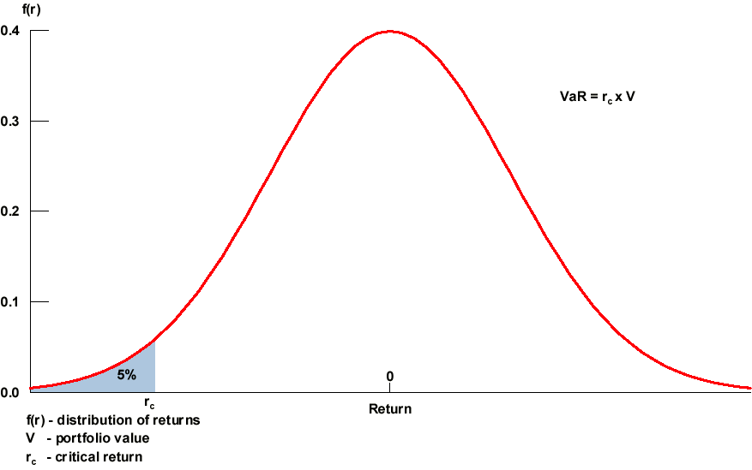
Value-at-Risk: Illustration

Slide 14
Value-at-Risk: Importance
 A requirement for any trading organization or a
major user of derivatives:
 Internal factors:
A summary of risks for senior management
and the Board of Directors.
Tool for setting trading limits and for
performance measurement.
 External factors:
Regulatory agencies, credit rating
agencies, creditors.

Slide 15
Extension of VAR to the Energy Industry
 Value-at-Risk developed originally for trading
portfolios of financial instruments
 Extension to portfolios of liquid, energy related
financial instruments is relatively straightforward
 Complications arise from inclusion of physical transactions and/or extension to physical operations of a plant or a pipeline
 Complications also arise from differences in the way energy prices behave from the way equity prices or interest rates behave
 Value-at-Risk for equity stakes in private companies is also not well defined
 Applicability of Value-at-Risk technology
to non-trading activities is a subject of a debate
Notes:
4

Slide 16
The Challenge of the Energy Industry
 Price discovery in the energy markets, illiquid markets
 Difficulties of modeling price dynamics
- gapping markets
- seasonality
 Complex option embedded in physical, often unique transactions
 The need to combine market and credit risk in a unified framework

Slide 17
Backtesting
 Losses should exceed Value-at Risk once in 20 days on average at the 5% level
 Backtesting is hard for illiquid commodities

Slide 18
Backtesting ENRON V@R (1/5/98 to 12/30/99)
Curve Shift P&L
Value at Risk
V@R Limit
100
Summer 1998 Power Price Spike
80
60
Hurricane Mitch
40
20
0
(20)
(40)
(60)
2/5/1998
3/5/1998
4/5/1998
5/5/1998
6/5/1998
8/5/1998
9/5/1998
10/5/1998
11/5/1998
12/5/1998
2/5/1999
3/5/1999
4/5/1999
5/5/1999
6/5/1999
8/5/1999
9/5/1999
10/5/1999
11/5/1999
1/5/1998
7/5/1998
1/5/1999
7/5/1999
12/5/1999

Slide 19
Energy Value-at-Risk
Numerical Techniques
Analytical: Mean/Variance Technique
 Simulation
- Historical
- Monte Carlo
 Stress tests (predefined scenarios)
 Enron’s approach: Monte Carlo
simulations, supported by statistical
analysis of historical prices

Slide 20
Mean/Variance Technique
The approach based on the assumption of
multivariate normal distribution of underlying returns
This method requires estimation of the correlation
matrix and standard deviations to produce an
estimate of variance-covariance matrix
In practical applications, the estimation is carried
out for a set of standardized (or elemental) instruments
Other instruments in the portfolio are mapped into the standardized instruments
For example, a bond may be represented as a portfolio
of zero-coupon bonds or a commodity swap may be represented as a portfolio of forward positions

Slide 21
Mean/Variance Technique (continued)
Portfolio Π of n instruments with the weights given by w_{i} (i=1,…,n)
The expected return of each instrument is r_{i}
The variances and covariances of returns are given by the variance-covariance matrix Ω
The expected portfolio return and variance are given by:
E[r] = Σw_{i} r_{i}
σ [r] = w^{T}Ω w
VAR = ( -1.645 • σ [r] + E[r] ) • Π

Slide 22
Mean/Variance Technique (continued)
A major weakness of the analytical approach: treatment of portfolios which include options
Distribution of returns of a portfolio containing options is not symmetric
Fat Tails: leptokurtic return distributions
imply higher probability of extreme outcomes
than normal distribution

Slide 23
Analytical VAR: Example

Slide 24
Monte Carlo Simulation
 Future prices, market rates, etc. are simulated using
– assumptions regarding stochastic processes they follow
– numerical inputs obtained through econometric estimation, using historical data, and/or inferred from current market variables (for example, option prices)
 Possibility of combining historical information with market expectations
 Simulated prices and market rates are used to calculate
values of the portfolio under different market conditions

Slide 25
Historical Simulation
 The technique based on actual historical prices, market rates, etc., observed over some period of time
 Historical market prices are used to derive the distribution of portfolio returns
 There are no assumptions regarding the stochastic processes and correlations for the underlying random factors
 Shortcomings
- for some instruments there may be no history of prices
- assumption that the future will mirror the past

Slide 26
Recommended Approach to Value-at-Risk for Portfolio of Energy Contracts
Simulations
Based on statistical model
Full re-pricing of the entire portfolio
In spite of the computational burden

Slide 27
Enron’s Value-at-Risk Model
Value-at-Risk methodology implemented for Enron’s portfolio is based on Monte-Carlo simulation of forward prices for all underlying commodities over specified time horizon (normally – 1 day).
Inputs to the model:
– Positions for each commodity (gamma – delta approach currently);
– Forward price for each commodity (provided by traders);
– Volatility for each commodity for each forward contract to be used in simulations;
– Correlations across commodities as well as across forward contracts of different maturity;

Slide 28
Enron’s Value-at-Risk Model
Outputs of the model: distribution of returns for each portfolio in the portfolio hierarchy
ENRON
GAS
POWER
LIQUIDS

Slide 29
Enron’s Value-at-Risk Model
(continued)
Calibration of the model as a very important part of V@R implementation:
– estimation of correlations;
– volatilities specification;
– price processes specification;

Slide 30
Importance of V@R Model Calibration
Portfolio consists of two offsetting positions on prompt month contracts on commodities C1 and C2.
For given positions (δ₁, δ₂), prices (p₁, p₂) and volatilities (σ₁, σ₂) for contracts on C1 and C2 VAR strongly depends on the correlation ρ between C1 and C2 which we use in the model:
VAR = 1.645 √ (δ₁p₁σ₁)² + (δ₂p₂σ₂)² – 2p(δ₁p₁ σ₁)(δ₂p₂σ₂)
VAR for a simple swap as a function of correlation
VAR
0
0.1
0.2
0.3
0.4
0.5
0.6
0.7
0.8
0.9
1
Correlation

Slide 31
VAR: Simulation Mechanism
Portfolio holdings (positions) are represented through
Deltas and Gammas (ignore vega, rho, cross-Greeks,
i.e., full revaluation).
Obtain new price, F_{new}, from Monte Carlo simulations
MTM Change in portfolio value:
Δ*(F_{new} - F_{old}) + .5*Γ*(F_{new} - F_{old})²,
where F_{new} is the new price obtained from the simulation.
1000 realizations of MTM are obtained for the portfolio.
The 95th percentile is used to obtain VAR.

Slide 32
Modules of Enron’s Value-at-Risk Model
 US Gas: forward contracts on NYMEX plus
about 300 hundred basis locations
– quite developed market;
– prices are liquid up to 60 months forward;
– history of prices available for more than
5 years daily;
– highly seasonal prices;
 US power: 15 regions, forward contracts for
peak and off-peak power
– developing market, deregulation started
recently;
– prices behavior changes from one year
to the next;
– highly seasonal prices;
– low liquidity beyond 12 months forward;

Slide 33
Modules of Enron’s Value-at-Risk Model (continued)
 Other commodities: liquids contracts (Crude Oil, Unleaded Gasoline, Propane, Butane, etc), Coal, Pulp and Paper, Condensate;
 European markets: UK Gas, UK Power,
Continental Gas, Continental Power, Nordic
Power;
 MG metals positions;
 Intramonth gas positions;
 Intramonth power positions;

Slide 34
Main Concepts of Enron’s VAR Model
“Primary” curves selection:
“Primary” curves are selected as mostly traded
commodities with liquid prices;
Reason: not every curve has sufficient price history information to perform statistical analysis for
V@R model calibration;
Implication: reduces the volume of calculations in
V@R model, allows analyzing of the outcome of
V@R model;
Every forward curve underlying Enron’s portfolio
is mapped into certain “primary” curve
Which implies correlation of 1 between this curve
and corresponding “primary” curve in V@R model
Monte-Carlo simulations;

Slide 35
Main Concepts of Enron’s VAR Model (continued)
Simulation of forward prices term-structure:
A portfolio of commodity contracts has exposure the
entire term structure of forward prices
Reshaping of the forward price curve may significantly
affect the performance of a portfolio
Modeling of the term structure requires capturing the correlations between different prices along the forward
price curve

Slide 36
Main Concepts of Enron’s VAR Model (continued)
 Statistical analysis of historical forward prices for “primary” curves:
– is based on 3 recent months of data;
– volatility is calculated as standard deviation of log-returns
of prices for prompt, prompt+1, prompt+2, etc. contracts;
– correlations across commodities are calculated based on
historical prompt month prices;
– Principal Component Analysis is performed for each commodity;
– statistical analysis is performed biweekly;

Slide 37
Gas Module of Value-at-Risk Model
Clustering analysis is performed to select “primary” or “core basis locations” from a set of 300 traded locations;
Regression analysis is performed for every basis curve versus the corresponding “core basis curve”. The hedge ratios are used in simulations in V@R model;
Principal Component Analysis is performed on all “core basis locations” jointly. The principal components derived from this analysis capture correlations across different core locations as well as term-structure of correlations across
forward contracts.

Slide 38
Geometric Brownian Motion
dP = μPdt + σPdz
P - market price
t - time
μ - drift
σ - volatility
dz - Wiener’s process
dz = ε√ dt
ε ∼ N(0,1)
P(t)=P(0) exp[(μ-σ*σ/2)t+σ*z]

Slide 39
Volatility: Black-Scholes
The critical input which is not directly observable
The option is uniquely priced as long as a buyer and a seller can agree on the volatility level
Volatility can be inferred from the option prices or estimated from historical prices
Historical volatility: standard deviation of logarithmic price returns:
In (P_{t} /P_{t-1}), annualized through multiplication by a relevant factor

Slide 40
Forward Volatility and Forward Forward Volatility
For a one-day Value-at-Risk we need to know volatility of each forward price over the next day
Forward volatility = average volatility of the forward price until it settles
30%
20%
10%
Forward correlation and forward forward correlation
Today
Forward
price settles
Time

Slide 41
Simulation of Forward Prices - Enron’s Solution
Price dynamics for the forward price curve is given by the following equation: ln[F(t,T)] = - σ(t,T)* σ(t,T)*dt/2 + σ(t,T)*dz(t,T)
where F(t,T) is a forward price at time t for delivery time T(t>T)
σ - volatility (j = 1,…,N)
dz - Brownian motion
 This is an extension of the standard Geometric Brownian Motion equation to several dimensions. This technique allows to model the forward curve as a unified object.
 Extension of the HJM model (Heath-Jarrow-Merton) to commodity prices. Important contributions of Cortazar, Schwartz and Amin.

Slide 42
Inputs to V@R Model: Correlations
Step 1: Calculate correlation matrix across different forward
contracts for a given commodity (use historical
log-returns of daily prices for each contract).
Step 2: Use this correlation matrix in V@R Model to simulate
random shocks for each forward contract. This step
requires decomposing the correlation matrix as a
product of some other matrix B and its transposed.
Then matrix B is applied to uncorrelated normally distributed
random variables to transform them into correlated random
variables which are used in Monte-Carlo simulations.

Slide 43
HJM Model for Term Structure Simulation of Forward Prices
Decomposition of correlation matrix is not unique:
there are multiple ways to represent a matrix as a product of some other matrix and its’ transposed. When forward contracts of different maturities are highly correlated with each other, it is possible to find a rectangular matrix B, such that matrix B
multiplied by B transposed is very close to correlation matrix C:
A B B^{T}
Columns of matrix B are called “factors” or “factor loadings”
or “principal components”.
=
X

Slide 44
HJM Model (Example: Factor Loadings for WTI)

Slide 45
Inputs to VAR Model: Volatilities

Slide 46
NG Prompt Month Volatilities (Historical and Implied) from 1/1/95 to 9/12/00)

Slide 47
Extensions of Value-At-Risk Model
 Incorporating different price processes;
 Capturing “fat tails”;
 Different measures of risk;
 Stress testing;
 Component VAR

Slide 48
Different Models for Price Simulation
Brownian motion (GBM)
Extension of GBM for forward prices (HJM)
Mean-Reversion models
Jump-Diffusion model
Combination of Mean-Reversion and Jump-Diffusion model;
Volatility switching models

Slide 49
Choosing Appropriate Price Process

Slide 50
Choosing Appropriate Price Process

Slide 51
Jump-Diffusion Process
 Main assumption behind the jump-diffusion process:
– log-normal diffusion process models the price changes resulting from arrival of normal information
– abnormal information resulting in shocks to the price is modeled through a Poisson process
 In the electricity markets the intersection of supply and demand (and sometimes transmission) produces frequent price spikes
 Floor reverting process: prices are likely to jump upward from the floor determined by the cost of generation in the most efficient units
 Jumps in the spot prices and/or across the seasonal
segments of the forward price curve

Slide 52
Jump - Diffusion Process (continued)
dS/S = μ dt + σ dz + dq
dq=Y - jump in case a shock arrives;
In Y ~ N(α,δ²)
π dt - probability of a jump on (t, t+dt)

Slide 53
Mean - Reversion Process
dS =β(S-α)dt + σSdz
α - long term mean;
β - speed of reversion;
σ - diffusion;

Slide 54
Challenges in Implementing Different Price Processes in VAR Models
 Parameter estimation based on historical prices:
– how the data fit the model;
– stability of estimated parameters;
 Implementing for a big portfolio of different commodities:
– imposing historically observed correlations;
– the meaning of “volatility” changes;

Slide 55
Risk Analytics: Component VaR
VAR decomposition/dissection by
time-buckets
traders
sub-portfolios
Useful in identifying risk-contributors and hedges
in a complex portfolio.
Algorithm based on conditional means of the
portfolio distribution.

Slide 56
Component VaR- Desk

Slide 57
Conclusions
Risk Management is an important part of Enron’s business
Efficient Risk Measurement System development is a joint effort of the whole organization involving Research, Information Technology, Risk Control, Traders

