Slide 1
Western Electricity and Gas Markets: Update
June 07, 2001

Slide 2
Current Situation:
Power Prices are Falling
*Demand is decreasing*
*Supply is increasing*
The market is working

Slide 3
Prices are Falling
  Natural Gas
  June prices at Topock fell to $7.85 / MMBtu – first time prices had fallen to below $8/MMBtu since November (Natural Gas Weekly)
    The American Gas Associate recently confirmed continued rapid replenishment of storage.
  Electricity
  Contracts for on-peak power to Southern California from July-September recently traded at $145 MWh, compared to up to $450/MWh in April (DJ Newswire)

Slide 4
Demand is Decreasing
Industrial load shedding and utility load reductions in Pacific Northwest
Higher retail rates in Pacific Northwest, which have been in effect since last fall
Higher CA retail rates going into effect in January and June 2001
Conservation: Californians used 11% less energy in May 2001 than in May 2000. This includes the demand that was projected to grow
(Source: California Energy Commission, L.A. Times, 06/06/01)
  Some predict demand will further decrease once consumers begin to get their bills reflecting higher electricity rates.

Slide 5
Demand is Decreasing
Weather:
The month of May was warmer than the normal in the state – as much as 8 degrees hotter in San Jose, according to the Western Regional Climate Centre.
On an average Northern California temperatures have been close to the 65ºF.
However, the recent drop in temperatures might be a temporary development as a hot summer is anticipated.

Slide 6
Supply is Increasing
More than a dozen plans have been submitted for new significant generation (WSJ, 6/6/01)
Increased imports: Hydropower from the Pacific Northwest has increased
(Source: L.A. Times, June 06, 2001)
Plants have been brought back on-line after maintenance
QFs are coming back online
Natural Gas Storage injections have increased significantly

Slide 7
Market Fundamentals at Work
Inelastic demand and tight supplies have been argued as reasons for rise in prices and failure of the markets
Factors like:
  rising natural gas prices;
  full capacity utilization of gas transportation capacity;
  severe drought conditions in the Northwest
    Worst Drought in 60 years
    (Source: The Wall Street Journal June 6, 2001)

Slide 8
Market Fundamentals at Work
(contd.)
    Water levels in the Columbia River system went down by 54% from normal
    (Source: The Wall Street Journal June 6, 2001)
  rising demand;
  reduction in imports; and
  rise in the price of tradable permits
resulted in rise in prices
reflecting market forces at work

Slide 9
Significant Market changes
FERC’s requirement that jurisdictional and non-juris. Gencos offer all available supply in the real time market has helped reduce prices
FERC’s order and other factors have encouraged parties to buy and sell power in the long-term and short-term forward markets
An abatement in demand, likely rate increases, cooler temperatures, increased gas injections and likely plant and pipeline investments have reduced forward prices

Slide 10
Futures Prices have dropped
Palo Verde Contract
700
600
500
400
$321/MWh drop
Contract Price ($/MWh)
300
200
100
0
10/1/2000
11/20/2000
1/9/2001
2/28/2001
4/19/2001
6/8/2001
7/28/2001
Trade Date
Source: NYMEX

Slide 11
Cash Prices Lowest in a year
All Indices in the Western Region have shown a decline in both the peak and Off-Peak prices

Slide 12
Firm Peak Prices:
DJ-Mid Columbia

Slide 13
Firm Peak Prices:
DJ-Palo Verde

Slide 14
Firm Peak Prices:
DJ-COB

Slide 15
Firm Peak Prices:
DJ-NP15

Slide 16
Firm Peak Prices:
DJ-SP15

Slide 17
Firm Off-Peak Prices:
DJ-Mid Columbia

Slide 18
Firm Off-Peak Prices:
DJ-Palo Verde

Slide 19
Firm Off-Peak Prices:
DJ-COB

Slide 20
Firm Off-Peak Prices:
DJ-NP15

Slide 21
Firm Off-Peak Prices:
DJ-SP15

Slide 22
Comparison of Weighted Megawatt Daily Prices: COB vs NP15

Slide 23
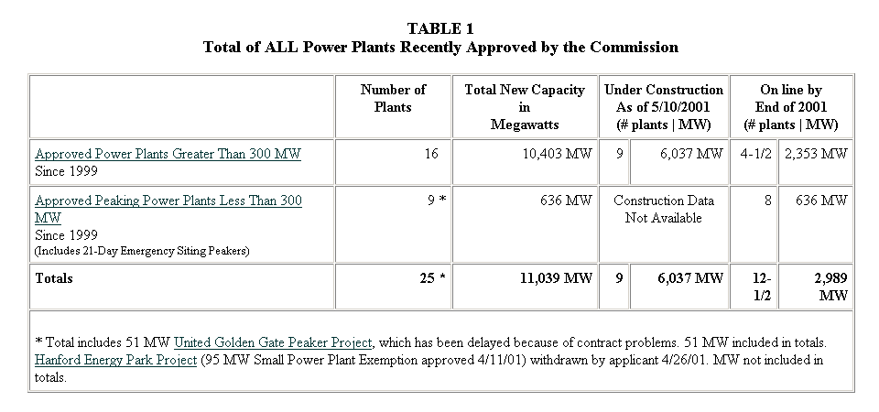
Supply Additions:
California Energy Commission

Slide 24
Qualifying Facilities (QFs)
QFs contribute more than 20% of the state’s daily supply
Unlike independent power generators, who can take the market prices, QFs sell power under an “avoided cost” formula defined by federal law and set by the CPUC
  The federal law, PURPA, was adopted in 1978 and was intended to bring cheaper and cleaner forms of electricity to market
  Although payments have been considered “above market” for many years, current contract prices are reasonable relative to wholesale market prices.
Roughly 2,000 MW of QFs were knocked offline due to the non-payment beginning December 2000 by Pacific Gas and Electric Co. and Southern California Edison
Source: Sacbee News Search, California Energy Commission DataBase

Slide 25
Qualifying Facilities (QFs)
March 2001, the CPUC ordered utilities to pay QFs for power on a going-forward basis but also modified the energy payment formula, making it uneconomic for many gas-fired plants to run and, thus, delayed the return-to-service of the QFs
Actions recommended to retain continued QF production:
  State must require the utilities to pay for the electricity already used, but not paid for
  State must ensure that QFs are paid on a timely basis at rates which reflect the actual costs of natural gas, ongoing operating and pollution control costs
  CPUC proposed decision on addressing these concerns is on agenda for June 13 meeting.

Slide 26
Gas Storage
California started 2000-01 with 152Bcf of natural gas in storage, 34Bcf below the 5-year (1995-99) average
During summer of 2000, natural gas requirement for electricity generation was strong due to unusually high cooling requirements
November 2000, nuclear power outages contributed to a draw of 27Bcf from storage
Low rainfall for 1999 and 2000 in the Northwest, significantly reduced hydro-electric generation, leading to sustained increase in gas-fired generation

Slide 27
Gas Storage
December cold weather and electricity outages caused by environmental concerns and equipment failure, resulted in a call on stocks
As of Jan.12, 2001 storage stocks were down by about 30% from the 5 year average

Slide 28
Gas Storage
Mid-February California’s working gas inventories were estimated at less than 70 Bcf, well below the 1995-99 average of 100 Bcf for the end of March
Reports of injections arrived as of March 15, but stocks in the Western Region remained at half the 5-year average
(Source: U.S. Natural Gas Markets: Recent Trends and Prospects for the Future, May 2001)
For week ended Friday, May 25 storage operators inject total net injections estimate of 99 Bcf (Source: American Gas Association).
(Source: Natural Gas Weekly Update, June 04, 2001)

Slide 29
Gas Storage
AGA reports another massive weekly injection figure of 117 Bcf for the week ending June 1
All indications of a drop in electricity prices

Slide 30
Conclusion
In response to high wholesale prices and an increase in retail rates (albeit delayed in California), supply is increasing and demand is decreasing
The market is working

