Slide 1

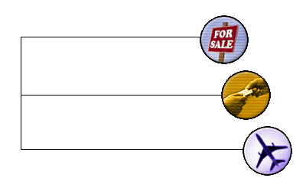
Introducing the transferable airline ticket
Buy transferable tickets and…

Slide 2
Company Profile
Founders | Frank Levy CEO, FairAir Jim Lawrence Board Member, FairAir Current EVP/CFO, General Mills Former EVP/CFO, Northwest Airlines and Board Member of Continental and TWA
Founded | December, 1999
Investors | Worldspan, $1 million (February 2001) Megunticook Management, $1.3 million (May, 2000) & $2.2 million (August, 2001) Private Individuals, $2.0 million across 3 rounds
Staff | 15, including 8 engineers ($170k/month burn rate)
Revenues | $11k in gross bookings in first week of operations

Slide 3
FairAir Update
FairAir has launched the world’s first exchange for transferable airline tickets
Our customers are heavily weighted toward leisure travel
Highly successful PR campaign underway
Worldspan is a strategic investor and strong partner
FairAir II: assimilate functionality into airline web sites

Slide 4
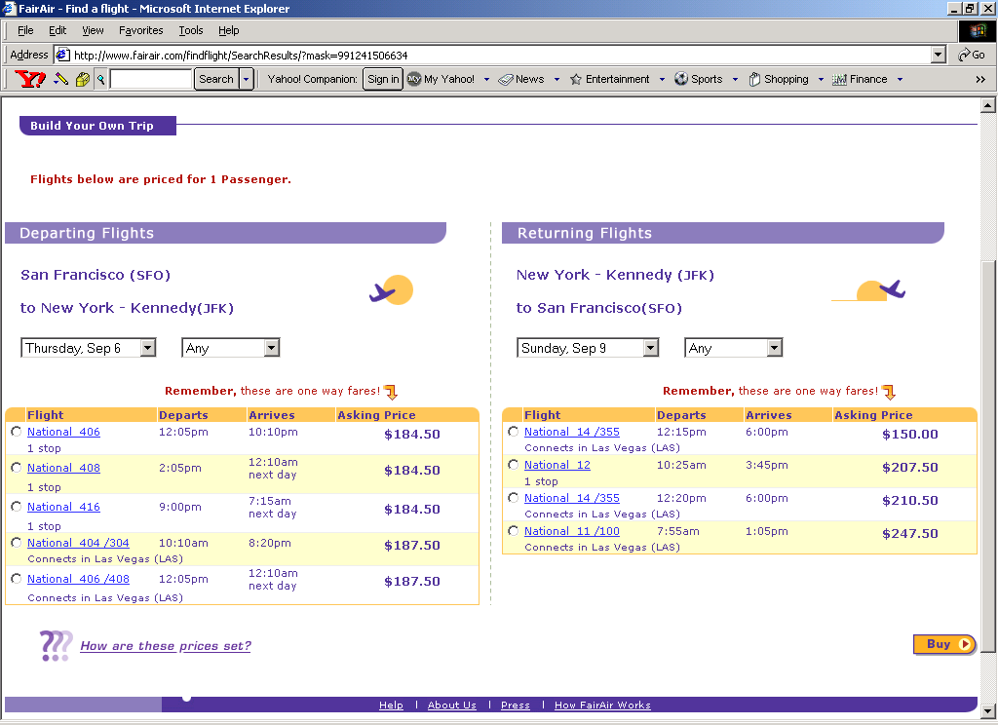
FairAir Today: Buying tickets
offered for sale by passenger (others offered by airline)

Slide 5
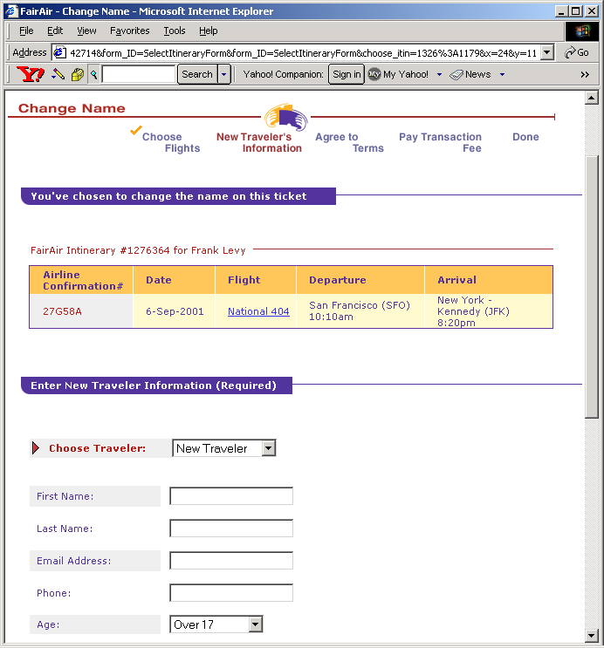
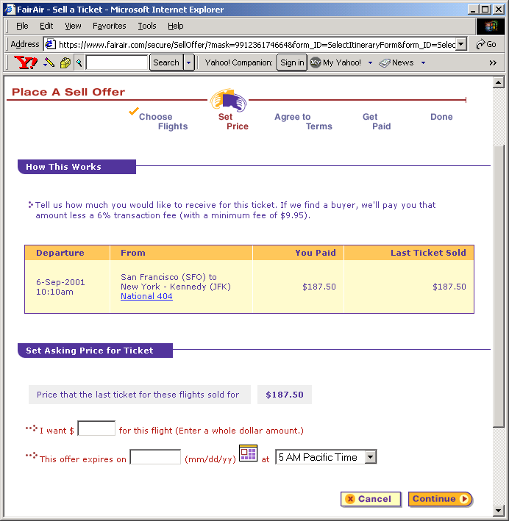
FairAir Today: Transfering and Selling
Either…Change the name
Or…Place your ticket up for sale

Slide 6
















Capturing the public imagination

Slide 7

Today: <1% of domestic markets
(connections only)
Key
TBD

Slide 8
Tomorrow: FairAir II
FairAir | FairAir II
Launched
Launching Q4
Private fares, one-way basis
Based on published fares, RT basis
Passenger keeps sale
proceeds, whatever the price
Passenger gets cash back; airline
gets additional collection
No commissions
No commissions
Airline waives its change fees
Airline waives its change fees
FairAir fees shared 50/50
Much lower sharing (in negotiation)
NWA: limited trial markets
Airline: system-wide roll-out
Modest co-marketing
Integration into airline’s own web site

Slide 9
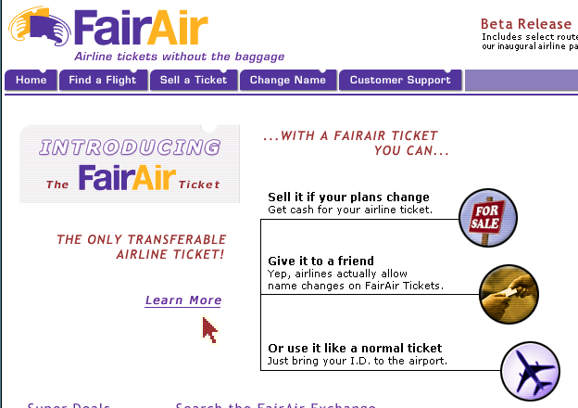
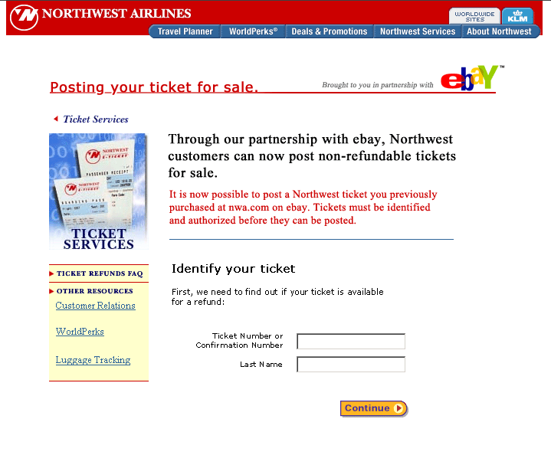
Tomorrow: technology platform for airlines
Today
Talks in Progress

Slide 10
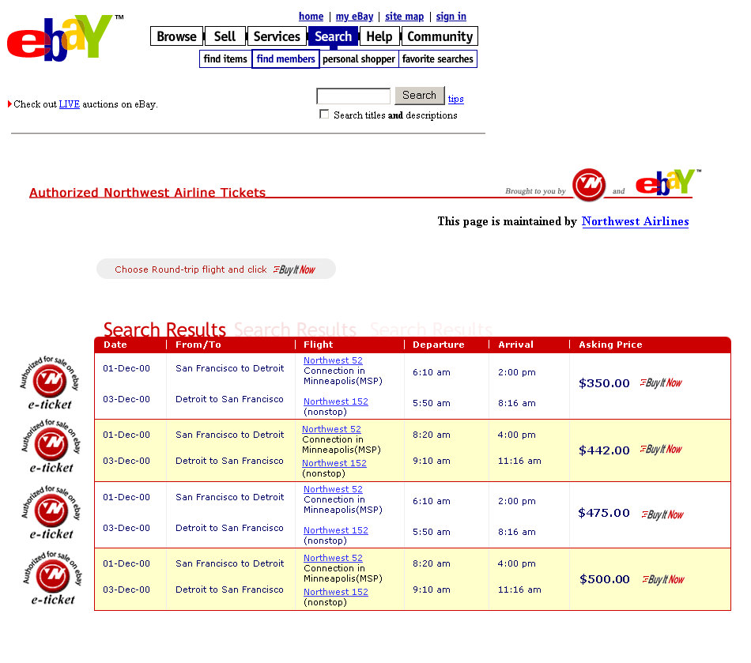
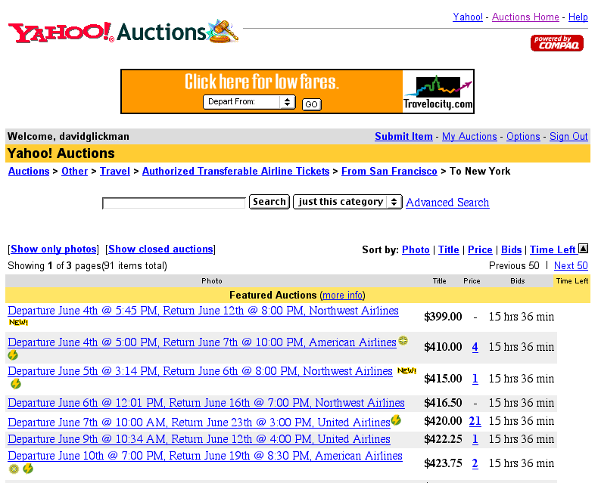
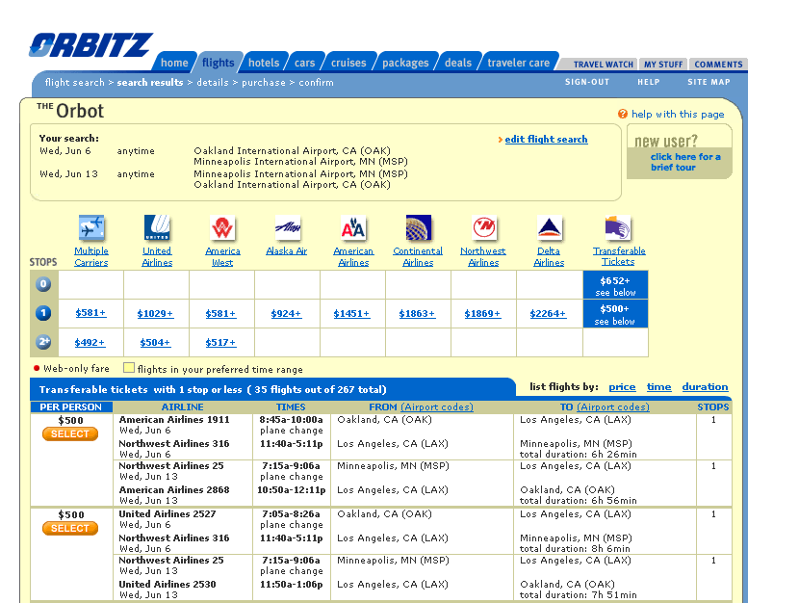
Tomorrow: distribution through 3rd parties
Talks In Progress
Potential new category in eBay
Potential listing in Yahoo! Auctions
Potential tab on Orbitz

Slide 11
Industry Drivers
CAGR ‘00-’03
42%
36%
Source: PhoCusWright

Slide 12
Latent Need for Transferability
6-10% of non-refundable tickets involve a change
The industry no-show rate is about 8%
3 reservations are made per passenger
10 years ago, up to 5% of people were flying on other people’s tickets
About 2% of airline revenues come from change fees
About 1.5% of airline revenues come from “breakage”
7% of NW flights in 1999 were sold out
FairAir believes sold-out flights actually peak at 12%
Volunteers are solicited on about 3% of flights

Slide 13
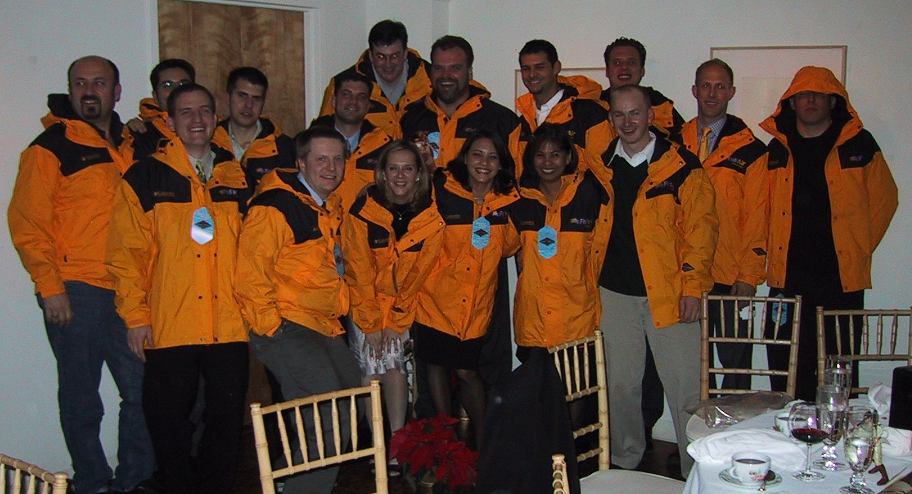
Very high talent/cost ratio
Engineering
(Java, Oracle, Linux/Solaris)
Reservations and Fulfillment
(customer service, ticketing)
Marketing
(design, product management)
Business Development
(airlines, online agencies)

Slide 14
Modest Funding Needs
$6.5 million raised to date.
Money in the bank lasts through early August.
We need at least $0.5 million promptly to avoid running out of money. $2.5 million would take us to profitability with FairAir II.
Worldspan has committed $1 million if others lead with $3.5 million and may still invest in smaller round.
Sabre has also expressed interest and Worldspan has given its blessing.

