Slide 1
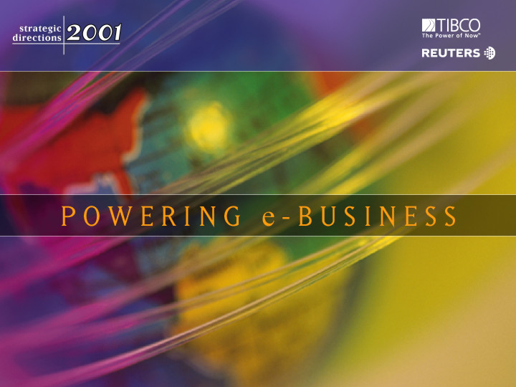

Slide 2
Jeff Skilling
President and CEO
ENRON

Slide 3

Economic Trade-Off
Cost of
Interaction
$
Value of
Specialization
Volume

Slide 4
Evolution of Economic Trade-Off
1300’s
Creation of
Money
1800’s
2000’s
$
Transportation &
Communication
Internet &
InfoTech
Barter
Economy
Volume

Slide 5
Types of Interaction Costs
Types of Interaction Costs
Credit
Legal &
Regulatory
Logistics
Price of
Successful
Economic
Transactions
Information
Seeking &
Gathering
Payments
Inventory

Slide 6
Cost of Interaction
Mining
Financial
Institutions
30-40%
60-70%
U.S.
India
55%
40-50%
Source: McKinsey

Slide 7
Business Structure
Business Structure
.90
Transformation
Interaction
1.0
1.0
1.0
.85
Finished
Product
.90
Transformation
Costs
Interaction
Costs
Total
Costs
3.45
3.00
6.45
.80
Finished
Product
Transformation
Costs
Interaction
Costs
Total
Costs
.95
.20
1.10
.20
1.20
.20
1.10
4.35
0.60
4.95

Slide 8
Interaction Costs are Radically Falling for Teller Transactions. . .
$1.50
$0.30
$0.01
1985
(Bank)
1995
(ATM)
2000
(Internet)

Slide 9
. . .and Natural Gas and Bandwidth Transactions
Time to Execute a
Long-Term Gas Contract
Time to Provision
Bandwidth
2-3 years
6-8 months
9 months
2-3 months
2 weeks
< 1 second
< 1 second
1981
1989
1997
2000
1995
Today
Next
Year

Slide 10
Change in Economics of
Business Structure
1.0
.10
1.0
.10
1.0
.10
.90
Transformation
Interaction
.85
Finished
Product
.90
Transformation
Costs
Interaction
Costs
Total
Costs
3.45
3.00
6.45
3.45
0.30
3.75
.80
Finished
Product
Transformation
Costs
Interaction
Costs
Total
Costs
.95
.20
1.10
.20
1.20
.20
1.10
4.35
0.60
4.95

Slide 11
Where’s the Opportunity?
.90
.10
.10
.10
.85
.90
.80
.95
.20
1.10
.20
1.20
.20
1.10

Slide 12
Where’s the Opportunity?
.90
.10
.10
.10
.85
.90
.80
Not
Cost
Competitive
.95
.20
1.10
.20
1.20
.20
1.10

Slide 13
Where’s the Opportunity?
.90
.10
.10
.10
Commoditized
Overcapitalized
Globalized
Can’t make compensatory
return in traditional asset
business
.85
.90
.80
.95
.20
1.10
.20
1.20
.20
1.10

Slide 14
Where’s the Opportunity?
.90
.10
.10
.10
Creating low cost, dependable
market interfaces
Market making
Logistics
Back office
Trade finance
.85
.90
.80
.95
.20
1.10
.20
1.20
.20
1.10

Slide 15
Where’s the Opportunity?
.90
.10
.10
.10
.85
.90
.80
Providing packaged turnkey
solutions for customers
Complex structures
Differentiation
Customization
“Virtual” Integration
.95
.20
1.10
.20
1.20
.20
1.10

Slide 16
. . . and Resource Model
Traditional
Asset intensive
Vertically integrated
Slow moving and rigid
Hierarchical
New
Networked
“Real options” oriented
Brain power intensive
Fast moving & entrepreneurial

Slide 17
Enron’s e-Commerce Strategy
Define and make new markets (core competency)
Utilize strong skills in risk intermediation & credit and risk control
systems
Expand and extend existing businesses and increase access to prices and products via e-Commerce
Enron’s strategy grows directly out of the Enron culture

Slide 18
In-House Technology Resources Wholesale Services
People
Expenditures
(Millions)
$358
1,380
1,154
$291
1999
2000
1999
2000

Slide 19
e-Commerce Initiatives
Commodities EnronOnline.com
Pulp, Paper & Lumber Clickpaper.com
Mid/Back Office CommodityLogic.com
Credit Enron Credit
Auction/Data Rooms DealBench.com

Slide 20
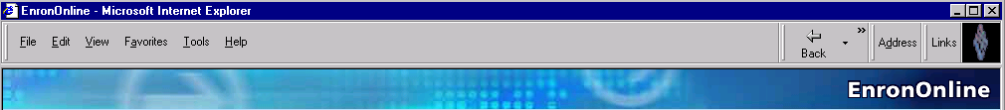
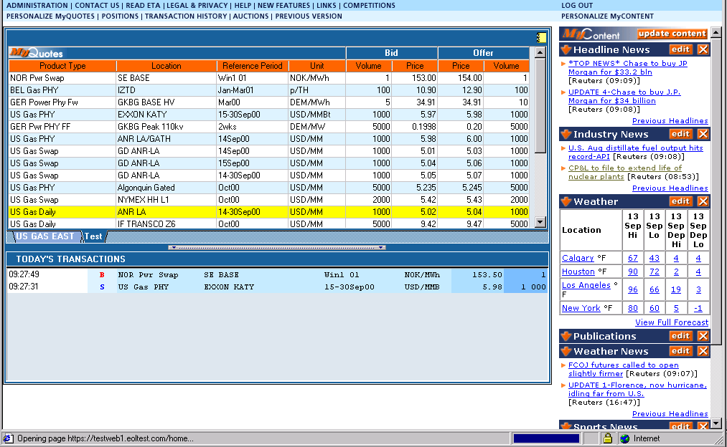
EnronOnline
Changing the Way Commodities are Bought and Sold
A Free Internet-based, Global Transaction System Which
Allow Counterparties to View Real Time Prices From Enron’s
Traders and Transact Instantly Online

Slide 21
EnronOnline Transactions Per Day

Slide 22
Enron Online Completed
1,000,000 transactions on
May 23, 2001

Slide 23
EnronOnline Statistics
Total Life to Date Transactions > 1,020,000
Average Daily Transactions > 4,700
Life to Date Notional Value of Transactions > $610 billion
Daily Notional Value Approximately $2.8 billion
Number of Products Offered: Approximately 1,600
Number of Currencies Traded in = 13
EnronOnline Version 1.0 Launch Date: November 29, 1999
EnronOnline Version 2.0 Launch Date: September 18, 2000

Slide 24
EnronOnline Product Slate
1999 - 4Q
May 2001
Natural Gas
U.S.
Canada
Power
U.S.
Nordic
Coal
Pulp & Paper
Plastics
Natural Gas
U.S.
U.K.
Belgium
Argentina
Canada
Power
U.S.
Germany
Holland
Switzerland
Australia
Coal
Europe
U.S.
International
Options
Continental power options
Nuclear outage knock-in call options
US & UK gas options
U.S. Gas Spreads
U.S. Gas Pipeline Capacity
Bandwidth
Weather
U.S.
Europe
Japan
Australia
Emissions
Crude & Refined Products
Asia
Petrochemicals
Plastics
LPG
U.S. Steel
Pulp & Paper
Auction
Emissions (U.S.)
Enbank virtual storage (U.K.)
Pipeline Capacity
Metals
U.S.
U.K. (LME Contacts)
Japan
Asia
Metal Spreads
U.K.
Sea Freight
U.S. Lumber
Auctions
Emissions
EnBank Virtual
Storage
Credit Derivatives
Aluminum
Japan
Holland
Options
Continental Power
Nuclear outage Knock-in call option
Nordic power
U.S. and U.K. gas
U.K.
Spain
Austria
Nordic Countries
Canada

Slide 25
EnronOnline Utilization
Online Transactions as
a % of Total Transactions
52%
55%
49%
39%
43%
25%
4Q 1Q 2Q 3Q* 4Q 1Q
1999
2000
2001
* The percentage of transactions on EOL declined in 3Q00 due to the purchases of MG Metals

Slide 26
EnronOnline Efficiency Gains
Transactions
Per Market Maker
Marginal
Cost Per Transaction
(Indexed)
3,084
100
25
672
1999
2000
1999
2000

Slide 27
EnronOnline vs. Major Competitors
North American Natural Gas and Power (TBtue)
31,151
24,228
22,594
23,149
10,625
3,680
3,119
1,021
1,689
1,452
1Q00
2Q00
3Q00
4Q00
1Q01
All Major Platforms Reporting Combined (Includes Altrade U.S. Gas, Intercontinental Exchange and NGX)
EnronOnline

Slide 28
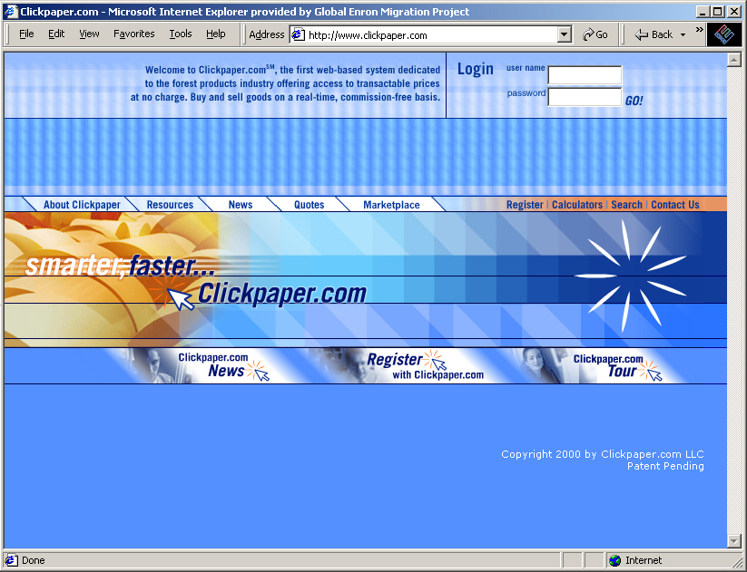
Clickpaper.com
Improving the Pulp & Paper Industry
A free, internet-based system to buy and sell Forest products with Enron in real time

Slide 29
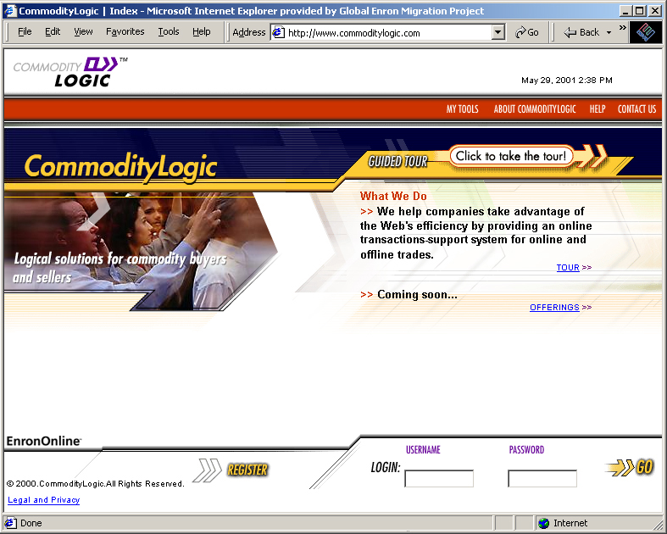
CommodityLogic.com
Making Back-office Systems More Efficient
An internet-based system that allows users to automate fulfillment process from confirmation through physical delivery, invoicing and payment

Slide 30
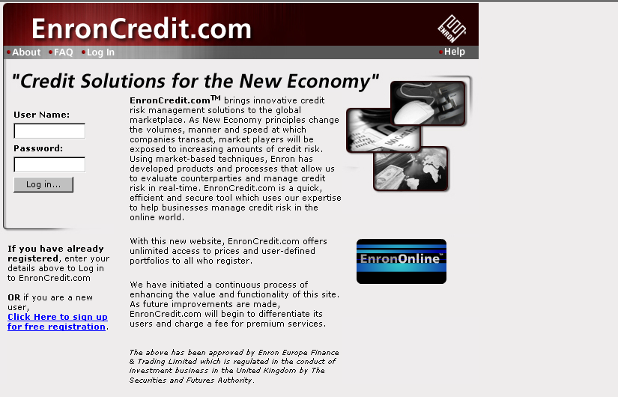
Enron Credit
Assessing and Managing Credit Risk
Provides live credit prices and enables customers
to hedge credit exposure

Slide 31
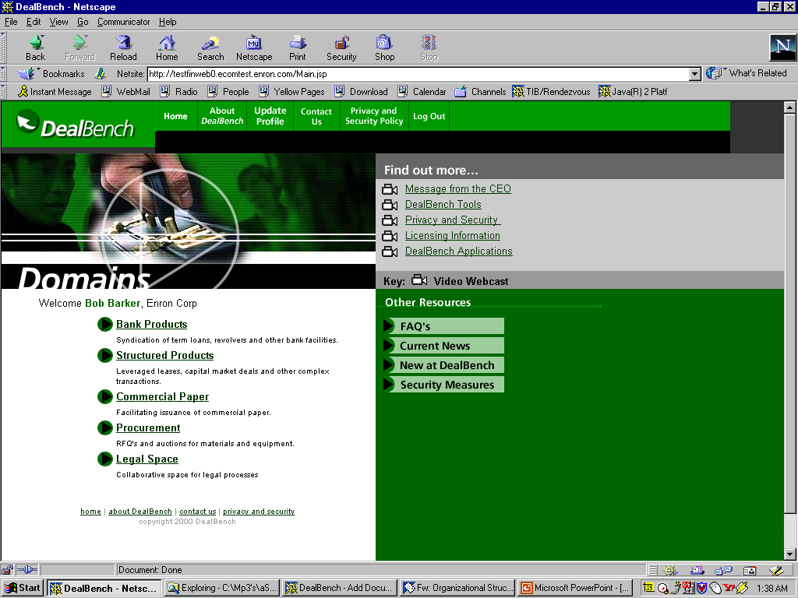
DealBench.com
Facilitating Price Discovery...The Art of the Paperless Deal
An internet-based system for auctions, online collaborations
using e-RFPs, internet roadshows and virtual data-rooms

Slide 32
Conclusion
Conclusion
“Sticking a big shiny ‘dot’ on your tired brick-and-mortar business model won’t do the trick. To truly excel, you’re going to have to reinvent your company fast enough to stay relevant in a dramatically discontinuous world.”
- Gary Hamel

Slide 34
The Internet: Fastest Social Change in History
U.S. Users (Millions)
Radio
Television
Cable
Internet
Source: Jupiter Communications

