Slide 1
Enron and the New Integration Model
Jeff Skilling
Southern Methodist University
March 27, 2001

Slide 2
Enron Annual Revenues
100.8B
40.1B
31.3B
20.3B
+ 54%
+ 28%
+ 151%

Slide 3
Earnings Performance (Recurring Per Diluted Share)
$1.47
$1.18
$1.00
$0.87
+ 15%
+ 18%
+ 25%

Slide 4
Management Efficiency
Income per Employee
Revenue per Employee
55,000
5.6 Mil
43,836
32,000
1.1 Mil
894,094
Enron
Industry
S&P Utilities
Enron
Industry
S&P Utilities
Source: msn-MoneyCentral © 2001

Slide 5
Enron Market Value*
62.5B
31.8B
18.9B
12.8B
*Uses baisc shares outstanding at 12/31

Slide 6
Enron Price/Earnings Ratio
56.6
37.6
28.5
23.9

Slide 7
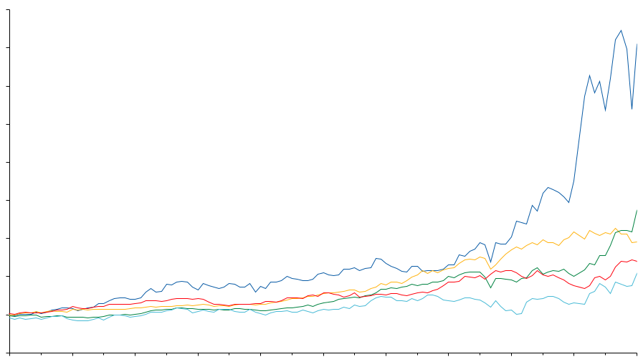
Total Return to Shareholders Jan 1, 1990 to February 28, 2001
1600
1400
Enron Corp.
S&P 500
Pipeline Avg.
Utility Avg.
E&P Avg.
1,151%
354%
571%
246%
183%
1200
1000
800
600
400
200
0
-200
Dec 90
Dec 91
Dec 92
Dec 93
Dec 94
Dec 95
Dec 96
Dec 97
Dec 98
Dec 99
Dec 00
Jan 01
Feb 01
Note: Calculated to February 28, 2001

Slide 8
Enron Corp
Enron Transportation Services
Enron Wholesale Services
Enron Energy Services
Enron Broadband Services

Slide 9
Economic Trade-Off
Cost of
Interaction
$
Value of
Specialization
Volume

Slide 10
Evolution of Economic Trade-Off
1300’s
Creation
of
Money
$
Barter
Economy
Volume

Slide 11
Evolution of Economic Trade-Off
1300’s
Creation
of
Money
1800’s
$
Transportation &
Communication
Barter
Economy
Volume

Slide 12
Evolution of Economic Trade-Off
1300’s
Creation of
Money
1800’s
2000’s
$
Transportation &
Communication
Internet &
InfoTech
Barter
Economy
Volume

Slide 13
Types of Interaction Costs
Credit
Legal &
Regulatory
Logistics
Price of
Successful
Economic
Transactions
Information
Seeking &
Gathering
Payments
Inventory

Slide 14

Cost of Interaction
Mining
Financial
Institutions
U.S.
30-40%
60-70%
55%
India
40-50%
Source: McKinsey

Slide 15
Business Structure
1.0
1.0
1.0
Transformation
Interaction
.90
Finished
Product
.85
Transformation
Costs
Interaction
Costs
Total
Costs
.90
3.45
3.00
6.45
.80
Finished
Product
Transformation
Costs
Interaction
Costs
Total
Costs
.95
1.10
1.20
1.10
.20
.20
.20
4.35
.60
4.95
<number>

Slide 16
Cost of Teller Transaction
$1.50
$0.30
$0.01
1985
(Bank)
1995
(ATM)
2000
(Internet)

Slide 17
Length of Time to Provision Bandwidth
6-8 months
2-3 months
< 1 second
1995
Today
Next
Year

Slide 18
Length of Time to Execute a Long-Term Gas Contract
2-3 years
9 months
2 weeks
< 1 second
1981
1989
1997
2000

Slide 19
Change in Economics of Business Structure
Transformation
Interaction
1.0
1.0
1.0
.90
.10
.10
.10
Finished
Product
.85
Transformation
Costs
Interaction
Costs
Total
Costs
.90
3.45
3.00
6.45
3.45
.30
3.75
.80
Finished
Product
Transformation
Costs
Interaction
Costs
Total
Costs
.95
1.10
1.20
1.10
.20
.20
.20
4.35
.60
4.95
<number>
<number>

Slide 20
Where’s the Opportunity?
.90
.10
.10
.10
.85
.90
.80
.95
.20
1.10
.20
1.20
.20
1.10
<number>

Slide 21
Where’s the Opportunity?
.90
.10
.10
.10
.85
.90
.80
Not
Cost
Competitive
.95
.20
1.10
.20
1.20
.20
1.10
<number>

Slide 22
Where’s the Opportunity?
.90
.10
.10
.10
Commoditized
Overcapitalized
Globalized
Can’t make compensatory
return in traditional asset
business
.85
.90
.80
.95
.20
1.10
.20
1.20
.20
1.10
<number>

Slide 23
Where’s the Opportunity?
.90
.10
.10
.10
Creating low cost, dependable
market interfaces
Market making
Logistics
Back office
Trade finance
.85
.90
.80
.95
.20
1.10
.20
1.20
.20
1.10
<number>

Slide 24
Where’s the Opportunity?
.90
.10
.10
.10
.85
.90
.80
Providing packaged turnkey
solutions for customers
Complex structures
Differentiation
Customization
“Virtual” Integration
.95
.20
1.10
.20
1.20
.20
1.10
<number>

Slide 25
Enron Opportunity
Traditional Model
Asset intensive
Vertically integrated
Slow moving and rigid
Hierarchical
New Model
Brain power intensive
Networked
“Real options” oriented
Fast moving & entrepreneurial

Slide 26
Enron’s Corporate Culture
Structure
Flat/Horizontal
Staff
Best & Brightest
Strategy
De-integration/
Virtual Integration
Super-
ordinate
Goal
Crusade for
free markets
Style
Loose/Tight
Shared
Values
Respect, Integrity,
Communication &
Excellence
Systems
PRC

Slide 27
The Challenge of Tomorrow—Reinvent!
“Somewhere out there is a bullet with your company’s name on it. Somewhere out there is a competitor, unborn and unknown, that will render your strategy obsolete. You can’t dodge the bullet—you’re going to have to shoot first. You’re going to have to out-innovate the innovators.”
Gary Hamel, Leading the Revolution

