Slide 1


Learning from the California Crisis Steve Kean EVP and Chief of Staff Eurelectric Conference June 12, 2001 Madrid, Spain
Notes:
Today’s discussion will include an overview of the Florida Gas Transmission system as well as natural gas markets in the US and policy challenges ahead.

Slide 2
Overview
What happened
Outlook
Lessons learned
Notes:
Today’s discussion will include an overview of the Florida Gas Transmission system as well as natural gas markets in the US and policy challenges ahead.

Slide 3
What Happened?
Supply and Demand Fundamentals
Politically compromised industry restructuring
Notes:
Today’s discussion will include an overview of the Florida Gas Transmission system as well as natural gas markets in the US and policy challenges ahead.

Slide 4
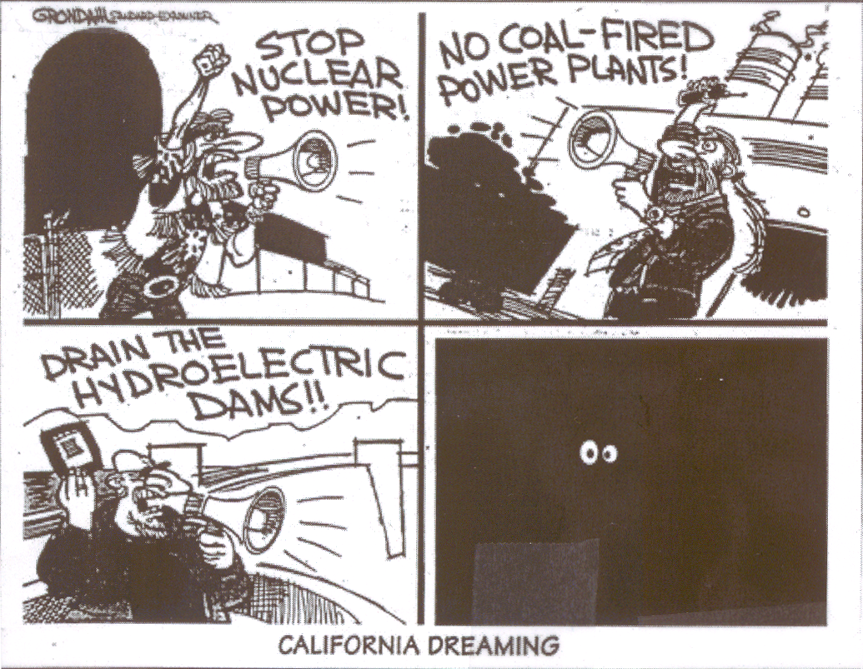
CALIFORNIA DREAMING

Slide 5
Supply and Demand
Economic growth throughout the West has driven up demand
Power plant construction hindered by regulation
Old power infrastructure leading to frequent breakdowns
Emissions limits constraining existing generation
Poor hydro conditions this year have reduced supplies available to import-dependent California
Notes:
Today’s discussion will include an overview of the Florida Gas Transmission system as well as natural gas markets in the US and policy challenges ahead.

Slide 6
Have We Been Fooled by Unusually Strong Hydro in Recent Years?
Volume Runoff Percent of Normal
Columbia River
California
2001
2000
1999
55%
80%
93%
94%
116%
108%
98%
153%
1998
1997
1996
152%
84%
138%
129%
Source: Columbia River data from NOAA/National Weather Service, Northwest Rivers Forecast Center. California data from CDWR
-7-

Slide 7
Historical Volume Runoff at The Dalles

Slide 8
Northwest Hydro Production: Last Year Actual vs. Normal

Slide 9
Northwest Hydroelectric Production: 2001 Forecast vs Last Year Actual

Slide 10
Northwest Hydroelectric Production: 2001 Forecast vs 1997 Actual

Slide 11
From Sound Economics to Political Compromise
1993-94 Blue Book: Pure deregulation / open access
1994-95 CPUC Orders: Emergence of centralized market institution
1995-96 The legislature takes over (AB1890):
1996-97 FERC “rubberstamps”
1998 Implementation: - $500 million computer system
- Three month delay
- Very little residential switching
- Some (10-15%) large customer switching
Something for everyone (customer choice, divestiture, environmental and rate payer subsidies, stranded cost recovery)

Slide 12
Summary
Very little new capacity added
Tight emissions limits
Increasing dependence on imports
Old, inefficient (polluting) facilities subject to breakdown
emissions costs
gas costs
Powerful “NIMBY/BANANA sentiment
Shortages → Blackouts
Skyrocketing wholesale prices
Flat to lower supply
Lower hydro capacity availability
Reduced imports into California
Rapid economic growth throughout Western U.S.
Increased demand
Bankruptcy
Utilities totally exposed to spot prices
Highly compromised, negotiated legislation
Retail Rate Caps (no demand response)
Stranded cost recovery mechanism inhibiting switching (utilities continue to serve most load)
State constructed spot market; no hedging
Deregulated wholesale prices

Slide 13
Outlook

Slide 14
Prices are Falling
Natural Gas
June prices at Topock fell to $7.85 MMBtu - first time prices had fallen to below $8/MMBtu since November (Natural Gas Weekly)
The American Gas Associate recently confirmed continued rapid replenishment of storage
Electricity
Contracts for on-peak power to Southern California form July- September recently traded at $145 MWh, compared to up to $450/MWh in April (DJ Newswire)
Notes:
Today’s discussion will include an overview of the Florida Gas Transmission system as well as natural gas markets in the US and policy challenges ahead.

Slide 15
Demand is Decreasing
Industrial load shedding and utility load reductions in Pacific Northwest
Higher retail rates in Pacific Northwest, which have been in effect since last fall
Higher CA retail rates going into effect in January and June 2001
Conservation: Californians used 11% less energy in May 2001 than in May 2000 (Source: California Energy Commission, L.A. Times, 06/06/01)
Some predict demand will further decrease once consumers begin to get their bills reflecting higher electricity rates
But, most of reduction appears to be weather-related, so far
Notes:
Today’s discussion will include an overview of the Florida Gas Transmission system as well as natural gas markets in the US and policy challenges ahead.

Slide 16
Supply is Increasing
Increased imports: Hydropower from the Pacific Northwest has increased (Source: LA Times, June 06, 2001)
Plants have been brought back on-line after maintenance
QFs are coming back on line
Natural Gas Storage injections have increased significantly
Notes:
Today’s discussion will include an overview of the Florida Gas Transmission system as well as natural gas markets in the US and policy challenges ahead.

Slide 17
Natural Gas Spot Prices - SoCal
(Daily midpoint in $/MMBtu)
$51
Source: Gas Daily

Slide 18
Natural Gas Prices - SoCal
(in $/MMBtu)
Spot (monthly midpoint average)
Future
Source: Gas Daily Price Guide (Dec ‘98 - Jun ‘01) and Gas Daily (5/25/01) ;and Enron

Slide 19
Peak Spot Electricity Prices - COB
(Daily weighted average in $/MWh)
$3,000
Source: Megawatt Daily

Slide 20
Electricity Prices - COB
(in $/MWh)
Spot (end of month)
Future
Source: Megawatt Daily, Nymex (6/5/01)

Slide 21
Peak Spot Electricity Prices - Palo Verde
(Daily weighted average in $/MWh)
$4,175
Source: Megawatt Daily

Slide 22
Electricity Prices - Palo Verde
(in $/MWh)
Spot (end of month)
Future
Source: Megawatt Daily, Nymex (6/5/01)

Slide 23
Futures Prices have dropped Palo Verde Contract
700
600
500
Contract Price ($/MWh)
400
$321/MWh drop
300
200
100
0
10/1/2000
11/20/2000
1/9/2001
2/28/2001
4/19/2001
6/8/2001
7/28/2001
Trade Date
Source: NYMEX

Slide 24
Lessons Learned

Slide 25
Lessons Learned
Liberalization did not cause California’s problems
supply and demand
regulatory barriers
to new facilities
to hedging
to choice and competition
Full liberalization is the answer for California
real choices, real opportunities to manage price risk
ease of entry to generation sector
real market prices to end users (phase in)
remove utility (and state regulators) from the procurement role
What doesn’t work
heated political rhetoric (actually increased costs in California)
price caps (discourage new production and conservation)
no alternative allocation mechanism proposed
Notes:
Today’s discussion will include an overview of the Florida Gas Transmission system as well as natural gas markets in the US and policy challenges ahead.

Slide 26
®

