Slide 1


Deregulation in the Aftermath of California Steve Kean EVP and Chief of Staff INGAA Analyst Conference Houston, Texas July 13, 2001
Notes:
Today’s discussion will include an overview of the Florida Gas Transmission system as well as natural gas markets in the US and policy challenges ahead.

Slide 2
Overview
Rationale for deregulation
California
What happened
Outlook
Lessons learned
Status of deregulation
Notes:
Today’s discussion will include an overview of the Florida Gas Transmission system as well as natural gas markets in the US and policy challenges ahead.

Slide 3
Rationale for
Deregulation
Notes:
Today’s discussion will include an overview of the Florida Gas Transmission system as well as natural gas markets in the US and policy challenges ahead.

Slide 4
Benefits of Deregulation
Not a “zero sum game”
Net benefits created
Better solutions to transition issues
Cost savings
Improved reliability
Improved product choices
Improved allocation of capital
Improved allocation of risk
Improved development and deployment of technology
Improved
speed
flexibility
solutions
to problems in the market

Slide 5
Benefits - Cost Savings Price Decrease from Deregulation in Five U.S. Industries
40%
Percent Decrease
Trucking
Railroads
Airlines
Long Distance Telecom
Natural Gas
Source: Brookings Institution/George Mason University

Slide 6
Benefits - Cost Savings U.S. Average Gas Prices by Sector 1985 vs. 1998 (In constant 1998 Dollars)
1985
1998
-26%
-34%
-49%
-56%
$/MMBtu
The average price to all end users has fallen 43% to date under open access. In
the decade prior to open access, prices increased by 71% adjusted for inflation.

Slide 7
Benefits - Cost Savings City Gate Gas Prices
$/MMbtu
Billions
Sources:
U.S. DOE Natural Gas Annual
U.S. DOE Natural Gas Monthly

Slide 8
Benefits - Cost Savings U.K. Market Transition Timeline (In Cents per KWH)
Wholesale Liberalization; Privatization of electricity supply, distribution and fossil fuel generation
Electricity supply choice extended to more large customers
Fossil fuel levy reduced; applied only to public sector generation
Coal industry privatized (stranded cost recovery)
Retail electricity competition begins
7.25¢
6.71¢
6.85¢
6.54¢
5.40¢
Source: OECD Data

Slide 9
Benefits - Product Choice
Electrons are fungible but contract terms and contracting parties are not
Physical product differentiation
quantity
delivery terms - firm, nonfirm and everything in between
flexibility to changes in load requirements (timing)
flexibility in take obligations-
equipment
ease -- combining services

Slide 10
Benefits - Efficiency in Capital Investment (Avoiding future stranded costs)
Open market produces forward price signals
market-driven, not projections
signals producers whether investment in new facilities will be supported by the market
Open market forces producers to find lowest cost solution
enhancements to existing facilities
conservation, DSM investments
“debottlenecking” of existing system
Forward market makes it possible to finance long term investments more economically

Slide 11
Benefits - More efficient allocation of risk
Price volatility imposes costs separate and apart from price level
investors
manufacturers
Today, risks of price volatility are allocated to those who are least able to handle them - end users
In an open market, risk is allocated to those in the best position to manage it - intermediaries

Slide 12
California
What happened
Outlook
Lessons learned
Notes:
Today’s discussion will include an overview of the Florida Gas Transmission system as well as natural gas markets in the US and policy challenges ahead.

Slide 13
What Happened?
Supply and Demand Fundamentals
Politically compromised industry restructuring
Notes:
Today’s discussion will include an overview of the Florida Gas Transmission system as well as natural gas markets in the US and policy challenges ahead.

Slide 14
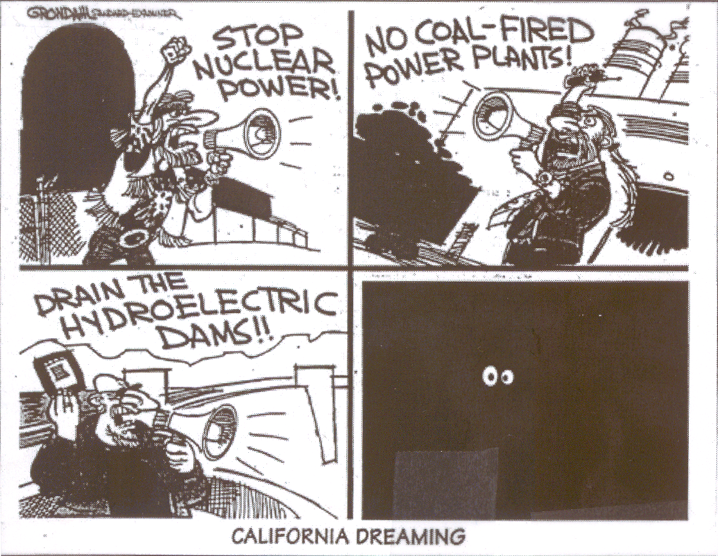
CALIFORNIA DREAMING

Slide 15
Supply and Demand
Economic growth throughout the West has driven up demand
Power plant construction hindered by regulation
Old power infrastructure leading to frequent breakdowns
Emissions limits constraining existing generation
Poor hydro conditions this year have reduced supplies available to import-dependent California
Notes:
Today’s discussion will include an overview of the Florida Gas Transmission system as well as natural gas markets in the US and policy challenges ahead.

Slide 16
Have We Been Fooled by Unusually Strong Hydro in Recent Years?
Volume Runoff Percent of Normal
Columbia River
California
2001
2000
1999
55%
80%
93%
94%
116%
108%
98%
153%
1998
1997
1996
152%
84%
138%
129%
Source: Columbia River data from NOAA/National Weather Service, Northwest Rivers Forecast Center. California data from CDWR

Slide 17
Historical Volume Runoff at The Dalles

Slide 18
From Sound Economics to Political Compromise
1993-94 Blue Book: Pure deregulation / open access
1994-95 CPUC Orders: Emergence of centralized market institution
1995-96 The legislature takes over (AB1890):
1996-97 FERC “rubberstamps”
1998 Implementation: - $500 million computer system
- Three month delay
- Very little residential switching
- Some (10-15%) large customer switching
Something for everyone (customer choice, divestiture, environmental and rate payer subsidies, stranded cost recovery)

Slide 19
Summary
Very little new capacity added
Tight emissions limits
Increasing dependence on imports
Old, inefficient (polluting) facilities subject to breakdown
emissions costs
gas costs
Powerful “NIMBY/BANANA sentiment
Shortages → Blackouts
Skyrocketing wholesale prices
Flat to lower supply
Lower hydro capacity availability
Reduced imports into California
Rapid economic growth throughout Western U.S.
Increased demand
Bankruptcy
Utilities totally exposed to spot prices
Highly compromised, negotiated legislation
Retail Rate Caps (no demand response)
Stranded cost recovery mechanism inhibiting switching (utilities continue to serve most load)
State constructed spot market; no hedging
Deregulated wholesale prices

Slide 20
Outlook

Slide 21
Prices are Falling
Natural Gas
June prices at Topock fell to $7.85 MMBtu - first time prices had fallen to below $8/MMBtu since November (Natural Gas Weekly)
The American Gas Associate recently confirmed continued rapid replenishment of storage
Electricity
Contracts for on-peak power to Southern California form July- September recently traded at $145 MWh, compared to up to $450/MWh in April (DJ Newswire)
Notes:
Today’s discussion will include an overview of the Florida Gas Transmission system as well as natural gas markets in the US and policy challenges ahead.

Slide 22
Demand is Decreasing
Industrial load shedding and utility load reductions in Pacific Northwest
Higher retail rates in Pacific Northwest, which have been in effect since last fall
Higher CA retail rates going into effect in January and June 2001
Conservation: Californians used 11% less energy in May 2001 than in May 2000 (Source: California Energy Commission, L.A. Times, 06/06/01)
Some predict demand will further decrease once consumers begin to get their bills reflecting higher electricity rates
But, most of reduction appears to be weather-related, so far
Notes:
Today’s discussion will include an overview of the Florida Gas Transmission system as well as natural gas markets in the US and policy challenges ahead.

Slide 23
Demand is Decreasing
Weather:
The month of May was warmer than the normal in the state-as much as 8 degrees hotter in San Jose, according to the Western Regional Climate Centre
On an average Northern California temperatures have been close to 65ºF
However, the recent drop in temperatures might be a temporary development as a hot summer is anticipated
Notes:
Today’s discussion will include an overview of the Florida Gas Transmission system as well as natural gas markets in the US and policy challenges ahead.

Slide 24
Supply is Increasing
Increased imports: Hydropower from the Pacific Northwest has increased (Source: LA Times, June 06, 2001)
Plants have been brought back on-line after maintenance
QFs are coming back on line
Natural Gas Storage injections have increased significantly
Notes:
Today’s discussion will include an overview of the Florida Gas Transmission system as well as natural gas markets in the US and policy challenges ahead.

Slide 25
Natural Gas Spot Prices - SoCal
(Daily midpoint in $/MMBtu)
$51
Source: Gas Daily

Slide 26
Natural Gas Prices - SoCal
(in $/MMBtu)
Spot (monthly midpoint average)
Future
Source: Gas Daily Price Guide (Dec ‘98 - Jul ‘01)and Enron

Slide 27
Peak Spot Electricity Prices - COB
(Daily weighted average in $/MWh)
$3,000
Source: Megawatt Daily

Slide 28
Electricity Prices - COB
(in $/MWh)
Spot (end of month)
Future
Source: Megawatt Daily, Nymex (7/11/01)

Slide 29
Peak Spot Electricity Prices - Palo Verde
(Daily weighted average in $/MWh)
$4,175
Source: Megawatt Daily

Slide 30
Electricity Prices - Palo Verde
(in $/MWh)
Spot (end of month)
Future
Source: Megawatt Daily, Nymex (7/11/01)

Slide 31
Futures Prices Have Dropped Palo Verde September Contract
Contract Price ($/MWh)
$318/MWh drop
Trade Date
Source: NYMEX

Slide 32
Lessons Learned

Slide 33
Lessons Learned
Liberalization did not cause California’s problems
supply and demand
regulatory barriers
to new facilities
to hedging
to choice and competition
Full liberalization is the answer for California
real choices, real opportunities to manage price risk
ease of entry to generation sector
real market prices to end users (phase in)
remove utility (and state regulators) from the procurement role
What doesn’t work
heated political rhetoric (actually increased costs in California)
price caps (discourage new production and conservation)
no alternative allocation mechanism proposed
Notes:
Today’s discussion will include an overview of the Florida Gas Transmission system as well as natural gas markets in the US and policy challenges ahead.

Slide 34
Status of
Deregulation
Notes:
Today’s discussion will include an overview of the Florida Gas Transmission system as well as natural gas markets in the US and policy challenges ahead.

Slide 35
Electric Restructuring Update
NH
WA
VT
ME
MT
ND
OR
MN
WI
NY
*
MA
ID
SD
MI
RI
WY
PA
*
CT
NE
IA
OH
NJ
NV
IL
IN
DE
UT
WV
VA
MD
CA
CO
KS
MO
KY
NC
TN
*Utilities Outsourcing
MA implementing process
Central Maine Power
Bangor Hydro
PECO
GPU
DQE
AZ
*
OK
AR
SC
NM
AL
GA
MS
AK
TX
LA
FL
HI
Restructuring Legislation/ Order Enacted
Restructuring Enacted, Delayed Implementation
A Commission and/or Legislative Investigation is Ongoing
No significant Activity
*
Source: Enron Government Affairs
Status current as of 07/01

Slide 36
Natural Gas Restructuring Update
For Residential and Commercial Customers
NH
WA
VT
ME
MT
ND
OR
MN
WI
NY
MA
ID
SD
MI
RI
WY
PA
CT
NE
IA
OH
NJ
NV
IL
IN
DE
UT
WV
VA
MD
CA
CO
KS
MO
KY
NC
TN
AZ
OK
AR
SC
NM
AL
GA
MS
AK
TX
LA
FL
HI
States with legislation passed or comprehensive PUC order
issued for all customers; however, the quality of access may vary
States with access for some commercial customers
Source: Enron Government Affairs
Status current as of 07/01
Note: Industrial open nationwide
States considering reform
Competitive Bidding for customer
No Activity

Slide 37
®

