Slide 1



Progress and Challenges
for Electricity Liberalization
Dr. Kenneth L. Lay
Chairman
®
XII Repsol YPF—Harvard Seminar
Palma, Majorca-Spain
July 7, 2001

Slide 2
Agenda
Lessons from the California electricity crisis
Progress of gas and electricity liberalization in the U.S. and Europe
Challenges to complete the liberalization process

Slide 3
Enron
A Neutrally Positioned Market Maker
Market Making Capabilities
Operating
Capabilities
Other
Capabilities
Cash Markets
Forward Markets
Futures Markets
Transactions
Logistics
Settlement
eCommerce Platforms
Risk Management Process
Capital
Define Product Standards and Contracts
Obtain Access to Physical Product
Develop Physical Distribution
Market Making Establishes Liquidity
Innovative Structured Products
Risk Management

Slide 4
California Wholesale Electricity Prices
vs. Enron Stock Price
$4,175

Slide 5
California Wholesale Electricity Prices
vs. Enron Stock Price
$4,175

Slide 6
What Happened in California?
Politically compromised industry restructuring (not “deregulation”)
Unfavorable change in supply and demand fundamentals (“the perfect storm”)
Politicized responses to distorted market—spiraling problems and “badwill”

Slide 7
Summary of the California Problem
Very little new capacity added
Tight emissions limits
Increasing dependence on imports
Old, inefficient (polluting) facilities subject to breakdown
  emissions costs
  gas costs
Powerful “NIMBY/BANANA” sentiment
Shortages
→ Blackouts
Skyrocketing wholesale prices
Flat to lower supply
Lower hydro capacity availability
Reduced imports into California
Rapid economic growth throughout Western U.S.
Increased demand
Bankruptcy
Utilities totally exposed to spot prices
Highly compromised, negotiated legislation
Retail Rate Caps
(no demand response)
Stranded cost recovery mechanism inhibiting switching (utilities continue to serve most load)
State constructed spot market; no hedging
Deregulated wholesale prices

Slide 8
Government
Intervention
NIMBY
S/D Shift
Spot
Dependence
Wholesale
Price Spikes
Wholesale
Price Spikes
Retail Price Caps
Shortages
Bankruptcies
Conflict
Lost
Confidence
Shortages
Bankruptcies
Jawboning Populist Threats New Intervention

Slide 9
Lessons Learned
Liberalization did not cause California’s problems
  Regulatory barriers to infrastructure, hedging, competition, and equilibration exacerbated by unfavorable supply and demand shifts
Full liberalization is the answer for California
  Real choices, opportunities to manage risk
  Eased entry for new generation
  Real market prices to end users (phase in)
  Remove utilities (and state regulators) from procurement
What doesn’t work
  Heated political rhetoric (actually increases costs in California)
  Price caps (discourages production and forces political rationing)
  Nationalization
Notes:
Today’s discussion will include an overview of the Florida Gas Transmission system as well as natural gas markets in the US and policy challenges ahead.

Slide 10
NIMBY and the Environment
Postponed modernization of gas plants creates more pollution from
  Higher utilization of older, less efficient plants
  Emergency new generation such as diesel units
Price spikes/shortages have resulted in air permit exceptions
Imports of emergency power to California have exported “environmental stress” to the Southwest and Northwest

Slide 11
California’s Aging Gas-Fired Powerplants
(BTU’s per KWH)
14,425
Gas Usage Premium = Emission Premium
40%
10,360
10,506
10,264
9,883
9,751
U.S. Average
California
NY
TX
LA
FL
Source: 1999 EEI Statistical Yearbook, Table 26

Slide 12
Emissions Comparison
California Power Generation
(pounds/MWh)
NO_{X}
SO₂
2.9
2.9
-80%
-99%
-85%
0.6
-60%
0.08
0.01
0.004
Old
Oil Boiler
Old
Gas Boiler
New
Gas CC
Old
Oil Boiler
Old
Gas Boiler
New
Gas CC
Source: Energy and Environmental Analysis, Inc.

Slide 13
Emissions Comparison
California Power Generation (cont.)
(pounds/MWh)
PM₁₀
CO₂
0.4
1,644
-75%
-32%
-26%
1,112
819
-60%
0.1
0.04
Old
Oil Boiler
Old
Gas Boiler
New
Gas CC
Old
Oil Boiler
Old
Gas Boiler
New
Gas CC
Source: Energy and Environmental Analysis, Inc.

Slide 14

The Golden “What f?”
“If I wanted to raise rates, I could have
solved this problem in 20 minutes.”
California Governor Gray Davis
March 2001

Slide 15
California’s Outlook is Improving
Supply is increasing
Demand is moderating
Gas and power prices are falling
Will a new message emanate from California?

Slide 16
Why Liberalization?
Market forces are “smarter” at allocating resources
Open markets reduce prices and improve quality, other things the same
Consumers like choice

Slide 17


Slide 18
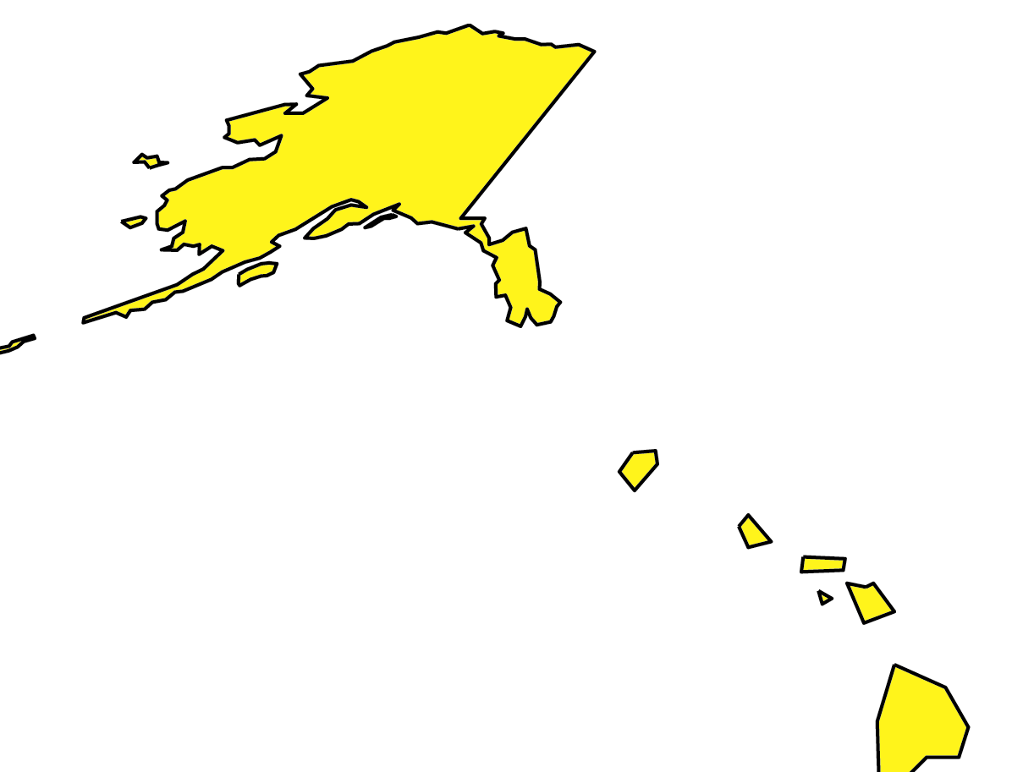
Power Liberalization in the United States
Most States are still moving ahead
Markets representing 4% of population and 5% of total load have elected to delay market opening
  Nevada and Oklahoma delayed indefinitely
  Arkansas, West Virginia and Montana postponed
*
*
DE
*
* Legislation and Regulatory Order have both been issued.
AK
Alaska
HI
Restructuring Legislation Enacted
Comprehensive Regulatory Order Issued
A Commission and/or Legislative Investigation is Ongoing
No Significant Activity
Status Current as of 06/01
57% of this $220B market is expected to be deregulated by 2004

Slide 19
Natural Gas Liberalization in the United States
For Residential and Commercial Customers
Hawaii
Alaska
States with legislation passed or comprehensive PUC order
issued for all customers; however, the quality of access may vary
States with access for some commercial customers
States considering reform
Source - Government Affairs as of 06/00
Note: Industrial open nationwide
No significant activity
Notes:
1
1

Slide 20
Progress of gas and electricity liberalization in Europe

Slide 21
Natural Gas Liberalization Summary
EU Directive Not Yet Effective
Very Limited Competition in Practice
Some Competition – On The Way To Full Liberalization
Fully Liberalized

Slide 22
Pace of Natural Gas Liberalization
UK
Spain
Market "Openness"
Netherlands
Ireland
Ireland
France
Denmark
Sweden
Belgium
Italy
Portugal
Greece
Austria
Luxembourg
Finland
Germany
0%
20%
40%
60%
80%
100%
Market Opening

Slide 23
Electricity Liberalization Summary
EU Directive Not Yet Effective
Very Limited Competition in Practice
Some Competition – On The Way To Full Liberalization
Fully Liberalized

Slide 24


Pace of Electricity Liberalization
UK
Sweden
Finland
Norway
Netherlands
Ireland
Market "Openness"
Denmark
Spain
Austria
Italy
Portugal
Luxembourg
Germany
Switzerland
France
Belgium
Greece
0%
20%
40%
60%
80%
100%
Market Opening

Slide 25
Positive EU Liberalization Developments
Faster-than-expected change in some countries
Maturing trading market
Role of EFET
Florence and Madrid processes
Number of countries adopting independent regulators
Proposed energy directive (“acceleration directive”)

Slide 26
Challenges to complete the liberalization process in Europe

Slide 27
EU Liberalization Issues
Cross-border access problem for gas and electricity
Lack of attention to wholesale markets
Resistance to the proposed energy directive
NTPA and unbundling problems

Slide 28
EU Liberalization Issues (cont…)
Concentration from integration/mergers
Upstream/importer concentration in gas
Inadequate policies from European Commission
Gas-oil price link on the continent

Slide 29
Competition Works!
“Since May 1999 all domestic electricity customers in Great Britain have been able to choose which companies supplies their electricity . . . . The 6.5 million customers who had changed their electricity supplier by June 2000 have seen their bills fall by £299 million [15 per cent real] . . . . The 19 million customers who have not switched suppliers could save up to £674 million, or 13% per cent of their annual bills were they to switch.”
- UK Office of Gas and Electricity Markets,
Giving Domestic Customers a Choice of Electricity Supplier (January 2001)

Slide 30
Security of Supply
Market signals intelligently drive production and consumption in open markets
Reserve development, LNG expansion, and financial hedges can meet growing customer requirements
Beware of “half slave-half free” approaches--the EU does not want to have a “California”
A sophisticated market can manage supply security under liberalization

Slide 31
Bad California Dreaming: Warnings for Europe?
Let the market work
  Reveal supply/demand imbalances rapidly
  Connect the functions of the wholesale and retail markets
Avoid political/regulatory “favors” to privileged market parties
Safeguard efficient functioning of the gas market

Slide 32
Governments and Civil Society
All Have a Role in Market Liberalization
Affordability
Reliability
Technological
Progress
Environmental and
Social Sustainability

Slide 33
®

