Slide 1
Enron Overview
Jeff Skilling
April 3, 2001

Slide 2
Enron Annual Revenues
100.8B
40.1B
31.3B
20.3B
+ 54%
+ 28%
+ 151%

Slide 3
Earnings Performance
(Recurring Per Diluted Share)
$1.47
$1.18
$1.00
$0.87
+ 15%
+ 18%
+ 25%

Slide 4
Management Efficiency
Income per Employee
Revenue per Employee
55,000
5.6 Mil
43,836
32,000
1.1 Mil
894,094
Enron
Industry
S&P Utilities
Enron
Industry
S&P Utilities
Source: msn-MoneyCentral © 2001

Slide 5
Enron Market Value*
62.5B
31.8B
18.9B
12.8B
*Uses basic shares outstanding at 12/31

Slide 6
Enron Price/Earnings Ratio
56.6
37.6
28.5
23.9

Slide 7
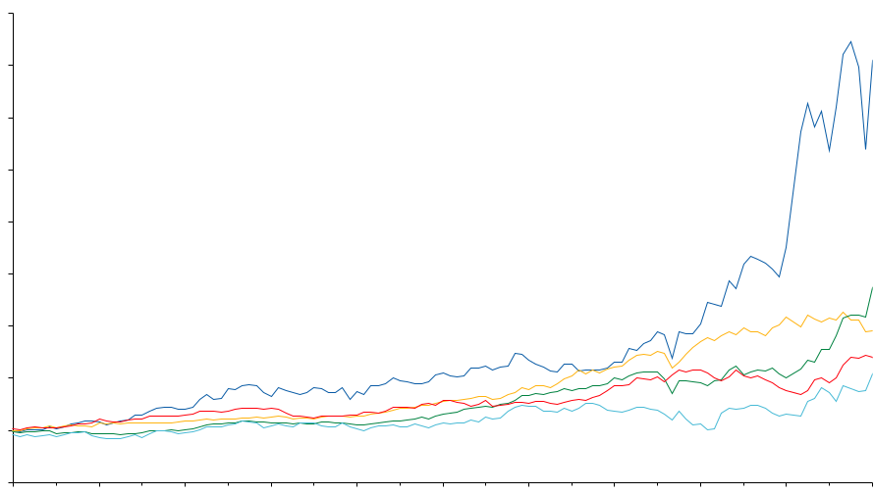
Total Return to Shareholders
Jan 1, 1990 to February 28, 2001
1600
1400
Enron Corp.
S&P 500
Pipeline Avg.
Utility Avg.
E&P Avg.
1,151%
354%
571%
246%
183%
1200
1000
800
600
400
200
0
-200
Dec 90
Dec 91
Dec 92
Dec 93
Dec 94
Dec 95
Dec 96
Dec 97
Dec 98
Dec 99
Dec 00
Jan 01
Feb 01
Note: Calculated to February 28, 2001

Slide 8
Enron Corp
Enron Transportation Services
Enron Wholesale Services
Enron Energy Services
Enron Broadband Services

Slide 9
Enron Opportunity
Traditional Model
Asset intensive
Vertically integrated
Slow moving and rigid
Hierarchical
New Model
Brain power intensive
Networked
“Real options” oriented
Fast moving & entrepreneurial

Slide 10
Changes in the Marketplace
Interaction costs declining due to streamlining, standardization and automation
Cost/benefit of vertical integration and consolidation significantly reduced
Efficient sourcing and packaging produces lowest cost product
  Sales
  Procurement
  Credit
  Inventory
  Settlement
Legal
Research
Documentation
Logistics

Slide 11
Enron’s Network Advantages
Access to Physical Product
Delivery Logistics Expertise
Leading Market-Making Capabilities
Risk Management Expertise
Ability to Structure Complex Customized Solutions
Well-Developed E-commerce
Significant Competitive
Advantages for Entering New Markets

Slide 12
Wholesale Merchant Opportunities
Enron’s Advantage
High Value Applications
Robust, Flexible Network
Scope and Scale
Liquidity
Market-Making
Risk Management
Technology
Finance
Commodity Risk Management
Benefits of Regional Arbitrage
Cross Commodity Arbitrage
Long-Term Origination
Wholesale Outsourcing
Asset Restructurings
Structured Finance
Enron’s Capabilities Enable Unique Value Creation

Slide 13
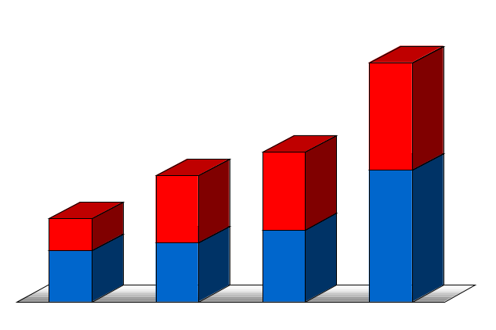
Wholesale Services
Physical Volumes
(BBtue/d)
Financial Settlements
(BBtue/d)
196,148
Power and Other
Gas
51,715
99,337
32,429
75,266
27,308
17,970
49,082
1999
2000
1997
1997
1998
2000
1998
1999

Slide 14
Expansion of Existing Business
Crude and Products
Coal
Weather
(Transactions)
(Transactions)
(Transactions)
3,111
1,629
8,305
9,158
7,435
5,099
715
305
321
46
250
16
1997
1998
1999
2000
1997
1998
1999
2000
1997
1998
1999
2000
Over 7,500 TBtue Avg. Daily Deliveries
240 Customers in 46 Countries
Over 100,000 Tonnes Avg. Daily Deliveries
190 Customers in 17 Countries
Over $1.5 Million (Notional) Average Daily Contracts
30 Customers in 8 Countries

Slide 15
Enron–Accelerating Market Development
Metals
Commodity
Product
Financial
Bandwidth
Australian Power & Gas
Pulp & Paper
Coal
Weather
Scandinavian Power & Gas
Plastics
Emissions
Financials (interest rate, equity)
UK Power & Gas
Electricity
Currencies
Natural
Gas
1985
1986
1987
1988
1989
1990
1991
1992
1993
1994
1995
1996
1997
1998
1999
2000
* Lighter shading indicates a developing market
Darker shading indicates a mature market

Slide 16
Enron Energy Services
In-house
Coordination
Enron
Outsourcing
Approach
Customer
Receives
Utilities
Software Vendor
Improved Core Business Focus
Redeployment of Capital
Reduced Operating Costs
Access to World-Class Capabilities
Controls Manufacturers
Commodity
Management
Architects
Engineers
Energy Information Management
Conditioned Air
Light
Managed Facilities
Equipment Manufacturers
Mechanical Contractors
Energy Asset
Management
Electrical Contractors
HVAC Svc Companies
Facilities
Management
Consultants
Specialty Contractors
Lenders
Capital
Management
Internal Treasury

Slide 17
Enron Energy Services
Executed Contracts
$16.0B
$8.5B
$3.8B
$1.2B
1997
1998
1999
2000

Slide 18




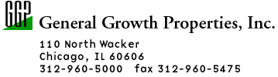
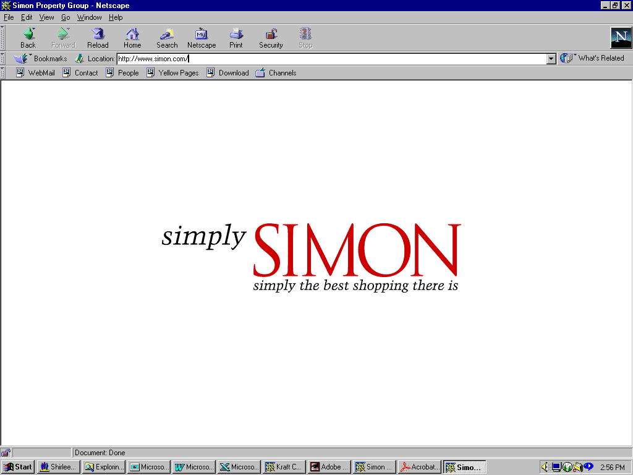















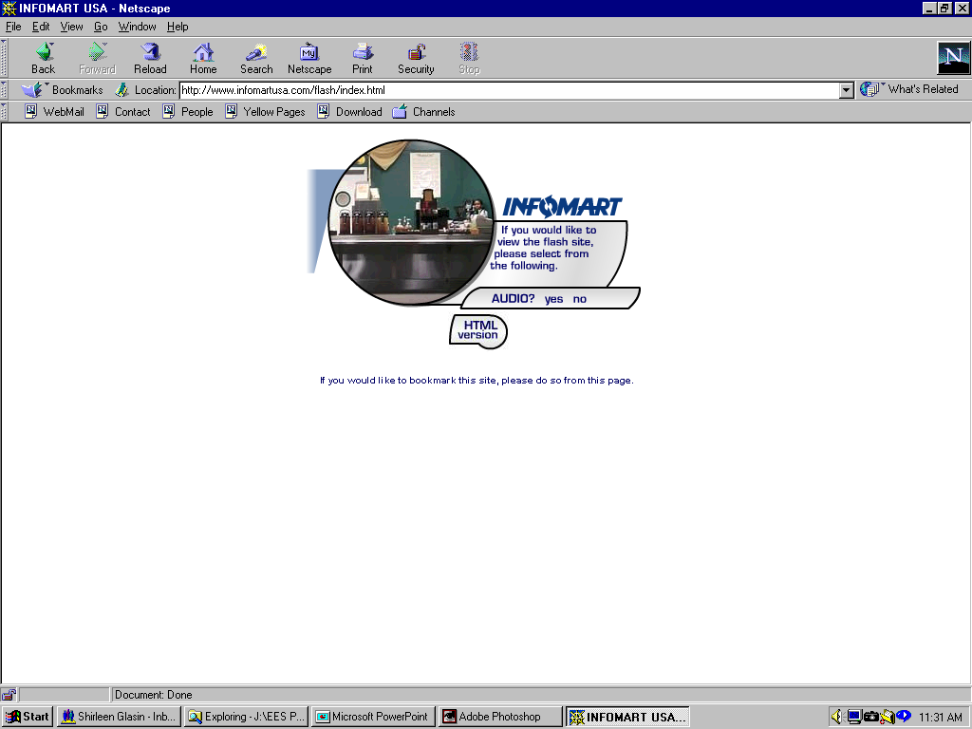



































Enron Energy Services
Executed Contracts
1997
Today
Structure

Slide 19
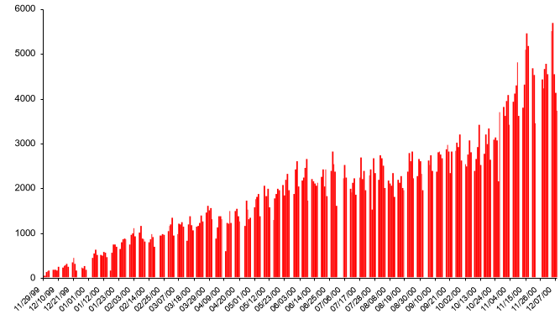
EnronOnline – Changing the Way Energy Is Traded
Free, Reliable Transaction System with Enron as Principal
Free, Reliable Transaction
System with Enron as Principal
02/28/01
01/31/01
11/29/99
12/21/99
06/14/00
12/07/00
12/10/99
01/01/00
06/25/00
10/13/00
11/26/00
01/12/00
03/07/00
07/17/00
08/08/00
01/23/00
08/19/00
09/10/00
02/03/00
02/14/00
02/25/00
03/18/00
03/29/00
04/09/00
04/20/00
05/01/00
05/12/00
05/23/00
06/03/00
07/06/00
07/28/00
08/30/00
09/21/00
10/02/00
10/24/00
11/04/00
11/15/00
Transactions per day

Slide 20
EnronOnline Efficiency Gains
Transactions
Per Market Maker
Marginal
Cost Per Transaction
(Indexed)
100
3,084
25
672
1999
2000
1999
2000

Slide 21

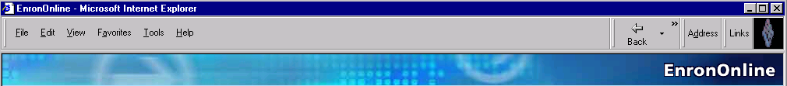
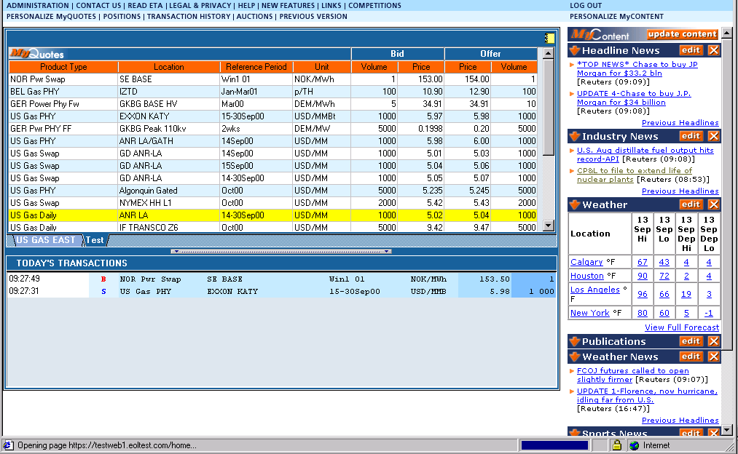
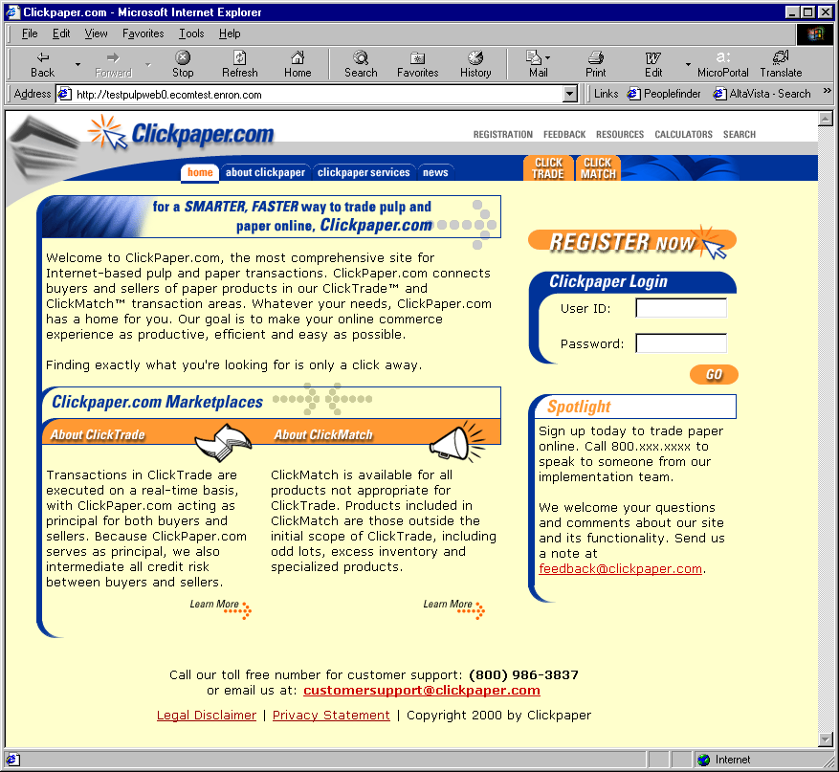
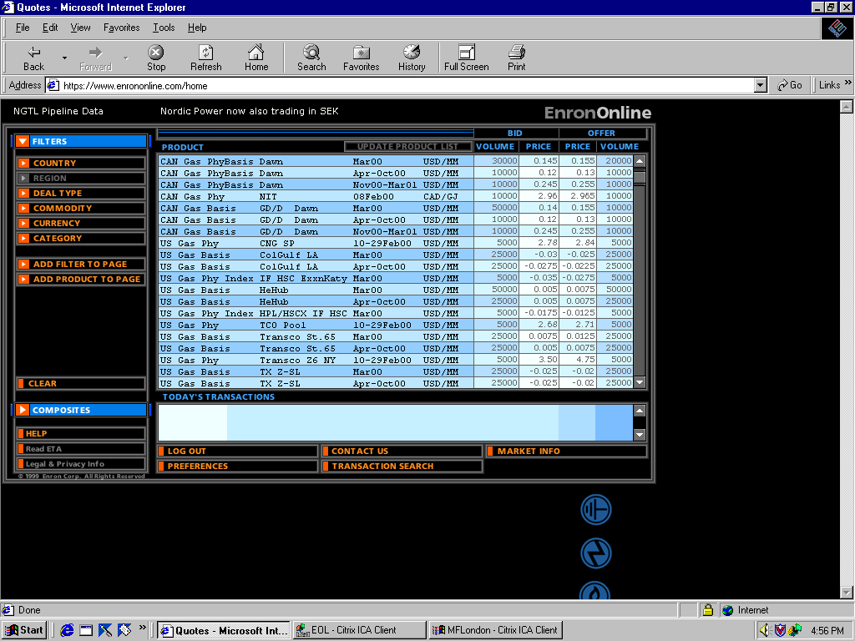
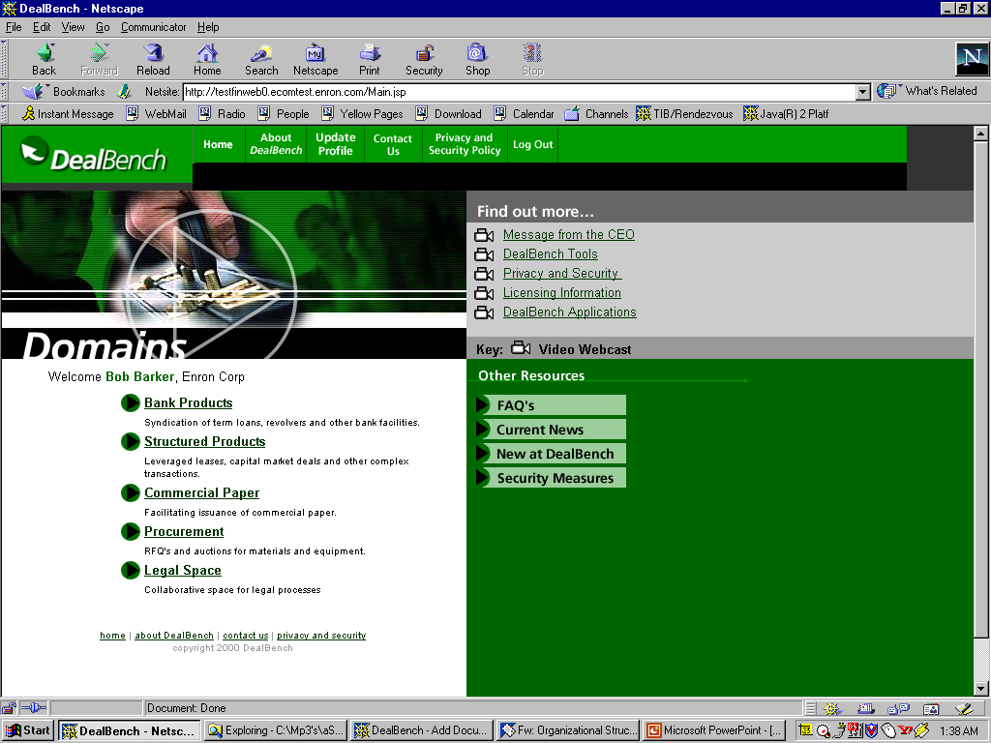
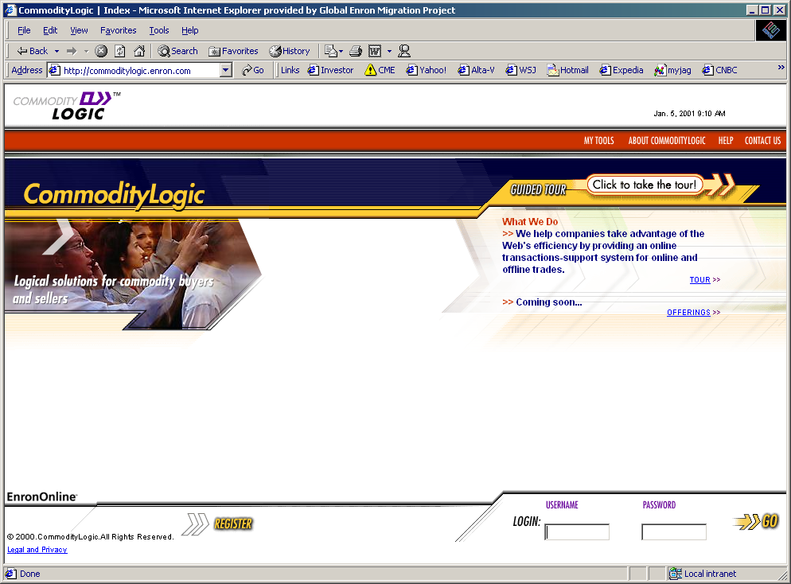
EnronOnline
V2.0
®
Enron Net Works
Clickpaper.com
EnronOnline
Deal Bench
CommodityLogic
Enron Credit

Slide 22
Commitment to Technology
People
Expenditures (Millions)
1,882
1,380
$522
1,154
$358
$291
1999
2000
2001E
1999
2000
2001E
New E-commerce Initiatives

Slide 23
®

