Slide 1

Weather Risk Management Products October, 2001

Slide 2
What is Weather Risk Management
Financial protection from any weather condition that adversely affects earnings
Generally volume risk management
Usually works in conjunction with price risk management, but can be a utilized to fill liquidity gaps in price risk management markets

Slide 3
The Impact of Weather Risk
“I am especially pleased that our strategy to hedge weather risk during the heating season has significantly reduced the impact that the much warmer that normal weather otherwise would have had on quarterly earnings.” Larry Brummett, ONEOK’s Chairman/CEO, January 5, 2000
"During the second quarter we suffered from the continuing effects of unseasonably cool and wet weather in our operating area, which included one of the coolest July's on record.” Joseph Ettore, Chairman/CEO, Ames Department Stores, September 13, 2000
“The most limiting factor I have here is the environment -- the heat & humidity . . . If milk cows aren't comfortable, they won't milk. --- I'd let the cows go to pasture, but they won't in fact leave the building when it's this hot.“ Tim Iwig, Dairy Farmer, Topeka, KS, August 29, 2000
“The warmer than normal weather had a negative affect on earnings of 14 cents per share for the first quarter.” Connecticut Natural Gas, January 26, 2000

Slide 4
WHICH FIRM WOULD YOU RATHER INVEST IN?
Earnings Variability
Warm winter
Cold winter
Which Firm…
Has a lower cost of capital?
Has a greater degree of management concentration on its core business?
Is less concerned about triggering bank covenants?
Does not hold emergency meetings when weather affects earnings?
Finds it easier to make and implement strategic planning/investment?
Is less likely to downsize or reduce product quality to cut costs?
Will receive a better valuation in the market place?

Slide 5
The Evolution of the Weather Market
Aug 1997
First weather-indexed commodity transaction (Utility/Enron)
Sep 1997
First financial transaction (Enron/Koch)
Sep 1998
First international transaction (Enron/Scottish Hydro)
Oct 1999
First weather bonds marketed and placed
Jan 2000
First weather contract traded on Enron-On-Line (“EOL”)
Sep 2000
First natural gas based precipitation collar
Estimated 5,000 deals completed with a notional value of over $7.0 Billion
> 2,100 transactions completed by Enron
Present
FUTURE
Broad End-User Participation
Greater On-Line Influence

Slide 6

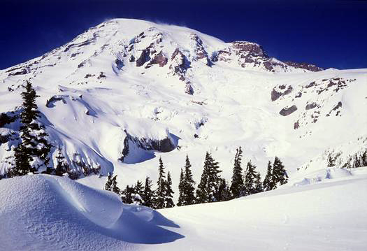
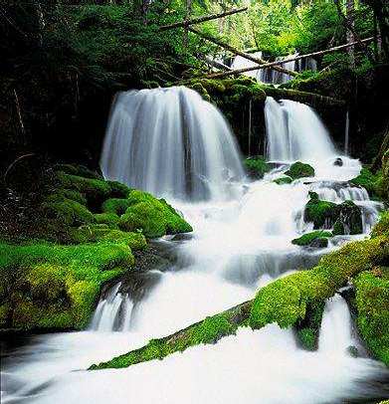
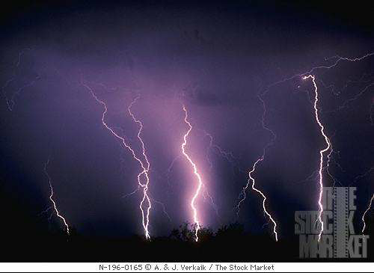

Commonly Traded Weather Indices
Degree Days (Heating, Cooling, Customized)
Temperature (Maximum, Minimum, Events)
Rainfall (Inches, Events)
Snowfall (Inches, Events)
Storm Activity (Intensity, Frequency)
Perceived Temperature (Wind Chill, Heat Index)
Combinations (Custom Index, Multiple Trigger)

Slide 7
Weather Risk Management Structures
Types of Contracts
Swaps, Caps, Floors, Collars
Term
Mainly seasonal, some monthly, a few daily
Several end user multi-year transactions
Size
$100/DD to $500,000/DD
Limits
Currently, all purely weather transactions are capped to create finite exposures
Locations
Hundreds of weather stations in the US alone
Regional exposures can be represented by baskets of several cities
Hybrids
Weather-linked financings
Securitizations

Slide 8
Price Determination/Discovery
Prices are a function of Actuarial, Forecast, and Portfolio Analysis.
Actuarial - Market pricing assumes some relationship to historical data. The 10 year average is usually a very good estimate of the market’s “view”.
Forecast - The market is influenced by both long and short term forecasts, but different players interpret these forecasts differently.
Portfolio Composition - Frequently, this is the largest determinant of price.

Slide 9
Degree Day Definitions
Cooling Degree Days (CDDs)
Summer measure of average daily temperature above 65ºF (18ºC) - Only positive values are reported.
Heating Degree Days (HDDs)
Winter measure of average daily temperature below 65ºF (18ºC) - Only positive values are reported.
Seasonal DD totals:
To determine the number of DDs for a season, add DDs for each day of the period.
Examples:

Slide 10
Weather Risk Management Terms
Cap – The seller pays the buyer whenever the defined weather index falls above the strike level. The payment shall be equal to the number of weather units the index deviates from the strike level times a notional amount per unit, up to a maximum limit. The buyer pays the seller an up front payment lump-sum payment for the transaction
Floor - The seller pays the buyer whenever the defined weather index falls below the strike level. The payment shall be equal to the number of weather units the index deviates from the strike level times a notional amount per unit, up to a maximum limit. The buyer pays the seller an up front payment lump-sum payment for the transaction
Collar - Under this agreement, seller pays the buyer whenever the defined weather index falls below above the cap strike and the buyer pays the seller whenever the weather index falls below the floor strike level. The payment in either case shall be equal to the number of weather units the index deviates from the strike level times a notional amount per unit, up to a maximum limit. No up-front payment required.
Swap – This a special case of a Collar where the the cap and floor strikes are the same. No up-front payment required.

Slide 11
How to Think About Weather Products
Equity Securities:
Date Trade Volume Price Notional
6/15/00 Buy 10,000 shares $4.00 $40,000
6/16/00 Sell 10,000 shares $4.30 $43,000
Profit = $3,000
Weather Product:
Date Trade Volume Price Notional
6/15/00 Buy $5,000/HDD 2000 HDDs $10,000,000
6/16/00 Sell $5,000/HDD 2010 HDDs $10,050,000
Profit = $50,000
In the weather market, the $$ don’t move, the degree days (HDDs/CDDs) do.
Daily HDD Definition: Max(65º - (Avg(T_{max}, T_{min}),0)
Daily CDD Definition: Max(Avg(T_{max}, T_{min}) - 65º ,0)

Slide 12

Market Composition
CAPITAL
MARKETS
Analysts
INSURANCE
FINANCIAL
WEATHER MARKET
END USERS
Energy Utilities/Local Distribution
Companies/Pipelines
Agriculture Companies
Ski & Vacation Resorts
Manufacturers
Construction Companies
Entertainment
Retail Stores
Transportation
Etc.
DEALERS
BROKERS
Energy Companies
Insurance/Reinsurance Companies
Financial Institutions
Inter-Dealer Transactions

Slide 13
Significant Weather Transactions
5 year $55 million Midwest US HDD floor (protection against warm winter)
3 year no limit Western US natural gas linked precipitation collar (protection against drought AND high gas prices)
5 year no limit Western US power linked precipitation collar (protection against drought AND high power prices)
5 year $200 million Northeast US HDD floor (protection against warm winter)
$25 million Southern US HDD floor option (protection against warm winter)
$40 million Western US CDD call option (protection against hot summer)
$200+ million equivalent European freeze call option (protection against more than normal freezing days) – not yet complete

Slide 14
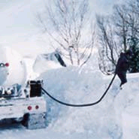
Case Study #1: Propane Dist Inc.
PD Inc., a retail propane distributor, mainly services residential customers. PD’s sales, concentrated in the Great Lakes region, is heavily affected by winter temperatures. The number of gallons sold is highly correlated to Heating Degree Days.

Slide 15
Case Study#1: Propane Dist. Inc.
PD’s sales are roughly distributed in the following area:
Dubuque, IA (20%); Madison, WI (25%); Grand Rapids, MI (15%); Buffalo, NY (30%); Erie, PA (10%)
Internal studies determined that marginal impact of one gallon sold on PD’s bottom line is $0.50.
Regression analysis has determined that, on average, one extra HDD increases propane sales in the region by 10,000 gal in the period Nov-Mar.

Slide 16
Case Study#1: Floor
Counterparty: PD, Inc.
Structure: Heating Degree Day (HDD) floor
Index: Cumulative HDD’s
Term: November 01, 2000 - March 31, 2001
Station: Proportionally weighted basket of cities as per breakdown in previous slide
Floor Strike: PD receives below 5,080 HDD’s (10-yr. average less 50% st. dev., or 5,257-177)
Payout: $5,000/HDD below strike ($0.50 * 10,000)
Limit: $2,500,000
Premium: ____________

Slide 17
Case Study#1: Floor
$
Warmer
Colder

Slide 18
Case Study#1: Costless Collar
Counterparty: PDC, Inc.
Term: Nov 1, 1999 - Mar 31, 2000
Index: Cumulative HDDs as measured at Official National Weather Service Station
Upper Strike: 800 HDDs (Enron receives above)
Lower Strike: 680 HDDs (PDC receives below)
Payment: $15,000/HDD
Limit: $4,000,000
Premium: NONE

Slide 19
Case Study#1: Collar Payout
PDC is only exposed to the weather when the collar is “inactive” (flat), between the strikes of 680 and 800, and beyond the $4MM limits at 413 and 1066

Slide 20
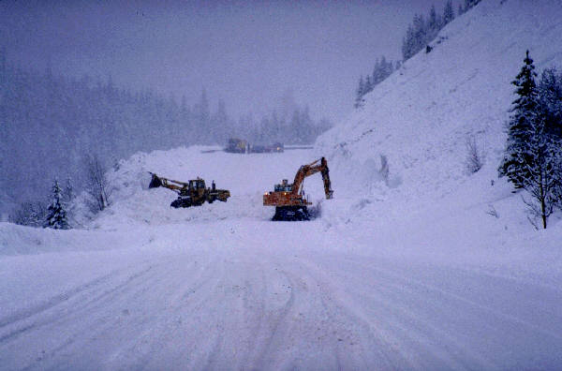
Case Study#2: Snow Dynamics, Inc.
Snow Dynamics (SD) is a contractor that provides snow removal services to municipalities in the Midwest. The number of hours contracted are directly correlated to the amount of snowfall in the region. SD has determined that, for every inch below 24” accumulated snowfall in a given winter, its gross margin will drop by $100,000.

Slide 21
Case Study#2: Snow Dynamics, Inc.
Counterparty: Snow Dynamics, Inc.
Structure: Snowfall Floor
Index: Cumulative snowfall
Term: November 01, 2000 - January 31, 2001
Station: Equally weighted basket of following snow belt cities:
Toronto, Greenbay, Minneapolis, Baltimore, Pittsburgh
Strike: 24 inches (28 - 4 = 10-y average - 50% standard deviation)
Payout: $100,000/inch below strike
Limit: $1,000,000
Premium: _________________

Slide 22

Case Study #3: Bombardier Rebate Program
Bombardier Inc., a large designer and distributor of snowmobiles, created an incentive which helped to protect itself against the lower sales and leftover inventory that accompany a mild winter

Slide 23
Case Study #3: Bombardier Rebate
As a marketing tool, Bombardier offered a $1,000 rebate to customers if snowfall levels did not reach half that of the previous three years
Bombardier funded this potential liability with snowfall floors structured in each major market the promotion was offered
44 cities
strikes set at average snowfall level
all-or-none payment of $1,000 if strike breached
up-front premium per unit which varied depending on the city

Slide 24
Case Study#3: Bombardier Term Sheet
Counterparty: Bombardier, Inc.
Structure: Snowfall digital floor
Index: Cumulative inches of snowfall as measured at Minneapolis-St. Paul International Airport (WBAN#14922)
Term: November 1999 - March 2000
Strike: 19.4 inches (Bombardier receives below)
Pay-out: $1,000 per unit sold once strike is breached
Limit: $1,000,000
Premium: _______________

Slide 25

Case Study #4: PSC Inc.
PSC Inc., a pool chemical supplies company, is heavily affected by summer temperatures. Mild (cooler than normal) summers have a negative effect on earnings.

Slide 26
Case Study #4: PSC Inc.
PSC’s sales are roughly distributed in the following area:
New York (20%); Baltimore (25%); Raleigh (15%); Chicago (30%); Louisville (10%)
Internal studies determined that marginal impact of one gallon of chemicals sold on PSC’s bottom line is $0.50.
Regression analysis has determined that, on average, one extra CDD increases chemical sales in the region by 10,000 gal in the period May-Sep.

Slide 27
Case Study#4: Floor (Put Option)
Counterparty: PSC
Structure: Cooling Degree Day (CDD) floor
Index: Cumulative CDD’s
Term: May 01, 2001 – September 30, 2001
Station: Proportionally weighted basket of cities as per breakdown in previous slide
Floor Strike: PSC receives below 5,080 CDD’s*
Payout: $5,000/CDD below strike ($0.50 * 10,000)
Limit: $2,500,000
Premium: ____________
* calculated as the 10-yr. Average (5,257) less 50% of a standard deviation (177), but the strike can be set at any level

Slide 28
Case Study#4: CDD floor payout structure
CDD Floor Payout
Payments from Enron to PSC offset lost sales due
to cooler than normal weather –
resulting in revenue stabilization
$
Premium paid by PSC to Enron allows PSC to enjoy a portion
of increased profits due to hotter than normal weather
CDDs
Cooler
Hotter

Slide 29
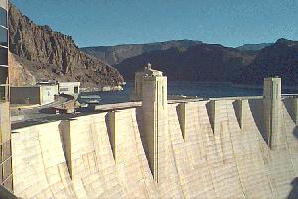
Case Study #5: HydroGen
HydroGen Inc., a hydro-based power generator, depends on rainfall from Oct. through Sep. to generate power. If there is not enough rainfall, HydroGen will need to buy natural gas in the spot market to run its gas-fired generators. HydroGen’s risk exposure is two-fold: a) Low rainfall; and b) High gas prices (in a low rainfall environment). This would represent a high risk for which HydroGen Inc. needs protection. Average Oct-Sep rainfall in Hydrogen’s watershed area is 52 inches with a sigma of 19 inches.

Slide 30
Case Study #5: Precip/Nat Gas Hydro Hedge
HydroGen has determined that if rainfall is less than 42.5 inches per year (Oct-Sep), it will need a rainfall put option spread with strikes of 42.5 inches and 25 inches.
For each 1/10 inch below 42.5 inches, HydroGen will receive 52,500 x the average of the daily Henry Hub gas price from Feb to Aug.
HydroGen will pay for this put spread by selling a call spread with strikes of K and 78 inches of rainfall. The payment per 1/10 inch in the call spread will be the same as the payment described for the put spread.

Slide 31
Case Study #5: Term Sheet
Counterparty: HydroGen, Inc.
Term: October 2000 - September 2003
Index: Cumulative inches of rainfall per year, as measured at Station X.
Put Strike: 42.5 inches (HydroGen receives below)
Call Strike: 53 inches (HydroGen pays above)
Payment: [Average Feb-Aug Henry Hub daily price x 52,500] per 1/10 inch
Put Limit: 25 inches
Call Limit: 78 inches
Premium: $0

Slide 32
Costless Collar Payout Given Different Gas Prices

Slide 33
Conclusions
Weather can affect businesses in various ways:
Demand of weather sensitive products and or services correlates to weather.
Supply of some traded goods and commodities is a function of weather, and its variability has a major impact on the general availability of these products in the market.
Weather risk management products can be designed to absorb the exact portion of a business’ weather exposure, leaving them with a residual risk that is commensurate with their risk tolerance.

