Slide 1
Project California Transfer Issues
March 13, 2000 Draft
[Incorporates V&E Comments]

Slide 2
Transfer Issues - Socal Summary

Slide 3
Transfer Issues - Nocal Summary

Slide 4
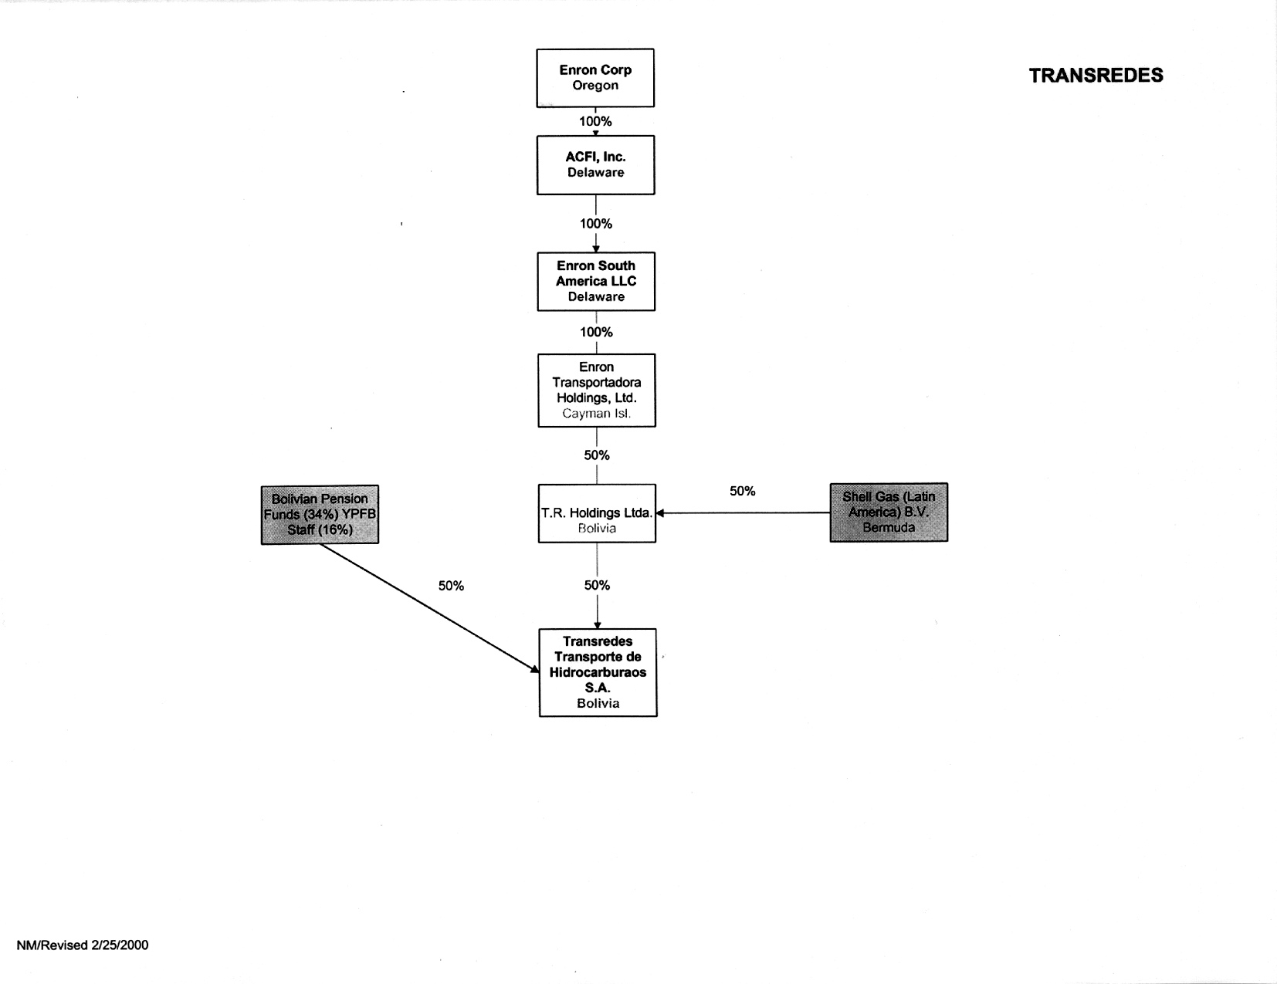
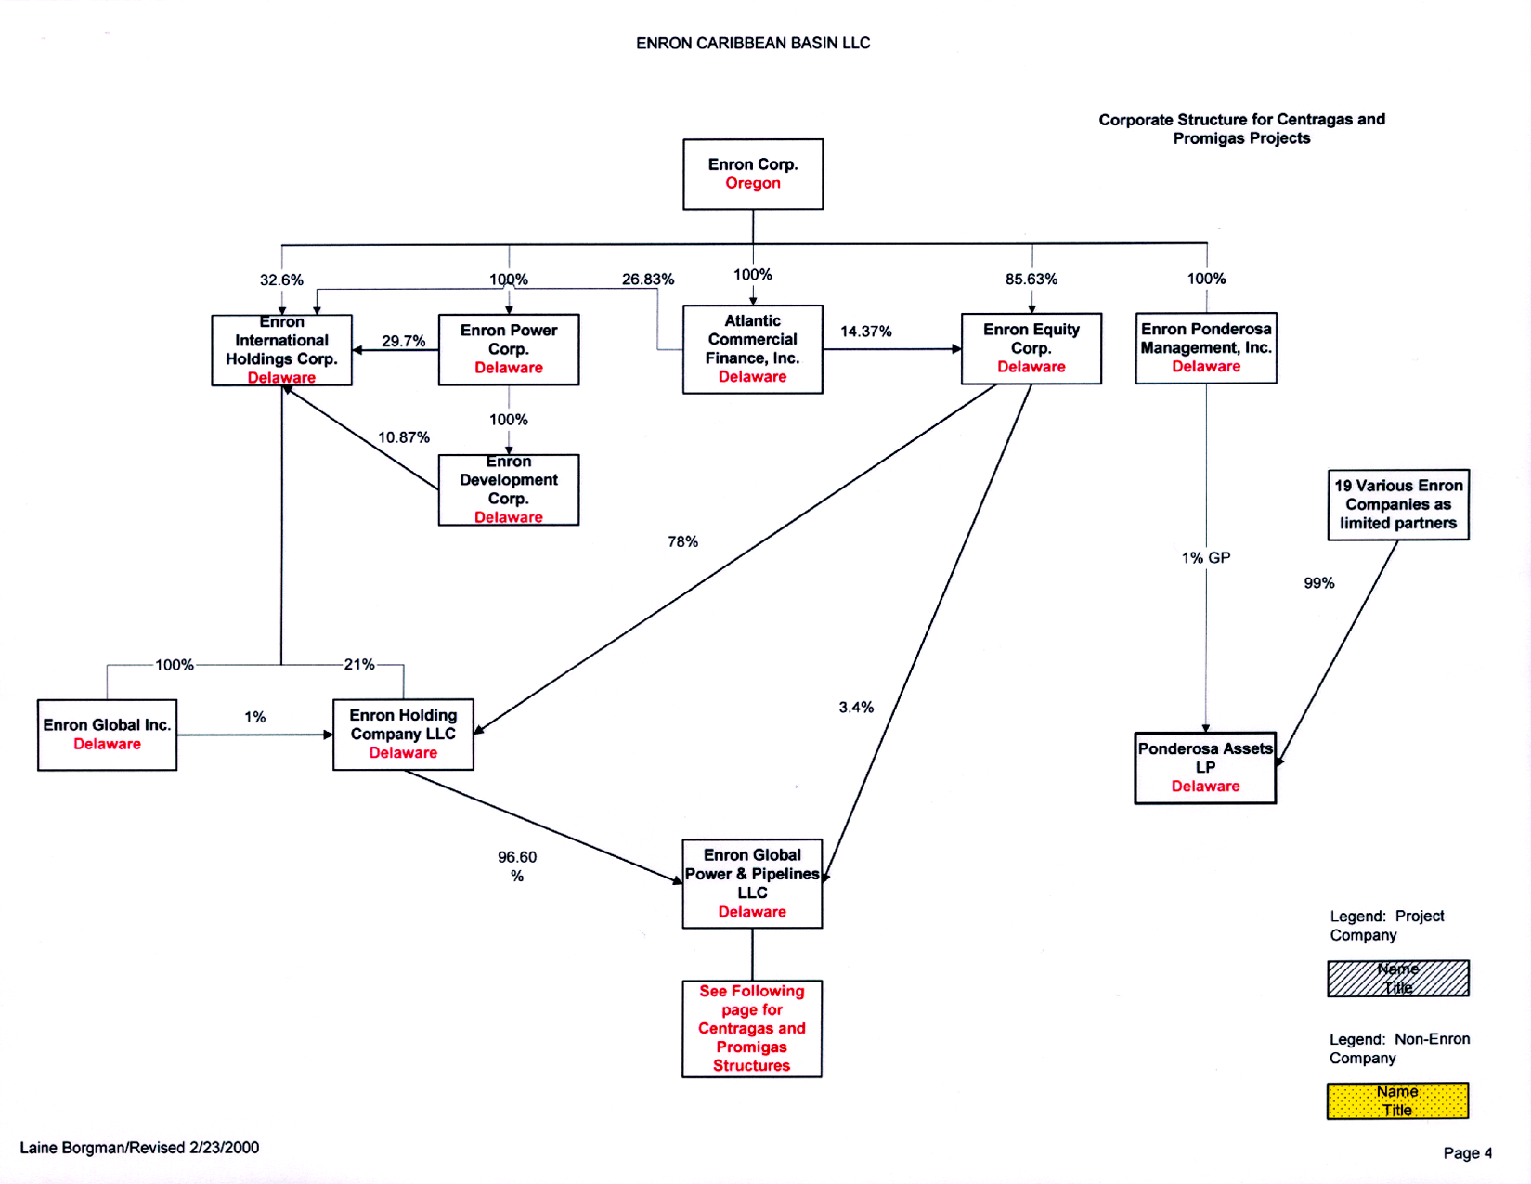
Transredes - Transfer Issues
Relevant Documents
Share Subscription Agreement dated 5/16/97 among Transredes, TR Holdings, Republic of Bolivia, Enron Corp (as the guarantor), Enron Transportadora Holding, and Shell Gas
Shareholders Agreement dated 12/4/96 between Enron Transportadora Holding and Shell Gas, and Amendment 1 dated 5/16/97
Key Issues
Per the Share Subscription Agreement, Enron Transportadora must continue to own TR Holdings and the Enron Corp guarantee is not released until the subscription amount is fully invested: $30.9 million remained to be invested as of 12/99.
As per Shareholder Agreement, any change of control will trigger preferential rights for Shell. There is an exclusion for change of control at Enron Corp and Enron Global Power & Pipeline.
Regulatory: consent will be required from the Ministry of Capitalization for a transfer if the subscription amount is not fully invested, pursuant to the Share Subscription Agreement.
Recommendations
Transfer shares of TR Holdings from ETH Ltd. to EPP
If subscription amount is fully invested, sell at Enron Global Power & Pipeline(EPP)
If not, sell at EPP and obtain indemnity for Enron Corp guarantee from purchaser
Recommended
Sale
Level

Slide 5
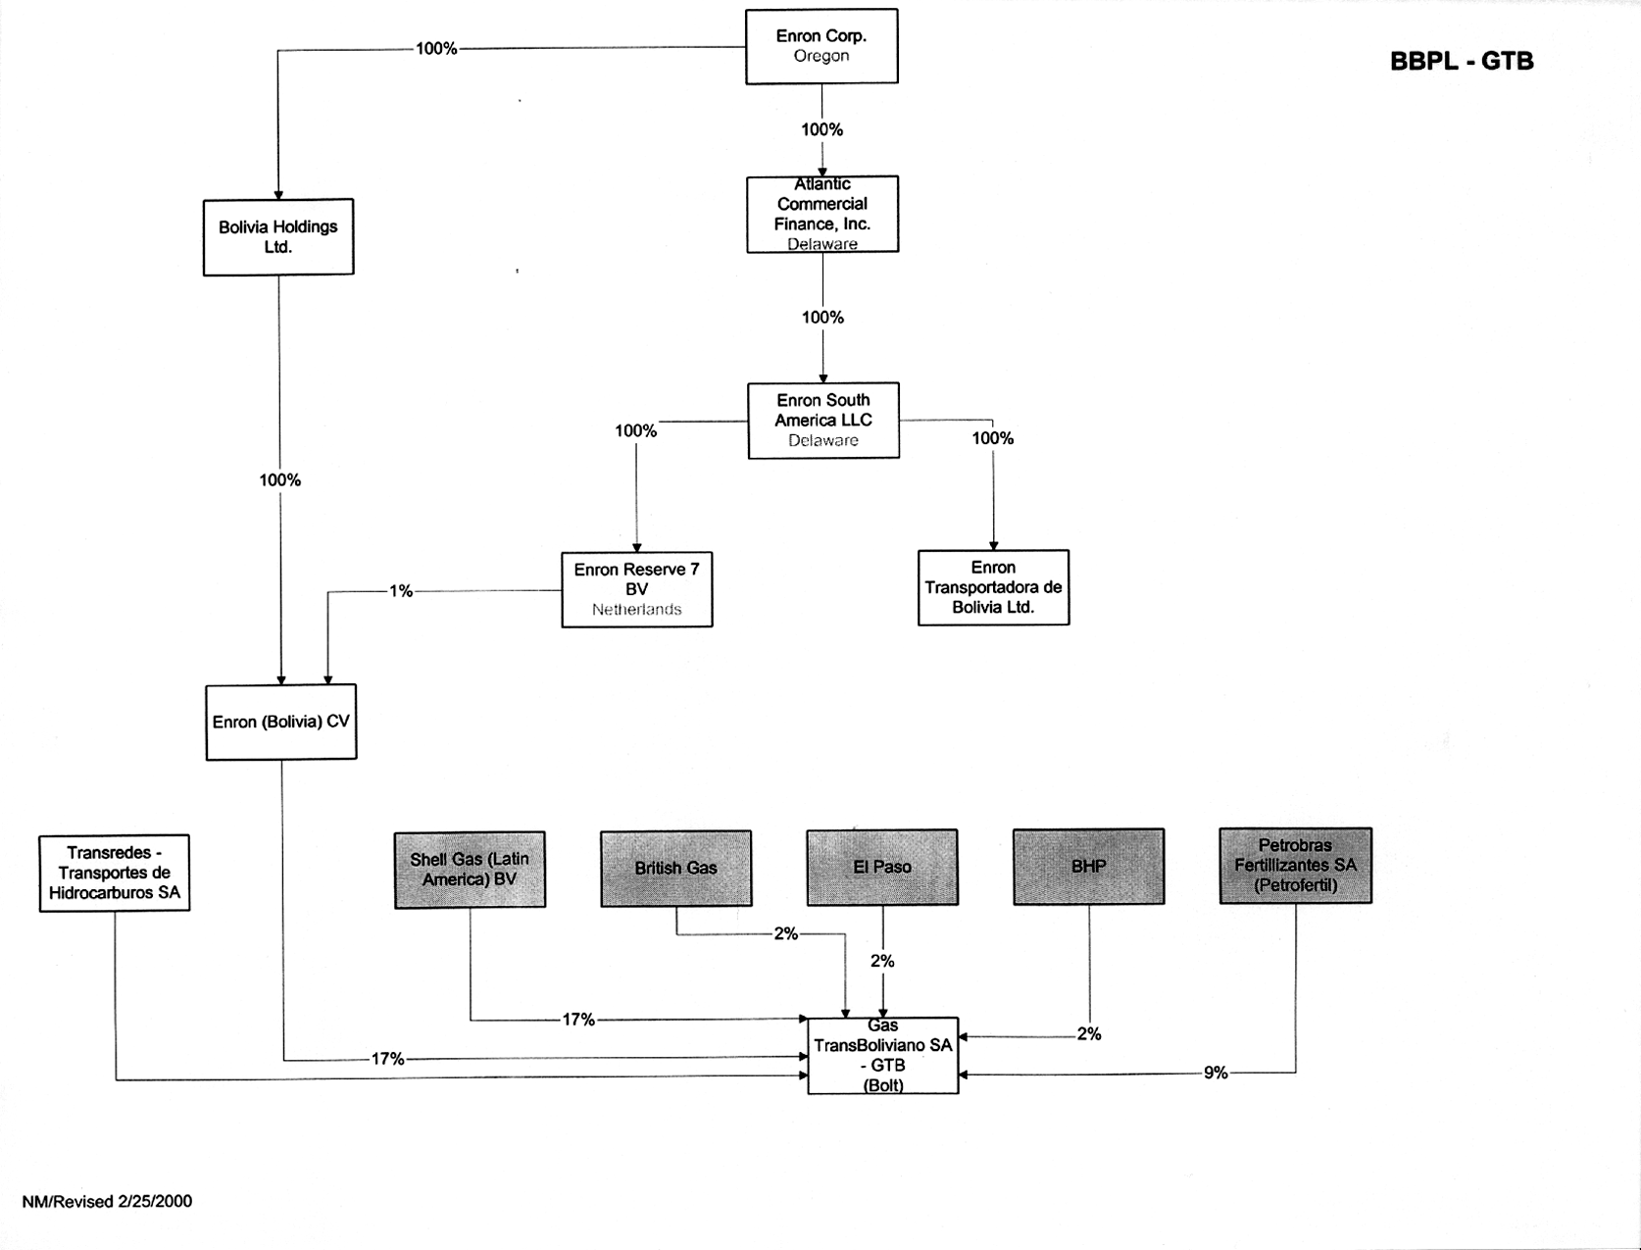
Brazil Bolivia Pipeline - Transfer Issues
Recommended
Sale Level
Relevant Bolivian Documents
GTB Shareholders Agreement dated 12/19/97 among Transredes, Enron (Bolivia) C.V., Shell, Petrobras, British Gas, El Paso and BHP.
Transredes BBPP Transfer Agreement dated 12/4/96 between Enron Transportadora, Enron (Bolivia) C.V. and Shell. Amendment 1 dated 5/16/97
Transredes Shareholder Agreement dated 12/4/96 between Enron Transportadora Holdings Ltd. and Shell Gas (Latin America). Amendment 1 dated 5/16/97.
51%

Slide 6
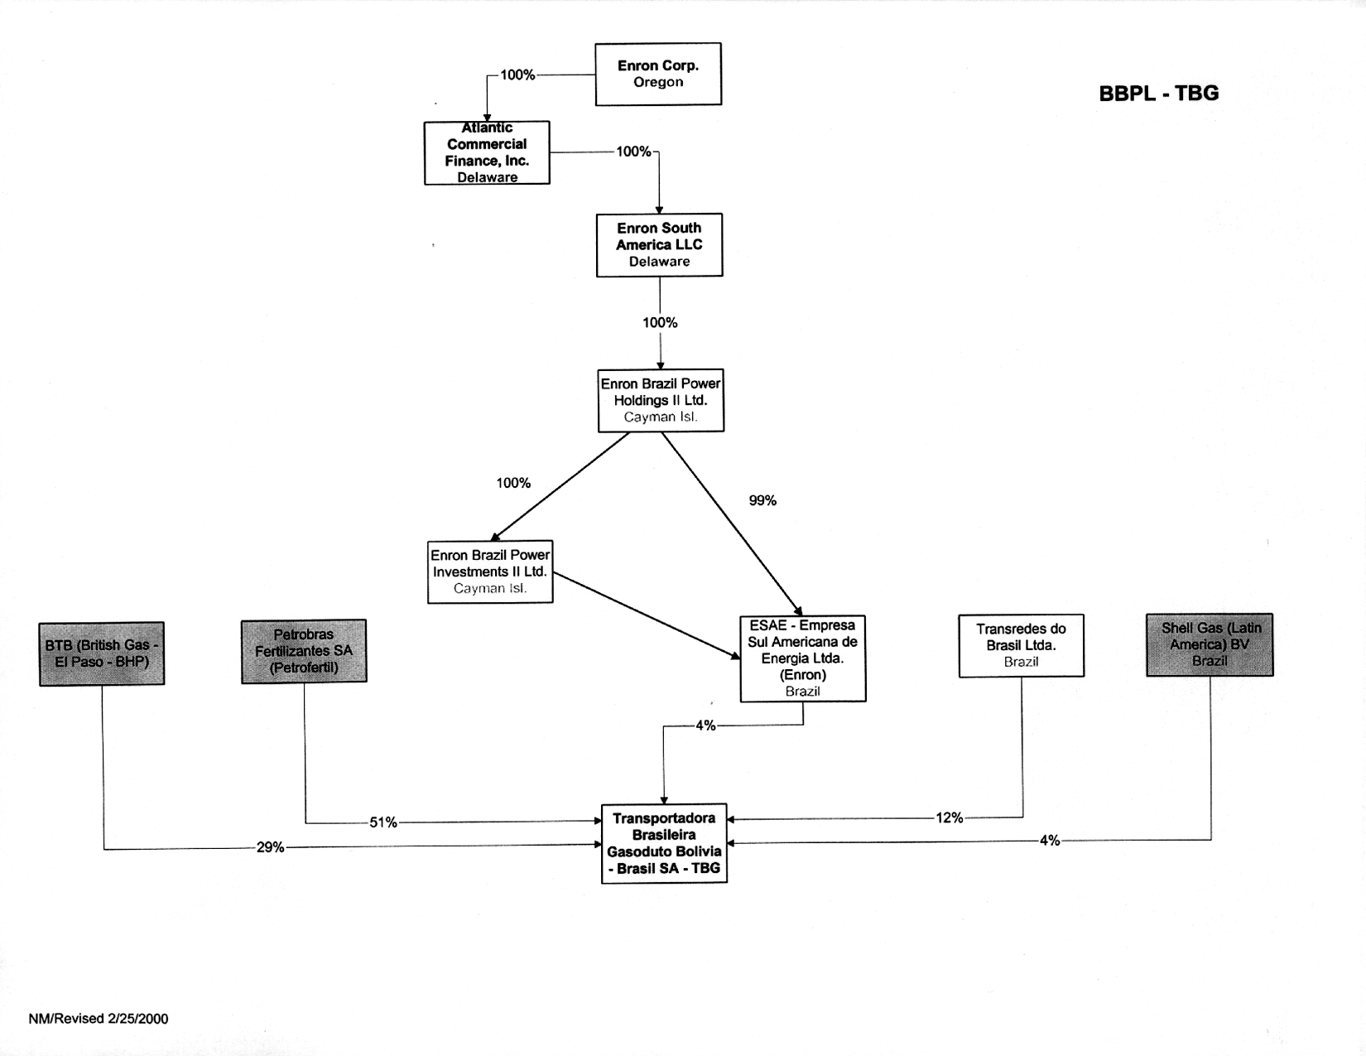
Brazil Bolivia Pipeline - Transfer Issues (Continued)
Relevant Brazilian Documents
TBG Shareholders Agreement dated 12/19/97, amended 4/17/98 among Petrofertil, BBPP Holdings (“BTB”), Transredes, Shell, and Enron (Bolivia) C.V.
Transredes BBPP Transfer Agreement dated 12/4/96 between Enron Transportadora, Enron (Bolivia) C.V. and Shell. Amendment 1 dated 5/16/97.
Transredes Shareholder Agreement dated 12/4/96 between Enron Transportadora Holdings Ltd. and Shell Gas (Latin America). Amendment 1 dated 5/16/97.

Slide 7
Brazil Bolivia Pipeline - Transfer Issues (Continued)
Key Issues
TBG Shareholders Agreement triggers preferential rights to all shareholders unless we sell far enough up the corporate chain where the net asset value of such entity attributable to holdings in TBG is less than 50%
The BBPP Transfer Agreement and the Transredes Shareholder Agreement allow Enron (Bolivia) C.V., Enron Transportadora Holdings Ltd., and their Affiliates to Transfer their interests in the Bolivia-Brazil Natural Gas Pipeline Project (the “BBPP”) to other Affiliates, including Enron Global Power & Pipelines, without triggering preferential rights for Shell.
BBPP Transfer Agreement and the Transredes Shareholder Agreement have change of control provisions which require Enron Corp. or Enron Global Power & Pipelines to control the Enron entities owning the Brazil Bolivia Pipeline interests (whether the owning entities be Enron (Bolivia) C.V., Enron Transportadora Holdings Ltd.. or their affiliate). A change of control of Enron Global Power & Pipelines itself does not trigger the change of control provisions and their preferential purchase rights for Shell.
Recommendations
Investigate sale at Enron Global Power & Pipeline level
Transfer shares of Enron(Bolivia) CV to EPP - (GTB)
Transfer shares of ESAE(Brazil) to EPP - (TBG)
Sell shares of EPP

Slide 8
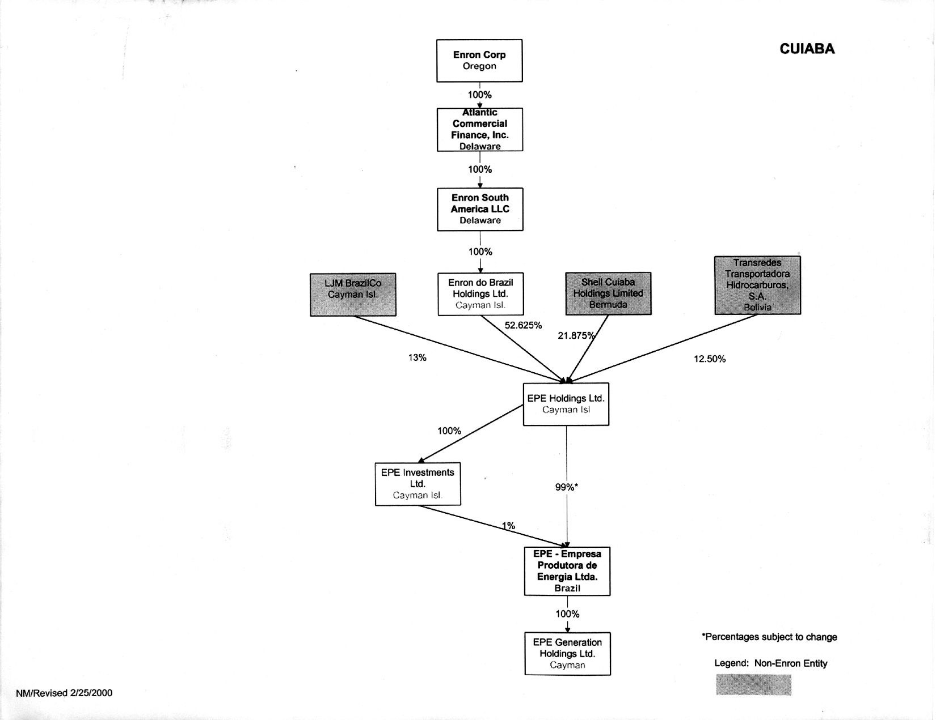
Cuiaba Integrated Project - Transfer Issues
Recommended
Sale Level
Relevant Documents
Downstream Agreement dated 12/4/96 among Enron Tranportadora Holdings Ltd., Enron Electric Mato Grosso de Sul C.V., Enron Electric Power Brazil C.V., and Shell Oversees Gas (Latin America) B.V. Amendment 1 dated 5/16/97. This Agreement covers “Western States IPPs” : EPE
Articles of Association of EPE Holdings dated 12/9/99
Power Purchase Agreement dated 11/17/97 and ratified as of May 4, 1998 among EPE, Furnas, and Electrobras.
Financing Documents
Common Terms Agreement as of 9/30/99 among EPE, Gas Bol, Gas Mat, OPIC, KFW, and various commercial banks (signed)
Interborrower Agreement Draft as of 12/22/99 among EPE, Gas Bol, Gas Mat, TBS, various Shell and Enron holding companies, Shell Overseas Trading Limited and Enron Corp (not executed)

Slide 9
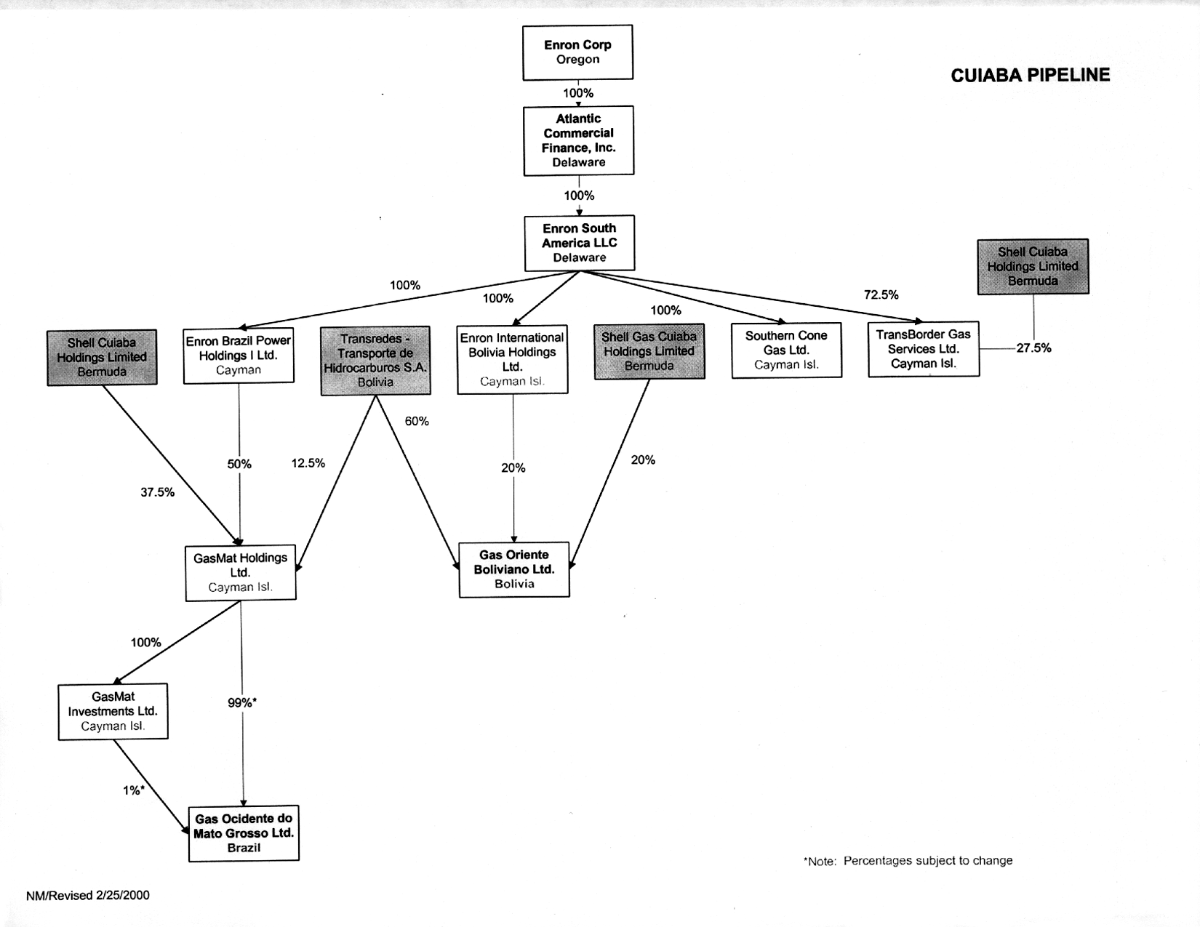
Cuiaba Integrated Project - Transfer Issues (Continued)
Relevant Documents
Letter Agreement dated 6/4/98 between Enron Electric Power Brazil C.V. and Shell. This Agreement subjects Trans Border Gas Services and Gas Mat Holding to the Downstream Agreement
Quotaholders Agreement dated 10/2/98 among Enron International Bolivia Holdings, Transredes, Shell and Gas Oriente Bolivia (Gas Bol)
Articles of Association of Gas Mat Holdings LTD dated 12/9/99
Financing Documents
Common Terms Agreement as of 9/30/99 among EPE, Gas Bol, Gas Mat, OPIC, KFW, and various commercial banks
Interborrower Agreement draft as of 12/22/99 among EPE, Gas Bol, Gas Mat, TBS, various Shell and Enron holding companies, Shell Overseas Trading Limited and Enron Corp
LJM Letter Agreement dated September 10, 1999

Slide 10
Cuiaba Integrated Project - Transfer Issues (Continued)
Key Issues
Under Downstream Agreement and the Share Letter Agreement, any “change of control” will trigger preferential rights for Shell with respect to EPE, Gas Mat, and TBS. There is an exclusion for change of control at Enron Corp and Enron Global Power & Pipeline L.L.C. level
Articles of Association of EPE Holdings Ltd., and GasMat Holdings Ltd., have preference rights triggered by change of control which go up to Enron Corp
Under the Quotaholders Agreement, any “change of control” will trigger preferential rights for Shell with respect to Gas Bol. This goes up to the Enron Corp level
Under the Common Terms Agreement there is a “change of control” if Enron Corp sells, assigns, of otherwise transfers any of the beneficial ownership or voting power that it holds, directly or indirectly, in any of EPE, GasMat, or GasBol before the project completion date or 10 years after project completion Enron Corp ceases to hold an economic interest of at least 25% in each borrower or Enron and Shell jointly cease to have a controlling interest in each Borrower or any shareholder transfers a controlling interest in any Borrower
Under the draft Interborrower Agreement, Enron Corp agrees that neither it nor its subsidiaries will effect any sale which would cause a change of control : Sale of any one of Transredes, EPE, GasMat, or GasBol would cause a change of control
Regulatory: (a) any change in ownership which effectively changes Gasmat’s operator requires prior consent of ANP (b) any change of ownership of Gasbol (all the way up the corporate chain) requires prior consent of SIRESE (c) the PPA with Furnas requires EPE to obtain the prior consent of Furnas for any change of control of EPE. Control is measured at the ownership level directly above EPE.
Recommendations
Sell stock in EPE, TBS, Gasmat Holdings, and Gas Oriente Boliviano to EPP
Investigate sale at Enron Global Power & Pipeline to avoid restrictions under Downstream Agreement
Financing Structure needs to be amended immediately: investigate impact on ongoing business
Ask purchaser to assume EPE, Gas Mat, and Gas Bol preference right risk
Sell stock in entities holding Cuiaba II, III rights to EPP

Slide 11
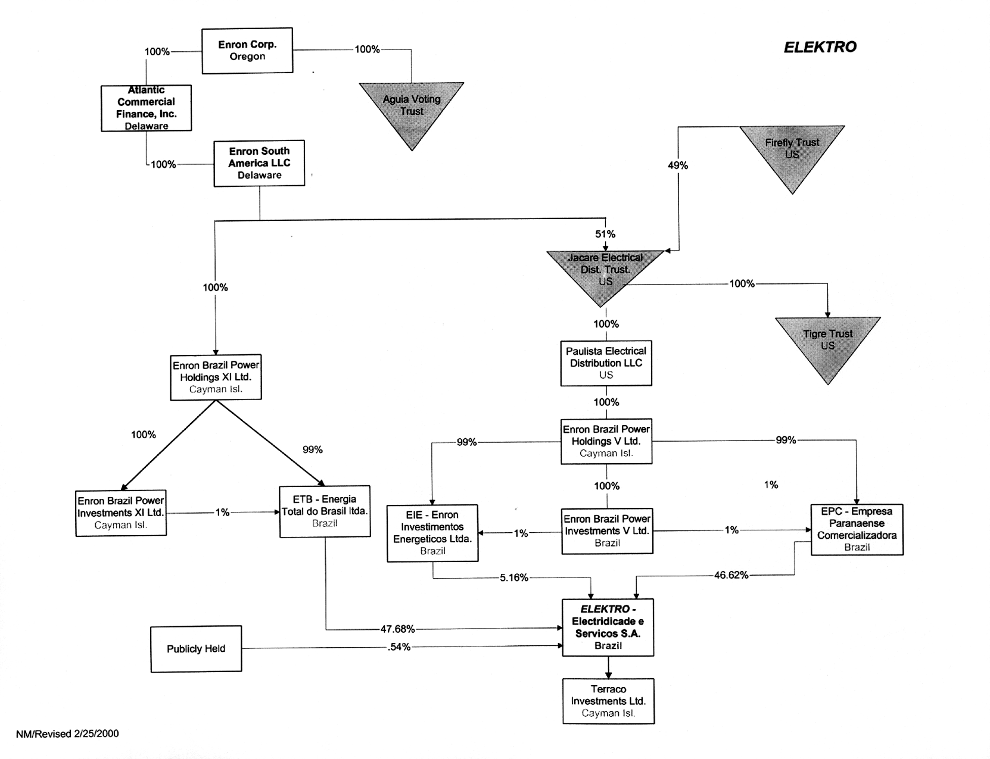
Elektro - Transfer Issues
Relevant Documents
ANEEL Regulation
Participation Agreement & Senior Loan Agreement (Firefly Debt)
Tax Recommended
Sale Level

Slide 12
Elektro - Transfer Issues (Continued)
Key Issues
Under the Firefly Debt Agreement Enron Corp. must directly or indirectly own at least 23% equity interest in Elektro and, together with Firefly Trust, have voting control of Elektro
Regulatory: (a) any change of control of Elektro [up to Enron Corp] requires ANEEL approval (b) repayment of intercompany debt on Elektro’s balance sheet may require Central Bank approval
Recommendations
Sell at level most favorable for tax
Sell the shares of EBPI XI, ETB-Energia Total de Brazil, EIE Brazil, EBPI V, and EPC
Repay Firefly debt and equity with transaction proceeds

Slide 13
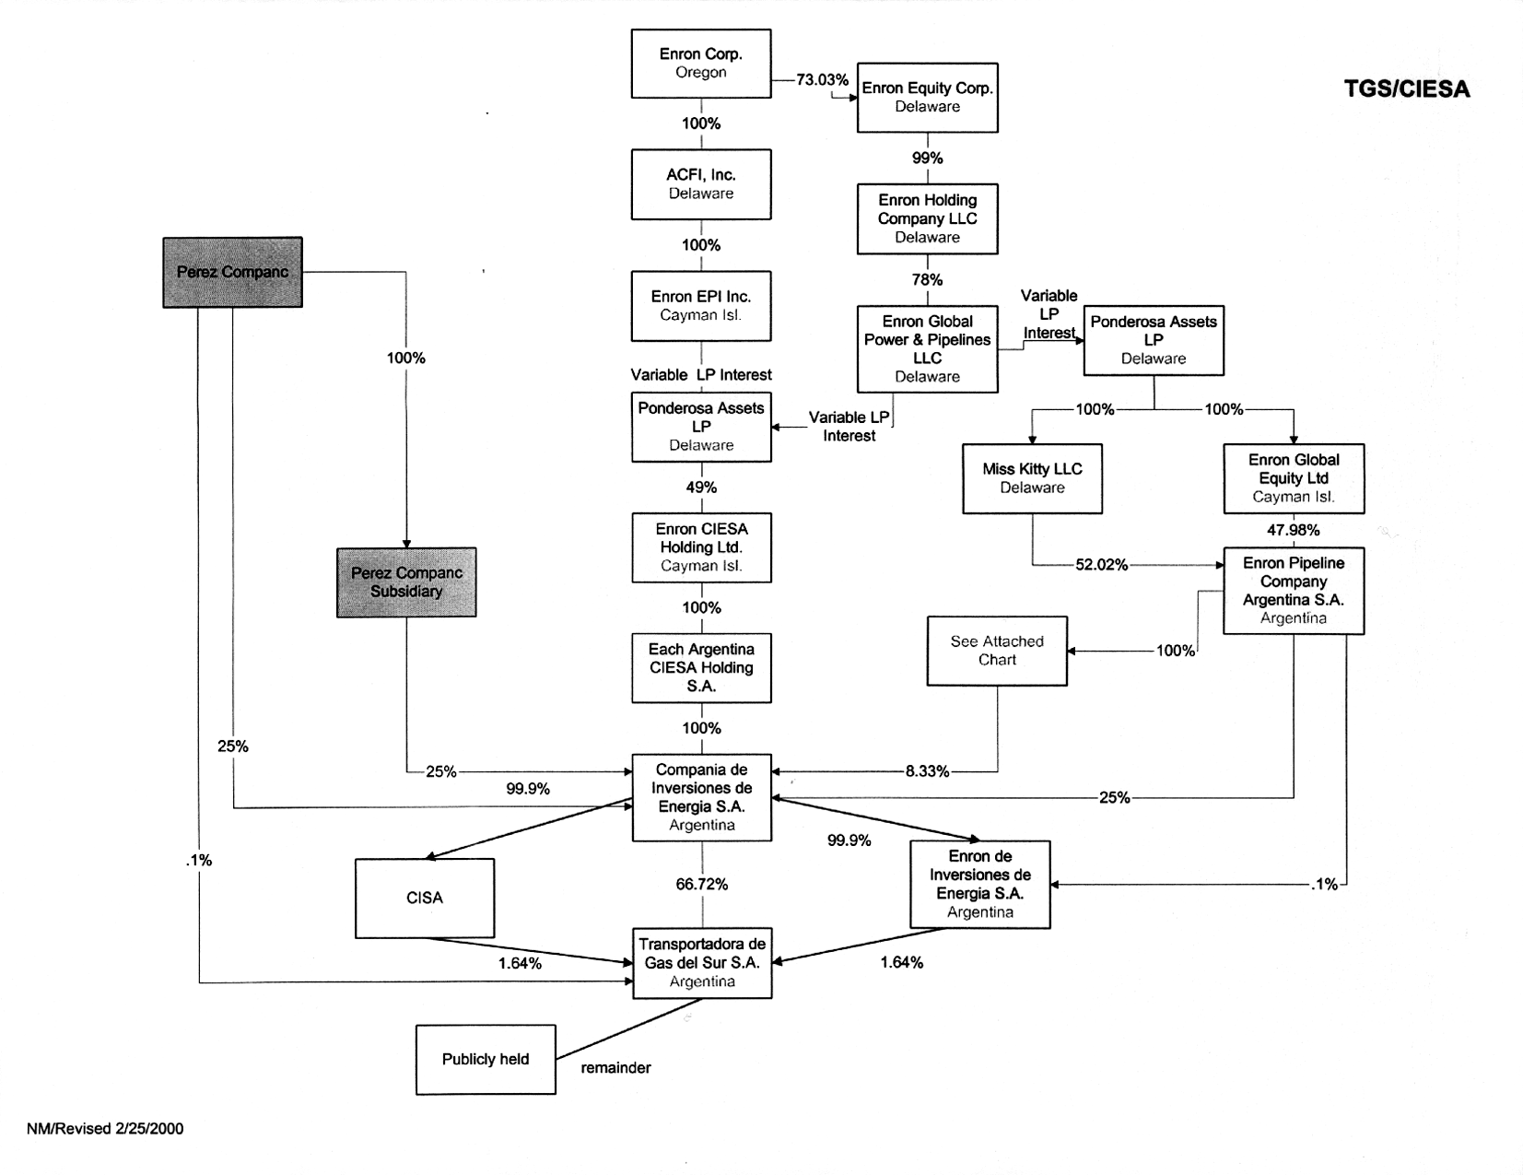
TGS - Transfer Issues
Relevant Documents
CIESA Owners Agreement of 11/13/92 among Enron Pipeline Company Argentina S.A. (EPSA), Citigas, Perez Companc and Argentina Private Development Trust Co. Ltd. (APDT)
CIESA Shareholders Agreement of 11/13/92 among EPCA, Citigas, Perez Companc and APDT
Argentine Gas Act
TGS Pliegos - Bidding rules of the Gas del Estado Privatization
$ 220 MM FRN Note Purchase Agreement dated 4/18/97 at CIESA
$ 251 MM Loan Agreement dated as of 4/5/99 among TGS and IDB
Xxx 16.67%
Tax Recommended
Sale Level

Slide 14
TGS - Transfer Issues (Continued)
Key Issues
The CIESA shareholders agreement provides preferential purchase rights to Perez Companc. These are however extinguished by transferring at a higher level
The CIESA shareholder agreement also has change of control provisions which trigger Perez Companc preferential rights. This provision goes all the way to Enron Corp. However, if Perez Companc exercises this right they would violate the Argentine Gas Act and would have 60 days to sell this additional interest.
Fair Market Value is determined by one of 5 appraisers nominated by EPCA and selected by Perez Companc.
Under the Noteholders agreement, if Enron Corp(& affiliates) together with Perez Companc own less than 50.1% of CIESA, the Noteholders can accelerate the notes. The Fiscal Agent, together with CIESA, can however amend the agreement if the Fiscal Agent (Societe Generale) believes that the change is not material. The other Noteholders are commercial banks
Under Loan Agreement, negative covenants restrict both transfers of assets and merger or dissolution by TGS and/or subsidiary without IDB consent. This transfer restriction would not apply at a higher level in the ownership chain.
Regulatory: (a) any transfer of ownership in EPCA up to Enron Corp requires consent from Enargas (b) any transfer of the Technical Assistance Agreement between TGS, CIESA & EPCA requires consent from Enargas, (c) producer restrictions on permitted buyer
Recommendations
Sell at the level which is most efficient for tax
Sell the shares of EPCA and EACH
Require Purchaser to take transfer risks

Slide 15
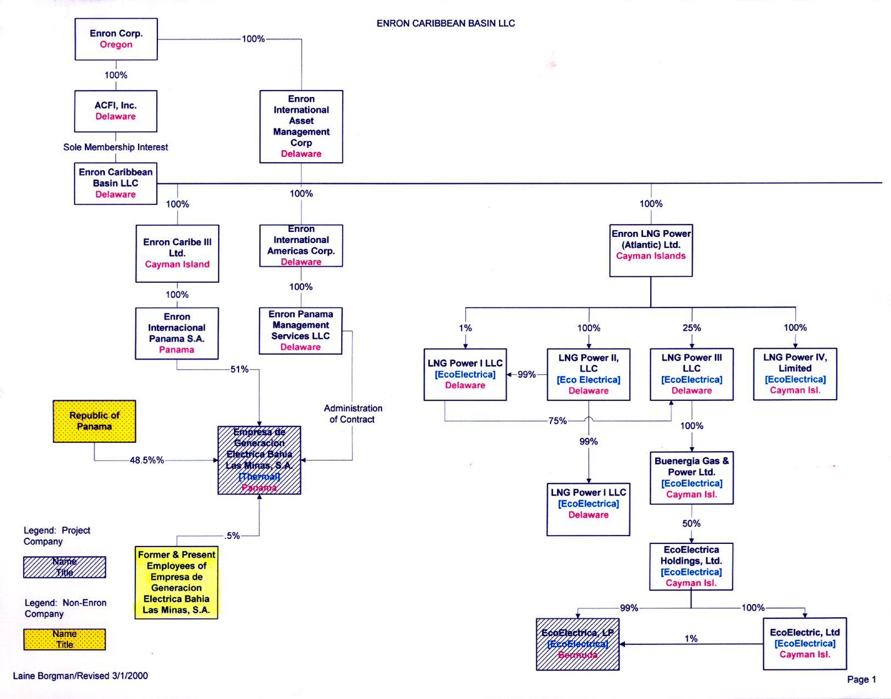
BLM - Transfer Issues
Relevant Documents
Pacto Social [Articles of Incorporation] of Empresa de Genracion Electrica Bahia Las Minas S.A. (EGEMINSA)
Pliego de Cargos [Bid terms]
Financing Documents
Need Review
Tax Recommended
Sale Level

Slide 16
BLM - Transfer Issues (Continued)
Key Issues
The Articles of Association provides that as long as the Republic of Panama owns at least 25% of EGEMINSA, its approval is required for the merger, liquidation or dissolution of EGEMINSA. This requirement goes up to Enron Corp
Under the Bid Terms, until 1/14/2004 Enron Caribe III Ltd. (up to Enron Corp) must maintain at least 25% interest in Enron Internacional Panama S.A. (EIPSA) and either Enron Caribe III Ltd. or EIPSA (up to Enron Corp) must control EGEMINSA
Recommendations
Seek consent of Government of Panama (ENTE)
Subject to favorable outcome on above, sell shares of interests in Enron Caribe III Ltd.

Slide 17
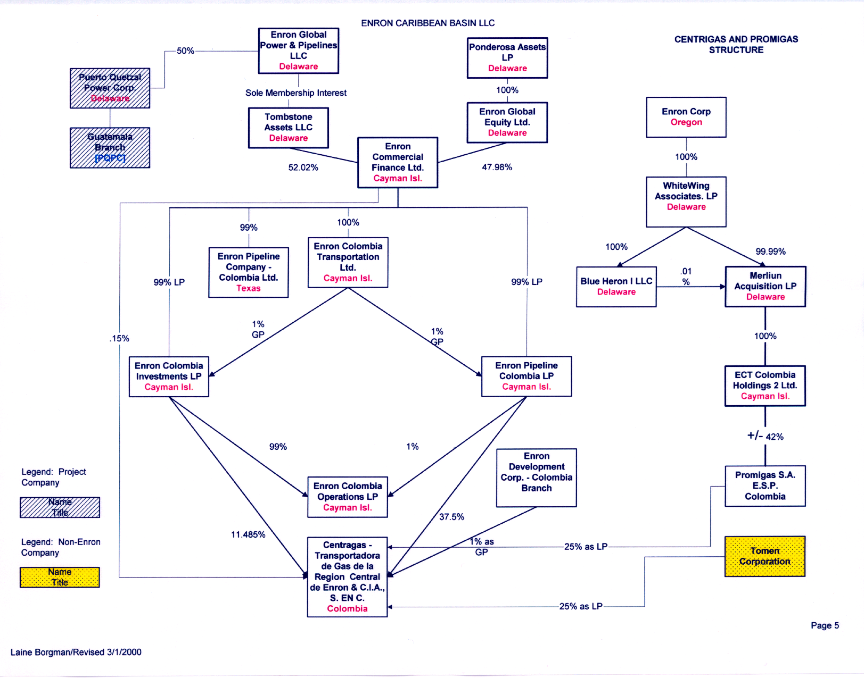
Centragas - Transfer Issues
Relevant Documents
Centragas Partners Agreement dated 9/13/94 among Enron entities
Agreement Among Partners dated 1/23/96 between Enron entities and Tomen Corp to establish terms of governance since addition of Tomen as a limited partner
Indenture dated 12/8/94 between Centragas and Bank of NY w.r.t issuance of 10.65% p.a. Senior Secured Notes due 2010 in amount of $ 172 MM
Ecopetrol Letter Agreement of 5/12/94 between Ecopetrol & Enron Corp
Tomen Corp Letter Agreement of 1/23/96 between Tomen Corp & Enron Corp
Tax Recommended
Sale Level
Xxx 16.67%

Slide 18
Centragas - Transfer Issues (Continued)
Key Issues
Preferential rights at the Centragas level are to the GP, Enron Development Corp., since this is an Enron entity it can be waived
Under the Indenture if Enron Corp ceases to own directly or indirectly 25% of Centragas, the noteholder has the right to cause Centragas to redeem notes
The Tomen Letter Agreement requires Enron Corp to directly or indirectly own at least 25% of Centragas through the operational phase
The Ecopetrol Letter Agreement requires Enron Corp to directly or indirectly own at least 25% of Centragas through the operational phase
Recommendations
Investigate feasibility of getting noteholder waiver ( which in turn would make it feasible to get waiver from Ecopetrol & Tomen)
Require Purchaser to take transfer/refinancing risks
Sell shares of ECFL level or higher to avoid Colombia tax

Slide 19
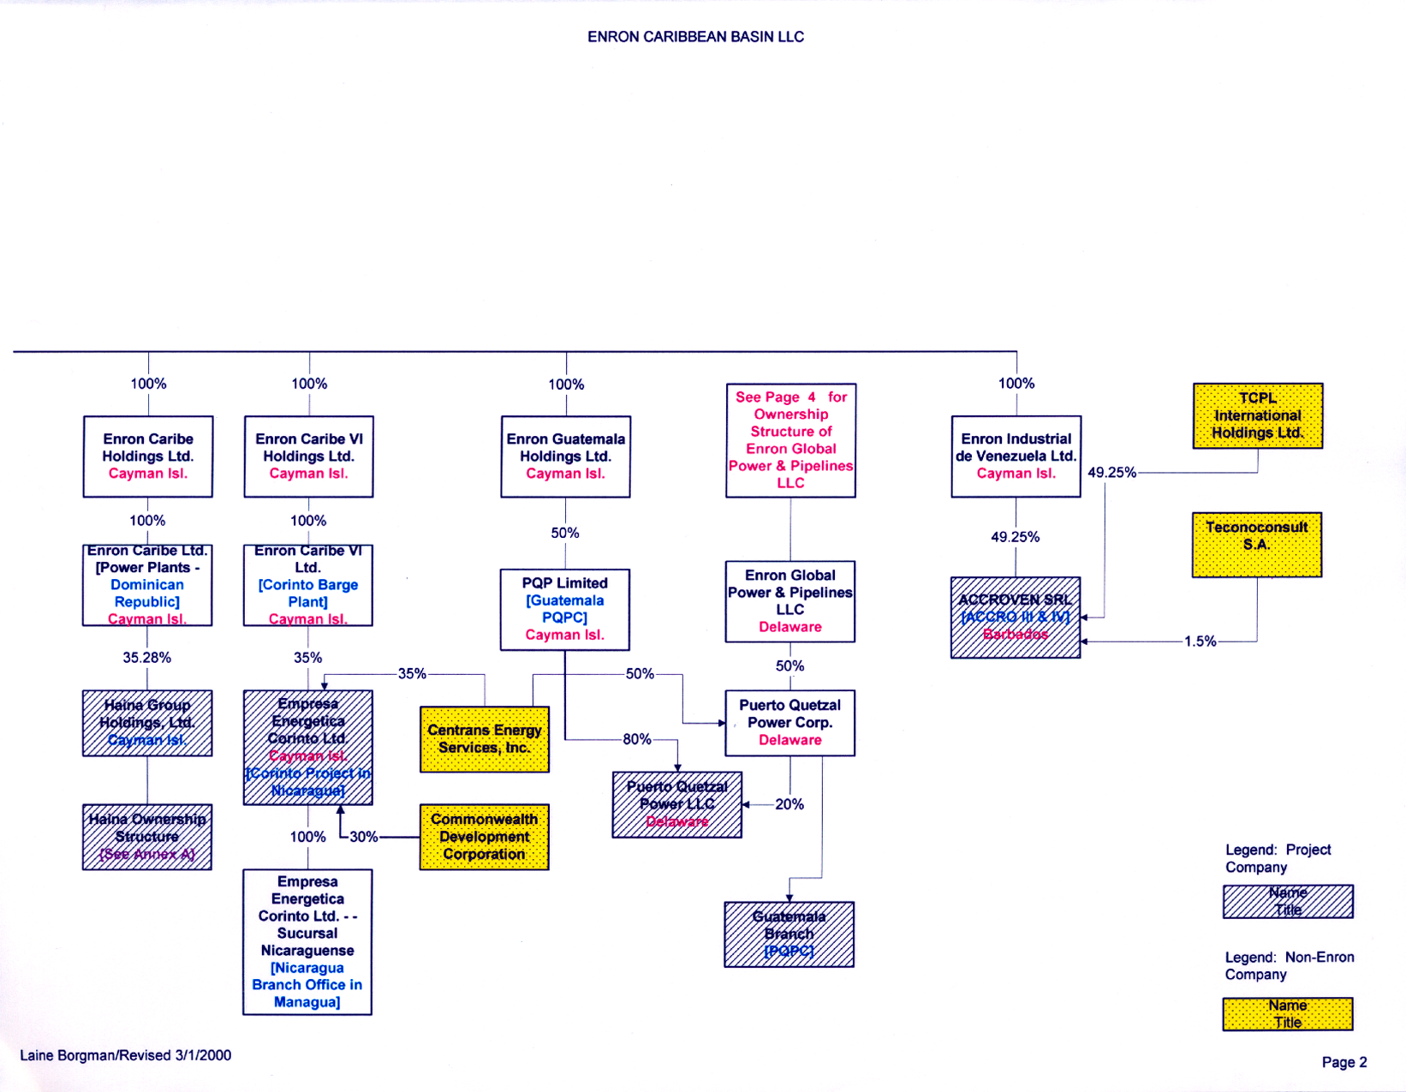
Corinto - Transfer Issues
Relevant Documents
Amended & Restated Stockholders Agreement among Centrans Energy Services Inc., Enron Caribe VI Ltd., CDC Holdings and Empresa Energetica Corinto Ltd. (“Project Company”) dated 3/31/99
Assumption Agreement dated 3/31/99 among Enron Caribe VI Ltd. and Centrans Energy Services Inc. (Reimbursement Agreement for Enron in case it is required to purchase the promissory note under the Purchase Agreement below)
Assumption Agreement dated 3/31/99 among Enron Corp and Commonwealth Development Corp (Reimbursement Agreement for Enron in case it is required to purchase the promissory note under the Purchase Agreement below)
Financing Documents
Purchase Agreement Between Enron Corp & the united States of America dated 3/31/99, In return for issuing MARAD G’eed bonds of $ 50MM to finance project, Empresa Energetica Corinto Ltd. issues a note to Marad. If an event of default occurs, Enron agrees to purchase the note.
Tax Recommended
Sale Level

Slide 20
Corinto - Transfer Issues (Continued)
Key Issues
Preferential rights exist under the Stockholders Agreement. This can be avoided by going above Enron Caribe VI Ltd.
Under the Assumption Agreement with Centrans Energy Services and the Assumption Agreement with Commonwealth Development Corp Enron Corp is required to maintain an ownership interest of at least 15% in the project company through the term of the Purchase Agreement is valid (extending to the note maturity date of October 2015)
Under Purchase Agreement, Enron Corp guarantees the MARAD bonds
Recommendations
Seek consent from Centrans and CDC on Assumption Agreement
Seek consent from MARAD to assign guarantee obligation to new purchaser
Sell at level most efficient from tax standpoint: Sell shares of Enron Caribe VI Ltd. (Cayman)

Slide 21
EcoElectrica - Transfer Issues
Relevant Documents
Shareholder’s Agreement (SA) dated 12/10/97 of EcoElectrica Holdings Ltd., among EcoElectrica Holdings Buenergia Gas & Power Ltd and KES Puerto Rico L.P.
LPG Storage and Services Agreement among EcoElectrica LP and Procaribe as Terminal Operator dated 10/31/97
Financing Documents
Credit Agreement dated 10/31/97 among EcoElectrica L.P. (project company) and ABN Amro & Banque Paribas as Initial co-Agents
Tax Recommended
Sale Level

Slide 22
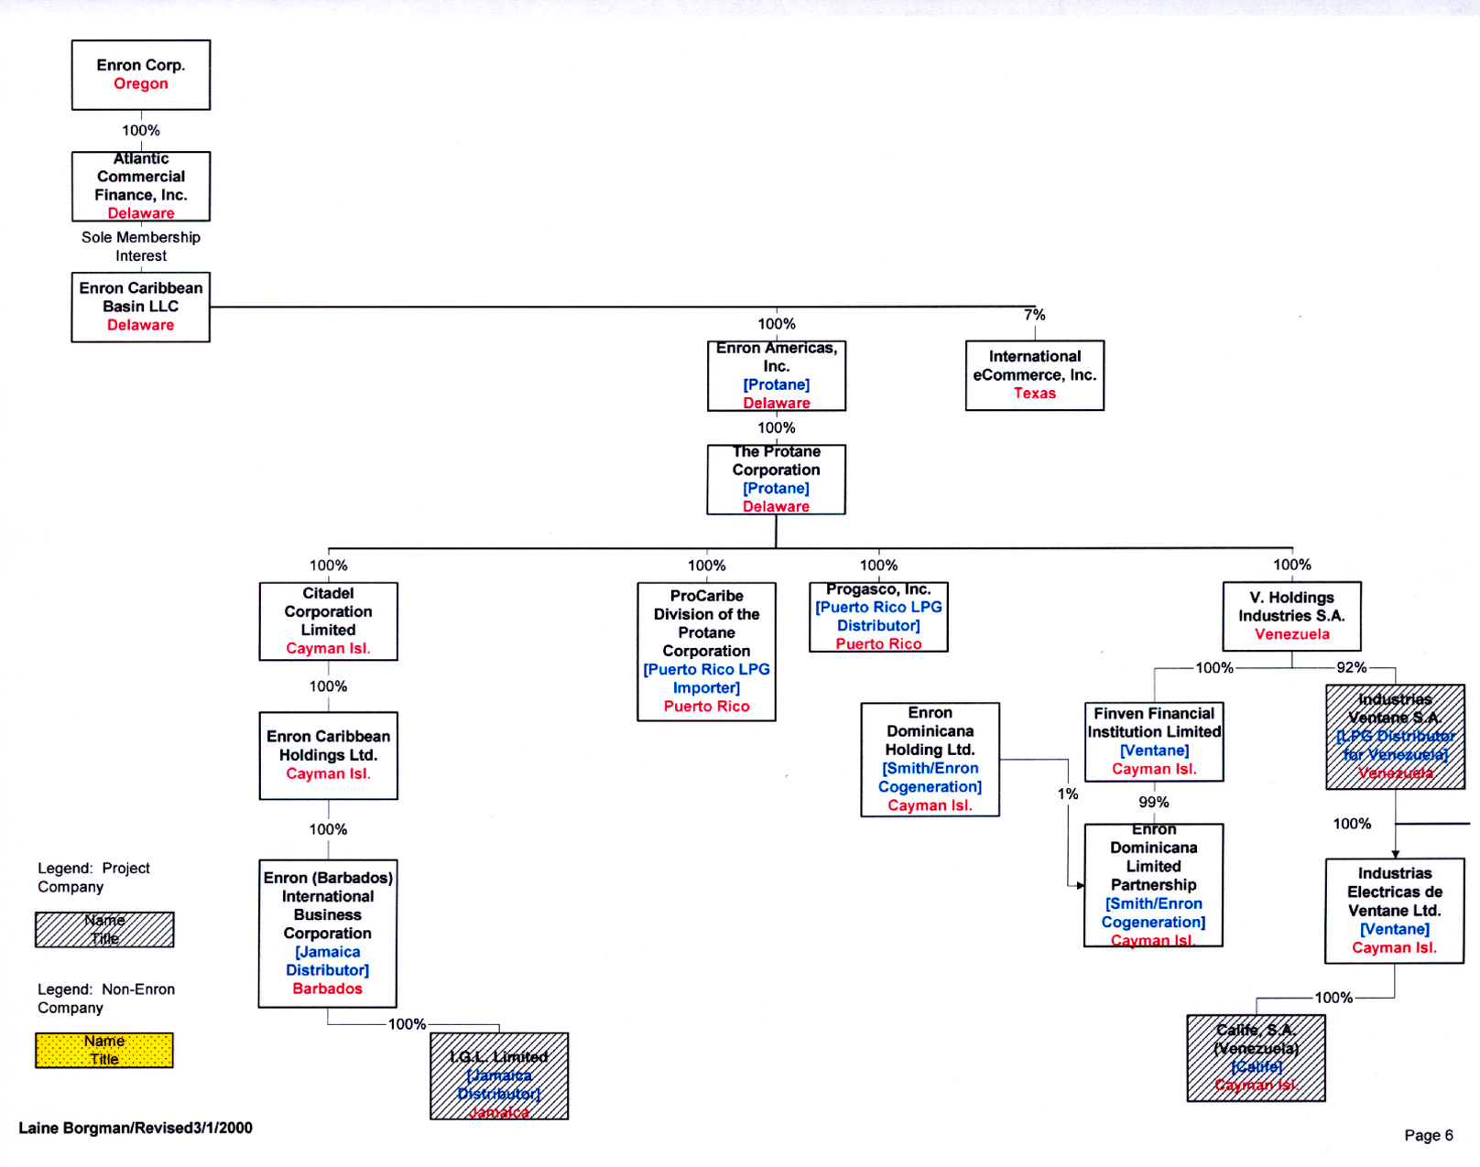
ProCaribe - Transfer Issues
Relevant Documents
LPG Storage and Services Agreement among EcoElectrica LP and ProCaribe as Terminal operator dated 10/31/97

Slide 23
EcoElectrica/Procaribe - Transfer Issues (Continued)
Key Issues
Under the Credit Agreement, Enron Corp must directly or indirectly own atleast 12.5% of EcoElectrica L.P. after CoD (March 2000)
Under the SA, if the transfer is made at the shareholder level and prior to the “Conversion Date” (under the Credit Agreement), transfer without consent is only possible if such transfer is not to a “Restricted Potential Transferee”. “Restricted Potential Transferee” means (i) AES Corporation and Total S.A., (ii) and “Atlantic Group Entity” (Amoco Corporation, Cabot Corporation, Repsol S.A,/Enegas, Phillips Petroleum Company, British Gas PLC or any Person that holds an equity interest in any such company except where such equity interest is represented by publicly traded securities), (iii) and Adverse Party (any party that is adverse to EcoElectrica Holdings, Ltd., EcoElectrica Ltd or EcoElectrica L.P. in a regulatory or legal matter that could result in material adverse effect), (iv) up to two other Persons designated by any transferees of KESLP within 60 days of any such transfer.
Any transfer to a “Restricted Potential Transferee” prior to the “Conversion Date”requires the consent to the other shareholders, not to be unreasonably, withheld, conditioned or delayed. However, if transfer is at shareholder level after the “Conversion Date”, no consent is required for transfer.
The LPG Agreement can be assigned to an entity acquiring EcoElectrica
Recommendations
Determine if “Conversion Date” has occurred under the Credit Agreement .
Obtain consent/waivers from lenders.
EcoElectrica: Sell at level most efficient from tax standpoint: Sell shares of Buenergia Gas & Power Ltd. (Cayman)
Sell at level most efficient from tax standpoint: ProCaribe: Sell any level above direct partner or shareholder

Slide 24
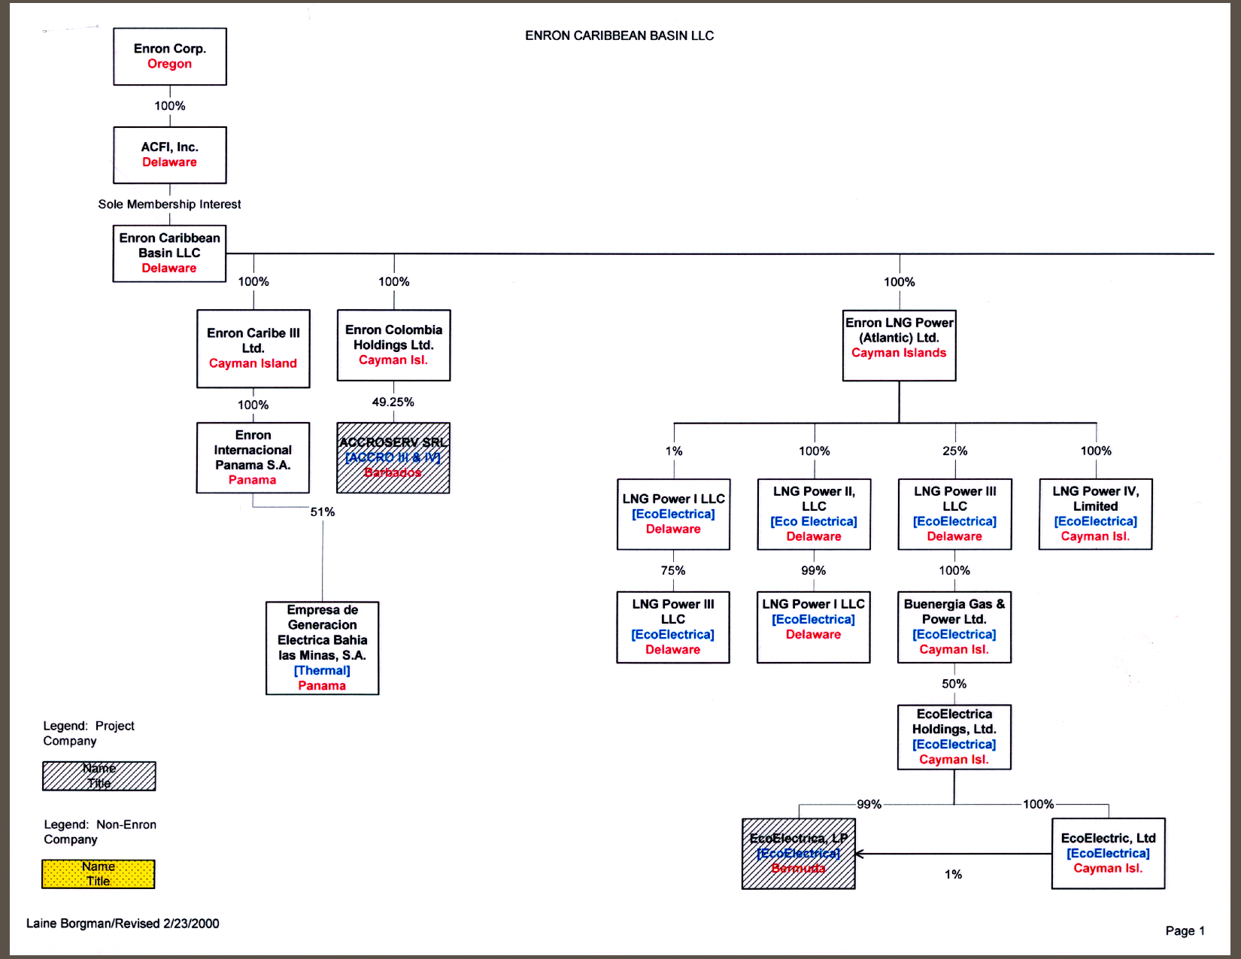
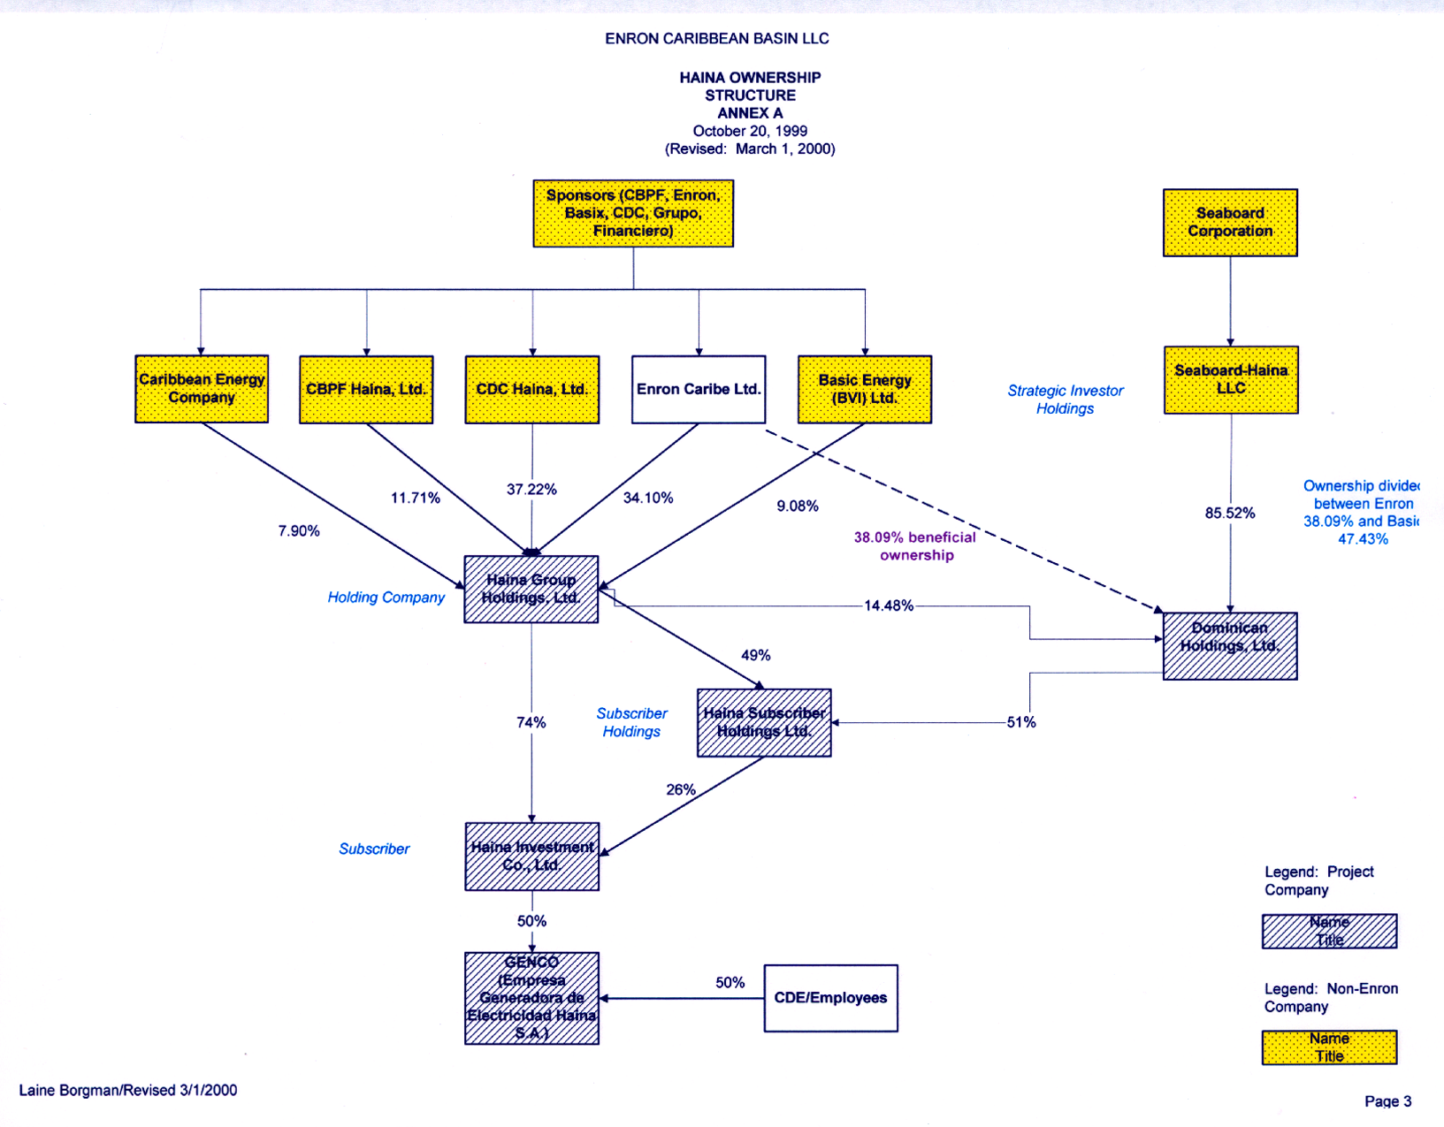
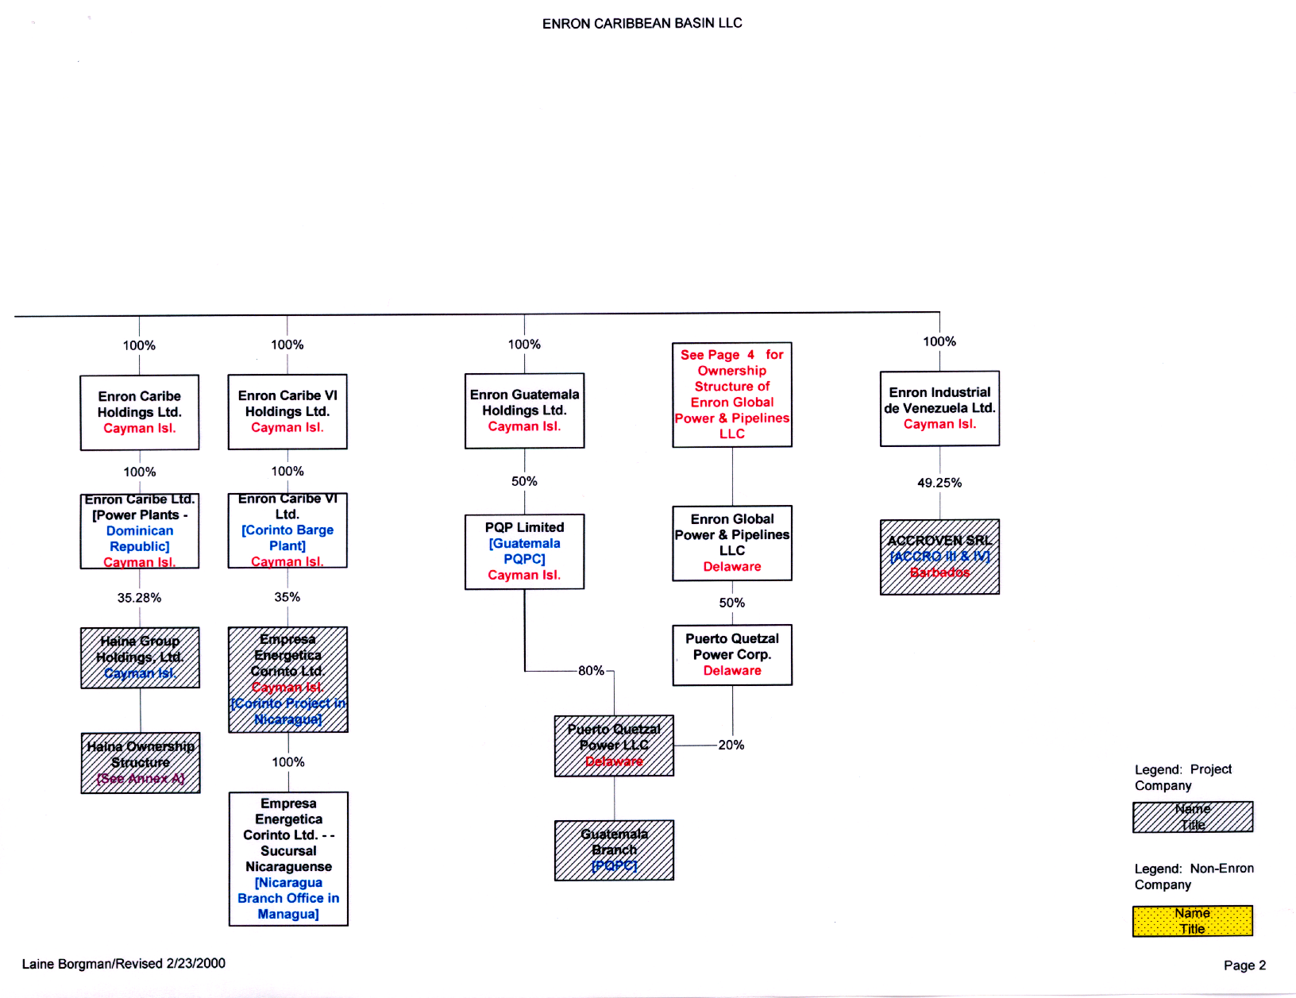
Haina- Transfer Issues
Tax Recommended
Sale Level

Slide 25
Haina- Transfer Issues
Relevant Documents
Shareholders Agreement dated 10/20/99 among CBPF Haina, Ltd., CDC Haina, Ltd., Enron Caribe, Ltd., Hart Energy (BVI) INC,. Seaboard-Haina LLC, Seaboard Corporation, Basic Energy (BVI) Ltd., Caribbean Energy Company, Haina Group Holdings, Ltd., Dominican Holdings Ltd., Haina Subscriber Holdings, Ltd., Haina Investment Co. Ltd.
Key Issues
As per Shareholder Agreement, Enron Caribe Ltd. (up to Enron Corp) can not sell its interest in Haina Investment Company Ltd., without triggering preferential rights.
Recommendations
Ask purchaser to take transfer risk
Negotiate consent
Sell shares of Haina Group Holdings Ltd.

Slide 26
PQPC - Transfer Issues
Relevant Documents
Shareholder’s Agreement (SA) among Enron Global Power & Pipelines LLC (“EPP”) and Centrans Energy Services Inc. dated as of January 9, 1996
Share Retention Agreement (SRA), among Enron Development Corp (“EDC”) and IFC dated March 31, 1993
Financing Documents
Guaranty Agreement (GING), among Enron, ING Bank, dated April 30, 1993. Guaranteeing ING’s “B” Loan under IFC Investment Agreement [Determine Size]
Tax Recommended
Sale Level

Slide 27
PQPC - Transfer Issues (Continued)
Key Issues
Under the SA, Preferential Rights to Centrans exist at the EPP level
Under the SRA, PQPC will be in default on its IFC Investment, in the event of a Change in Control, which occurs if Enron Corp, and/or an affiliate fails to own at least a 50% interest in PQPC, or if a non-Enron affiliate becomes or takes control of the facility Operator
Enron shall remain obligated under the GING notwithstanding a merger, sale of assets, or other change of control of PQPC
Review PPA (missing)
Recommendations
Obtain consent/waivers from IFC and GING. If approval is not granted, the buyer can refinance the debt.
Sell at level most efficient from tax standpoint: Shares of EPP & Enron PQP Limited

Slide 28
Promigas & Ventane - Transfer Issues
Relevant Documents
Promigas
Colombian Securities Regulations
Ventane
Venezuelan Securities Regulations
Tax Recommended
Sale Level

Slide 29
Promigas & Ventane - Transfer Issues (Continued)
Key Issues
Because Promigas is a public company on the Bogota stock exchange, no purchaser can buy more than 10%of Promigas without a public tender offer or within the process of a public auction for sale promoted by the seller. This requirement applies even if the sale takes place further up the corporate chain
Since Ventane is a public company listed on the Caracas stock exchange a prospective buyer can not acquire a “significant participation” in the company without a public tender offer - since Enron owns 97% of Ventane, this is not a significant issue [Needs Confirmation]
Recommendations
Promigas: Sell shares of ECT Colombia Pipeline Holdings 2 Ltd. to avoid Colombian tax
Sell Ventane above direct partner or shareholder level (Likely to be taxable in Venezuela)
Negotiate sale mechanism with purchaser: tender or auction

Slide 30
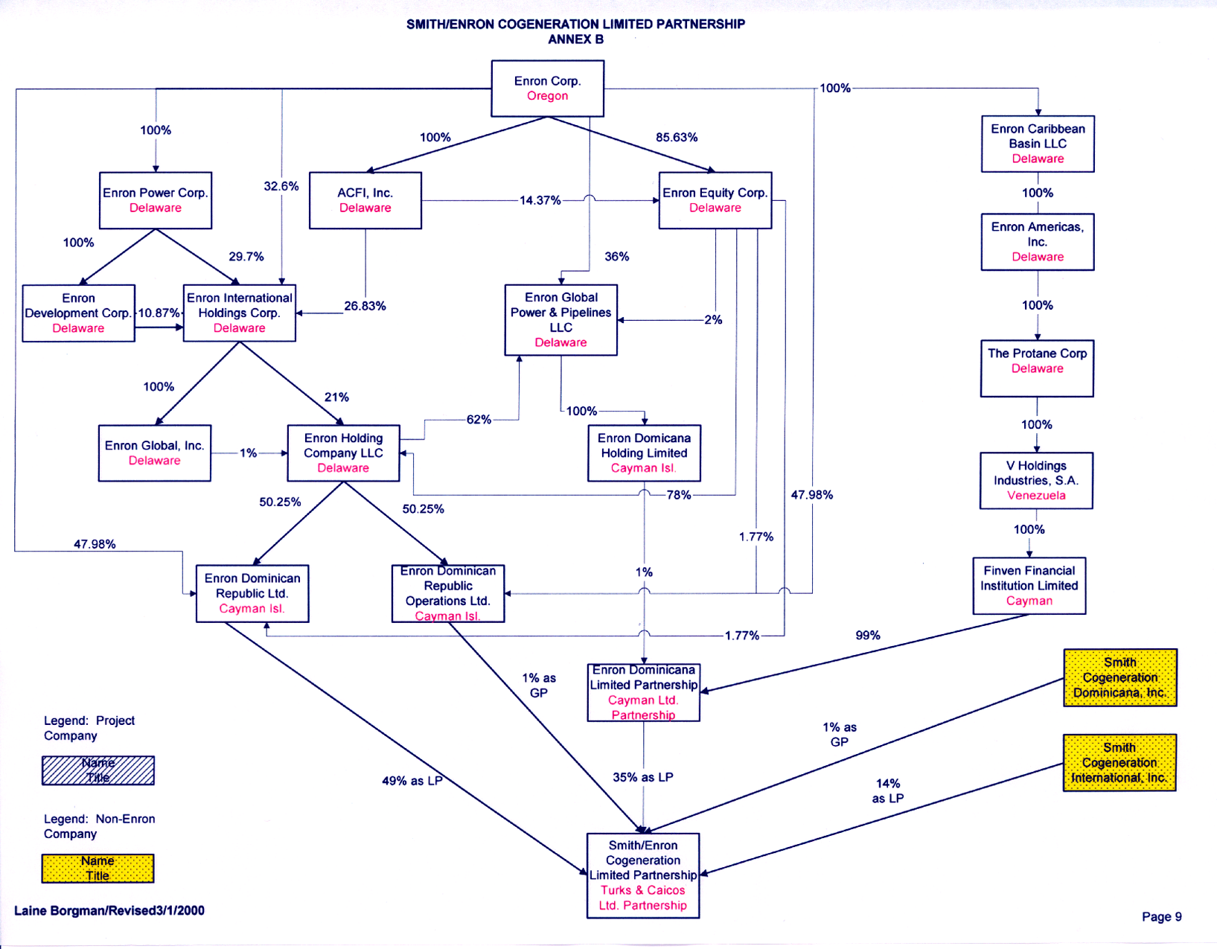
SECLP - Transfer Issues
Relevant Documents
SECLP Partnership Agreement, among Smith Cogeneration Dominicana, INC., Smith Cogeneration International, INC. Enron Reserve I B.V. and Atlantic Commercial Finance B.V. dated December 15, 1994
Smith/Enron O&M Partnership Agreement, among Smith Cogeneration Dominicana, INC., and Enron Reserve I B.V. dated March 1, 1994
Share Retention Agreement, among Smith/Enron Cogeneration L.P., Enron Reserve I B.V., Atlantic Commercial Finance B.V., Smith Cogeneration Dominicana, Inc., IFC, and Commonwealth Development Corporation dated November 11, 1994
Financing Documents
IFC Investment Agreement, among Smith/Enron Cogeneration L.P. (“SECLP”) and International Finance Corp. (“IFC”) dated November 1, 1994
CDC Loan Agreement, among SECLP and Commonwealth Development Corp. (“CDC”) dated June 8, 1995
Loan Agreement, among Deutsche Investitions (“DEG”) and SECLP dated July 27, 1995
Tax Recommended
Sale Level

Slide 31
SECLP - Transfer Issues (Continued)
Key Issues
Transfer (or mortgage) of interest requires consent of all other partners for both SECLP and Smith Enron O&M.
SECLP will be in default on its IFC Investment, CDC Loan, and DEG Loan Agreements in the event of a Change in Control, which occurs if Enron Corp, and/or an affiliate fails to own at least a 20% interest in SECLP, or if a non-Enron affiliate becomes or takes control of the facility Operator or the Enron General Partner (Dominican Republic Operations Ltd. or Enron Reserve I B.V. as the case may be) or controls the facility Operator or the Enron General Partner.
Recommendations
Sell above the partner level to avoid consent of partners: Sell shares of Enron Dominican Republic Limited (Cayman), the Enron Domicana Republic Operations Limited (Cayman), the Enron Dominicana Ltd. (Cayman)
Obtain consent/waivers from IFC, CDC, and DEG.
Ask purchaser to take transfer risk.

