Slide 1
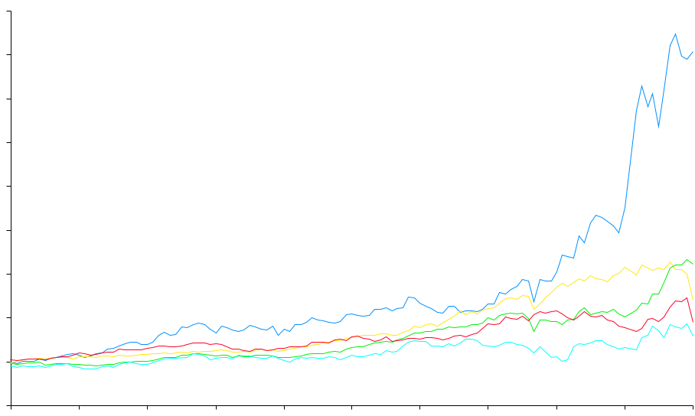
Total Return to Shareholders
January 1990 to December 2000
1600
1400
Enron Corp.
S&P 500
Pipeline Avg.
Utility Avg.
E&P Avg.
1415%
383%
545%
281%
217%
1200
1000
800
600
400
200
Aug 00
0
-200
Dec 90
Dec 91
Dec 92
Dec 93
Dec 94
Dec 95
Dec 96
Dec 97
Dec 98
Dec 99
Nov 00
Dec 00
Note: Calculated to December 31, 2000

