Slide 1


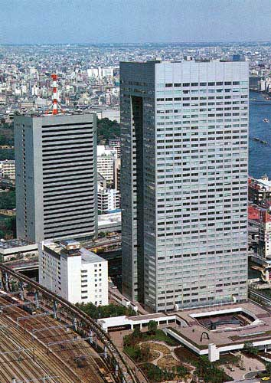
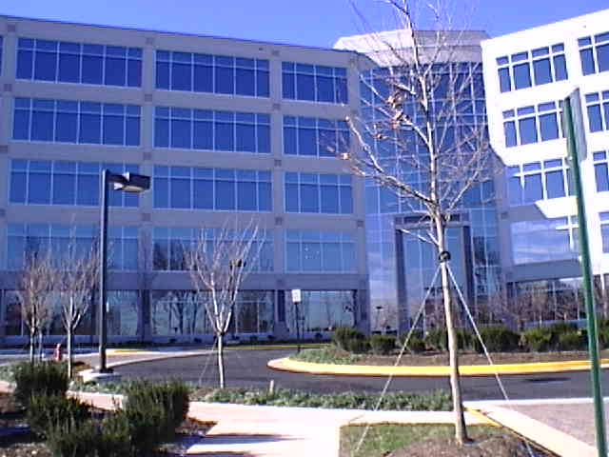
e-Solutions Company Corporate Overview
Presented by Toshiba Consultant Center in Fairfax (TCCF)
Toshiba America Information Systems, Inc. Toshiba Consultant Center in Fairfax
13900 Lincoln Park Drive, Suite 240
Herndon, VA USA 20171
Tel: 703.375.0400
Fax: 703.375.0401
1-1, Shibaura 1-chome, Minato-ku, Tokyo 105-8001, Japan
Tel: +81-3-3457-4511
Fax: +81-3-3456-1631

Slide 2
Toshiba Corporate Profile
World leader in high technology…an integrated manufacturer of electrical and electronic products spanning information & communications equipment and systems
PC and other computer related products and systems
Electronic components & materials
Power systems & industrial equipment
Consumer products
125+ years of operation (since 1875)
190,000 employees worldwide and over 300 consolidated subsidiaries
(US: $7.4 billion and nearly 10,000 employees)
Annual sales in FY 2000 over ¥5.7 trillion (~$50B) on a consolidated basis

Slide 3
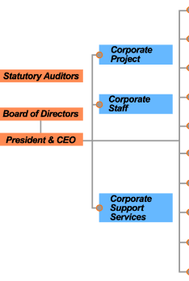
Toshiba Japan Organizational Profile
We are representing
~$20B
19 Divisions
20,000 Employees
10 Major Companies represent the Toshiba Group

Slide 4
The e-Solutions Company business centers on providing Information and Communications Technology (ICT) solutions and services to customers in these areas:
Digital Broadcasting Services
Internet Application Services
Systems Integration Services
Automated Information Systems
Unique strengths in ICT position the e-Solutions company for leadership as a total system and service provider in Digital Broadcasting; System Integration (SI) and Solutions Services for business and government; Internet-based Services, including Application Service Provider (ASP) services; Telecommunications Systems; Automated Information Systems; Intelligent Transportation Systems (ITS) and Automotive Systems.

Slide 5
More than a supplier of Information and Communications Technology (ICT) …
Delivery of expertise and solutions that help customers to achieve growth and prosperity
Earned reputation as a synthesizer and provider of corporate systems and services.
Our defining vision is “Collaborative Innovation”:
Constantly listen to the voices of customers
Share their problems and demands
Brainstorm together; bear risks and, from the numerous possibilities available, provide the solution that offers the maximum possible result
We feel that “Collaborative Innovation” is an approach to creating value that can be objectively evaluated and that consequently strengthens customer reliance.

Slide 6
- Hiroo Okuhara, President
- Shinsuke Kawamura, Executive Vice President
- Kunio Takezawa, Executive Vice President
- Sakae Yanagawa, Chief Fellow - Matoi Iizuka, Chief Technology Executive
e-Net Business Div.
Information Systems Center
Mutsuhiko Nagamatsu,VP
Tsuruta, VP
Government & Public Corporation
Information Systems Div.
SITC (System Integration Tech. Center)
Takashi Ikeda, VP
Dotemoto, VP
Solutions Division 1
Tokyo/Kansai System Center
Akira Maki, VP
Toshio Kobayashi, VP
Solutions Division 2
Fuchu / Ome e-Solutions Works
Kozo Sawada, VP
Telecommunications Systems Div.
Yanagi-Cho / Komukai e-Solutions Works
Hiroshi Takaoka, VP
Media & Content Division
ITS & Automotive Business Planning Div.
Osami Suzuki, VP
Yukinobu Suzuki, GM
Computer & Network Platform Div.
eS Strategy Division.
Kunihiro Nagura, VP
Yasuo Miyabe, GM
System Components Div.
Yoshiaki Sato, VP

Slide 7
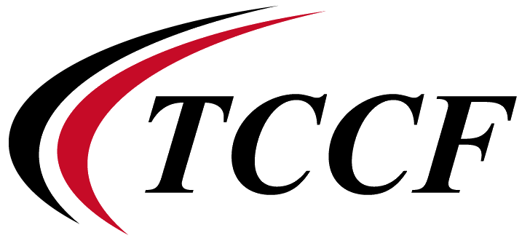
About
The Toshiba Consultant Center in Fairfax (TCCF) provides an active and strategic "bridge" between Toshiba’s e-Solutions Company in Japan and the US which facilitates and promotes strategic business development, information & technology research and exchange, partnerships, alliances, special projects and other collaborative activities.
Formally established in April 1999
Located in Herndon, VA -- in the heart of the Northern VA High-Tech Corridor where nearly half of the world's Internet traffic passes through and has the country's highest Internet penetration rate at 60 percent. Over 3,500 technology companies are headquartered in the area, a number expected to balloon to more than 24,000 by 2002.
A small but very strategic operation funded entirely by the Toshiba e-Solutions Company but also reporting in a dual capacity to Toshiba America Information Systems

Slide 8
Activities
Coordination between (e-Solutions Company) and the US regarding System Integration & IT Service Business
1.) Identification, Support & Promotion of NEW Business Opportunities
Examples: Document Conversion/ASP/SSP Business (IMC)
Data Center/IT Outsourcing Business (LMGT)
Applications (TIBCO/InConcert)
Financial Solutions (Boltzmann Model)
Super-High Resolution Displays (3200X2400; 192 ppi)
IT Information Transfer & Exchange from the US
Information services focused on US IT trends TCCF Forum, White Papers and Reports
3) Initiate SI & IT Service Business

Slide 9
Toshiba in the US IT Services Market
The U.S. IT services market is large and innovative, and Toshiba is interested in extending its participation in the market.
Toshiba has a global client base but no internal service capabilities outside of Asia.
Toshiba’s strategy is to enter the U.S. IT services market and become a global leader.
We are accelerating globalization and the creation of new business models by cooperating with different types of businesses and forging alliances with international partners

Slide 10
Our Purpose Today
To briefly describe a new Toshiba Japan initiative and technology innovation related to Financial Services and obtain your initial reactions through discussions.
To jointly explore and consider the potential joint benefits of a relationship between our two companies.

Slide 11
Introducing Dr. Yuji Uenohara

Slide 12
A Few Questions
Based upon the information contained in the briefing:
1. Would you think that this technology would be of significant interest to Enron ?
2. Where would you see the most applicability for this new model?
3. If, in fact, this model significantly outperforms the traditional Black-Scholes models, would it be considered to be a "break through" ?
4. Toshiba is very interested in partnering with key enterprises in the US and abroad (similar to their relationship with Daiwa Securities in Japan to provide a win-win scenario -- would Enron be interested in pursuing this type of relationship with Toshiba ?

