Slide 1
Spread Options
Presented by
Vince Kaminski
Enron Research Group
Houston, Texas
28 September, 2000

Slide 2
Spread Options
Definitions and types
Futures spread options
NYMEX crack spread options
Pricing
Terms:
Crack, heat, frac, spark, NOB, TED spreads
Exchange option
Eta

Slide 3
Spread Options
An option on the difference of two prices
Payoff definition
Call: max [X-Y-K,0]
Put: max [K-(X-Y),0]
X(Y): price of commodity x(y)
K: strike price
Special case: K=0:
Option to exchange one commodity for another
Very popular in the energy markets

Slide 4
Payoff (Put on a Spread)
Spread
Strike
Option
Payoff
Time

Slide 5
Types of Spread Options
Location spreads
Calendar spreads
Processing spreads
Crack gasoline spreads
Heat spreads
Spark spreads
Frac spreads
Quality spreads
Intermarket vs. Intramarket options
OTC vs. exchange-traded spread options

Slide 6
Spread Options
Economic Rationale
Economic rationale for a spread option: a producer is long spread with short-term marginal cost being the strike price
Put spread options purchased by a producer: protection of profit margins
Call spread options sold by a producer: generation of cash

Slide 7
Intermarket Spread
The purchase of a futures
contract and the sale of a
futures contract in a
different, but related
commodity
Used to hedge
incremental refining
output or the current and
projected inventory cost
as seasonal demand
shifts
Refiners
Marketers
Traders

Slide 8
Crack Spread
A specialized form of
inter market spread
using crude oil and its
products
To protect profit margins
for a current refining run
or future product
margins
Refiners
Traders

Slide 9
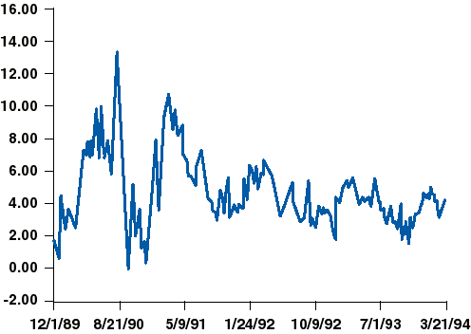
NYMEX Gasoline Crack Spread
First Nearby Unleaded Gasoline Minus Crude Oil
Dollars/Barrel

Slide 10
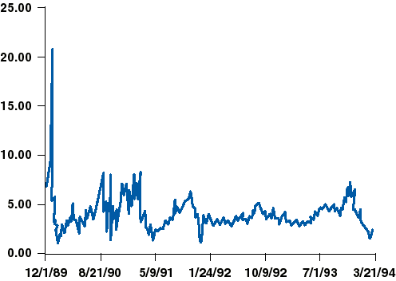
NYMEX Heating Oil Crack Spread
First Nearby Heating Oil Minus Crude Oil
Dollars/Barrel

Slide 11
Historical Spread Deviations
Extremely cold weather (e.g., December of ’89)
Persian Gulf crisis of 1990-1991
Attempted Soviet coup in August of 1991
Environmental acts regulating formulation of gas and sulfur content of distillates

Slide 12
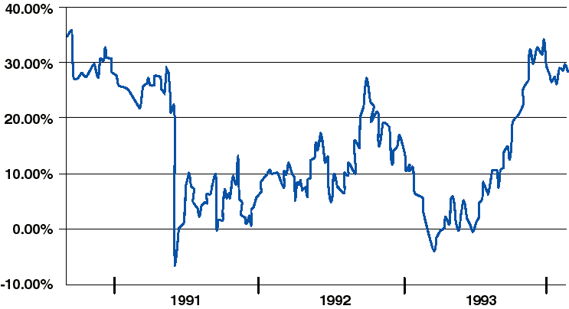
Correlation Between Natural Gas and Heating Oil
Historical correlation for trailing 6 months

Slide 13
Historical Spread Deviations
Extremely cold weather (e.g., December of ’89)
Persian Gulf crisis of 1990-1991
Attempted Soviet coup in August of 1991
Environmental acts regulating formulation of gas and sulfur content of distillates

Slide 14
Crack Spreads
Most common are:
Crude
5
3
2
1
Product A
3
2
1
1
Product B
2
1
1

Slide 15
NYMEX Spread Option Users
Refiners
Long cracks (long products/short crude)
Buy puts
Product traders
Short cracks (short products, use WTI to hedge)
Buy calls
Unbranded gasoline distributors
Short gasoline purchases
Buy OTM calls

Slide 16

Options on Spread
(General Properties)
Exchange option: a special case of spread option (K=0)
Spread call (K) < [call(K₁) + put (K₂)]
K = K₁ - K₂
Obvious: separate options give more flexibility to the holder. Therefore, they cannot be worth less than the spread option. In other words: the holder of a call and a put has an option to decouple them. This option has to be worth something.
- variance
- correlation

Slide 17
Heating Oil Crack Spread
NYMEX
Put and call on the 1:1 futures price differential between
NY Harbor heating oil and WTI crude
HO x 42 - CL = heat crack
Call option: The right to hold a long position in the
underlying heating oil futures contract and a short
position in the underlying crude oil futures contract
(the same NYMEX trading month)
Short and long positions, respectively, for the put

Slide 18
Gasoline Crack Spread Option
Put and call options on the 1:1 futures price differential between NY Harbor unleaded gasoline and WTI crude
HU x 42 - CL = gasoline crack
Definition of the call and put options analogous to the heat crack options

Slide 19

Spread Options Pricing
Closed Form Formula
Developed by D. Wilcox
F - the forward spread
K - the strike price
t - valuation time
T - expiration time
T-t - life of the option (years)
σ - volatility (absolute)
r - risk free interest rate
N(.) - the cumulative normal distribution function
n(.) - the standard normal density function

Slide 20
Spread Options Pricing
Closed Form Formula
Assumption of normal distribution of the spread
Volatility expressed in absolute terms
Delta of the option expressed in terms of the “spread”
The formula is inconsistent with the standard option pricing assumptions
Better than Black-Scholes (by any standard) for the spread options
Widely used by the practitioners

Slide 21

Spread Options: Valuation
No closed form formula for a general case
Pricing requires use of numerical methods
Starting point: the formula for the price of a call
X(Y) - price of commodity X(Y)
K - strike price
f(X, Y) - probability density function
T - t - life of the option (years)
T - expiration time
t - valuation time
r - interest rate

