Slide 1
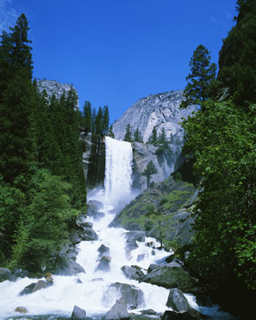
Three Rivers Allocations Meeting
Attendees:
Rita Wynne
Greg Steagall
Anita Luong
Fred Boas
Clem Cernosek
Stella Morris
Karry Kendall
Daren Farmer
Pat Clynes
Robert Lloyd
Howard Camp
Jackie Young
Mandey MacKinnon
Blanca Lopez
Date: Thursday, February 17, 2000
Time: 2:00-3:00pm
Location: EB49C1

