Slide 1
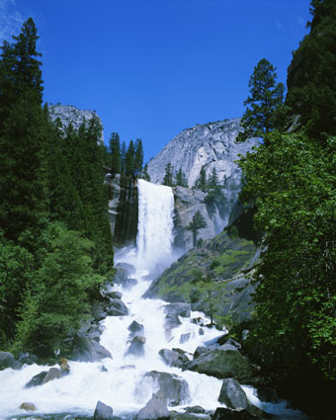
Three Rivers Allocations Meeting
Attendees:
Rita Wynne
Greg Steagall
Anita Luong
Fred Boas
Clem Cernosek
Stella Morris
Karry Kendall
Daren Farmer
Pat Clynes
Robert Lloyd
Howard Camp
Jackie Young
Mandey MacKinnon
Date: Thursday, February 10, 2000
Time: 11:30-1:00pm (Luncheon)
Location: EB37C1

