Slide 1
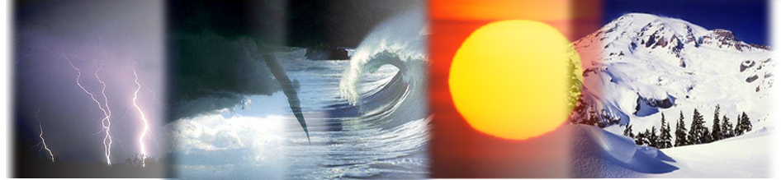
WEATHER RISK MANAGEMENT
Lynda Clemmons
Enron North America Corp.
February 16, 2000

Slide 2
The Impact of Weather
Weather Risk is not acceptable
“The near-record warm temperatures of the past two years have led to poor financial results for [energy] companies, and investors appear to be concerned...” Goldman Sachs Investment Research
“I am especially pleased that our strategy to hedge weather risk during the heating season has significantly reduced the impact that the much warmer than normal weather otherwise would have had on quarterly earnings.” Larry Brummett, ONEOK’s Chairman/CEO, January 5, 2000
“weather ‘insurance’ for 1998 helped offset some of our lost gas revenues due to a warm winter…we will pursue more options like this in the future…” David C. Mebane, Chairman/CEO, Madison Gas & Electric

Slide 3
The Evolution of the Weather Market
Aug 1997
First weather-indexed commodity transaction (Utility/Enron)
Sep 1997
First financial transaction (Enron/Koch)
Sep 1998
First international transaction (Enron/Scottish Hydro)
Sep 1999
Weather futures trade on the Chicago Mercantile Exchange
Oct 1999
First weather bonds marketed and placed
Estimated 3,000 deals completed with a notional value of over $5 Billion
~ 800 deals completed by Enron
Present
FUTURE
Broad End-User Participation
Highly Structured Products

Slide 4

How is the Market Structured?
DEALERS
Energy Companies
Financial Institutions
CAPITAL
MARKETS
FINANCIAL
WEATHER MARKET
Weather Bonds
Alternative Risk Funds
END USERS
Energy Utilities / Local Distribution
Companies/Pipelines
Agriculture Companies
Ski & Vacation Resorts
Manufacturers
Construction Companies
Entertainment
INSURANCE
BROKERS
Inter-Dealer Transactions

Slide 5
Structures
Types of Contracts
Swaps, Caps, Floors, Collars, Exotics
Term
Mainly seasonal
Multi-year transactions
Size
Up to $500,000/DD
Exposure Limits
Transactions capped
Locations
Domestic/International
Baskets (Multiple cities)
Hybrids
Securitizations
Weather-linked products

Slide 6
Degree Days
Cooling Degree Days (CDDs)
Summer measure of average daily temperature above 65ºF (18ºC)
Heating Degree Days (HDDs)
Winter measure of average daily temperature below 65ºF (18ºC)
HDD Example:
If the average of the daily high and the daily low temperatures is 52ºF, then there are 13 HDDs for that day
To determine # of HDDs for a winter season, add HDDs for each day of the period

Slide 7

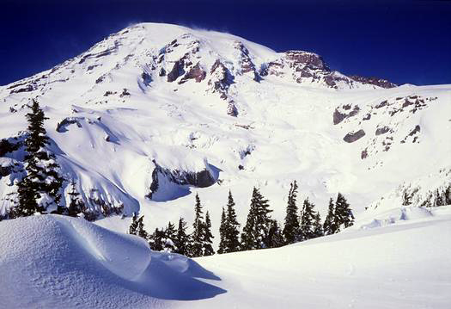
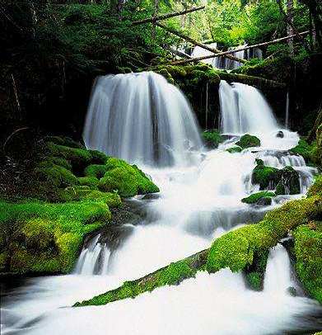
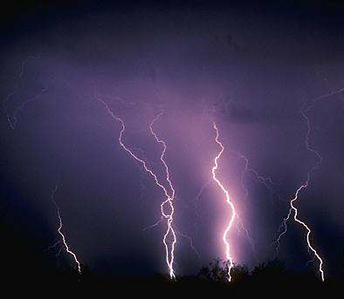

Common Indices
Degree Days (Heating, Cooling, Customized)
Temperature (Maximum, Minimum, Events)
Rainfall (Inches, Events)
Snowfall (Inches, Events)
Streamflow (CFS, MAF)
Storm Activity (Intensity, Frequency)
Perceived Temperature (Wind Chill, Heat Index)
Combinations (Custom Index, Multiple Trigger)

Slide 8
The First Step: Assessment
Earnings Variability
Where are the locations
When will the weather affect revenues
Size of exposure
Binary vs. Incremental Risk
Warm vs. Cold Exposure
Single vs. Multiple Year Trade

Slide 9
El Niño and La Niña: Climate Considerations
Trading Effects:
El Niño kick started the weather market
The following two years of La Niña showed the volatility the market was capable of achieving
The Bid/Offer Spread has been wide because of La Niña

Slide 10

Weather with other Energy Derivatives
Weather (Temperature) and Power Option
Weather (Temperature) and Gas Daily Options
Weather (Temperature) and Heating Oil Option

Slide 11
Weather Futures vs. the OTC Market
Weather Futures
Standardized Contact Terms
Temperature Only
Ten Cities
Futures & Option Contracts
Central Credit Clearinghouse
OTC Market
Specialized Products
Different Maturity Dates
Various Indices
100’s of Cities
Fully Customizable
Counterparty Credit Concern

Slide 12
QUESTIONS? CASE STUDY I: Temperature Floor and Collar CASE STUDY II: Rainfall Cap
Notes:
People don’t question the value of what a weather derivative can bring into the market, but finding a good price is rough. Are weather derivatives expensive?
The bid/offer spread last year was wide. Has it narrowed down any further?
How liquid is the market?
Is it true that limited quality of historical weather data and pricing models are preventing a robust market from emerging?

Slide 13
Case Study I
Issue:
Spark Co. experiences depressed winter earnings due to mild temperatures
Problem:
Warmer than normal winter weather in their service territory decreases demand for gas
Margin analysis indicates that for each HDD below normal, Spark Co. loses approximately $15,000 in earnings
Objective:
Spark Co. wishes to take advantage of a cool winter and protect itself against a warmer than normal winter

Slide 14
Alternatives
Floor: Spark Co. could purchase an HDD floor that will protect earnings during a warmer than “normal” winter by receiving payments of $15,000 per HDD below the floor. Additionally, the floor will allow them to retain the upside associated with cooler than “normal” winter weather
Collar: Spark Co. could purchase an HDD floor to provide downside protection against a warmer than normal winter and, to offset the cost of the floor, simultaneously sell an HDD cap that limits its upside in the event of favorable weather. If great weather does prevail, it will pay Enron $15,000 per HDD above the cap, which should be offset by a weather-related increase in revenues

Slide 15
Winter Season Floor Structure
Counterparty: Spark Co.
Term: Nov 1, 1999 - March 31, 2000
Index: Cumulative HDDs as measured at Official National Weather Service Station
Strike: 680 HDDs (10% below 10yr mean of 755)
Payment: $15,000/HDD
Limit: $4,000,000
Premium: To be determined

Slide 16
Winter Season Floor Payout
Spark Co is protected from a warmer than expected winter and is compensated $15,000/HDD below 680 HDDs
Payments from Enron to Spark Co offset lost sales due to warm weather stabilizing revenues until the $4MM limit is reached at 413

Slide 17
Winter Season Collar Structure
Counterparty: Spark Co.
Term: Nov 1, 1999 - Mar 31, 2000
Index: Cumulative HDDs as measured at Official National Weather Service Station
Upper Strike: 800 HDDs (Enron receives above)
Lower Strike: 680 HDDs (Spark Co. receives below)
Payment: $15,000/HDD
Limit: $4,000,000
Premium: NONE

Slide 18
Winter Season Collar Payout
Spark Co. is only exposed to the weather when the collar is “inactive” (flat), between the strikes of 680 and 800, and beyond the $4MM limits at 413 and 1066

Slide 19
Case Study II: Rainfall
Issue:
Spark Corp. experiences depressed earnings due to above average rainfall
Problem:
Greater rainfall than normal in their drilling territory decreases drilling activity
Margin analysis indicates that for each inch of rain above normal, Spark Corp. loses approximately $150,000 in earnings
Objective:
Spark Corp. wishes to take advantage of a dry season and protect itself against a wetter than normal season

Slide 20
Solution
CAP (CALL): Spark could purchase a rainfall cap that will protect earnings during above “normal” rainfall seasons by receiving payments of $150,000 per inch of rain above the cap strike. Additionally, the cap will allow them to retain the upside associated with dryer than “normal” weather

Slide 21
Revenue Protection: Rainfall Cap
Counterparty: Spark Corp.
Instrument: Rainfall Cap (CALL)
Term: May 1, 2000 - September 30, 2000
Index: Cumulative inches of rainfall measured at official weather station in US
Call Trigger: 25 inches (10% above 10 yr. Avg. 22.7 inches )
Payment: $150,000/inch
Limit: $2,000,000
Premium: to be determined

Slide 22
Rainfall Cap Payout
Spark Corp. is protected from decreased drilling activity due to greater than expected rainfall and is compensated $150,000/inch above 25 inches (10% of the 10yr average of 22.7 inches) to a maximum of $2MM
Payments made from Enron to Spark to offset lost revenue due to above normal rainfall - stabilizing revenues until the $2MM limit is reached at 38 inches

