Slide 1
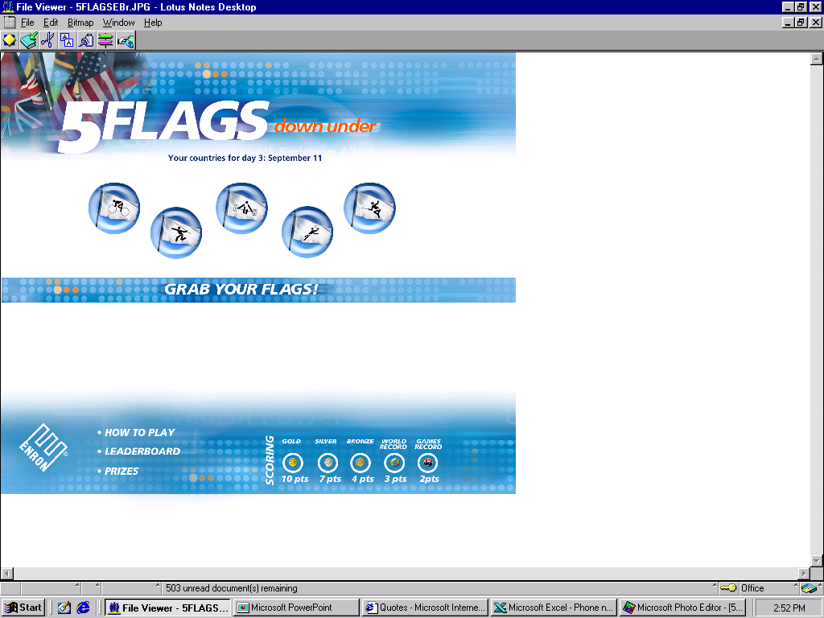
This is the look that we would like all the pages to have.

Slide 2
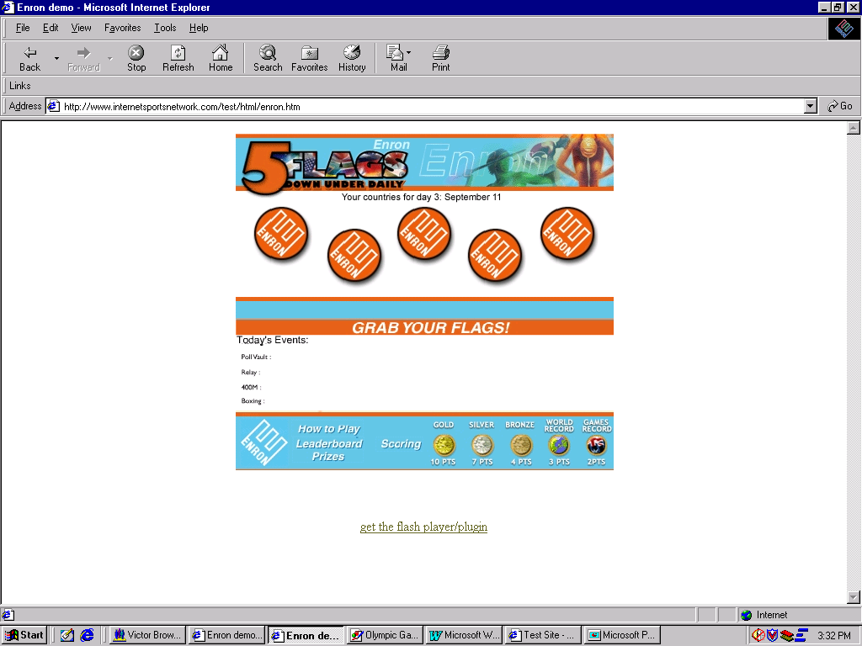
The EnronOnline Games
EnronOnline invites you to take part in
The EnronOnline Games
for the chance to win some great prizes (link to prizes).
For further details and free registration please select your country of residence in the drop down box below.
Country of Residence
If the events are not scrolling then
Disclaimers: This Game is only available to residents of ______________________________________________________________. Furthermore, due to the operation of law in Japan, we will be unable to award prizes whose value exceeds 100,000 Yen to Japanese residents.
The EnronOnline Games is not affiliated with or endorsed by any party other than EnronOnline, LLC and Internet Sports Network, Inc.

Slide 3
The EnronOnline Games
We regret that due to regulatory issues The EnronOnline Games can not be extended to your country of residence.

Slide 4
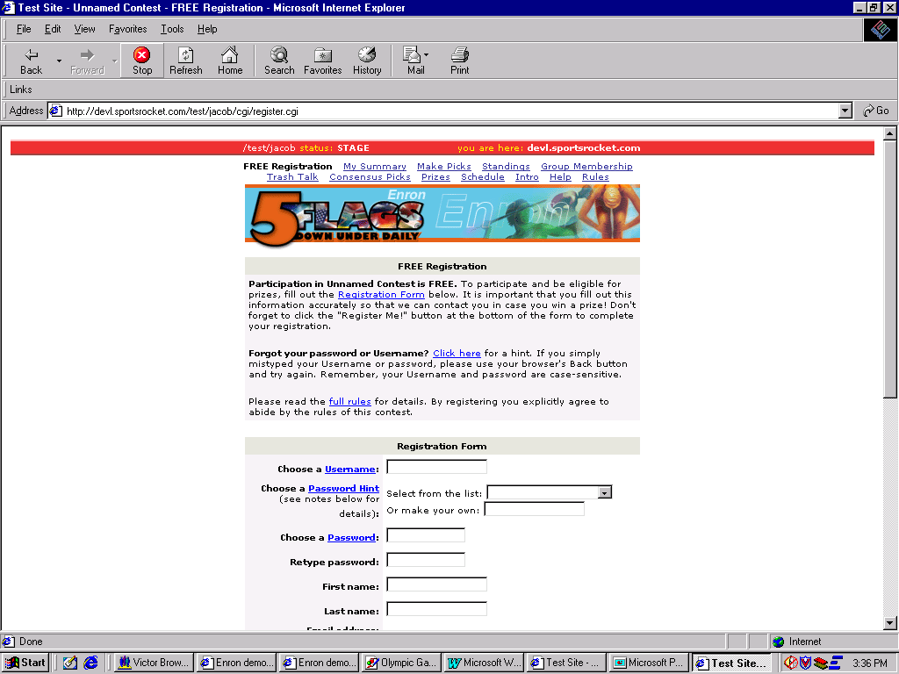
The EnronOnline Games
Change “Full Rules” to “Official Rules”.
Need to insert disclaimer re country of residence (should be similar to front page)
Also need to display this language on this page:
"In the course of your registration for the game, you are required to provide, or Enron may otherwise obtain, personal information about you. By registering for this game, you expressly consent to Enron using this information to assess the function and performance of the game and to administer the game and the prizing. Any information which you provide or which Enron otherwise obtains will be used solely by Enron and will not be sold or made available to third parties, with the exception of the third parties providing data processing, hosting or similar services to Enron, including, but not limited to, Internet Sports Network, Inc."
Note: password should not be the same as your EnronOnline pasword.

Slide 5
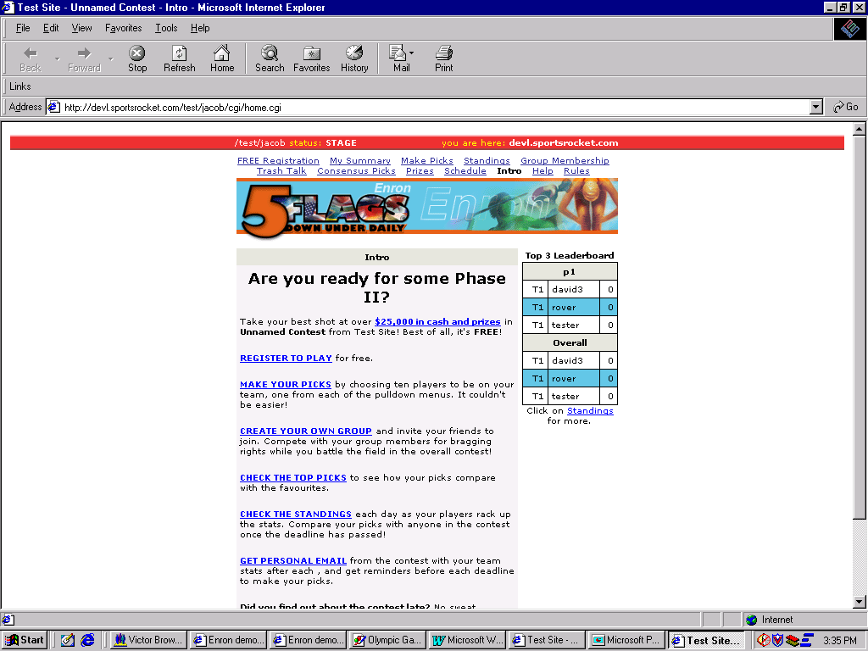
The EnronOnline Games

