Slide 1
Coal-based Electricity Energy Security for Texas and the Nation
Texas Conservative Forum
Sept. 27, 2001

Slide 2
Year 2000 Energy Consumption by Source
86% of Total U.S. Energy Needs Are Supplied by Fossil Fuels
Source: DOE/EIA
* Includes Hydropower

Slide 3
Source: EIA 2000 AER

Slide 6
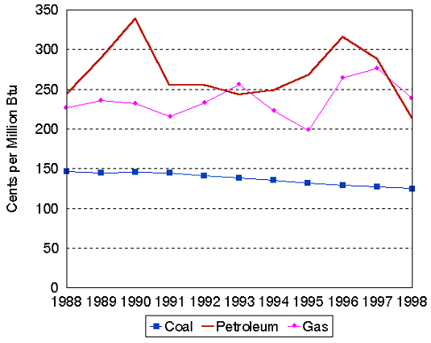
Fuel Prices (1988-1998)
Source: DOE/EIA

Slide 7
Coal Use by State
TX-37%
CA-1.2%
New England-18.3%
Source: EIA Electric Power Annual 2000

Slide 8
Texas Generation Mix
Coal-based electricity accounted for 37%
Largest user of coal-based electricity in the nation
Texas burned 99.75 million tons of coal in 2000
Fifth largest coal producing state
Source: EIA Electric Power Annual 2000

Slide 9
Coal Offers Powerplants Low Delivered Fuel Cost
Coal is significantly lower than natural gas ($1.23 vs. $4.16 per MMBtu)
Low fuel prices and low production cost allow coal units to remain economical
Source: EIA Electric Power Annual 2000

Slide 10
Household Energy Expenditures
as a Share of Income
30%
29%
25%
20%
Percent
15%
13%
10%
5%
4%
0%
Over
$10,000-
Under
$50,000
$25,000
$10,000
Income
Source: DOE Survey of Household Energy Expenditures

Slide 11
Environmental Goals Being Met Even With Increased Coal Utilization
Coal
Electric Generation
NOx
SO2
PM (soot)
Source: EPA Environmental Trends 2000

Slide 12
Increasingly Clean Power
From Coal-based Plants
Source: EPA and EIA

Slide 13
Emission Comparison of Lignite/Coal-fueled Power Plants 1999
U.S. Avg. Texas Avg. Diff.
Sulfur Dioxide 1.17 .86 -26%
Nitrogen Oxide .49 .32 -35%
(Calculated in #/mmbtu)

Slide 14
Texas Coal Units are already third cleanest in US
According EPA, Texas had the 3rd lowest average coal-fired NOx rate in US (0.34#NOx/MMBtu). Only CT and AR had lower average NOx rates.
Texas NOx rate was 36% below national average rate of 0.53#NOx per MMBtu
1998 Texas rates will decline further due to additional reductions required by SB7
Source: US Environmental Protection Agency
1998 Emissions Monitoring Data Reports

Slide 15
Sulfur Emissions (SO2) Texas Coal-based Powerplants
Texas is in total attainment with SO2 air quality standards
Texas coal-based powerplant emission rate was 0.78#/MMBtu, 31% less than the national average (1.04#/MMBtu)
Additional 40-45,000 tons of SO2 reductions will occur from implementation of SB7
Source: EPA CEMS Data
EPA AIRData NET Tier Report

Slide 16
NOx Emission Texas Coal-based Powerplants
Account for only 10% of total Texas NOx emissions
Texas 2000 coal emission rate was 0.30#/MMBtu, 33% less than the national average
2nd lowest rate in nation (behind only Connecticut)
Additional reductions SB7 (50%) and ozone SIP (80->90% in Houston)
Source: EPA CEMS Data
EPA AIRData NET Tier Report

Slide 17
Existing Texas Regulations will Require
Additional Emission Reductions
SB7- June 1999
25% SO2 reduction from 1997 levels at 4 pre-NSPS coal-fired units by 2003
50% Seasonal NOx reduction from “grandfathered” coal and gas powerplants by 2003 (2 Coal stations, 73 Gas-fired stations)
Ozone Attainment Plans
Powerplants in Houston-Galveston area must reduce NOx emissions by roughly 85%

Slide 18
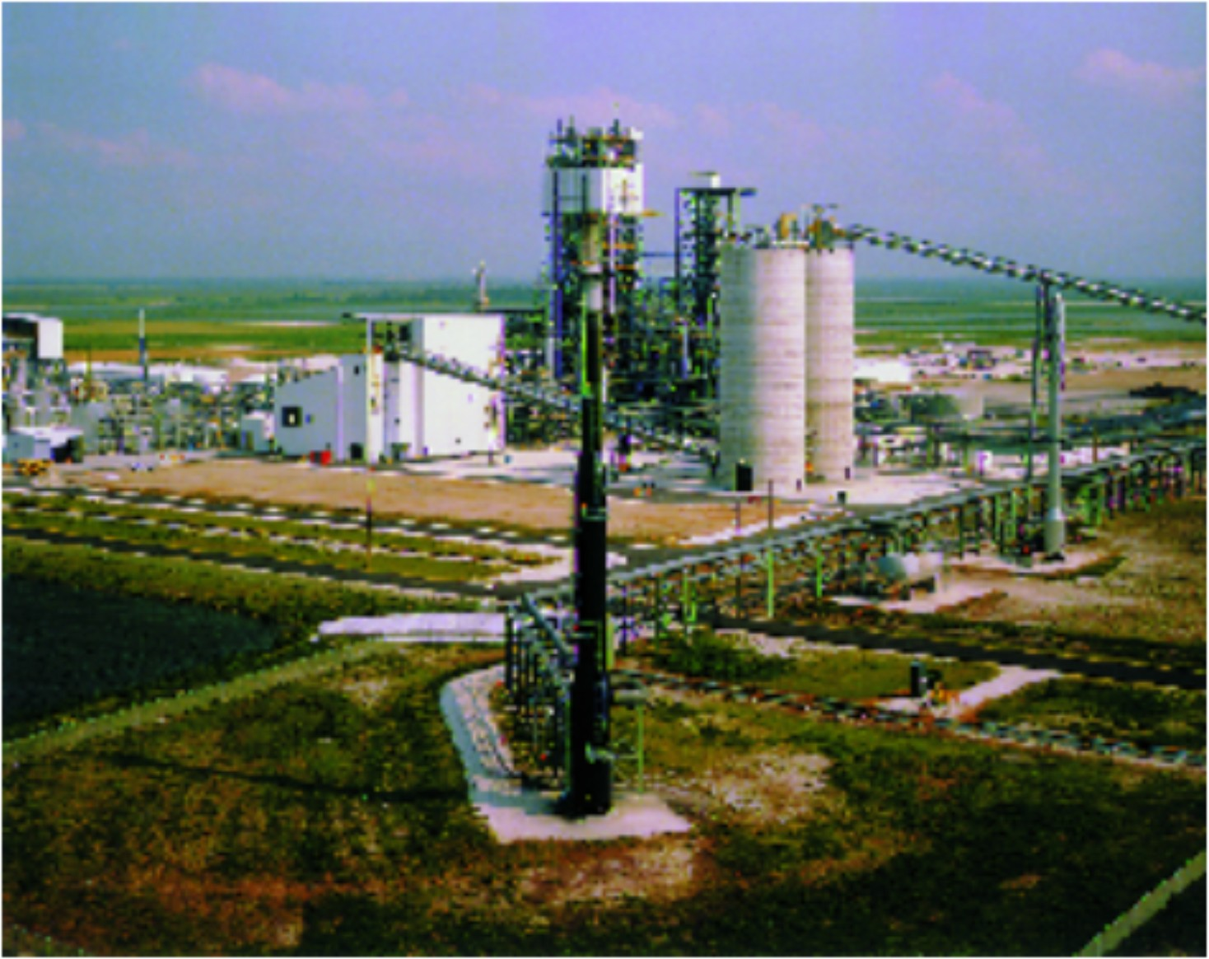
Vision 21
U.S. DOE Clean Coal Technology
Coal Gasification = NGCC
Increase efficiency by 35%
Economical by 2015

Slide 19
Performance Targets foe Coal-based Generation
Performance
Target
Today
2010
2020
Capital Cost, $/kW
900 - 1300
900 - 1100
1000-1500*
45 - 60
Efficiency, %HHV
40
45
SO₂, Removal %
95
97
99
NO
lbs/mmbtu
0.1 - 0.3
0.08
X
0.05
HAPs
(hazardous air pollutants)
define goals
meet goals
meet goals
Waste Utilization, %
100
50 - 75
15 - 30
Overall Emissions
Significant
Deminimis
Reductions from
Emissions
Today’s Technology

Slide 20

Power for the Future
Zero Emissions Coal-based Power Plant
Source: Zero Emissions Consortium

