Slide 1
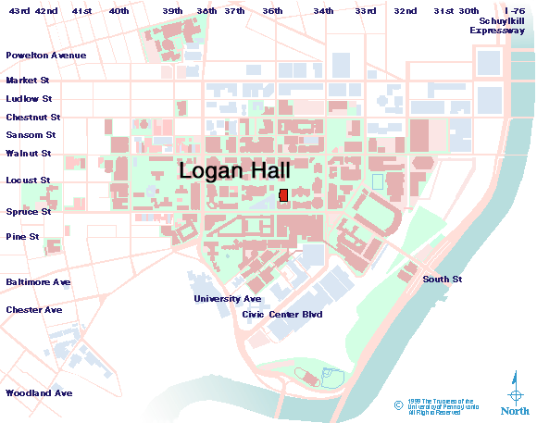
Wharton Risk Management and Decision Processes Center
Advisory Committee Meeting
December 7, 2001, 8:30 am – 4:30 pm
Terrace Room, Logan Hall
249 South 36th Street . Philadelphia . PA . 19104
Contact: Tara Marie Newman, Phoen: 215-898-5688, Fax: 215-573-2130 Email: tmnewman@wharton.upenn.edu

