Slide 1
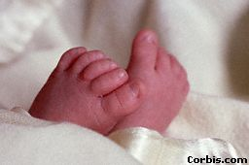
An Angel will be joining Tammy & Mike
and her name will be
RILEY DANAE
Please join us for a baby shower
and Banana Splits
Thursday, May 24th
from 3:00 – 4:00 p.m.
The Energizer
Baby Riley is registered at
Babies-R-Us

