Slide 1
2000-2001 Texas Legislative/Regulatory Strategy

Slide 2
Texas Water Supply
Texas split between water rich east, and water scarce west
Most large cities (e.g. Houston, DFW, Austin) and industrial users are in the eastern half of the state and do not face imminent scarcity
Municipal water supplies facing impending shortfall
El Paso
San Antonio
Lower Rio Grande Valley (a number of smaller opportunities)
Water transfers are less highly regulated in TX than in many Western states
Senate Bill 1 has focused attention of both state and local governments on TX water resource challenges

Slide 3
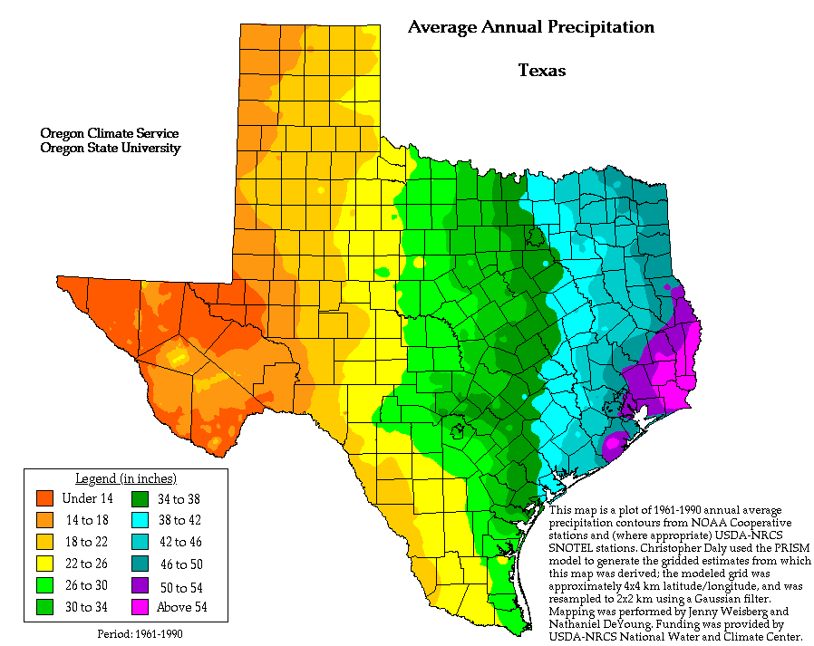
Texas Precipitation
El Paso
Del Rio
San Antonio and Edwards Aquifer
Laredo
Lower Rio Grande
River Valley
McAllen

Slide 4
Texas Population Growth

Slide 5
Texas Supply/Demand Projections
* Includes both surface and groundwater
Source: Texas Water Development Board (TWDB), 1997

Slide 6
Water Use in Texas by Sector
1995
2050
Source: TWDB, 1997

Slide 7
Other Texas Supply Considerations
No significant man-made conveyance systems (e.g., California aqueducts) linking wet and dry regions
Interbasin transfers are subject to substantially punitive regulations
Lack of conveyance and restrictions on interbasin transfers result in:
very regional markets
difficulty in realizing short-term gains from water sales/leasing

Slide 8
Projected Texas Urban and Agricultural Water Use

Slide 9
Texas Water Utilities
Overwhelming majority of Texas water and wastewater treatment systems are publicly owned and operated
Population growth, aging infrastructure and more stringent environmental requirements will increase agency and utility district costs, absent alternate sources of funding

Slide 10
Estimated Water Infrastructure Needs by 2020 (millions in 1999 dollars)

Slide 11
Legislative/Regulatory Issues: Water Rights
Water is a private property right in Texas
Water rights can be bought, sold and, in some cases, leased
Surface and ground water rights are treated differently

Slide 12
Legislative/Regulatory Issues: Surface Water Rights
Surface rights obtained by filing a claim with the state based on a “first in time, first in line” appropriative allocation system
The earlier you file, the more “senior” your rights and more likely you are to get your water each year
Many surface water sources are fully appropriated/subscribed, especially in water poor areas

Slide 13
Legislative/Regulatory Issues: Groundwater Rule of Capture
Groundwater is governed by the "rule of capture". This means a property owner is entitled to as much water as he/she is able to extract from below his/her property.
Rule of capture is widely understood to be impractical, but has been upheld in recent court cases
Some support for abolishing "rule of capture" has been building, and it is no longer the framework governing groundwater extraction from the Edwards Aquifer.

Slide 14
Legislative/Regulatory Issues: Transfers/Sales of Water Rights
Transfers are allowed, but a permit must be obtained from the Texas Natural Resources Conservation Commission (TNRCC) for two reasons
change of use status (e.g., Irrigation => Municipal), approval is generally a quick and simple process
change in the point of diversion (e.g., downstream => upstream) can be more difficult due to third party concerns and instream flow requirements

Slide 15
Legislative/Regulatory Issues: Interbasin Transfers
Interbasin transfers (movement of water among watersheds) are rendered less effective by the "junior" rights provision
In basin of origin water, very senior rights assure that water will be available in most/all years
Once transferred to another basin, rights become junior and assume a filing date equal to the date of sale.
Junior rights fall to the end of the line in the basin of origin, and if basin is fully appropriated, will only be useful during very wet years.

Slide 16
Legislative/Regulatory Issues: Permit Streamlining
No central repository of information about local and quality of Texas water resources, capacity and quality of conveyance and storage facilities, regional plans and projects, or permit requirements and status
Exodus of experienced permit staff makes permitting process longer and adds to cost

Slide 17
Legislative/Regulatory Issues: Water Infrastructure Funding Needs
Insufficient funding exists to meet future needs
Legislation to create a Water Facilities Fund (HB 1802 - Lewis) was soundly defeated in 1997
State and local agencies may need to seek private partners for future projects

Slide 18
Legislative/Regulatory Issues: Water Marketing Challenges
Unseen obstacles - if deals are there, why haven't they been done?
Interbasin transfer restrictions
Groundwater district opposition
Local community resistance
Local knowledge needed to identify opportunities
Value of water rights is highly weather dependent
Intrabasin value of rights appreciates slowly (less than 10% annually) under most conditions

Slide 19
Legislative/Regulatory Goals
Secure greater private sector participation in development/operation of water supply and water/wastewater treatment facilities
Eliminate junior rights provision on interbasin transfers
Make water conservation districts’ jurisdiction based on hydrological, rather than political, boundaries
Take advantage of "Sunset" evaluations of critical agencies (e.g., TNRCC, TWDB) to influence water-related rules

Slide 20
Legislative/Regulatory Goals
Encourage conjunctive use of surface and groundwater
Allow conserved water to be transferred or sold
Establish market-based online water permitting and trading system in Texas

Slide 21
Dry-year Options
Challenges
Potentially capital intensive
Droughts are highly unpredictable
Interest in these products closely tied to recent weather-related events
Lack of sophistication in the water market
Opportunities
Could be a means to preserve viability of agriculture in Texas
Program lends itself to private development and operation
May postpone need for long-term interbasin transfers
Internet allows for transparent, easily accessible information
Azurix has only viable website to date capable of implementing such a program

Slide 22
Key Legislative Relationships
Texas Senate
Senator Rodney Ellis, President pro Tem
Senate Natural Resources Committee
Senator Buster Brown, Chr
Senator Robby Cook
Senator Ken Armbrister, V-Chr
Senator Jon Lindsay
Lt. Governor Rick Perry
Barry McBee, Chief of Staff

Slide 23
Key Legislative Relationships
Texas House
Representative Pete Laney, Speaker
Representative Rob Junell
House Natural Resources Committee
Representative David Counts, Chr
Representative Ron Lewis, V-Chr
Hillco Partners

Slide 24
Key Regulatory Relationships
TNRCC
Robert Huston, Chr
Ralph Marquez
John Baker
Jeff Saitas, Executive Director
Ron Pedde - Dir, Water Permits & Resource Management

Slide 25
Key Regulatory Relationships
Edwards Aquifer Authority (EAA)
San Antonio Water System (SAWS)
Texas Department of Agriculture
Texas Municipal League
Texas Irrigation Council
Hillco Partners

