Slide 1
Transwestern Pipeline Company
Customer Service Update
Shelley Corman
November 8, 2001

Slide 2
Gas Logistics
Shelley Corman
COMMERCIAL SUPPORT
CAPACITY MANAGEMENT
Brad Holmes
Director
Business Applications
Rick Dietz
Director
Contract Support
Services and Controls
Steve January
Sr. Director
Gas Control
Lynn Blair
Director
Customer Service Teams
HotTap Help Desk:
1-800-421-6221
EDI:
Mary Draemer
Contracts:
Denis Lee
Elizabeth Brown
Accounting:
Richard Hanagriff
Gas Control Advisor:
Darrell Schoolcraft
Outage Coordination:
Jerry Graves
TW Team:
Laura Giambrone
Bert Hernandez
Christine McEvoy
Beverly Miller
Chris Miller
Tracy Minter
Amy Mulligan
Linda Ward
TW Team Advisor:
Terry Kowalke
Notes:
Today, I’d like to spend a few minutes to make sure you get to know our FGT Gas Logistics team and feel comfortable that there is a live human being at the other end of that electronic transaction.
Our Gas Logistics team provides transactions and gas control support for all the pipelines that Enron operates.
This slide shows the key players involved in serving FGT on a day to day basis. I have brought along with me a laminated version of this chart which shows not only these individuals names, but also phone and pager information.
We see our role in Gas Logistics as being responsible to see that contractual commitments are translated in actual gas flows. It takes several disciplines to make that happen:
Brad Holmes and his group make sure that we have the processes and systems to handle the daily transactions. This group provides postings and support for the HotTap website. They also staff the 24 hour HotTap helpdesk and provide support for customers that send in transactions via EDI.
Rick Dietz and his teams handle commercial support. They make sure contracts and capacity release transactions are processed timely, that accurate invoices and imbalance statements are sent to you and they research concerns that you have about flow volume data.
Mike Bryant and his team are responsible for gas control, line pack management and optimization. Many of you talk with Mike and Dannis on a daily basis to get a system status and coordinate with your operating plans.
Sheila Nacey leads the customer service team. This team works with customers to set up their scheduled quantities for the upcoming day and works with customers to eliminate imbalances during the month.

Slide 3
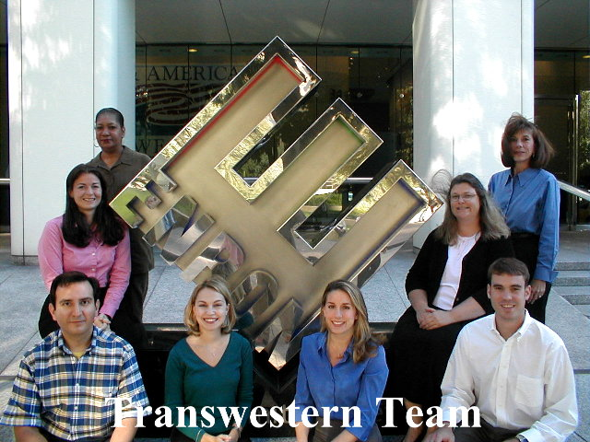

Slide 4
What is Good Customer Service?
Access to timely and accurate information
Use of technology to deliver information in a convenient format
Representatives that understand the customers’ needs and are able to answer a range of questions (or committed to tracking down a response ASAP)
Notes:
Daily gas transportation is not a flashy business. Its very detailed and the process continues over and over again 24 hours a day, 7 days a week.
Based on the feedback that you have given us in surveys and at customer meeting, it seems to boil down to three categories: Information, technology and people.
I’ve already talked a little about our organization and the human element of customer service. Let me talk a little about how we are doing in the areas of technology and information.
But, first some more humor to wake you up.

Slide 5
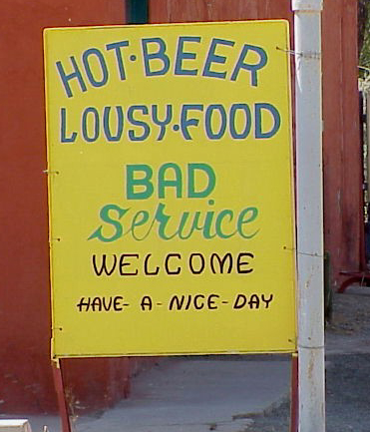

Slide 6
Customer Service Milestones
Email notification system (critical notices, bump notices, scheduled cuts)
Invoice and imbalance statements added to website
Expanded HotTap Helpdesk to provide central contact for logon and application concerns
New scheduling systems screens
  Pooling contracts
  Scheduled quantities by cycle
  Path detective to track scheduling cuts
Hands on customer training workshops
Notes:
Seriously though – We are committed to moving forward with better ways of doing things. We have been talking to you and your staff about this since 1999. We were unhappy with our performance in customer satisfaction surveys and were determined to improve in your eyes.
Since then, we have held annual operations meetings with you an your staff to talk in detail about what we are doing well and where we can improve.
As a result of your feedback, we have made a number of significant changes
Last year we implemented a new scheduling system. Your feedback this year indicates that it is easy to use and delivers dependable scheduled quantity reports.
We began to use automatic email notices to warn you of key business changes. This gives you the flexibility to leave your desk even though the business has become 24/7.
No one wants FGT to call Alert Days. But you realize that because the FGT system operates at a high load factor without the benefit of storage, that the system operates on reduced flexibility for days and periods of the year. You told us that you could better deal with 10 or 15% alert days when we see conditions tighten. In the last year we have not had to call an Alert Day with less than a 10% tolerance and in fact most Alert Days have still permitted 15% flexibility.
We worked with you to convert the real-time operational flow data from an old application to a new web-based system. This means that you can check on your flow status from home or anywhere that you can dial-in to HotTap.
We implemented the measurement desk as a single point of contact for customers and FGT field staff to log gas measurement concerns. At the customer meeting last year we talked to you about our vision of how the measurement desk can help make prior period adjustments a thing of the past.
And, we began to publish invoice and imbalance statements in electronic form.

Slide 7
Continuing Customer Service Initiatives
Contract/Capacity Release system
Customer control of security access
Making critical notices more pager/palm device friendly
HotTap webpage navigation
Outage coordination
Notes:
But you provided us lots more feedback at the May operations meeting. Some of which we haven’t yet completed.
You told us that because of staff changes and for internal control reasons, you would like the ability to administer your own password access (I.e. decide who on your staff if authorized to submit capacity release, who can submit nominations, etc).
You told us that you like the automatic email notification, but that you would like more description in the header text that can be picked up by your pager or palm device
We recently conducted an on-line survey on HotTap and received suggestions about how to line the most commonly needed information to the start page.
You told us that you would like to see a listing of allocated points on the website.
In addition to the feedback you provided, we also have initiated our own efforts to improve the outage coordination process. I’d like to talk about that for a minute.

Slide 8
Tropical Storms & Computer Viruses
Past emergency plans were designed around physical operations and weather situations and provide for a transition of operations to Omaha
Recent events have presented a different type of challenge, driven more by communications and network outages
Physical operations were not adversely affected.
Notes:
We appreciate the way that you have worked with us during the Tropical storm in June and more recently, during periods of Internet unavailability
We all developed hurricane disaster recovery plans and Y2K plans, but things have changed much even in the time since these past plans.
Hurricane plans typically provided 24-48 hrs advance notice to cut over to back-up systems
Communication outages or virus offer no advance warning
With intraday nomination there is never an easy period of time to cut over to a back-up server
Customers depend on email notifications more than ever before
Gas control and scheduling functions are tied to Internet availability.

Slide 9
Implications for Emergency Planning
Broaden scope of current reaction plans to cover systems, communications and building situations
Revise Houston/Omaha back-up site strategy to provide for a series of interim back-up solutions, including working from home and alternate Houston locations
Reflect the multiple locations of staff during an emergency
Employ multiple communication channels with employees and customers
Notes:
This slide can be summed up with one cliché – Don’t put all your eggs in one basket.
We have learned to operate with people in multiple locations – the office, home, and offsite locations
We have updated our contact lists and learned to carry these lists
We set up phone conference bridges during periods of abnormal operations and have staff call-in. We can always cancel later if they prove unnecessary.
And, we have learned to employ multiple channels to communicate with you our customer.

Slide 10
Customer Communications
Phone coverage from 7 AM until 10 PM weekdays
Continuous pager coverage – nights, weekends & during abnormal operations (e.g., tropical storm)
HotTap Help Desk availability 24/7
Automatic email notification of scheduling cuts and critical notices
Manual back-up email approach if Enron Internet unavailable
Back-up HotTap servers in Houston and Omaha to handle scheduling system outages
Pipeline status phone line
In case of operational emergency, call Gas Control
Notes:
We want you to feel comfortable that you can get in touch with us no matter what the contingency -- whether it’s a last minute transportation transaction or an external event.
The customer service staff mans the phones in person until 10 PM each day are available by pager at all other times.
Sometimes your representative is on the phone and you need an immediate answer – perhaps its 11:29 AM and you need to get a nomination in. You can call the HotTap helpdesk. They also man the phones during the day and carry a pager at other times.
We have automated email notice capability and this year we’ve learned to use a back-up Internet provider if the Enron website is down.
When our scheduling server is down, we can route you to another address. Sometimes you may not even notice that this is happening.
And, if you have an operational emergency you can always, always call gas control.

Slide 11
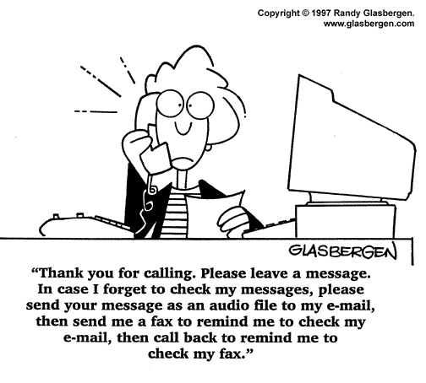
Notes:
Hopefully this isn’t the experience that you have when you call on our FGT team.
Admittedly, however, that while technology helps us get things done – sometimes it also removes the personal aspect of service.

Slide 12
Let Us Know What We Are Doing Well
Let Us Know What We Can Do Better
We Appreciate Your Business!
Notes:
We are so happy that you take the time to come to FGT meetings and provide us feedback.
We hope that we have demonstrated to you that we indeed act on your feedback
So keep it coming and we’ll do our part.

