Slide 1
Transwestern Deal Analysis
January 25, 2002

Slide 2
Background:
Analysis started with contracts in place as of November, 1996. All capacity release contracts were eliminated. A total of 427 contracts were evaluated over a 61 month period.
After the initial analysis was presented, it was determined that several issues should be resolved. The first was to evaluate all contracts on a price per MMbtu basis.
Revenue data was captured from the invoicing system by contract by month. The Fixed Rate was determined by dividing Total Revenue by Primary Contract Volume. The Net I to I Rate was collected for each contract comparing net actual index between primary delivery and receipt points for each month, less calculated fuel.
2

Slide 3
The second refinement had to with subdividing the data by the direction of transportation utilized. Each contract was assigned a direction category based on its primary receipt / delivery point combination. The data breaks out as follows:
East to East
Ignacio to Blanco
San Juan Lateral
San Juan East
West Capacity
530
460
1
342
1,023
occurrences
occurrences
occurrences
occurrences
occurrences
22.5%
19.5%
0.0%
14.5%
43.5%
Since there is only one lateral agreement for one month, no analysis will be done on this category. There were 4 I to I
West Capacity deals actually done that had to be eliminated from the data.
3

Slide 4
Analysis of East to East by Contract
The FREQ Procedure
Pricing
Frequency
Percent
Cumulative Frequency
Cumulative Percent
Fixed
105
88.24
105
88.24
I to I
14
11.76
119
100.00
Of the 119 East to East contracts, 105 or 88% had the average Fixed Rate higher than the Net I to I Rate would have generated.
The MEANS Procedure
Pricing
N
Mean
Std Dev
Minimum
Maximum
Fixed I to I
119 119
$0.0745 -$0.0113
$0.0383 $0.0841
$0.0026 -$0.1907
$0.1794 $0.5338
The average Fixed Rate was $.0745 compared to -$.0113 for average Net I to I. While the average Net I to I was negative, it also blew out to a maximum of $.5338.
4

Slide 5
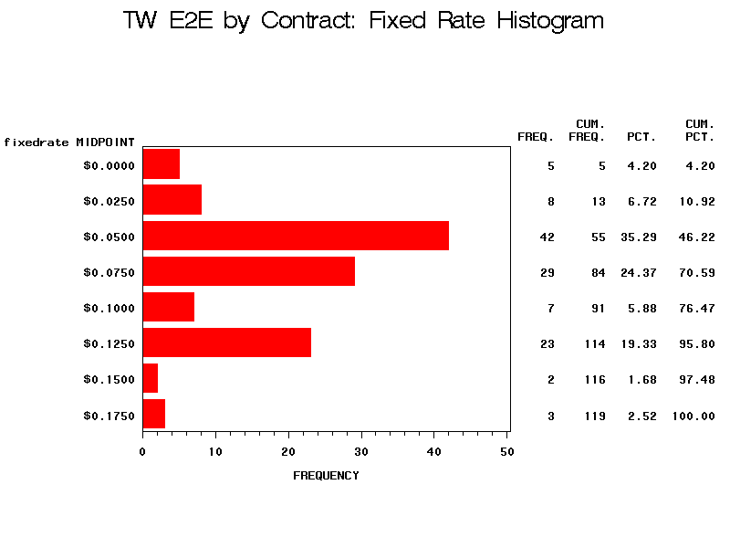
5

Slide 6
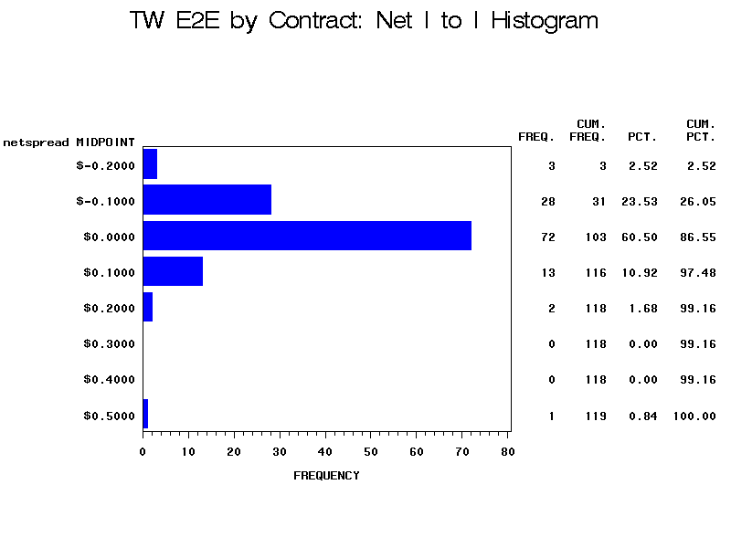
6

Slide 7
Analysis of Ignacio to Blanco by Contract
The FREQ Procedure
Pricing
Frequency
Percent
Cumulative Frequency
Cumulative Percent
Fixed
30
53.57
30
53.57
I to I
26
46.43
56
100.00
Of the 56 Ignacio to Blanco contracts, 30 or 54% had the average Fixed Rate higher than the Net I to I Rate would have generated.
The MEANS Procedure
Pricing
N
Mean
Std Dev
Minimum
Maximum
Fixed I to I
56 56
$0.0631 $0.1130
$0.0333 $0.1925
$0.0100 -$0.0159
$0.1499 $0.7963
The average Fixed Rate was $.0631 compared to $.1130 for average Net I to I. While the minimum Net I to I was negative, it also blew out to a maximum of $.7963.
7

Slide 8
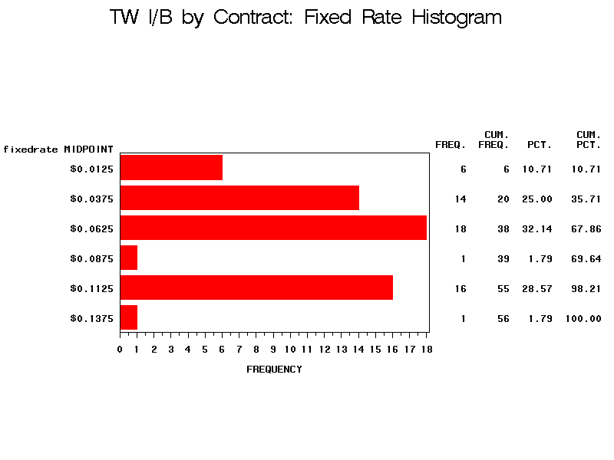
8

Slide 9
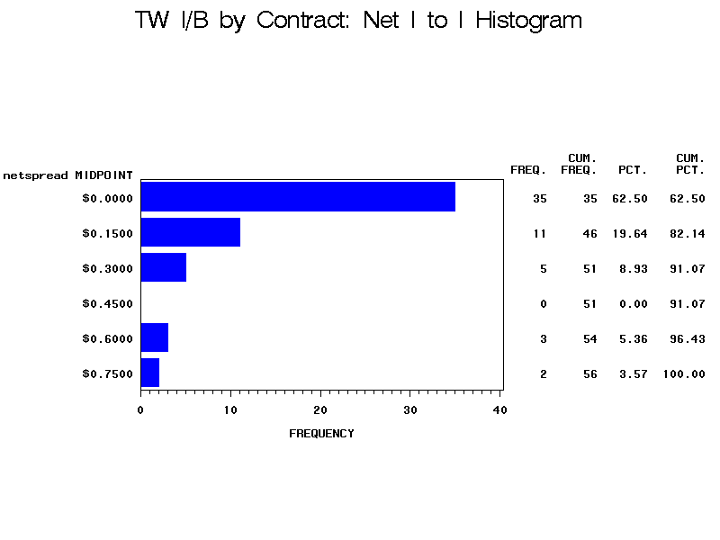
9

Slide 10
Analysis of San Juan East by Contract
The FREQ Procedure
Pricing
Frequency
Percent
Cumulative Frequency
Cumulative Percent
Fixed
25
54.35
25
54.35
I to I
21
45.65
46
100.00
Of the 46 San Juan East contracts, 25 or 54% had the average Fixed Rate higher than the Net I to I Rate would have generated.
The MEANS Procedure
Pricing
N
Mean
Std Dev
Minimum
Maximum
Fixed I to I
46 46
$0.0821 $0.0826
$0.0667 $0.1466
$0.0033 -$0.2451
$0.2300 $0.4751
The average Fixed Rate was $.0821 compared to $.0826 for average Net I to I. While the averages are comparable, the Net I to I went significantly negative and spread out to a maximum of $.4751.
10

Slide 11
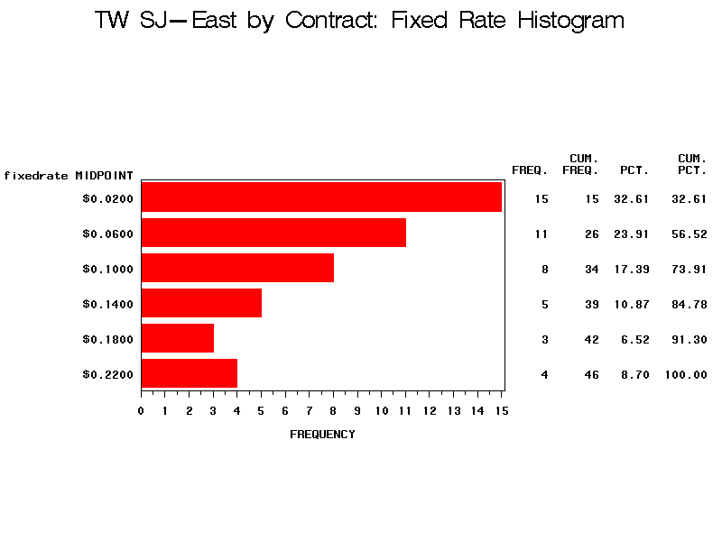
11

Slide 12
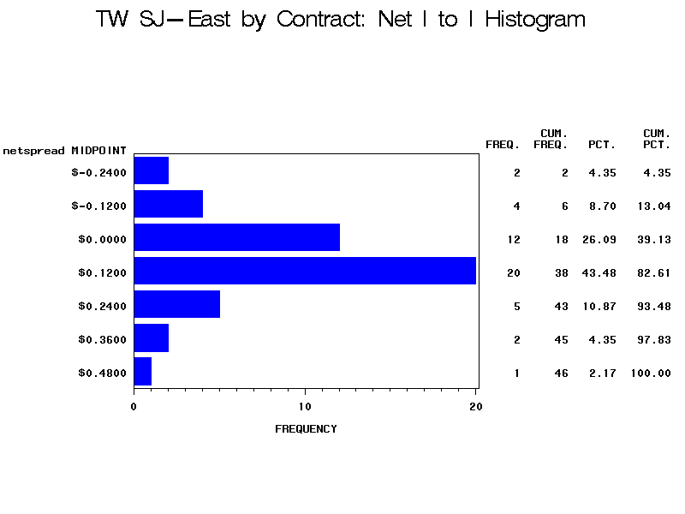
12

Slide 13
Analysis of West Capacity by Contract
The FREQ Procedure
Pricing
Frequency
Percent
Cumulative Frequency
Cumulative Percent
Fixed
57
32.39
57
32.39
I to I
119
67.61
176
100.00
Of the 176 West Capacity contracts, 57 or 32% had the average Fixed Rate higher than the Net I to I Rate would have generated.
The MEANS Procedure
Pricing
N
Mean
Std Dev
Minimum
Maximum
Fixed I to I
176 176
$0.0982 $0.4467
$0.0870 $0.9654
$0.0016 -$0.2571
$0.4289 $7.2235
4 I to I deals were removed from the data. The average Fixed Rate was $.0982 compared to $.4467 for average Net I to I. More important, the Net I to I standard deviation is very large, suggesting significant skewness of the data which is shown in the second histogram.
13

Slide 14
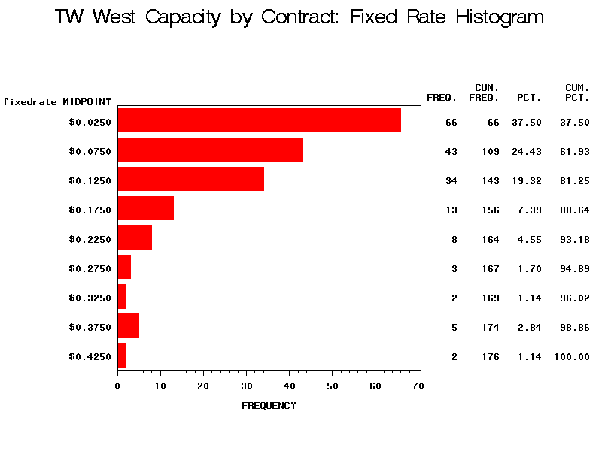
14

Slide 15
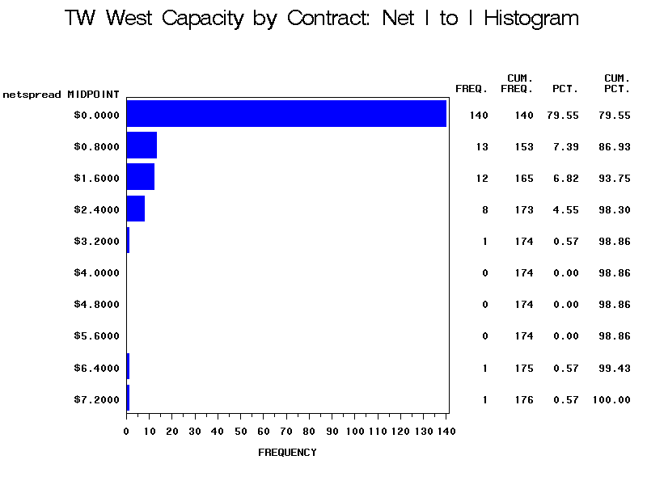
15

Slide 16
Analysis of East to East by Month
The FREQ Procedure
Pricing
Frequency
Percent
Cumulative Frequency
Cumulative Percent
Fixed
61
100.00
61
100.00
I to I
0
0.00
61
100.00
Of the 61 months, 100% had Fixed Rate Revenue higher than Net I to I Revenue would have generated.
The MEANS Procedure
Pricing
N
Mean
Std Dev
Minimum
Maximum
Fixed I to I
61 61
$0.0708 -$0.0334
$0.0205 $0.0543
$0.0375 -$0.2155
$0.1405 $0.0864
The average Fixed Rate was always better than the average Net I to I Rate. For East to East contracts, it is clear that these contract should probably not be negotiated on an I to I basis.
16

Slide 17
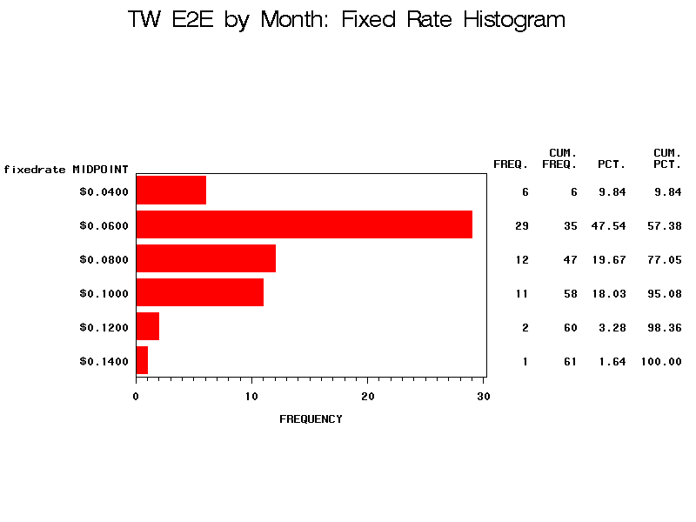
17

Slide 18
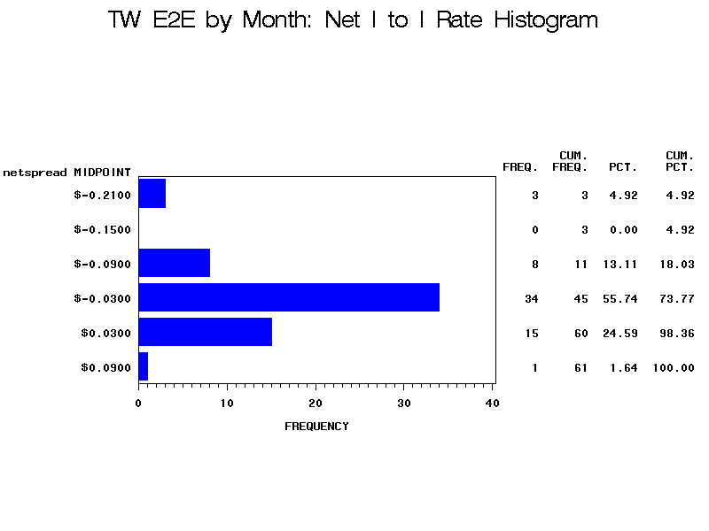
18

Slide 19
Analysis of Ignacio to Blanco by Month
The FREQ Procedure
Pricing
Frequency
Percent
Cumulative Frequency
Cumulative Percent
Fixed
30
49.18
30
49.18
I to I
31
50.82
61
100.00
Of the 61 months, 30 or 49% had Fixed Rate Revenue higher than Net I to I Revenue would have generated.
The MEANS Procedure
Pricing
N
Mean
Std Dev
Minimum
Maximum
Fixed I to I
61 61
$0.0476 $0.0649
$0.0139 $0.1212
$0.0260 -$0.1914
$0.0932 $0.4763
The averages for Fixed Rate and Net I to I Rate were similar. The Net I to I Rate was much more volatile as is noticeable in the standard deviation, minimum and maximum.
19

Slide 20
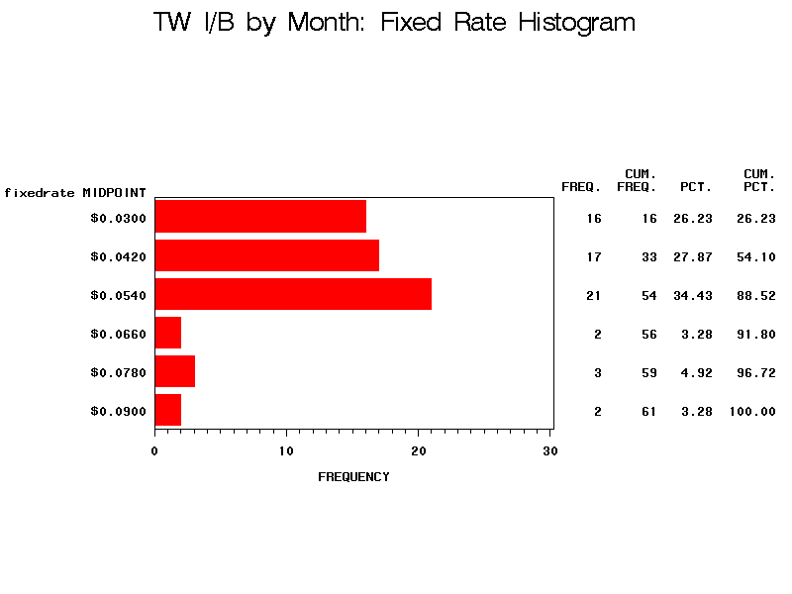
20

Slide 21
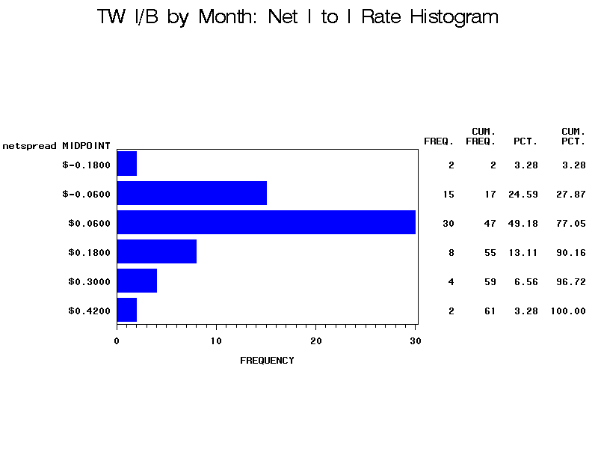
21

Slide 22
Analysis of San Juan East by Month
The FREQ Procedure
Pricing
Frequency
Percent
Cumulative Frequency
Cumulative Percent
Fixed
35
57.38
35
57.38
I to I
26
42.62
61
100.00
Of the 61 months, 35 or 57% had Fixed Rate Revenue higher than Net I to I Revenue would have generated.
The MEANS Procedure
Pricing
N
Mean
Std Dev
Minimum
Maximum
Fixed I to I
61 61
$0.1455 $0.1568
$0.0386 $0.2788
$0.0519 -$0.5230
$0.2200 $1.0222
The averages for Fixed Rate and Net I to I Rate were similar. The Net I to I Rate was much more volatile as is noticeable in the standard deviation, minimum and maximum.
22

Slide 23
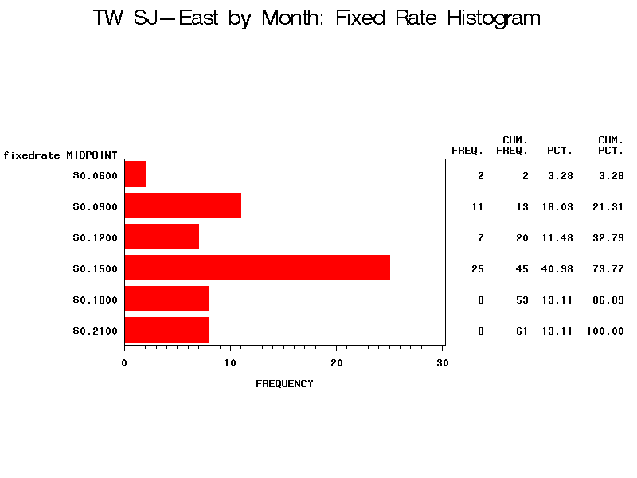
23

Slide 24
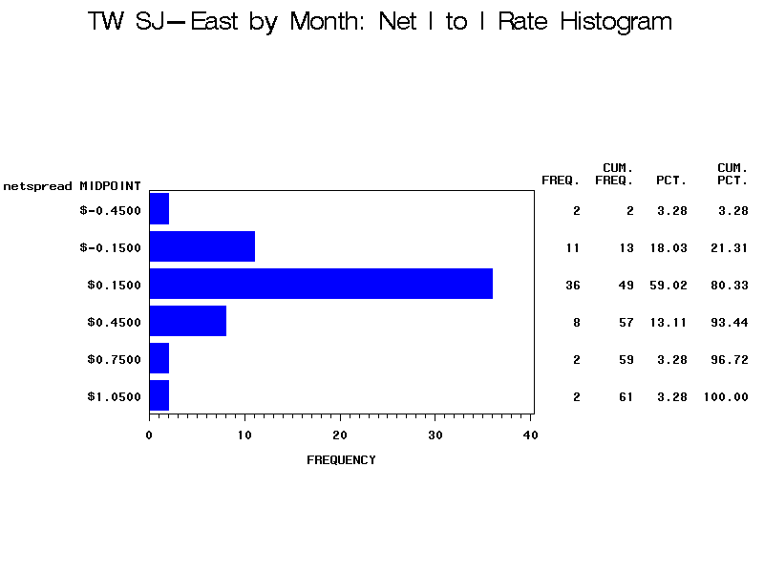
24

Slide 25
Analysis of West Capacity by Month
The FREQ Procedure
Pricing
Frequency
Percent
Cumulative Frequency
Cumulative Percent
Fixed
24
40.00
24
40.00
I to I
36
60.00
60
100.00
Of the 60 months, 24 or 40% had Fixed Rate Revenue higher than Net I to I Revenue would have generated.
The MEANS Procedure
Pricing
N
Mean
Std Dev
Minimum
Maximum
Fixed I to I
60 60
$0.1410 $1.0658
$0.0663 $2.5398
$0.0090 -$0.1002
$0.2396 $9.8881
4 I to I were removed from the data. The averages for Fixed Rate and Net I to I Rate were vastly different. The Net I to I Rate was much more volatile as is noticeable in the standard deviation, minimum and maximum.
25

Slide 26
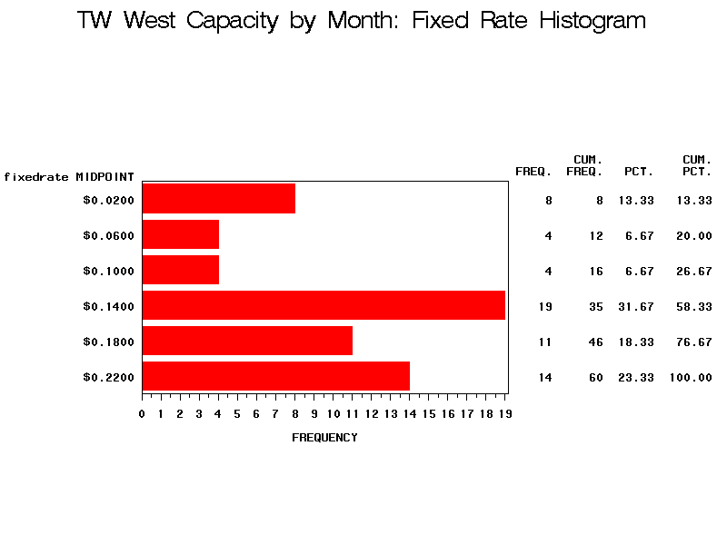
26

Slide 27
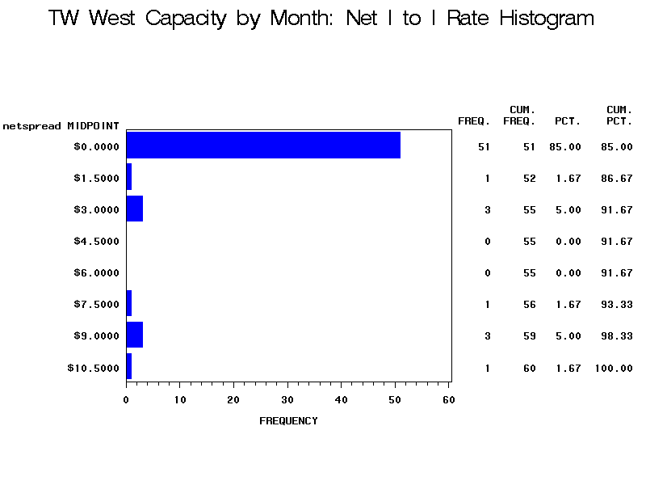
27

Slide 28
Preliminary Conclusions:
At first glance, it seems clear a risk averse party would choose a guaranteed revenue stream. This conclusion would be correct in the long term. The short term however is not mean reverting, primarily due to weather.
There was a paradigm shift however in California border pricing starting June, 2000 through June, 2001. If this pricing shift were anticipated, I to I deals would be recommended.
The Ignacio to Blanco and West Capacity Analysis was redone, excluding the June 2000 to June 2001 period.
28

Slide 29
Ignacio-Blanco by Month (Excl June 01-02)
The FREQ Procedure
Pricing
Frequency
Percent
Cumulative Frequency
Cumulative Percent
Fixed
22
45.83
22
45.83
I to I
26
54.17
48
100.00
Of the 48 months remaining, 22 or 46% had Fixed Rate Revenue higher than Net I to I Revenue would have generated.
The MEANS Procedure
Pricing
N
Mean
Std Dev
Minimum
Maximum
Fixed I to I
48 48
$0.0481 $0.0657
$0.0127 $0.1215
$0.0260 -$0.1276
$0.0911 $0.4763
The averages for Fixed Rate and Net I to I Rate were similar. The Net I to I Rate are still more volatile as is noticeable in the standard deviation, minimum and maximum.
29

Slide 30
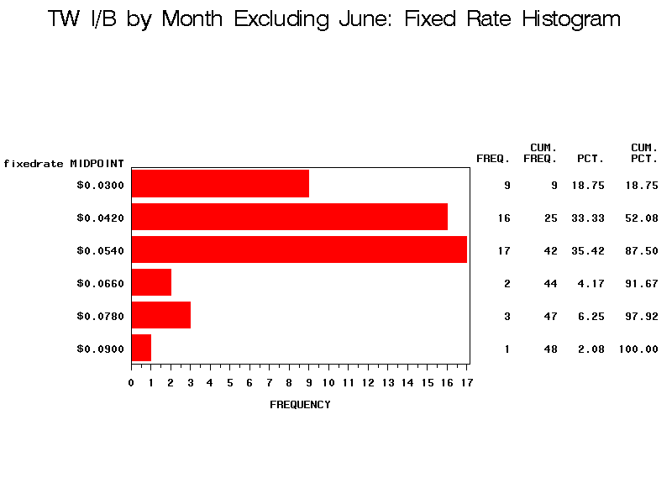
30

Slide 31
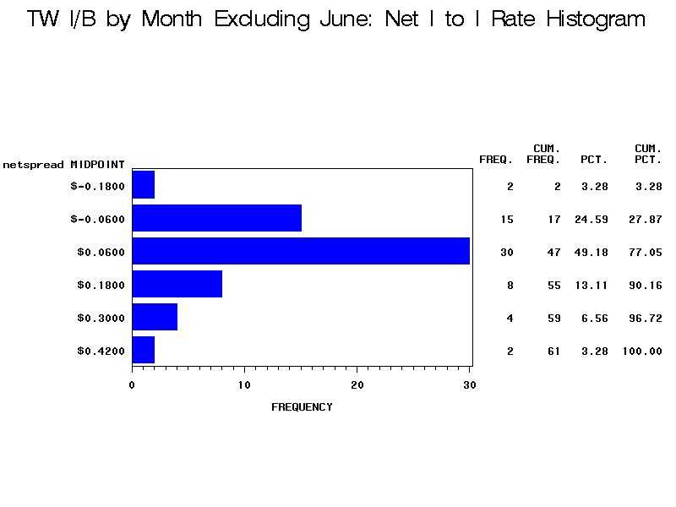
31

Slide 32
West Capacity by Month (Excl June 01-02)
The FREQ Procedure
Pricing
Frequency
Percent
Cumulative Frequency
Cumulative Percent
Fixed
23
48.94
23
48.94
I to I
24
51.06
47
100.00
Of the 47 months remaining, 23 or 49% had Fixed Rate Revenue higher than Net I to I Revenue would have generated.
The MEANS Procedure
Pricing
N
Mean
Std Dev
Minimum
Maximum
Fixed I to I
47 47
$0.1217 $0.1334
$0.0615 $0.1418
$0.0090 -$0.1002
$0.2396 $0.4872
The averages for Fixed Rate and Net I to I Rate were similar. The Net I to I Rate are still more volatile as is noticeable in the standard deviation, minimum and maximum.
32

Slide 33
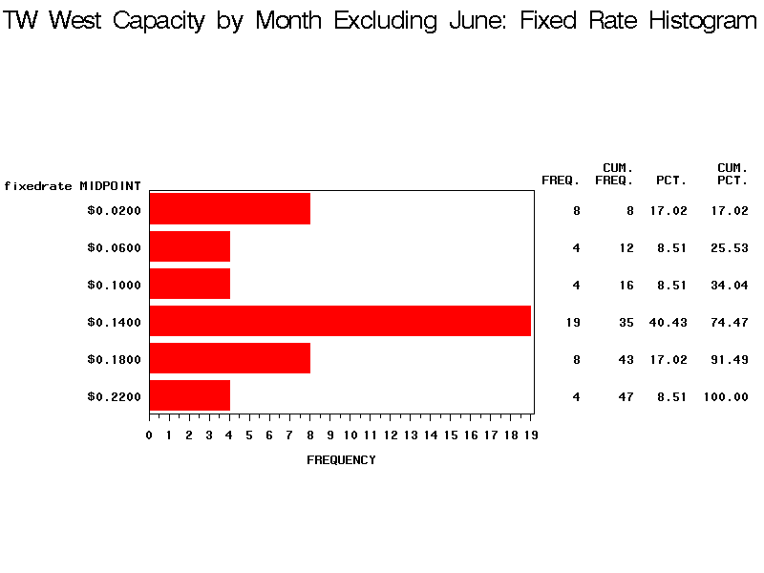
33

Slide 34
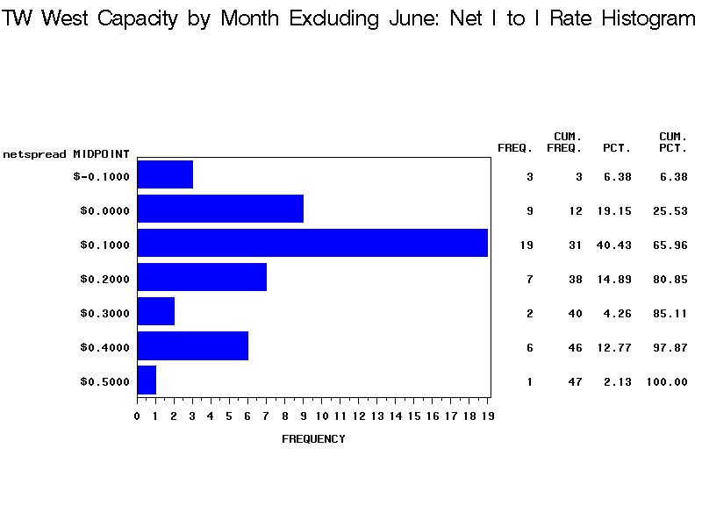
34

Slide 35
Seasonality:
The data seems to suggest that it may make sense to seasonally enter into I to I deals. A seasonal analysis of Ignacio to Blanco and West capacity were completed looking at averages by month.
35

Slide 36
Ignacio to Blanco Seasonal / Monthly Basis
The MEANS Procedure
Month=Summer
Pricing
N
Mean
Std Dev
Minimum
Maximum
Fixed I to I
36 36
$0.0480 $0.1156
$0.0138 $0.1253
$0.0327 -$0.0211
$0.0911 $0.4763
Month=Winter
Pricing
N
Mean
Std Dev
Minimum
Maximum
Fixed I to I
25 25
$0.0471 -$0.0080
$0.0144 $0.0663
$0.0260 -$0.1914
$0.0932 $0.1344
Month=April
Pricing
N
Mean
Std Dev
Minimum
Maximum
Fixed I to I
5 5
$0.0520 $0.0651
$0.0163 $0.0465
$0.0342 $0.0249
$0.0736 $0.1369
Month=May
Pricing
N
Mean
Std Dev
Minimum
Maximum
Fixed I to I
5 5
$0.0453 $0.0331
$0.0113 $0.0182
$0.0327 $0.0125
$0.0585 $0.0534
36

Slide 37
Ignacio to Blanco Seasonal / Monthly Basis
The MEANS Procedure
Month=June
Pricing
N
Mean
Std Dev
Minimum
Maximum
Fixed I to I
5 5
$0.0518 $0.1663
$0.0170 $0.1297
$0.0328 $0.0101
$0.0764 $0.3338
Month=July
Pricing
N
Mean
Std Dev
Minimum
Maximum
Fixed I to I
5 5
$0.0467 $0.1271
$0.0111 $0.0627
$0.0327 $0.0400
$0.0604 $0.2054
Month=August
Pricing
N
Mean
Std Dev
Minimum
Maximum
Fixed I to I
5 5
$0.0461 $0.1580
$0.0106 $0.1188
$0.0327 $0.0545
$0.0610 $0.3065
Month=September
Pricing
N
Mean
Std Dev
Minimum
Maximum
Fixed I to I
5 5
$0.0427 $0.1133
$0.0091 $0.2048
$0.0327 -$0.0211
$0.0552 $0.4763
Month=October
Pricing
N
Mean
Std Dev
Minimum
Maximum
Fixed I to I
6 6
$0.0507 $0.1411
$0.0212 $0.1785
$0.0348 -$0.0203
$0.0911 $0.4680
37

Slide 38
Ignacio to Blanco Seasonal / Monthly Basis
The MEANS Procedure
Month=November
Pricing
N
Mean
Std Dev
Minimum
Maximum
Fixed I to I
5 5
$0.0487 -$0.0076
$0.0166 $0.0734
$0.0315 -$0.1276
$0.0741 $0.0585
Month=December
Pricing
N
Mean
Std Dev
Minimum
Maximum
Fixed I to I
5 5
$0.0451 $0.0039
$0.0103 $0.0582
$0.0314 -$0.0400
$0.0547 $0.1051
Month=January
Pricing
N
Mean
Std Dev
Minimum
Maximum
Fixed I to I
5 5
$0.0454 -$0.0291
$0.0069 $0.0401
$0.0357 -$0.0903
$0.0532 $0.0036
Month=February
Pricing
N
Mean
Std Dev
Minimum
Maximum
Fixed I to I
5 5
$0.0446 -$0.0301
$0.0089 $0.0956
$0.0312 -$0.1914
$0.0534 $0.0647
Month=March
Pricing
N
Mean
Std Dev
Minimum
Maximum
Fixed I to I
5 5
$0.0516 $0.0230
$0.0261 $0.0656
$0.0260 -$0.0372
$0.0932 $0.1344
38

Slide 39
West Capacity Seasonal / Monthly Basis
The MEANS Procedure
Month=Summer
Pricing
N
Mean
Std Dev
Minimum
Maximum
Fixed I to I
35 35
$0.1527 $0.7083
$0.0626 $1.6755
$0.0196 -$0.0802
$0.2396 $8.9762
Month=Winter
Pricing
N
Mean
Std Dev
Minimum
Maximum
Fixed I to I
25 25
$0.1246 $1.5663
$0.0692 $3.3814
$0.0090 -$0.1002
$0.2236 $9.8881
Month=April
Pricing
N
Mean
Std Dev
Minimum
Maximum
Fixed I to I
5 5
$0.1401 $0.6992
$0.0613 $1.3555
$0.0650 $0.0484
$0.2349 $3.1232
Month=May
Pricing
N
Mean
Std Dev
Minimum
Maximum
Fixed I to I
5 5
$0.1355 $1.8424
$0.0794 $3.9885
$0.0196 -$0.0395
$0.2350 $8.9762
39

Slide 40
West Capacity Seasonal / Monthly Basis
The MEANS Procedure
Month=June
Pricing
N
Mean
Std Dev
Minimum
Maximum
Fixed I to I
5 5
$0.1424 $0.7840
$0.0696 $1.5687
$0.0425 -$0.0013
$0.2354 $3.5884
Month=July
Pricing
N
Mean
Std Dev
Minimum
Maximum
Fixed I to I
5 5
$0.1467 $0.2315
$0.0778 $0.2831
$0.0316 -$0.0802
$0.2356 $0.6334
Month=August
Pricing
N
Mean
Std Dev
Minimum
Maximum
Fixed I to I
5 5
$0.1480 $0.3438
$0.0772 $0.3235
$0.0322 $0.0495
$0.2294 $0.8423
Month=September
Pricing
N
Mean
Std Dev
Minimum
Maximum
Fixed I to I
5 5
$0.1792 $0.7664
$0.0440 $1.0733
$0.1318 $0.0682
$0.2396 $2.6659
Month=October
Pricing
N
Mean
Std Dev
Minimum
Maximum
Fixed I to I
5 5
$0.1772 $0.2909
$0.0449 $0.1777
$0.1143 $0.1328
$0.2294 $0.5601
40

Slide 41
West Capacity Seasonal / Monthly Basis
The MEANS Procedure
Month=November
Pricing
N
Mean
Std Dev
Minimum
Maximum
Fixed I to I
5 5
$0.1172 $0.2310
$0.0721 $0.2746
$0.0375 -$0.0307
$0.1945 $0.6326
Month=December
Pricing
N
Mean
Std Dev
Minimum
Maximum
Fixed I to I
5 5
$0.1271 $2.0802
$0.0671 $4.3671
$0.0356 -$0.1002
$0.2017 $9.8881
Month=January
Pricing
N
Mean
Std Dev
Minimum
Maximum
Fixed I to I
5 5
$0.1153 $1.8645
$0.0811 $3.9614
$0.0119 -$0.0458
$0.2117 $8.9482
Month=February
Pricing
N
Mean
Std Dev
Minimum
Maximum
Fixed I to I
5 5
$0.1301 $1.6950
$0.0798 $3.6263
$0.0090 -$0.0342
$0.2236 $8.1800
Month=March
Pricing
N
Mean
Std Dev
Minimum
Maximum
Fixed I to I
5 5
$0.1332 $1.9610
$0.0759 $4.2103
$0.0166 -$0.0598
$0.2236 $9.4908
41

Slide 42
Conclusions:
In a normal pricing outlook environment, a risk averse party should choose a guaranteed revenue stream, especially for long term commitments.
If there is a departure from normal pricing, I to I deals should be seriously considered. If I to I deals are completed, an exit strategy should be in place to lock in spreads above a predetermined level.
Seasonally, it may make sense to negotiate I to I deals for Ignacio to Blanco in the summer only. Demand for NWPL is typically lower than supply in the summer, causing an index differential between San Juan and the Rockies. This situation normally reverses in the winter.
42

Slide 43
Conclusions: (continued)
Due to the volatility of the California market, it is much more difficult to determine in advance if I to I rates would generate more revenue on a seasonal basis. Statistically, it appears that I to I rates would generate more revenue in August, September and October, without much downside risk (see p.40).
During the peak of the California energy crisis, the border spread was forecasted to be blown out for up to 5 years. In retrospect, the blow out only lasted 13 months. A well defined exit strategy would have had to be in place to maximize the upside.
43

Slide 44
Price Volatility Example for Cal ‘02:
Quotes
Feb ’00
Feb ’01
Oct ’01
SoCal
$0.114
$1.828
$0.092
Perm
$-0.144
$0.079
$-0.138
Spread
$0.258
$1.749
$0.230
44

Slide 45
Recommendations:
In order to generate more revenue, Transwestern will have to assume more risk. One way would be to enter into I to I priced deals. Based on the data, Transwestern should concentrate in the following areas:
Ignacio to Blanco – Summer Only
West Capacity – Specific Summer Months
45

Slide 46
West Capacity Seasonal (Excl) / Monthly Basis
The MEANS Procedure
Month=Summer
Pricing
N
Mean
Std Dev
Minimum
Maximum
Fixed I to I
27 27
$0.1356 $0.1574
$0.0603 $0.1496
$0.0196 -$0.0802
$0.2396 $0.4872
Month=Winter
Pricing
N
Mean
Std Dev
Minimum
Maximum
Fixed I to I
20 20
$0.1030 $0.1009
$0.0596 $0.1272
$0.0090 -$0.1002
$0.1835 $0.3921
Month=April
Pricing
N
Mean
Std Dev
Minimum
Maximum
Fixed I to I
4 4
$0.1164 $0.0933
$0.0355 $0.0402
$0.0650 $0.0484
$0.1417 $0.1320
Month=May
Pricing
N
Mean
Std Dev
Minimum
Maximum
Fixed I to I
4 4
$0.1106 $0.0590
$0.0653 $0.0792
$0.0196 -$0.0395
$0.1721 $0.1468
46

Slide 47
West Capacity Seasonal (Excl) / Monthly Basis
The MEANS Procedure
Month=June
Pricing
N
Mean
Std Dev
Minimum
Maximum
Fixed I to I
3 3
$0.1035 $0.0596
$0.0532 $0.0556
$0.0425 -$0.0013
$0.1395 $0.1075
Month=July
Pricing
N
Mean
Std Dev
Minimum
Maximum
Fixed I to I
4 4
$0.1341 $0.1311
$0.0837 $0.1990
$0.0316 -$0.0802
$0.2356 $0.3926
Month=August
Pricing
N
Mean
Std Dev
Minimum
Maximum
Fixed I to I
4 4
$0.1337 $0.2192
$0.0812 $0.1896
$0.0322 $0.0495
$0.2294 $0.3833
Month=September
Pricing
N
Mean
Std Dev
Minimum
Maximum
Fixed I to I
4 4
$0.1728 $0.2915
$0.0479 $0.1809
$0.1318 $0.0682
$0.2396 $0.4872
Month=October
Pricing
N
Mean
Std Dev
Minimum
Maximum
Fixed I to I
4 4
$0.1703 $0.2235
$0.0487 $0.1090
$0.1143 $0.1328
$0.2294 $0.3744
47

Slide 48
West Capacity Seasonal (Excl) / Monthly Basis
The MEANS Procedure
Month=November
Pricing
N
Mean
Std Dev
Minimum
Maximum
Fixed I to I
4 4
$0.0979 $0.1306
$0.0666 $0.1827
$0.0375 -$0.0309
$0.1835 $0.3921
Month=December
Pricing
N
Mean
Std Dev
Minimum
Maximum
Fixed I to I
4 4
$0.1085 $0.1282
$0.0607 $0.1662
$0.0356 -$0.1002
$0.1785 $0.2628
Month=January
Pricing
N
Mean
Std Dev
Minimum
Maximum
Fixed I to I
4 4
$0.0912 $0.0935
$0.0700 $0.1245
$0.0119 -$0.0458
$0.1703 $0.2572
Month=February
Pricing
N
Mean
Std Dev
Minimum
Maximum
Fixed I to I
4 4
$0.1067 $0.0738
$0.0697 $0.1033
$0.0090 -$0.0342
$0.1743 $0.1999
Month=March
Pricing
N
Mean
Std Dev
Minimum
Maximum
Fixed I to I
4 4
$0.1106 $0.0785
$0.0654 $0.1064
$0.0166 -$0.0598
$0.1661 $0.1933
48

