Slide 1
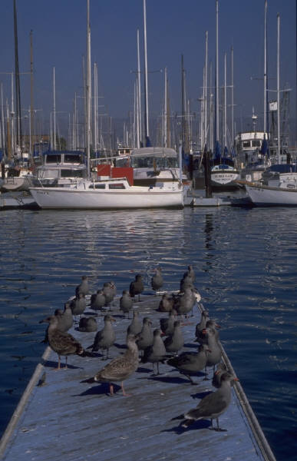
Transwestern Pipeline Company
Customer Meeting
November 8 ⁻ 9, 2001
Topics include:
System Operation
Marketing Update
E-Commerce News
November 9
8-3 pm
Individual Training Sessions
Nominations, Confirmations, Invoices On-Line
South Shore Harbour
League City, Texas
For your convenience a block of rooms has been reserved through
October 19, 2001 at our corporate rate.
For reservations call (281)334-1000 and refer to the Transwestern Pipeline Conference.
If you have any questions, please call
Ava Garcia at (713) 853-5842.

