Slide 1
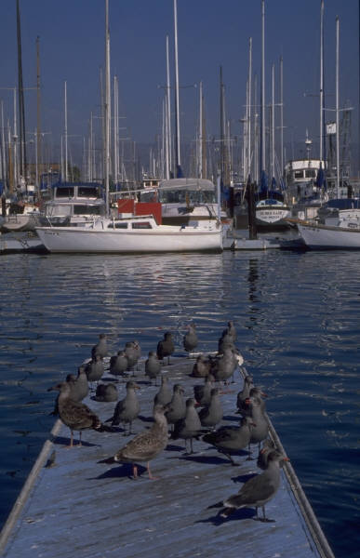
Transwestern Pipeline Company
Customer Meeting
November 8th & 9th, 2001
Topics include:
System Operation
Marketing Update
E-Commerce News
TMS & Flowing Gas Training Class
November 9
8-3 pm
South Shore Harbour
League City, Texas
A block of rooms has been reserved through
October 19, 2001.
For reservations call 281-334-1000 and
refer to the Transwestern pipeline meeting to obtain the corporate rate.
If you have any questions, please call
Ava Garcia at 713-853-5842.

