Slide 1
The Failures of Open Access An Analysis of Transmission Behavior Summer 1999
Enron Corporation
March 30, 2000
Tabors Caramanis & Associates
Cambridge, MA 02138

Slide 2
Failures of Open Access
THE PROBLEM
The system structure and the behavioral incentives impede competition.
Market foreclosure in key load centers during high-price days.
Competition is foreclosed due to the actions and to the benefit of certain transmission providers.
These providers profit from the high prices caused or exacerbated by their actions.

Slide 3
Why is Open Access not Working?
THE CAUSE
Ability to exercise market power
Natural monopoly
Significant flexibility and discretion in operational rules
Restricted market (native load exclusion)
Incentives to exercise market power
Vertical integration
Market-based rates for affiliates
Lack of incentives for efficient, maximal system utilization
Inability to enforce rules
System relies on self-policing
Data are poor, inaccessible and incomplete

Slide 4
How Do We Know?
We have observed both the violation and exploitation of rules and
at least the potential for benefit on the part of transmission providers.
1. Opportunistic use of Transmission Loading Relief (TLR) procedures
2. Opportunistic use of Available Transfer Capability (ATC)
3. Opportunistic use of Native Load Exclusion
4. Opportunistic reservation (and use) of Capacity Benefit Margin (CBM)

Slide 5
How Do We Know?
In almost all of our observations shown, the dates correspond to days
with high price spikes during summer 1999.
We have chosen AEP for illustration for two reasons:
Good data availability
They are a security coordinator and vertically integrated transmission provider whose affiliates have market-based rates.
However, we have observed similar behavior in several other regions.

Slide 6
How Do We Know?
We observed a general trend of market foreclosure for service over
paths through AEP from the south and south-east into the north and
northwest (MECS, Cinergy), with substantial AEP activity in these
markets.

Slide 7
Opportunistic Use of TLRs
TLR
SALIENT RULES
TLR Invocation
Any utility can request a TLR due to a security violation on their system, and the security coordinator (SC) exercises discretion in invoking the TLR.
TLR Response
An SC has the sole discretion to restrict incremental interchange transactions if a TLR reaches level 2 based on Participation Transfer Distribution Factors (PTDFs)
However, they are allowed to override PTDF recommendations if they believe a flow or curtailment relieves the constraint.

Slide 8
Sample TLRs: June 10-12, 1999 AEP-MECS
TLR
Two significant TLRs were called on June 10th and 11th, 1999 in the
AEP area, on Central Ohio and on Cook/Dumont.

Slide 9
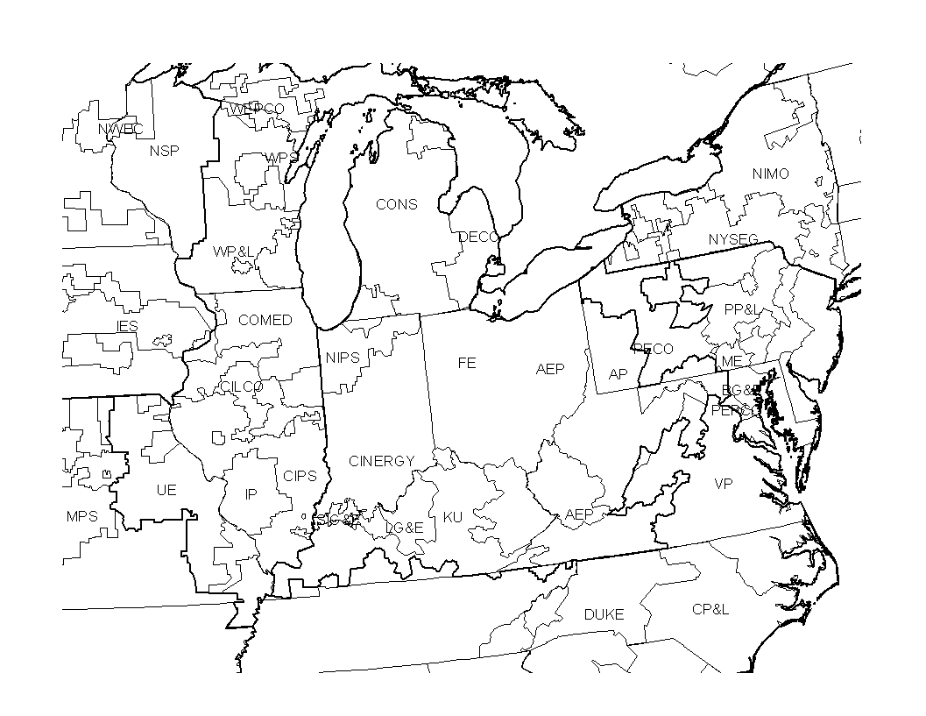
Interchange Transactions Subject to Restriction by SC
TLR
1
2
Transactions,
PTDF >5%
TLR Location
1. Cook and Dumont
765/345 Level 3
2. Central Ohio Level 3
Source: OASIS

Slide 10
Posted Available Transfer Capability (ATC)
TLR
ATC data posted by AEP shows that paths into MECS had assignments of ATC inconsistent with their corresponding PTDFs.
Namely, PTDFs for the TLRs called for the path AEP-MECS were higher than 5 percent, yet they had high ATC postings, while other paths did show zero ATC.

Slide 11
Evidence of Benefit to AEP During TLR
TLR
During those days, AEP Marketing had reserved 68% of the MWh into MECS.
Customer Codes: AEPM - AEP, Koch - Koch Energy, PECO - PECO, CPLC - Carolina Light & Power, CRGL - Cargill - Alliant
DETM - Duke Energy, EPMI - Enron Capital

Slide 12
Refused Transactions into MECS During TLR
TLR
AEP also refused several other transactions into MECS on those days. These refusals were also inconsistent with ATC postings.
Customer Codes: AEPM - AEP, Koch - Koch Energy, CPMT - Cinergy Services

Slide 13
AEP to MECS PTDF Comparison
TLR
PTDFs are posted by NERC on a seasonal basis. The PTDFs calculated on two separate occasions for AEP-MECS are higher than 5 percent.

Slide 14
Example TLRs: AEP-CIN July 21-23 , 1999
TLR
In another example, similar behavior and impact was seen for the same flowgate, which impacted sales into Cinergy.

Slide 15
Interchange Transactions Subject to Restriction by SC
TLR
1
2
Transactions,
PTDF >5%
TLR Location
1. Marysville -
E. Lima Level 2
2. Central Ohio Level 3
Source: OASIS

Slide 16
Posted Available Transfer Capability (ATC)
TLR
Again, AEP-CIN has PTDFs higher than 5 percent, but high ATC postings. On the other hand, another path into Cinergy (from Virginia Power) did have ATC reduced consistent with its PTDF.

Slide 17
During the TLR events, AEPM reserved 30% of the MWh into Cinergy, and refused several requests for service from CPL&E.
Evidence of Benefit to AEP During TLR
TLR
Note that no ATC data was posted by AEP for CPLE -CIN.

Slide 18
July 21-23 AEP-CIN PTDF Comparison
TLR
PTDFs are posted by NERC on a seasonal basis. The PTDFs calculated on two separate occasions for AEP-CIN are higher than 5 percent.

Slide 19
Opportunistic ATC
ATC
We observed several methods to foreclose markets or create barriers to entry on OASIS by AEP as a monopoly service provider of transmission service.
Missing ATC Posting - absence of ATC data for certain paths
Improper Refusals - denial of service on the grounds of unavailable capacity despite sufficiently high ATC postings
Preferential service - service granted to marketing affiliate with refusals to competitors with similar requests.
Daily vs. Hourly - posting low ATC data day-ahead, and engaging actively in non-firm hourly market.
In several of these instances we found that AEP’s marketing affiliate may have gained from AEP’s actions as a transmission provider.

Slide 20
Missing ATC Data AEP-Cinergy
ATC
Sample Paths:
AMRN-CIN and IP-CIN: There are both accepted & refused requests on this path, but no firm ATC postings available.
CPLE-CIN , DUK-CIN, and TVA-CIN: There are refused requests on these paths, but no firm ATC postings available for either of them.
AP-CIN and FE-CIN: The posted ATC for all service increments in July is at least 2000 MW. Total accepted requests amount to less than 350 MW, yet several requests are refused on the grounds of zero ATC.

Slide 21
Missing ATC Data AEP-Cinergy
ATC
For paths that show no ATC data, service requests have been refused.
Customer Codes: AEMC - Aquila Energy Marketing, Koch - Koch Energy, DETM - Duke Energy, EPMI - Enron Capital
DYPM - Dynergy Power Marketing

Slide 22
Concurrent with missing ATC and service refusals, AEPM shows substantial non-firm sales into Cinergy.
ATC
Missing ATC Data AEP-Cinergy

Slide 23
Improper Refusals AEP-MECS
ATC
We observed service denials despite non-zero ATC, and overlapping confirmed requests by AEP’s marketing affiliate.
*Aggregate Capacity (MW) for transactions of identical Path, Customer, Increment, Class, and Date

Slide 24
Preferential Access
ATC
We observed service denials on paths through AEP on days with price spikes, as shown in the next 2 slides, but high available ATC into and out of AEP.

Slide 25
Preferential Access
ATC
Refused request
path
June 8, 1999 - Paths Refused Firm Service by AEP
Source: OASIS

Slide 26
Preferential Access
ATC
3,4
Refused request
paths
July 6, 1999 - Paths Refused Firm Service by AEP
Source: OASIS

Slide 27
Daily vs. Hourly Ameren
ATC

Slide 28
Parking - Opportunistic Native Load use
Native
Load
Positive values represent sales out of AEP over and above AEP’s excess generation and tariff-based imports
Negative values represent generation in excess of exports

Slide 29
Parking - Opportunistic Native Load use
Native
Load
Parking - the use of extra-tariff capacity reserved for native load for off-system sales by AEP’s marketing affiliate.
Calculation:
Identified hour of peak export per day
Estimated AEP’s generation surplus load during that hour Compare the sum of OASIS-based imports scheduled into AEP and generation available for export with the net MWh export (Total MWh out of AEP - Total MWh into AEP)
A positive value indicates Parking: AEP is using its native load exclusion transmission capacity that is not transparent on OASIS to make profitable sales from its marketing affiliate.

Slide 30
Summary of AEP Activity
Native
Load

Slide 31
CBM
AEP Capacity Benefit Margin
AEP has stretched its CBM requirement as defined by ECAR’s guidelines for CBM, which are specific only with regard to minimum requirements. AEP has full discretion in determining its CBM.
ECAR requires that the CBM be based at a minimum on a generation backup requirement equivalent to the size of the largest unit, less that system’s reserve. AEP’s CBM is based on the outage of the two largest units, a total of 2,600 MW.
ECAR specifies the mathematical sum of CBMs set aside on interfaces may exceed the generation backup requirement if a system is connected to smaller or equal-sized systems with unequal assurances of generation backup. AEP explicitly has a 125 percent adjustment to account for the unavailability of reserves east of AEP during east coast heat waves.
ECAR rules allow for CBM and TRM capacity to be sold as non-firm. It is unclear if AEP offers any of this capacity for non-firm transmission reservation.

Slide 32
Solutions
Remove ability to exploit market power - RTO
Remove negative incentive to exploit market power - vertical unbundling, suspension of market-based rates,
Create positive incentives to maximize system utilization - TransCo

