Slide 1
ENERGY DERIVATIVES Introduction and Overview of ISDA’s Activities and Committee Work
Mark Haedicke
Managing Director and General Counsel
Enron Capital & Trade Resources Corp.
Director of ISDA
Vancouver - March 26, 1999

Slide 2
Existing Energy Commodity Market
Introduction

Slide 3
Exchange-Traded Energy Contracts
Natural gas
US natural gas
- Henry Hub - NYMEX (1990)
- West Texas - KCBOT (1995)
- Permian Basin - NYMEX (1996)
- Alberta, Canada - NYMEX (1996)
UK natural gas - IPE (1997)
Propane - NYMEX (1997)
US
- Heating Oil - NYMEX (1978)
- Unleaded gasoline - NYMEX (1981)
- Light sweet crude - NYMEX (1983)
UK
- Gasoil - IPE (1981)
- Brent crude oil - IPE (1988)
Singapore
- Heavy fuel oil - SIMEX (1989)
- Dubai crude - SIMEX (1990)
- Gasoil - SIMEX (1992)
- Brent crude oil - SIMEX (1995)
Coal
- Central Appalachian - NYMEX (Proposed)
Oil and Oil Products

Slide 4
Exchange-Traded Energy Contracts
Electricity
US
- California/Oregon Border - NYMEX (1996)
- Palo Verde, Arizona - NYMEX (1996)
- Cinergy - NYMEX (1998)
- Entergy - NYMEX (1998)
- Commonwealth Edison (Midwest) - CBOT (1998)
- Twin Cities - MGE (1998)
- Tennessee Valley Authority - CBOT (1998)
- Pennsylvania/ New Jersey/Maryland (PJM ) - NYMEX (1999)
- PJM Western Hub - CBOT (1999)
Scandinavia
- System Norway/Sweden - Nord Pool (1992)
- System Finland - EI-EX (1996)
Australia
- New South Wales Electricity - SFE (1998)
Futures Contract
- Victoria Electricity Futures - SFE (1998)
Contract
New Zealand - NZFOE (1997)

Slide 5
NYMEX Natural Gas Futures Volumes (TCF)
Source: NYMEX

Slide 6
NYMEX Electricity Futures Volumes (GWh) (Commenced March 29, 1996)
Palo Verde
COB
Source: NYMEX

Slide 7
Volume Traded on the Nordpool Electricity Spot and Futures Markets (TWh)

Slide 8
Anticipated Growth

Slide 9
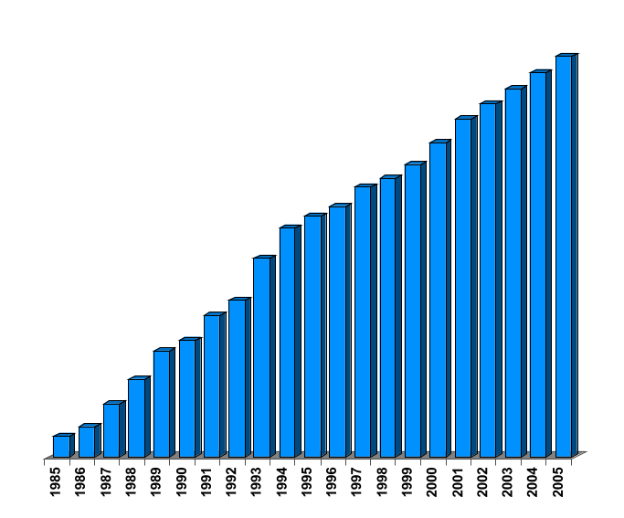
North American Natural Gas Historic and Projected Non-Traditional Market (Tcf)
27.7
26.9
26.1
25.3
24.6
23.9
23.2
21.9
22.5
19.4
20.3
18.5
16.1
12.7
11.4
8.5
9.4
6.3
4.3
1.6
2.4
Estimate

Slide 10
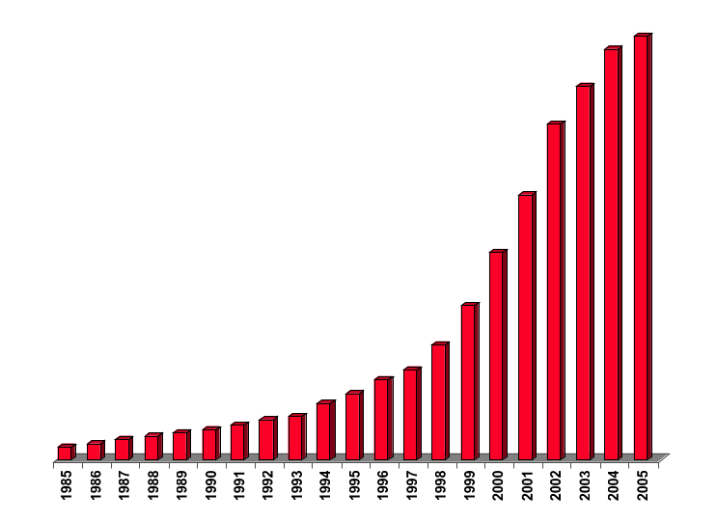
North American Electricity Historic and Projected Non-Traditional Market (Million MWh)
3,894
3,772
3,435
3,088
2,437
1,905
1,142
1,059
732
830
519
602
276
318
363
395
146
184
214
247
120
Estimate

Slide 11
Anticipated Growth Areas
European energy generally
Coal
BTU trading

Slide 12
Overview of ISDA Activities

Slide 13
Energy Commodity Derivatives Committee (formed in 1998)

Slide 14
Purpose of the Committee
Promote use of ISDA documentation for energy commodity derivatives
- Initial Focus:
- North American power markets
- European markets
North American natural gas and Australian power markets already use ISDA documentation extensively

Slide 15
Purpose of the Committee
Development of energy bridge
- Bring existing documents under the ISDA Master Agreement
- Facilitate netting with physical agreements

Slide 16
Purpose of the Committee
Education
- Houston seminar held in February 1999

Slide 17
Commodity Derivative Definitions (available Summer 1999)

Slide 18
Update Price Sources
U.S. (increased from appx. 75 to 360)
Europe and elsewhere

