Slide 1
TEXAS DEREGULATION
THE CURRENT STATE
Marianne Carroll
Carroll & Gross, L.L.P.

Slide 2
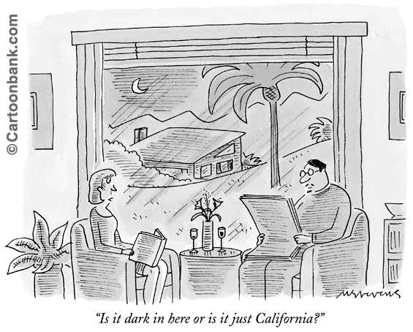
TEXAS – NOT CALIFORNIA
California shivers -
Texas smirks?

Slide 3
TRANSITION TO COMPETITION
California – heading to retail competition since the 1994 Blue Book Order
Texas – wholesale market, open access established first, in 1995-1996; retail competition not mandated until 1999

Slide 4
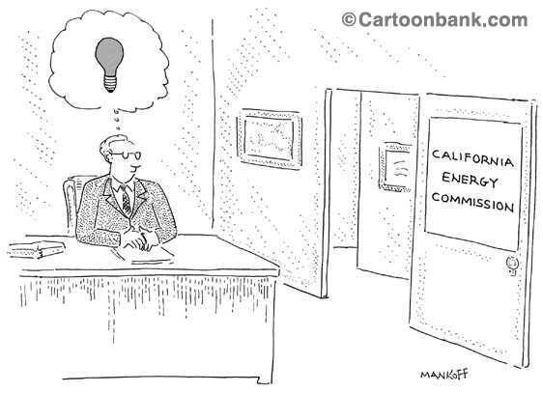
SUPPLY AND DEMAND
California – CEC command and control; overly optimistic projections of demand and supply; utility and landowner opposition – led to severe supply shortages
Texas – favorable regulatory climate, clear “rules of the road” – the market responded with a surplus of generating capacity

Slide 5
MARKET STRUCTURE
California – Partial deregulation, divestiture, stranded cost recovery – elimination of “headroom”
Texas – Separation of generation, delivery and sales functions, UCOS cases, Price to Beat – will there be enough “headroom?”

Slide 6
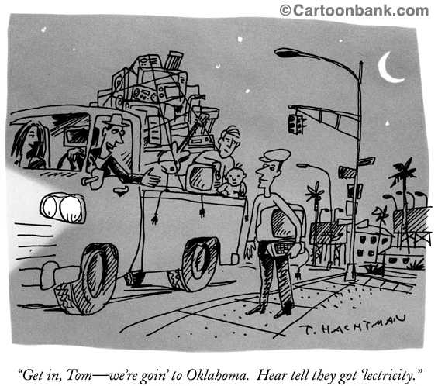
IMPLEMENTATION OF RESTRUCTURING IN TEXAS
23 Rulemaking Projects
8 Business Separation Plans
8 Unbundled Delivery Rate/Stranded Cost Cases
ERCOT Protocols

Slide 7
WHERE ARE WE NOW?
Interim tariffs (delivery charges) have been approved
Customer education campaign ready to roll
Customer switches for the pilot projects in process – power to flow to switched customers in ERCOT beginning on July 6
SPP to file for certification as a Qualifying Power Region possibly next week
Price to Beat filings to be made by Monday – fuel factor cases pending
POLRs have been designated for each utility service area
True-up Rule published

Slide 8
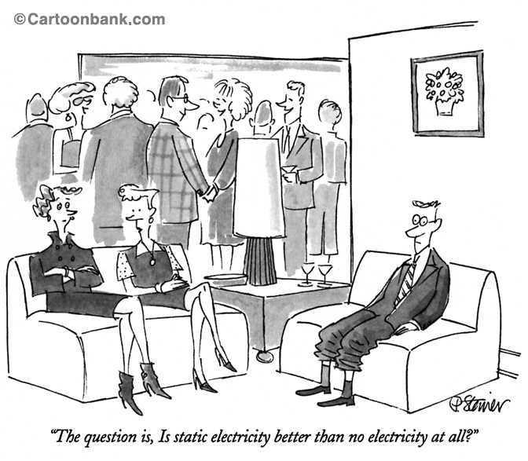
NEXT STEPS/ PREDICTIONS?
Texas will have plenty of electricity for the next few years, and wholesale prices should be low
Demand will continue to grow
Regulation: Delivery rate cases; environmental clean-up cost cases; true-up cases
Market power complaints
The MOD squad

