Slide 1
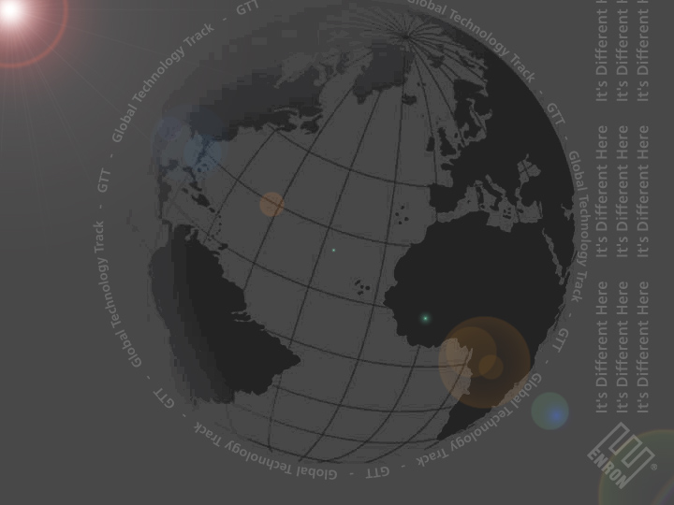
Why Enron?
Notes:
Business Model
Core Competencies

Slide 2
Why Enron?
The strength of our business is fueled by innovation through technology.
Notes:
Business Model –
•Strength of the core business provides the capital necessary to enable the eCommerce value chain
•We are running the revenue through an already profitable business as opposed to other eCommerce companies that have the choice to either make it or break it.
•Just as Sun says in their commercials, we are the dot in dot com, Enron is the com in dot com.
Core Competencies –
•Traditionally, Enron core competencies have been Risk Management and Trading
•The business of Risk Management and Trading rely heavily on information

Slide 3
Why Enron?
Because technology is changing the way we do business!
Notes:
•Technology has always been important at Enron
•Progression of the role of technology from necessary evil, to mission critical, to business enabler
•Suddenly realized than not only is technology a business enabler, technology is the business
•Formation of Enron Net Works around the global technology groups in order to create electronic markets

Slide 4
Why Enron?
“In five years time, all companies will be Internet companies,
or they won’t be companies at all.”
        Andrew Grove, Chairman, Intel Corp.
We are already there…
Notes:
Enron technologists create business opportunities that otherwise could not exist
•The job of the Enron technologist is to ask how we can exploit technology to do business that we never could have done
The Technology Companies, Enron Net Works and Enron Broadband Services – Delivery across the Internet. The stake holder group we are developing for is the world; therefore our direction is the basis for Internet success.

Slide 5
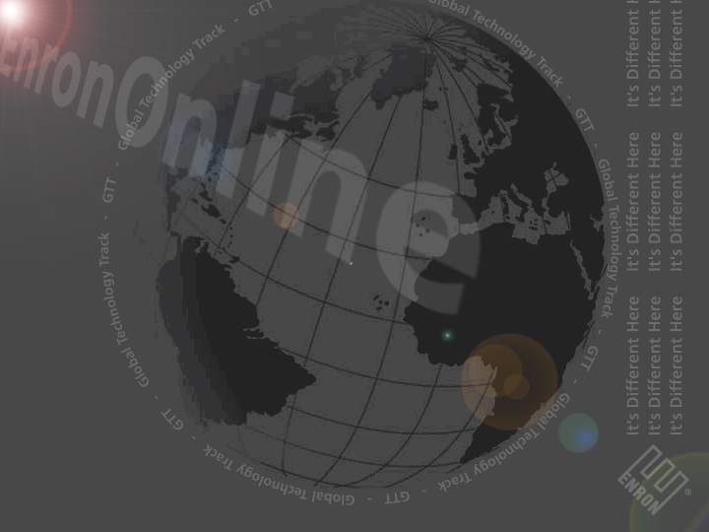
Technology Offerings
EnronOnline is the largest eCommerce website in the world.
Does $2.5 billion in transactions daily; more than eBay does in a year
Imagine the technologies employed to support a business that
does more in one day than some eCommerce companies do in a year.
EnronOnline is the largest commodities exchange platform in the world.
Think of the opportunities this creates for you as an Enron Technologist.
Notes:
•Largest eCommerce company in the world
•Markets are a social structure for information processing and prices
•Now, with the advent of the web, that social structure can be
augmented and accelerated through technology
•By exploiting state of the art technology to enable the eCommerce
value chain
•From eCommerce development to internally developed applications, all development is based on scalability
•Our technology must be responsive to the exponential growth we are seeing in our business
•At Enron, technology is the way we do business and we have the capital to keep up with speed, new market places, and the rate of change.
• Object-oriented development
• Multi-tiered applications
• TIBCO – middle tier messaging system
• Java
• EJB (Enterprise Java Beans)
• Distributed Architecture using EJB
• Microsoft ASP and Active X
• C++
• Microsoft Visual Basic
• ORACLE (database)
• UNIX
• NT
• Sun Solaris (the flavor of UNIX)

Slide 6

Technology Offerings
Enron and Blockbuster
  (VOD) Video On Demand Solution using DSL
Technology Enron is applying:
  Intertrust (toolkit)
    Digital Rights Management
  Motorola Set Top Box with Mosaic Browser
  (small platform browser) using C++
  nCube Video Pumps
  C++, Java
Notes:
•Intertrust is a toolkit
•nCube is a company
•nCube reference also refers to hardware and software

Slide 7
Technology Offerings
Broadband Operating System (BOS)
Advanced Quality of Service (QoS) controls to high-speed
network devices
Incorporates Enron's knowledge of trading and risk
management
Involves a complex software development effort
Team includes PhDs, network engineers, and software
technologists that has received multiple patents and awards
for its work
Notes:
QoS provides dynamic tiered service levels to applications
Knowledge of trading and risk management creates more dynamic network capacity market
Development effort involves advanced work in protocols (COPS, XML), distributed processing, real-time event systems, network device abstraction, and policy based network systems

Slide 8
Technology Approach
We use industry-leading technology to build both our core systems and our Internet–enabled solutions, such as:
Java/EJB
Microsoft DNA (Visual Basic,
ASP, IIS, COM)
C++
TIBCO – messaging-oriented
middleware
Oracle
SQL Server 2000
Unix
NT
Worldwide WAN based upon
Cisco router technology
Notes:
Fortune Magazine’s Most Innovative Company for the past five years
•The innovative companies are the ones who try new things, new technologies
•Enron has the financial power to try; Enron has the financial power to fail
•Most start up companies have the financial power to try but not to fail
•Enron never fails, we switch direction
•Because of the Enron business model, divestiture of assets, because of the EnronOnline platform, Enron can enter industries and create commodity markets quickly and efficiently without much incremental cost.

Slide 9
Enron Technologist Path
“It is not our intention to take young people and throw them into mission critical tasks. We pride ourselves on having a very complete stable of resources at all skill levels. Our goal is to develop each of our Technologists into seasoned technology professionals; however,
no one starts there.”
Notes:
•Teach people how to do a project right, not just throw code together
•Offer a nice evolution for technologists in that there are things for them to do while they are learning
•We call this methodology Task Development
•For example, EnronOnline development. The less experienced technologists are writing Java tasks to begin with, not the core backend EJB
•This assures new technologists are fully trained
•This ensures we are not putting the core platform in potential jeopardy
•Emphasis on training in the core technologies and development process
•UML (Unified Modeling Language) is the Documentation Language
Mid to back office systems are massive and the intellectual challenges are significant
Whether you are developing for the thin client, the mid to back office systems, supporting infrastructures and architectures, the opportunity is to be a part of enabling and supporting the eCommerce value chain.

Slide 10
The Global Technology Track
The Program
  Two-year development program
  One-year rotations
  Promotions based on performance
Training
  Three-week orientation
  Technical training
Coaching
Notes:
Teach people how to do a project right, not just throw code together
•Offer a nice evolution for technologists in that there are things for them to do while they are learning
•We call this methodology Task Development
•For example, EnronOnline development. The less experienced technologists are writing Java tasks to begin with, not the core backend EJB
•This assures new technologists are fully trained
•This ensures we are not putting the core platform in potential jeopardy
•Emphasis on training in the core technologies and development process

Slide 11
Technology Roles
Application Development
Infrastructure
Product Development
Notes:
•Emphasis on training in the core technologies and development process
•Client Server
We are moving towards applying the same technology platform across the enterprise that makes the Internet technically feasible:
Thin client
n-tiered
Enterprise Database
•Technology focused or designed focus

Slide 12
Recruiting Dates at CMU
Interview Dates
  Round 1 Interviews - November 13th
  Round 2 Interviews - November 14th
Resume Drop Deadline
  October 24th
Submit your resume to the Career Center by October 24th to be considered for an interview.
Notes:
Benefits include: competitive salary, bonus program, in house fitness center, stock options, casual work environment, casual dress.

Slide 13
Why Enron?
It’s Different Here
Notes:
Fortune Magazine’s Most Innovative Company for the past five years
An old world company that has successfully made the transition to the new world economy

