Slide 1
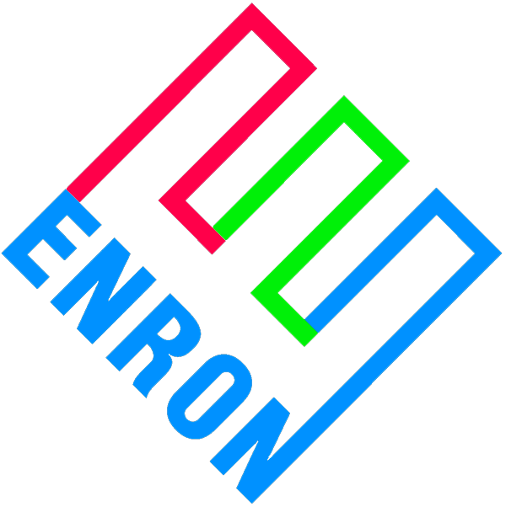
Strategic Alliance Proposal for the Asset Management of
TECO Assets by Enron
April 2000

Slide 2
Overview
Asset Management Concept
“Enterprise Relationship” vs. Build
  Essential Requirements of Successful Merchant Company
    Human Requirements
    Market Requirements
    Corporate Requirements
  Disadvantages of “Building Your Own”
  Advantages of Enterprise Relationship
Enron vs. Other Providers
Deal Structure

Slide 3
Asset Management Concept
An innovative “Enterprise Relationship” whereby TECO will utilize the merchant and administrative capabilities of Enron.
Enron will be responsible for the commercial management of TECO’s assets.
TECO will have employees intermingled with Enron employees.
Significant cost savings.
Elimination of “trial & error” costs and mistakes.
Immediate utilization of Enron resources, reporting and markets.
Enron will manage TECO portfolios separately and exclusively for TECO’s account.
In simplest terms, Enron will be the marketing and trading department for TECO.

Slide 4
Essential Requirements of
A Successful Merchant Company
Significant investment in Human Resources
Risk mitigation discipline
Controls
Innovation
Markets and outlets for products and services
Culture

Slide 5
Human Requirements
Commercial Functions
  Trading Capability-hourly, daily, spot and forwards
  Risk Management & Hedging
  Marketing
  Origination & Sales
  Structure & Analysis
Administrative Functions
  Portfolio administration & Operational Accounting
  Risk Analysis & Reporting
  Risk Controls & Measurement
  Financial & General Accounting
  Legal

Slide 6
Market Requirements
Wholesale customers
Trading counterparts
Industrial
Market making ability
Creditworthiness

Slide 7
Corporate Requirements
Interwoven Corporate Policies
  Trading Policy
  Risk Management Policy
  Compensation Plans
  Mark to Market Accounting
  Post audit and reviews
Culture
  Merchant personnel and policies are usually different than the rest of corporation

Slide 8
Disadvantages of “Build Your Own”
Recruiting, hiring and moving people is a lengthy process.
Motivating and retaining people is an inexact science.
Training inexperience people is costly and lengthy.
Margin for error is great.
“Restart-ups” are common problem.
Many companies (Cinergy, PG&E, El Paso) have had several “start-ups”.
Gaining customer diversified customer base takes years.
Backoffice infrastructure costly and can be ineffective during rapid grow stage.

Slide 9
Advantages of Enterprise
Immediate access to all requirements.
Have direct oversight and involvement.
Collaborative approach.
Market presence is immediate.
Large inherent risks are immediately quantified and reported on a daily MTM basis.
Significant cost savings.
TECO retains full control of its system and operations.
Expand TECO footprint.
Positive reaction from Wall Street and Board.

Slide 10
Enron vs. Other Providers
Merchant company culture from Board down.
Enron merchant activities started in 1986.
Undisputed leader provider of power, gas and derivatives.
World wide capabilities in energy and communications markets.
Active in all energy commodities.
Most diverse market share.
Largest infrastructure in the industry.
Most Innovative Company 4 years running.

Slide 11
Possible Deal Structures
Fee only
Fee and performance
Performance
Risk Sharing

Slide 12
Fee Only Structure
TECO
All Commodity
Outputs, Capacity, Energy,
Ancillary Services
ENA
All Commodity
Outputs, Capacity, Energy,
Ancillary Services
Markets
All Commodity
Inputs, Coal, Gas, Oil
All Commodity
Inputs, Coal, Gas, Oil
Commodity Price Pass Through
Commodity Price Pass Through
Complete access to
Enron’s Merchant Capabilities
and Markets
Fees
Risk: Highest
Risk Profile: 100% TECO
P&L: 100% TECO
P&L Result: Volatile

Slide 13
Fee & Performance Structure
TECO
All Commodity
Outputs, Capacity, Energy,
Ancillary Services
ENA
All Commodity
Outputs, Capacity, Energy,
Ancillary Services
Markets
All Commodity
Inputs, Coal, Gas, Oil
All Commodity
Inputs, Coal, Gas, Oil
Commodity Price Pass Through
Commodity Price Pass Through
Complete access to
Enron’s Merchant Capabilities
and Markets
Fees
Performance Bonus
Risk: High
Risk Profile: Shared
P&L: Shared
P&L Result: Volatile

Slide 14
Performance Structure
TECO
All Commodity
Outputs, Capacity, Energy,
Ancillary Services
ENA
All Commodity
Outputs, Capacity, Energy,
Ancillary Services
Markets
All Commodity
Inputs, Coal, Gas, Oil
All Commodity
Inputs, Coal, Gas, Oil
Commodity Price Pass Through
Commodity Price Pass Through
Complete access to
Enron’s Merchant Capabilities
and Markets
Performance Bonus
Risk: High
Risk Profile: Shared
P&L: Shared
P&L Result: Volatile

Slide 15
Risk Shifting Structure
TECO
All Commodity
Outputs, Capacity, Energy,
Ancillary Services
ENA
All Commodity
Outputs, Capacity, Energy,
Ancillary Services
Markets
All Commodity
Inputs, Coal, Gas, Oil
All Commodity
Inputs, Coal, Gas, Oil
Fixed Price for Outputs
Market Pricing
Fixed Price for Inputs
Market Pricing
Access to
Enron’s Merchant Capabilities
and Markets dependent on risk
Risk: Lowest
Risk Profile: Enron’s
P&L: Fixed
P&L Result: Stable

