Slide 1
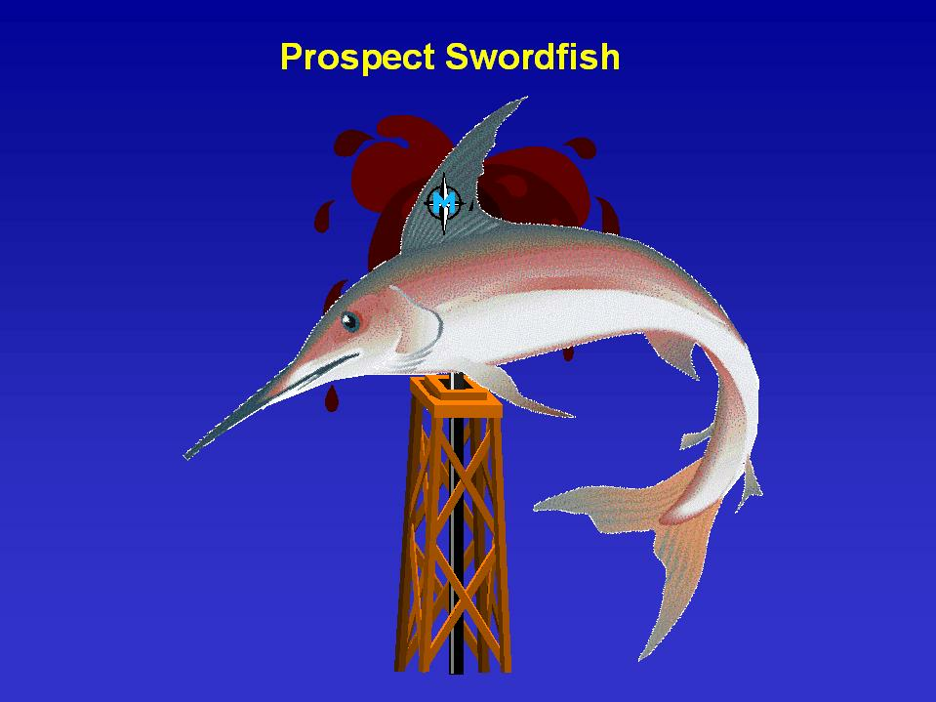
September 12, 2001

Slide 2
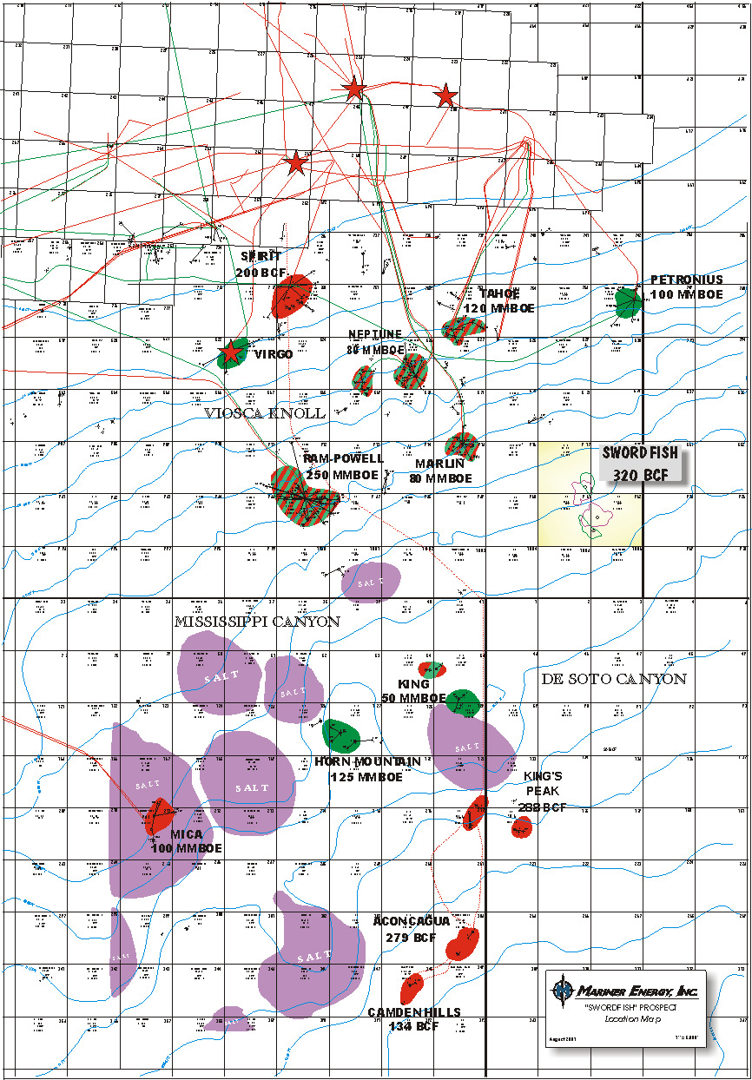
Viosca Knoll 917 / 961 / 962
(Swordfish)
WI Ownership: Mariner 25% (Operator)
BP 50%
Open 25%
Water Depth: 4000’ to 4800’
Acquisition: Earn interest by carrying BP on 2
wells
Development Type: 2 Well Subsea Tieback
(22 -27 miles)
Mean Gross Reserves: 262 BCFE (M62 Sand)
107 BCFE (M64 Sand)
Gross Capex: $117MM
Schedule: Spud First Well (December 2001)
First production (January 2003)
Expected Peak Rate: 177 MMCFE/D

Slide 3
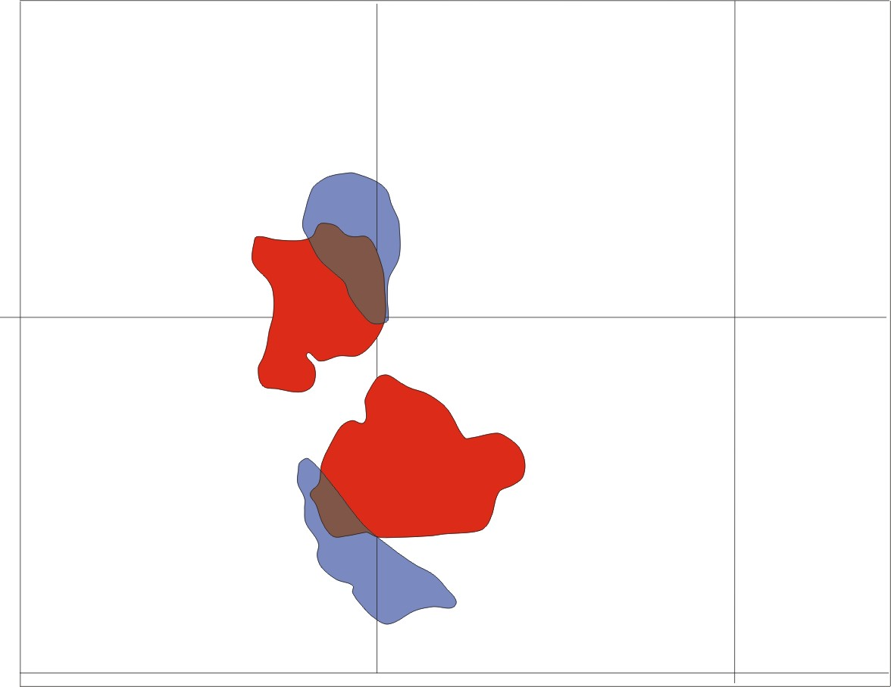
Swordfish Development Plan
Reserves
M64 North
41 BCF
1.5 MMBC
M62 North
80 BCF
3 MMBC
M62 South
134 BCF
5 MMBC
M64 South
47 BCF
1.7 MMBC
Sand Avg. Depth
M62 12,400’
M64 12,000’

Slide 4
Swordfish Project
(Deal Terms)
Spud initial well by December 31, 2001
BP carried for a 50% WI on initial well
Mariner has the option to drill a second well, or bail out of project
BP carried for a 50% WI on second well
Mariner has the option to continue with development, or bail out of project
BP must elect to participate after the second well, or farm out for a 10% ORRI
BP is carried for 50% on the completion of two wells
BP is carried for the first $1,000,000 on the subsea system
BP is heads up on the remaining development cost

Slide 5
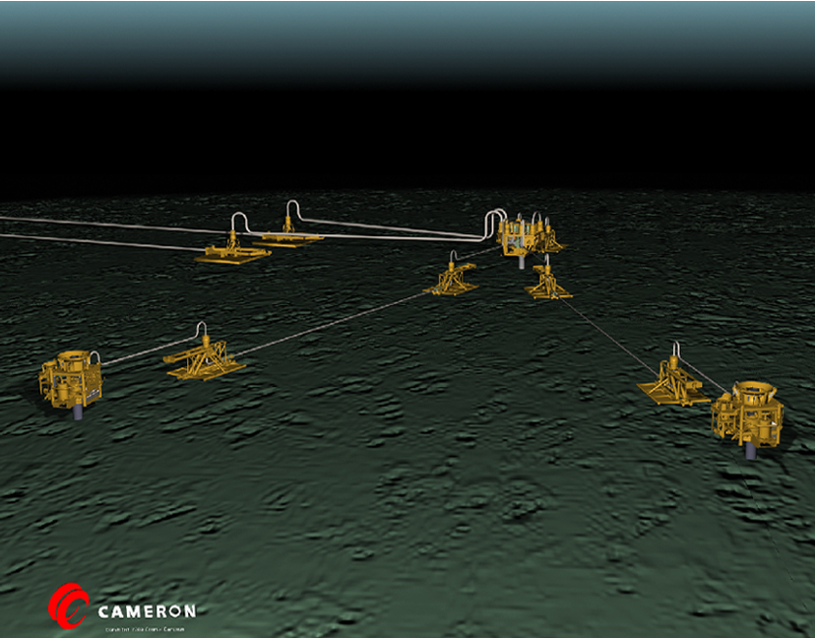
Swordfish Project
Swordfish
2 Well Development
Economic Input
Gross Net
($MM) ($MM)
Initial DHC- 12.9 6.5
DHC- 12.5 6.3
Completions- 29.7 14.9
Subsea Systems- 62.0 16.0
Total 117.1 43.7
Operating Expense
Fixed + Interventions- $190 M/mo
Chemicals- .03/MCF/.23/BBL
Processing- .25/MCF/1.20/BBL
Transportation- .20/MCF/1.30/BBL
Production Rate -145 MMCF/5400 BCPD
Field Life- 10 Years

Slide 6
Swordfish Project

Slide 7
Swordfish Project
(Most Likely Economics)

Slide 8
Swordfish Project
(Downside Protection)
Robust Economics Mariner economic reserve threshold is significantly
below mean reserves.
Royalty Relief If reserves are less than 150 Bcfe, could
potentially qualify for royalty relief. (1/8th royalty).
BP Threshold If reserves are less than 150 Bcfe, BP is likely to
farm out.
BP is not focused on the M64. May farm out.
May use this subsea system to develop other small accumulations in the area.

Slide 9
Swordfish Project
(Downside Reserve Sensitivities)

Slide 10
Swordfish Project
(Conclusion)
Economics are strong with good downside protection.
G&G and operational risk are moderate to low.
BP is the 1st or 2nd largest leaseholder in the Deepwater.
If Mariner performs wells on this project, could lead to other opportunities.

