Slide 1
Strategy to Promote the Evolution
of the Natural Gas Industry
A Global View
Joseph W. Sutton
Second Annual Summit:
Oil & Gas Investments in Brazil
September 29, 2000

Slide 2
Enron Today: International Portfolio

Slide 3
Creating a New Energy Model
Traditional
Energy Model
Hard asset intensive
Vertically integrated
Slow moving and rigid
Hierarchical
New
Energy Model
Brain power intensive
Networked
Oriented toward “real options”
Fast moving
Entrepreneurial

Slide 4
Enron’s Energy Network Model
Applications
Utility Facility
Operations
& Management
Energy
Outsourcing
Fuel
Management
Services
eCommerce
Applications
Physical Delivery
Contracts
Price Risk
Management
Contracts
Settlement
Services
Peaking &
Storage Services
Finance
Market Making
Contract Access
Enron or 3rd Party Assets

Slide 5
New Economy, New Solutions
Traits of a New Economy company
Strength comes from knowledge, not just from physical assets
A New Economy company must operate globally, transferring ideas, people and services from region to region
New Economy companies understand that constant innovation is their only defense against competition
Success in the New Economy requires the flexible use of information to restructure an organization and boost productivity

Slide 6
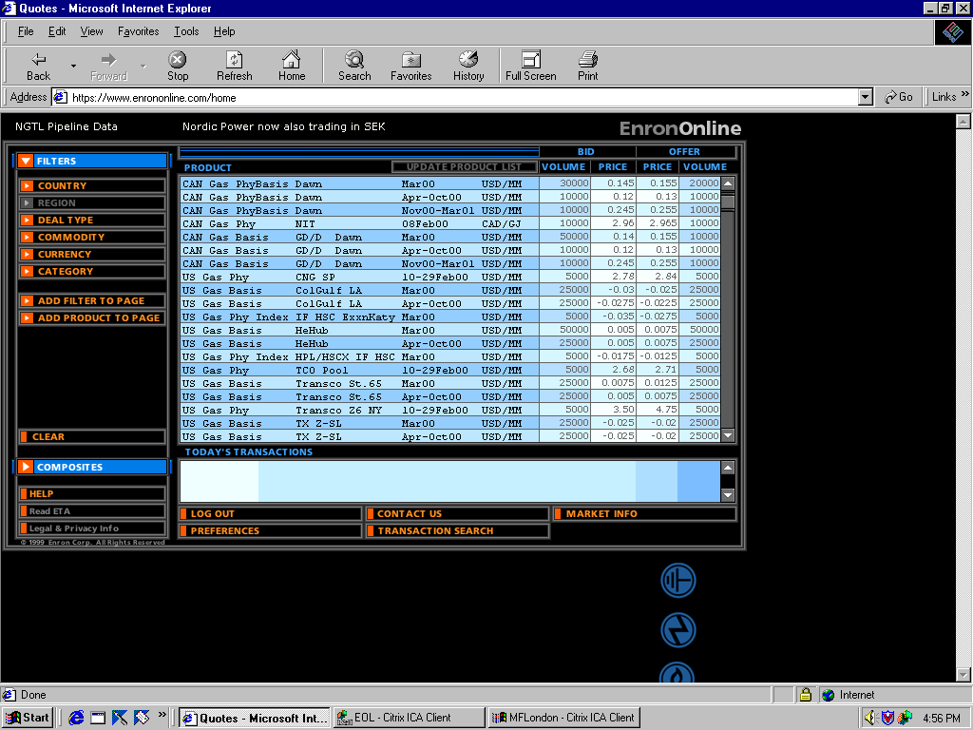
EnronOnline
Extending Enron’s Products to the Internet
Free, Reliable Transaction System with Enron as Principal
Fully Integrated into Enron’s
Established Risk Management
and Logistic Processes
Utilizing Site to Offer Energy-Related Auction Capabilities
Expands Enron’s Information Base and Market Knowledge
“Tried and Tested” Platform for Expanding Enron’s
eCommerce Activity

Slide 7
Rapidly Increasing Utilization of EnronOnline
(Transactions)
100%
100%
100%
100%
100%
100%
100%
100%
100%
25%
33%
39%
45%
45%
52%
59%
59%
59%
Dec
Jan
Feb
Mar
Apr
May
Jun
Jul
Aug
EnronOnline
Traditional

Slide 8
Evolution of the Natural Gas Industry
Stage 1: Closed Markets
Stage 2: Open Access Begins to Allow
Wholesale Marketing and Gas
Transportation Access
Stage 3: Widespread Transportation Access and
Open Access Begins to Allow Transport
on Distribution Systems
Stage 4: Full Competition in Wholesale and
Retail Markets

Slide 9
Evolution of the Natural Gas Industry
Stage 1
Stage 2
Stage 3
Stage 4
X
Fully Bundled Industry
X
Wholesale Market
X
Transportation
X
X
Distribution
X
X
X
Retail Market
Key
Closed access
Open access
X

Slide 10
Country Rankings in Gas Market Evolution
Stage 1
Stage 2
Stage 3
Stage 4
China
France
Nigeria
Venezuela
Vietnam
Brazil
India
Japan
Mexico
Russia
Argentina
Chile
Netherlands
So. Korea
Spain
Australia**
Canada**
England
Germany
United States**
** some states only

Slide 11
Benefits of U.S. Gas Market Evolution
In $ MCF
(Real 1999 Prices)
BCF
Marketed Gas
U.S. Wellhead
Gas Price/$ MCF
Avg. Industrial
Gas Price
Commercial
Avg. Gas Price
Stage 1 Closed Market (1983)
16,220
$4.33
$5.99
$9.35
Stage 2 Marketers and Open
Access Transport Begin (1985)
17,280
$4.97
$6.12
$8.52
Stage 3 Marketers and Open
Access Transport Matures (1992)
19,540
$2.20
$3.37
$5.79
Stage 4 Competition in Industrial
and Commercial Markets
(1998)
21,300
$2.14
$2.86
$5.59
31% ↑
51% ↓
40% ↓
40% ↓
Source: U.S. DOE Natural Gas Annual and U.S. DOE 1998 Natural Gas Monthly

Slide 12
Benefits of England’s Gas Market Evolution
In $ MCF
(Real 1999 Prices)
Excluding Taxes
BCF
Marketed Gas
U.K.
Residential
U.K.
Industrial
1990
2059
$7.33
$3.41
1995
2690
$7.02
$2.74
1996
3182
$7.18
$2.12
1997
3216
$7.14
$2.22
1998
3300
$6.46
$2.28
1999
3487
$6.40
$2.21
68% Increase
13% Decrease
35% Decrease
Source: dti, Digest of UK Energy Statistics 2000

Slide 13
Why Change is Possible
Producers increasingly control their own sales to end use markets or to marketers
Gas Producers
Computerized tracking of flows, unbundled accounting play a key role in the gas merchant business
Wholesale Market
Shippers pay only for the services they use on an unbundled basis, resulting in more favorable rates
Gas Transportation
New technologies and market structures promote distribution open access to enable customers to ship gas separate from buying it
Gas Distribution
Small customer access may be possible and desirable to enhance competition and choice to all market segments
Retail Market

Slide 14
Five Key Success Factors for
Achieving Competitive Gas Markets
Competition throughout the supply chain
Capacity expansion aligns with market requirements and economic dispatch
Clear and frequent price signals drive production, sales and transport economics
Managing risk efficiently
Increased commercial opportunities make markets more efficient

Slide 15
Five Steps to Achieve Policy Reform
Define a Vision for the Restructuring of the Gas Industry
Quantify the Expected Benefits
Identify the Opportunity Costs of Not Changing
Identify Potential Obstacles to Change
Establish an Implementation Plan

Slide 16

Convergence of Gas and Power Markets in South America
VENEZUELA
LNG from Trinidad
and Venezuela
NEW DEVELOPMENTS WILL LEAD TO EXPLOSIVE GROWTH:
Huge Proven Reserves
  Gas reserves in Bolivia, Argentina and Brazil are currently estimated to be 24 Tcf, 33 TCF and 15 TCF, respectively. Another 20 Tcf + in Peru as back-up.
Brazil Going Thermal
  Over the next five years, Brazil will require 15,000 MW of additional generation capacity.
  Government-sponsored emergency program for MW by 2003 -- Mostly gas fired
Infrastructure Build Out
  Gas delivery infrastructure is almost complete.
  Almost all major reserves are now linked to the market.
Privatizations/Deregulation
  Credit-worthy counter-parties facilitate financing of infrastructure.
  Market-driven investment decisions favor gas development
COLOMBIA
ECUADOR
Fortaleza
BRAZIL
Natal
Northeast Brazil
gas reserves
PERU
Recife
Lima
BOLIVIA
Cuiabá
Salvador
Camisea gas reserves
La Paz
LNG from Nigeria
Santa Cruz de la Sierra
Belo Horizonte
Bolivian and NW Argentina
gas reserves
Vitória
PARAGUAY
São Paulo
Rio de Janeiro
CHILE
Curitiba
ARGENTINA
(1)
Campos and Santos Basin
gas reserves
Neuquen
gas reserves
(1)
Porto Alegre
Santiago
URUGUAY
Montevideo
Buenos Aires
Natural gas demand centers
Pipelines in operation
Pipelines under construction/development
Tierra del Fuego
gas reserves
(1)
Competing Projects

Slide 17
Major Regulatory Challenges For
a Healthy Gas Industry
Introduction of effective competition
Need for multiple buyers and sellers
Open Access for delivery infrastructure
“Open borders” for energy flows
Pricing signals in line with economic efficiency
Unbundling of commodity and fixed costs
Distance-based and interruptible tariffs are key (especially for thermal generation)
Price mixing at the distribution (regulated) level, not at the supply (competitive) level

