Slide 1

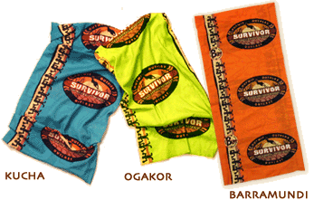
Survivor Junkies Unite!
Dave and Cara are hosting a survivor party Thursday night!
Pizza, Beer, and Barramundi for all.
16346 S.W. Wright St., Aloha
503-848-7684
7 pm till we get voted off!

