Slide 1
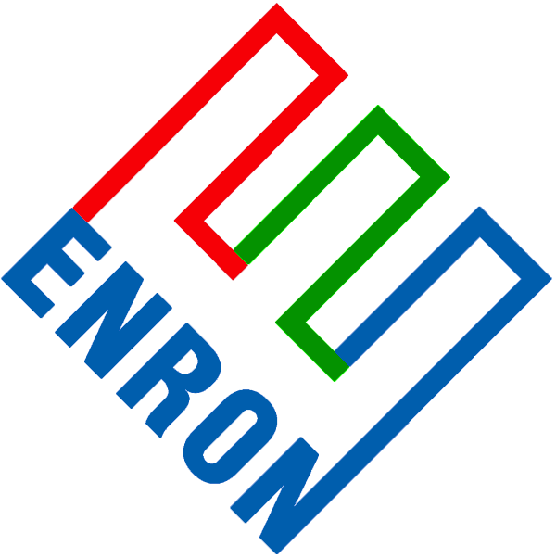
Western Producer Services
Prepared for:
Suncor
October 5, 2001

Slide 2
Producer Services
Enron North America offers producers a variety of marketing and asset related services, including the following:
Risk Management programs
Commodity Services
Wellhead purchases
Logistical outsourcing
Transportation management
Asset Monetizations
Strategic Planning
Fundamental Analysis
Completely integrated gathering, compression and purchase options

Slide 3
Powder River Basin Services
Enron North America and it’s affiliate, Bear Paw Energy work together to offer a complete array of products and services for producers in the Powder River Basin of Wyoming.
This service combines the physical gathering, compression, measurement, transportation, logistics and marketing into one package.
The result of this combined service gives producers the ability to concentrate on exploration and production and receive one-stop shopping for their gas management services.
This combination has been very well received by the independent producing community making Enron and Bear Paw the largest non-producer affiliated gathering/marketing company in basin.

Slide 4
Marketing Proposal
Assuming that Bear Paw is gathering Suncor’s gas, ENA can provide Suncor a wellhead purchase under the following terms:
Term: November 1, 2001 – 0ctober 31,2002
Price: For the first 80% of the Monthly Nomination the price will be the Inside FERC CIG North System Index minus $.03 per mmbtu less the applicable gathering charges. For the remaining 20% of the monthly nomination the price will be the Gas Daily Midpoint Index for CIG minus $.03 less the applicable gathering charges (the Gas Daily pricing is designed to absorb any swings in production volumes).
Included in this service ENA will coordinate all logistics with Bear Paw and provide Suncor with a “wellhead netback” price for use in royalty distributions.

