Slide 1
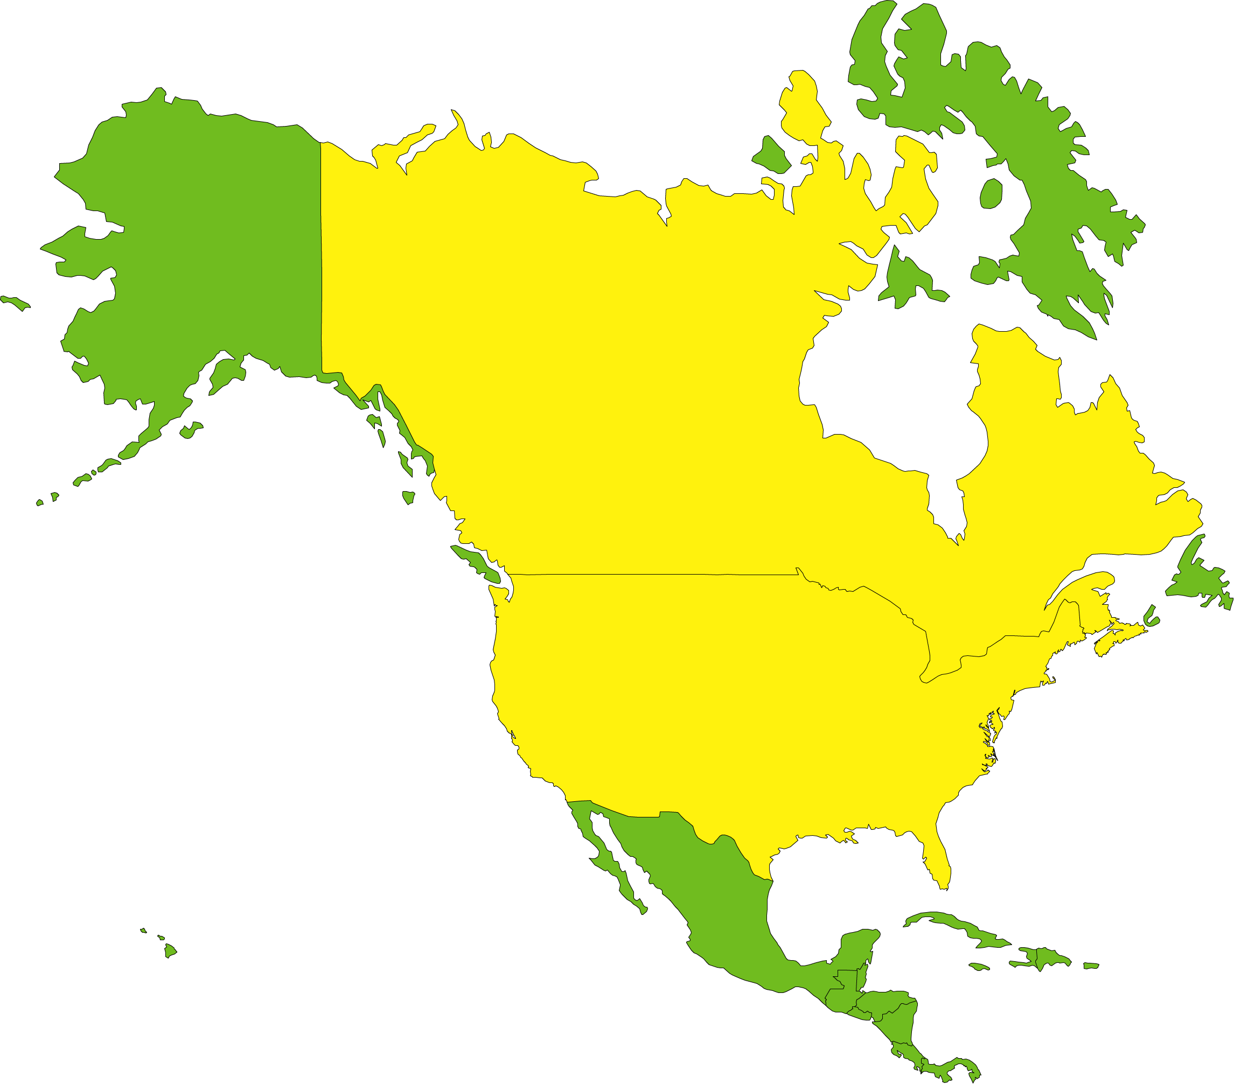
North America
Canada
United States

Slide 2
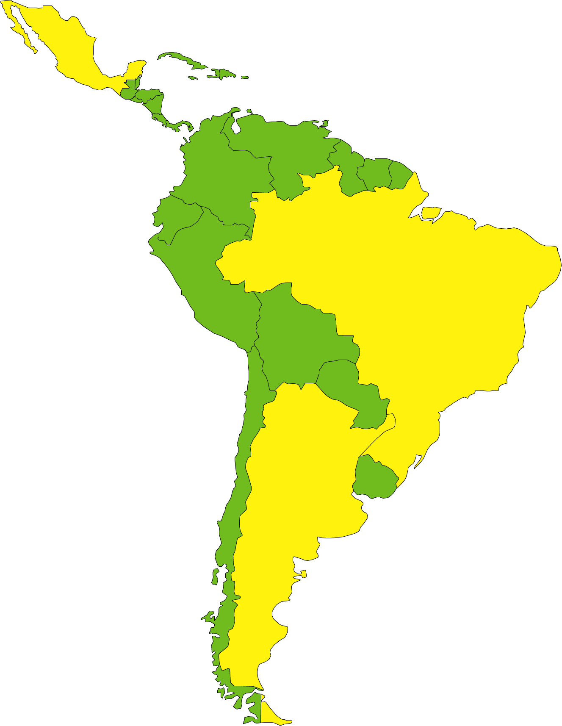
Latin America
Mexico
Brazil
Argentina

Slide 3
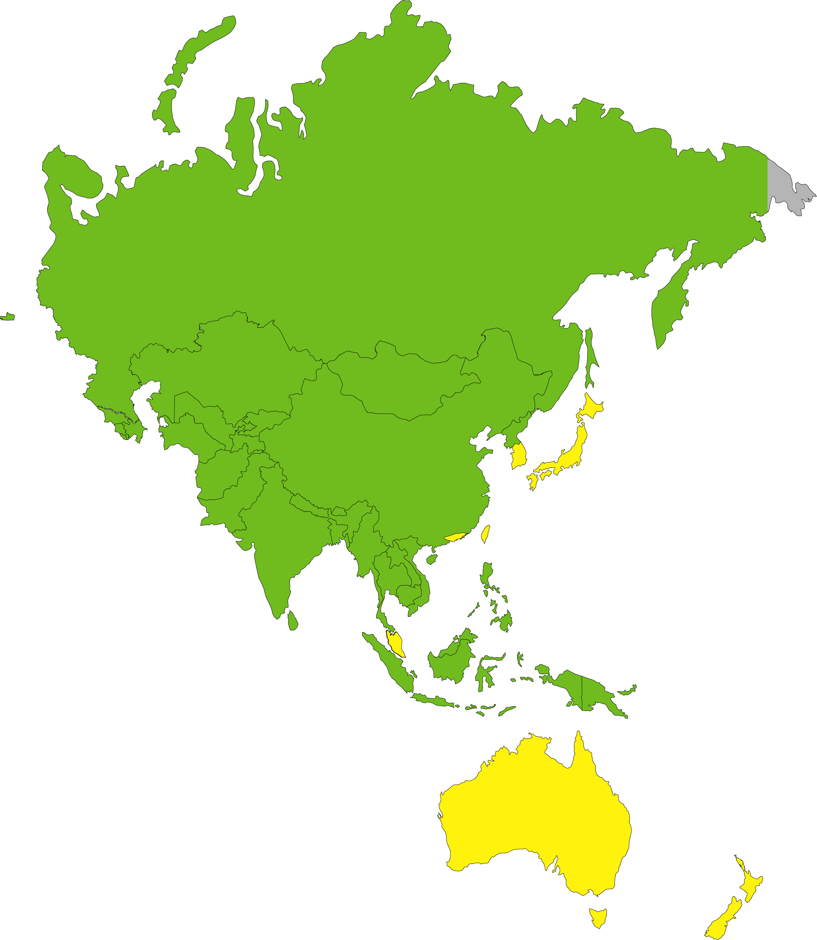
Asia/Pacific
S. Korea
Japan
Hong Kong
Taiwan
Singapore
Australia
New Zealand

Slide 4
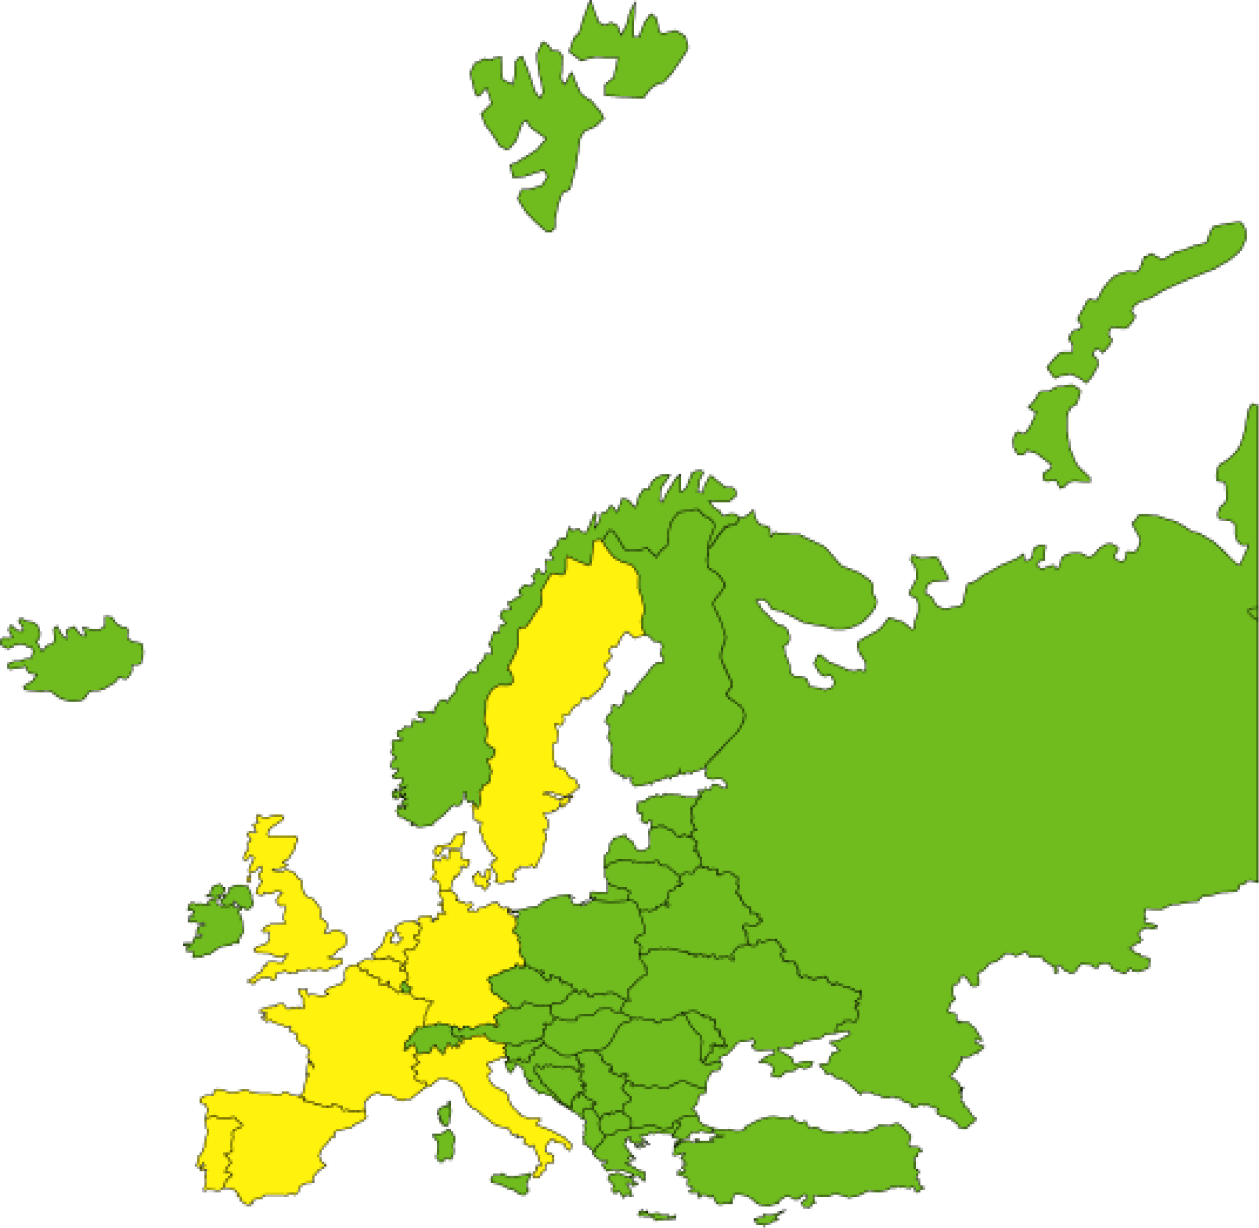
Europe
Sweden
UK
Denmark
Netherlands
Belgium
Germany
France
Italy
Portugal
Spain

Slide 5
Monopoly Guy
World’s Leading
Company

