Slide 1
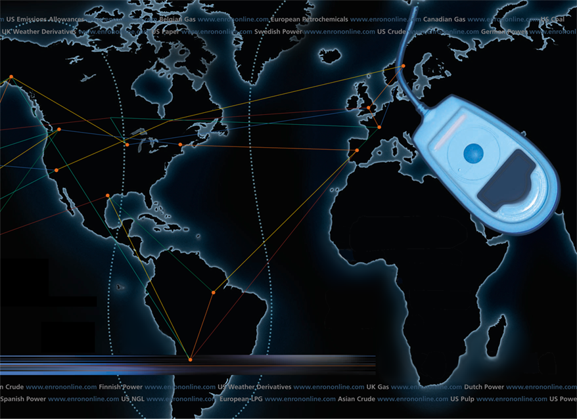
Putting the Energy into e-commerce
EnronOnline
TM
TM
Notes:
Thank you
E-commerce and its growth are clearly one of the hottest topics around
From boardrooms to breakfast tables, .coms always slip into the conversation
for this very reason, it is with great pleasure that I take this opportunity to speak with you today about e-commerce and Enron’s most recent venture onto the internet
E-business is clearly a windfall for both consumers and businesses as improved communication and efficiencies in conducting business help to eliminate barriers to price discovery and reduce the costs of conducting business
In just over 4 months EnronOnline has revealed the potential for improving the efficiency of energy markets
Let me tell you how

Slide 2
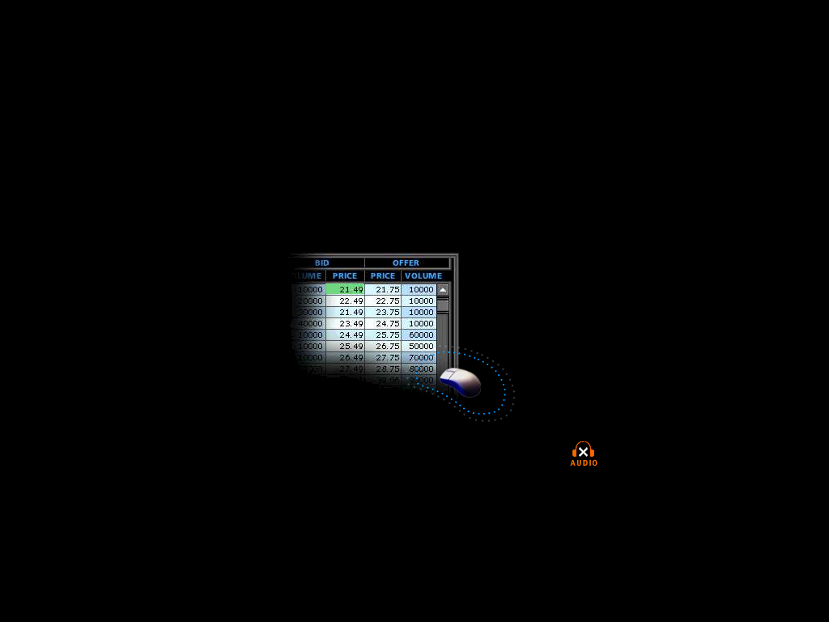
What is EnronOnline?
A Free, Internet-based, Global Transaction System Which Allows Counterparties to View Real Time Prices From Enron’s Traders and Transact Instantly Online
click & transact
Notes:
In May of 1999 Enron management became frustrated with the prospect of forming an alliance to take energy transacting on the internet. Confident that the internet was the right solution for its customers Enron made the decision to embark on the creation of an internet based transaction system.
Louise Kitchen of the the London office diverted a trip to a customer meeting and boarded a plane and visited several Enron offices to develop a plan. Within weeks the EnronOnline development team was in full stride designing a real time pricing system.
In August of 1999 I was asked to assemble a team of individuals responsible for the global operations of EnronOnline.
Four months later EnronOnline was launched.
This effort would not have been successful if we did not have the ability to make quick decisions on our own.
I suspect that several of the alliances which have been formed recently to create energy transaction sites will find it difficult to keep up with the changing marketplace while making decisions by committee.

Slide 3
Enron’s global wholesale transaction business
…………..moves online
    November 1999 US Natural Gas
    Canadian Natural Gas
    December 1999 Coal
    Nordic Power
    Plastics
    Pulp & Paper
    US Power
    January 2000 Continental European Power
    Continental European Gas
    Emissions
    LPG
    Oil & Refined Products
    Petrochemicals
    UK Gas
    UK Power
    Weather
    February 2000 EnBank Virtual Storage Auction (UK)
    March 2000 Credit Derivatives
    Enron Emissions Auctions (US)
    Australian Power
    Summer 2000 Bandwidth
    European Coal
Clicks & Mortar
Notes:
As evidenced by our launch schedule we have been able to quickly add new products and services based upon the demands of the marketplace.
At this time we have several product initiatives moving forward, many of which have been proposed by our customers
At this time we have no less than 5 different auction proposals before us for consideration. Many of these initiatives will most likely be live within weeks.

Slide 4
EnronOnline Statistics
Total Life to Date Transactions > 88,000
Currently > 45 % of Enron’s Transactions
Average Daily Transactions > 1,200
Life to Date Notional Value of Transactions > $34 billion
Daily Notional Value Approximately $600 Million
Currently > 32% of Enron’s Notional Volume
Number of Products Offered - Approximately 650
Number of Currencies Traded in = 11
Development Time Approximately 7 Months
Announcement Date October 26, 1999
Launch Date November 29, 1999

Slide 5
How does EnronOnline differ from current way our customers currently conduct business?
Currently With EnronOnline
Internet
Enron
Enron
Notes:
EnronOnline in its simplest form is an extension of our existing business
Before we talked on the phone to our customers now we transact directly with our customers over the internet.
EnronOnline is a platform which allows the various Enron entities to transact directly with their customers in a much more efficient manner.

Slide 6

Making the global market
Notes:
The real time prices that are seen on EnronOnline are pushed out on the internet by individual traders
These prices are visible for all customers to see via the internet
This methodology significantly increase the price discovery capability of all counterparties that transact in wholesale energy and other commodities
This allows even the smallest municipality to have access to real time prices with very competitive bid and offer spreads
I recently received a email from a trader from a marketing company that indicated that we really are providing excellent price discovery when Pemex (the Mexican Gas Company) can quote a tight two way market.

Slide 7
Making the global market
Notes:
By allowing our traders from around the world to put prices on the web, we truly create a transparent global market

Slide 8
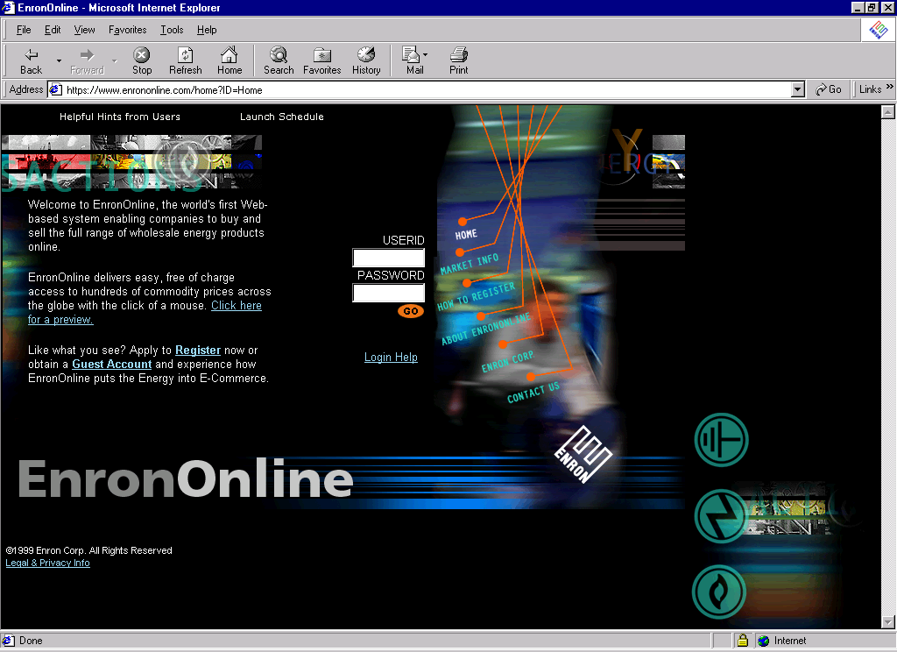
www.EnronOnline.com
New User
*******
Notes:
Now I would like to give you a glimpse of our system so that you can see how simple the functionality is.
This simplicity allows all players in the marketplace equal access to competitive pricing and the capability to purchase or sell that commodity quickly and cost effectively. There is no charge for using our system.

Slide 9
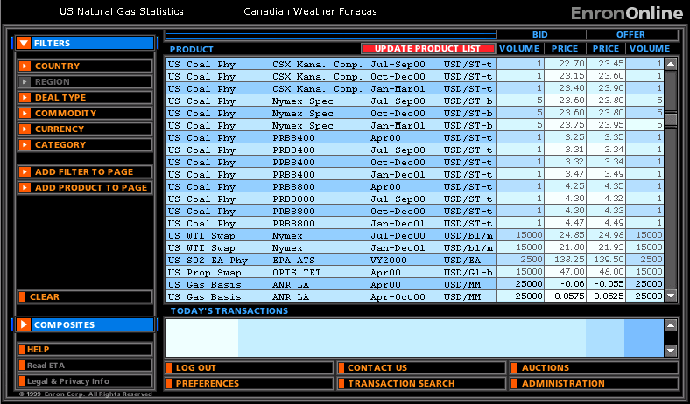
Live Quotes Page
Notes:
Once a company has logged in they immediately have access to view all the products offered by the Enron companies.

Slide 10
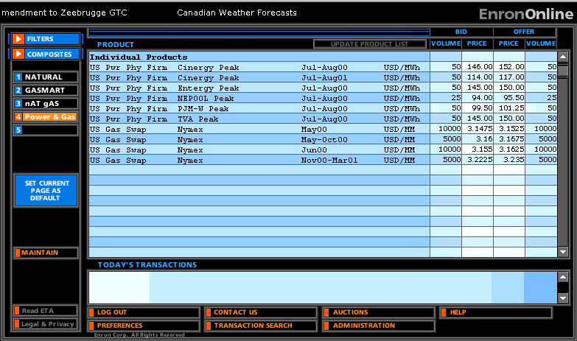
Composite Page
Notes:
By filtering the products and creating a composite page a customer can view just the products they are interested in
In this case I have created a composite page of summer power prices and Natural Gas Henry Hub products

Slide 11
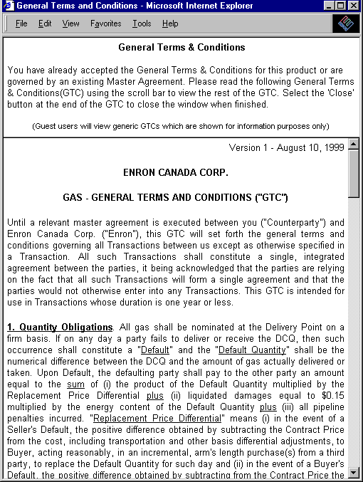
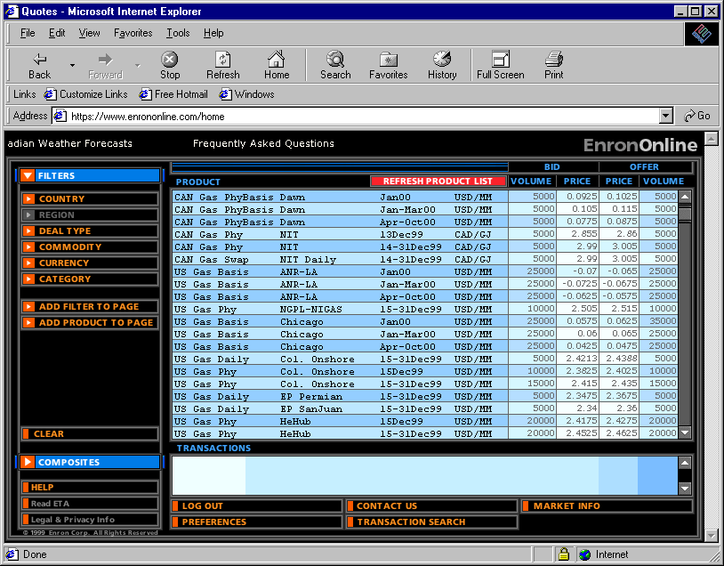
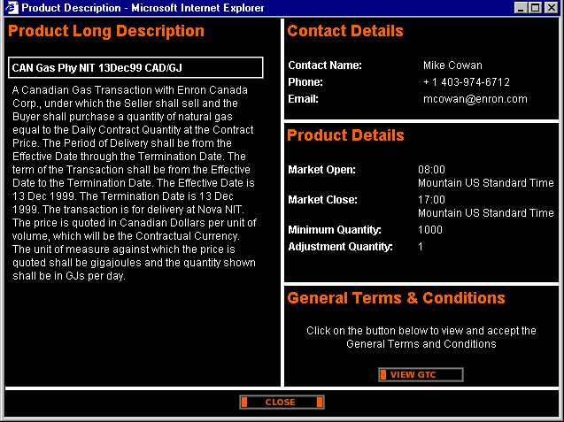
Legal Definition and Product Information
Notes:
The customer has the ability to view more detailed information concerning the contractual terms of the transaction online

Slide 12
Contractual Framework
Password Application
Registration Form (if necessary)
Electronic Trading Agreement
General Terms and Conditions (or existing Master Agreement)
Notes:
The contractual format in its simplest form is made up of essentially three agreements

Slide 13
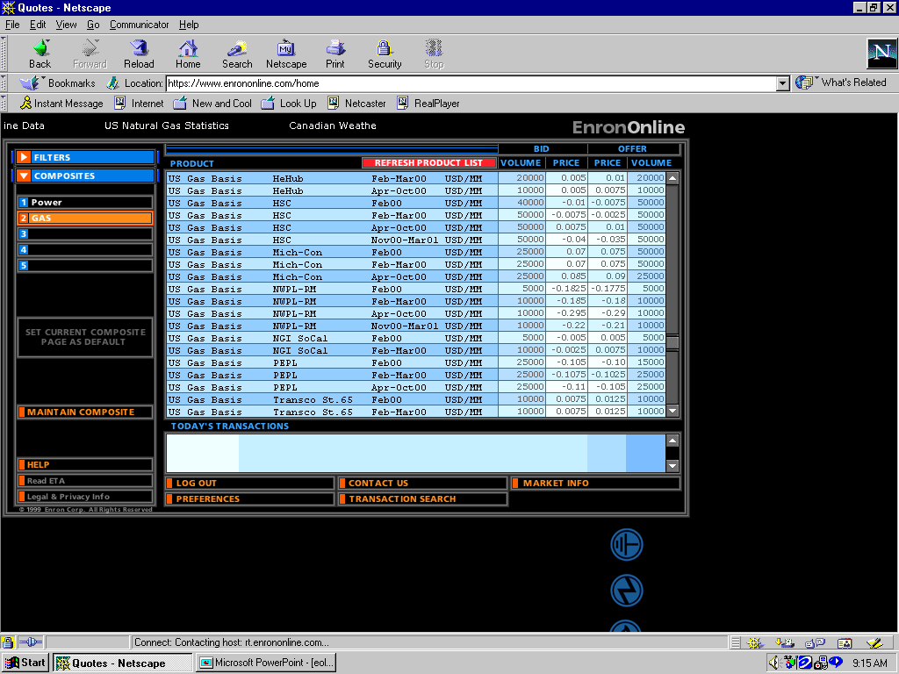
Click on Bid or Offer Price

Slide 14
Submission Screen

Slide 15
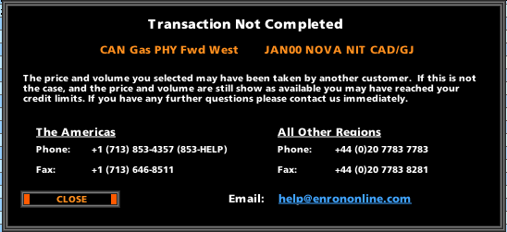
Failed Transaction

Slide 16
Why a Transaction Might Fail
The price has moved
The requested volume is no longer available
The Credit Limit has been exceeded

Slide 17
Successful Transaction

Slide 18
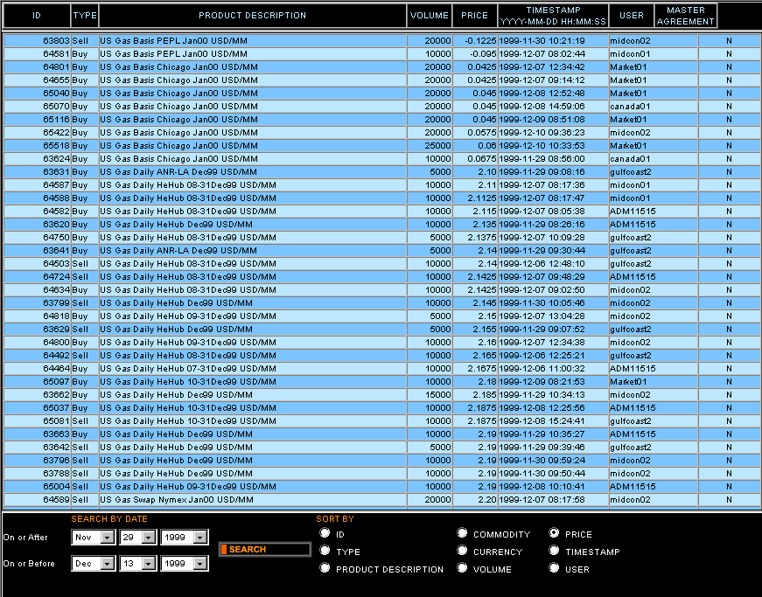
Transaction Search

Slide 19
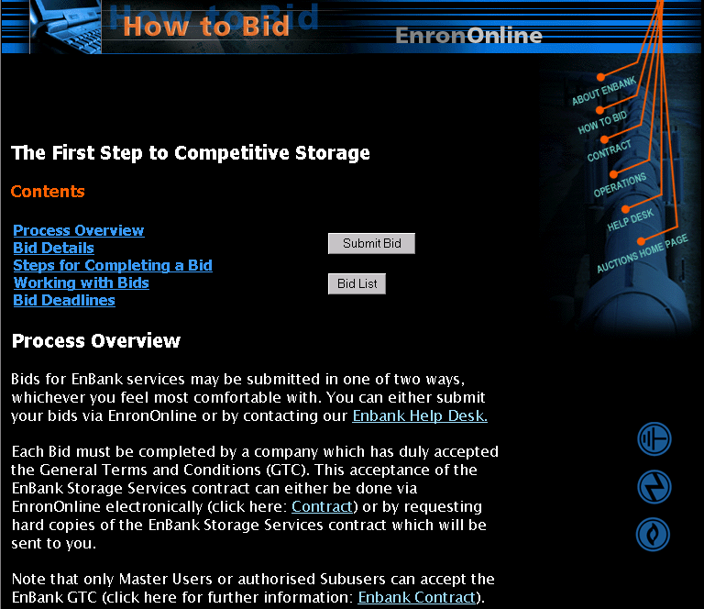
EnronOnline Auctions
TM
Puts the Energy into e-commerceTM
Notes:
In addition to buying and selling commodities online, EnronOnline offers auctions
to date we have conducted three auctions
The first auction was done with virtual storage in the UK

Slide 20
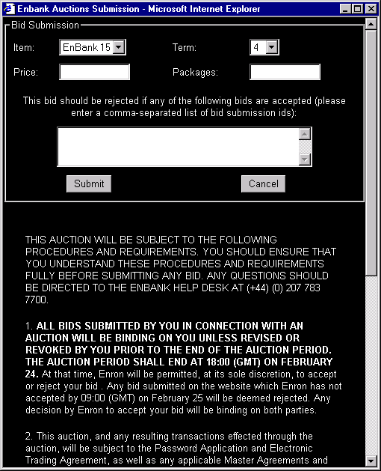
EnronOnline Auctions
TM
Puts the Energy into e-commerceTM

Slide 21
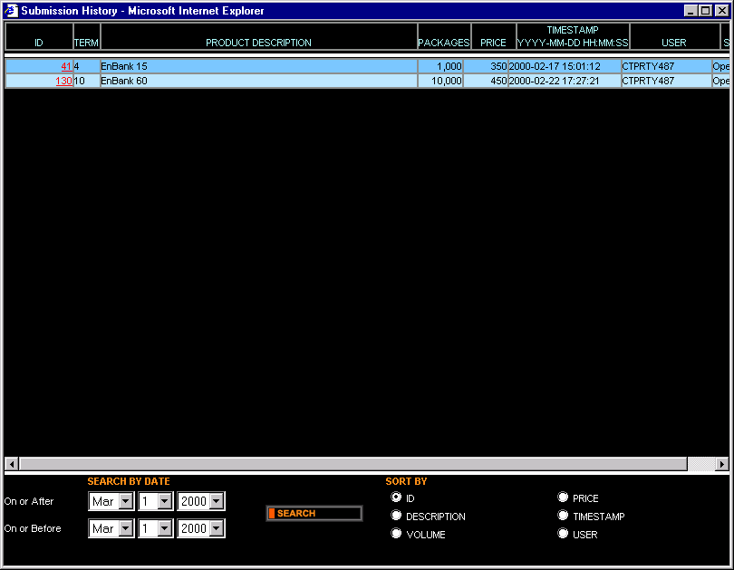
EnronOnline Auctions
TM
Puts the Energy into e-commerceTM

Slide 22
Utilization of EnronOnline
(% of Transactions)
Traditional Channels
EnronOnline

Slide 23
Transactions via EnronOnline
(Weekly)

Slide 24
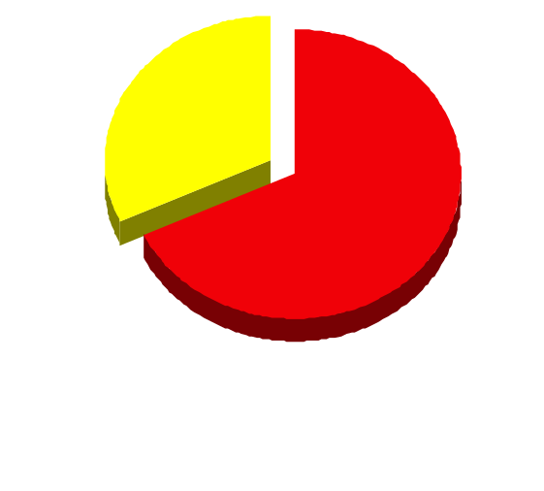
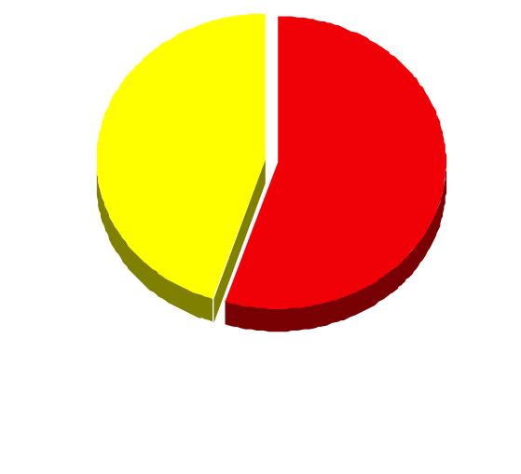
EnronOnline Versus Traditional Channels
(Currently)
Volume
Transactions
32%
45%
55%
68%
EnronOnline
Traditional Channels

Slide 25
Spread Comparison 1999 Broker Quote Vs. 2000 EnronOnline*
2000 EOL
1999 Broker
* May Henry Hub Quotes - 3/30/99 Vs 4/17/00

Slide 26
Btu Equivalent Spread Comparison*
Power
Natural Gas
* April 17, 2000 Henry Hub May - Oct Gas Vs. Power Jul - Aug

Slide 27
Number of Locations and Products*
Power
Natural Gas
*April 14, 2000

Slide 28
Possible New Applications for EnronOnline
Gas Transportation
  Imbalance Trading and Netting
  Capacity Auctions
  Capacity Release
NERC Market Redispatch

Slide 29
Benefits of EnronOnline
Free of charge
Real-Time Pricing Information
Access to complementary markets and product information
Simple access via the Internet
Easy to use
Fast and Secure Execution
Enron’s Best Prices
Adaptable to Market Demands

Slide 30


