Slide 1
State Monitoring Outsource Agreement
Stateside Associates
Monitoring energy issues in our non-core states
Issue teams are staffed by analysts with regulatory or legislative experience
Direct contact with decision making bodies
Analysis regarding legislative or regulatory outlook
Customized website for Enron, with bi-monthly updates
E-mailed or faxed alerts for hot topics / urgent news targeted to specific contacts

Slide 2
Topics covered:
Deregulation/Reregulation
Consumer education and protection
Low income energy assistance programs
Renewable portfolio standards
System benefit charges
Rate increase applications
Rate making issues
Divestiture
Licensing
Market entry and exit
Stranded costs
Aggregation
Generation siting
Net metering
Pilot programs
POLR
Emissions
Divestiture

Slide 3
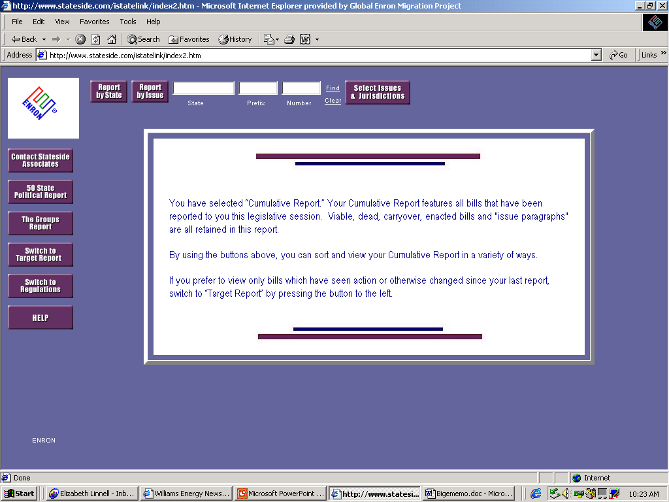
Enron’s Site

