Slide 1
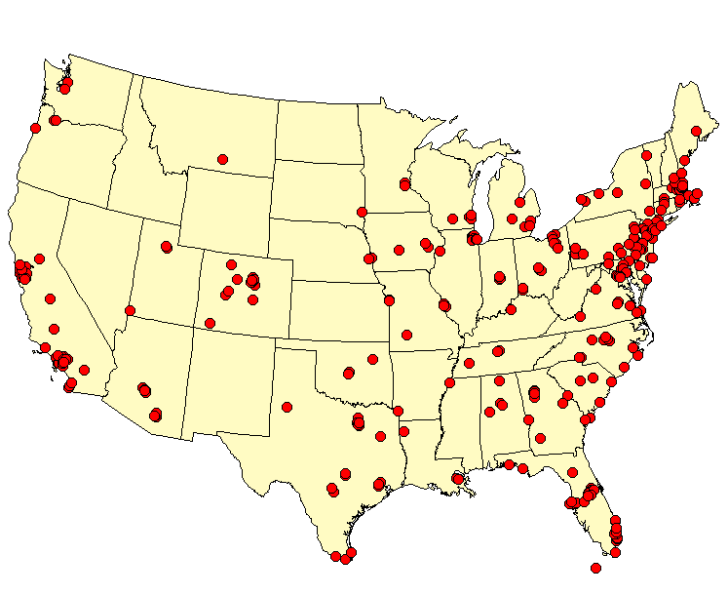
Starwood
US Property Locations
N
W
E
S

