Slide 1
Exelon Infrastructure Services
New Technologies Organization
Starline 2000 & 200 CIP
Date October 1st, 2001
Presenter: Ted T. Fiala

Slide 2
Development of Program at Exelon
Licensing agreements signed between Starline TT and Exelon Infrastructure Services in March 2000.
Training of crews in May 2000 with first installation by Exelon performed in June 2000
Starline 2000 process application for mains
  4-inch through 24-inch diameter
  Multiple 45 degree bends
  Cast Iron or Steel
  Inches W.C. pressure through 60 psig systems
Starline 200 process application for services
  ¾ -inch through 4-inch diameter
  Multiple bends/offsets
  Inches W.C. pressure through 60 psig systems

Slide 3
Benefits of CIP liners for Natural Gas Systems
Significant savings compared to traditional replacement methods.
Bonding/adhesion improved due to sandblasting cleaning process.
Ability to tap existing services using internal robotics reduces restoration costs.
New services connections can be made using traditional tapping equipment due to adhesion improvements.
Service life of Starline CIP liners is tested to be greater than 30 years.

Slide 4
Benefits of Exelon Infrastructure Services
Management staff and workforce over 100 years combined gas utility experience.
Successful liner products installed for 7 different major utilities this year.
Over 7,000 employees working in 48 U.S. states focused on Utility Infrastructure enhancement allows for complete turnkey program.
Commitment to exceed customer expectations while providing high quality service in a safe and effective manner.

Slide 5
12-inch CIP project for Con Edison Companies
Tony Hranicka (Project Manager) coordinated project for Con Ed.
Project involved the lining of 650’ of 12-inch Cast Iron main in Yonkers.
Project was located along Ashbuton Avenue between Broadway and Warburton Aves.
Main is located under paving with no option to direct bury new main out of paving.
Con Ed prepared openings for the lining, performed all live gas work and removed a 10 foot section of pipe at each opening for internal pipe access.
EnviroJet Technologies supported the project for Con Ed by removing any potential contaminates from the main prior to sandblasting.

Slide 6
STARLINE 2000 Process Steps

Slide 7
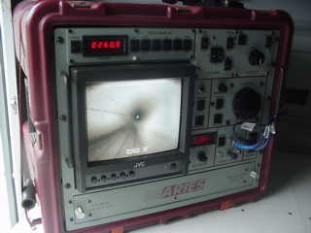
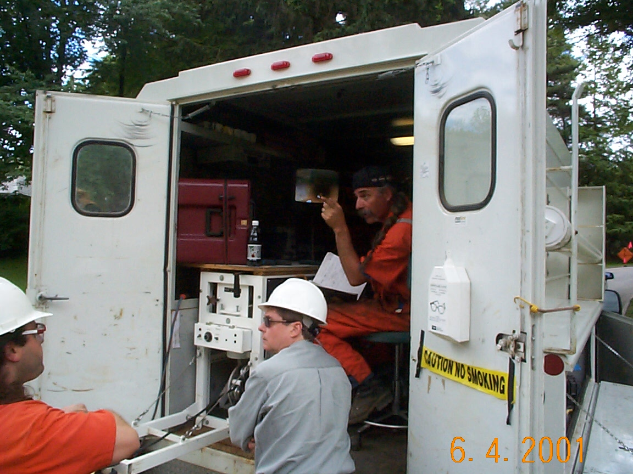
Once decontaminated, the main is visually inspected using a robotic camera

Slide 8
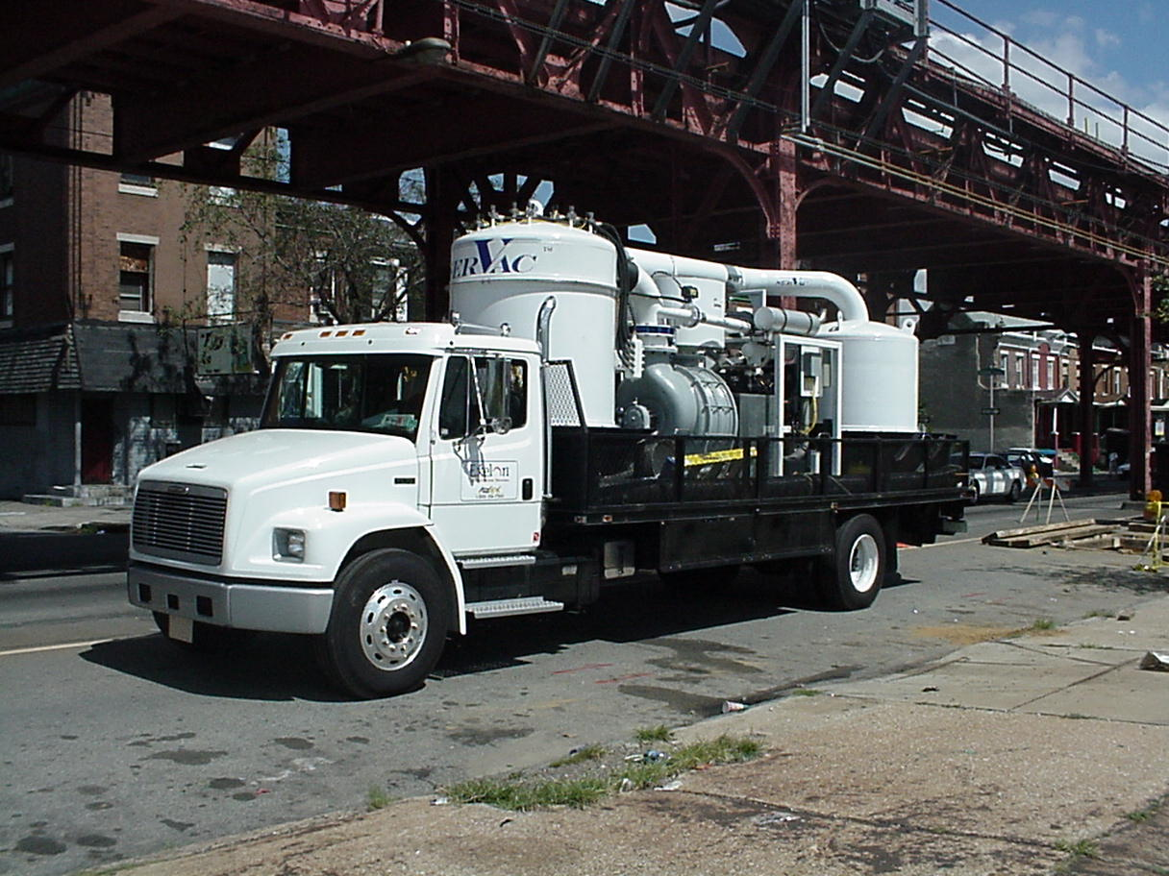
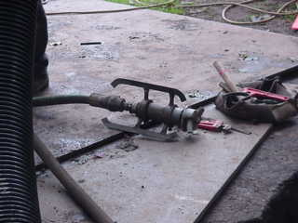
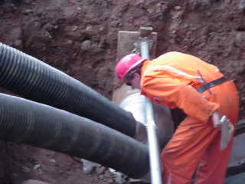
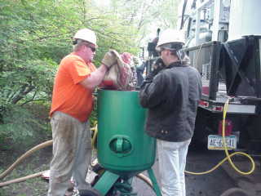
After the initial inspection, the pipe cleaning is performed using a combination of sand blasting and vacuuming

Slide 9
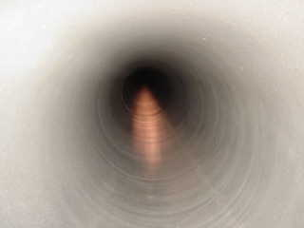
A second camera inspection is then performed to ensure the effectiveness of the cleaning for proper adhesion.

Slide 10
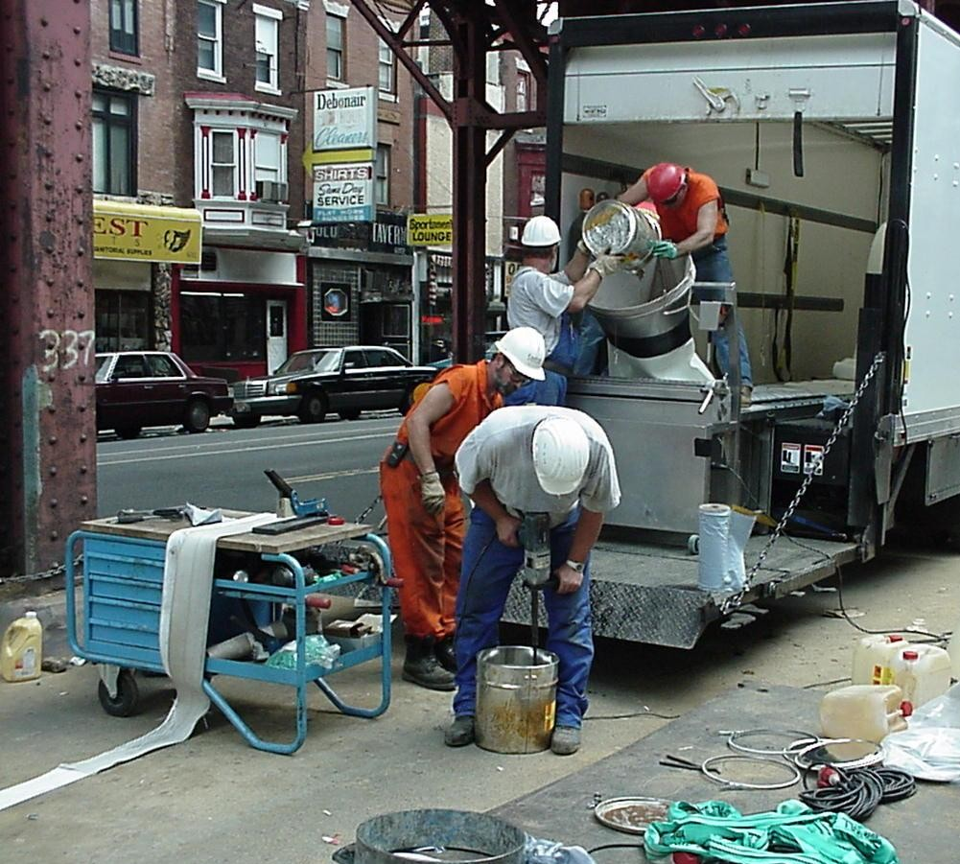
Epoxy is mixed and poured into liner material

Slide 11
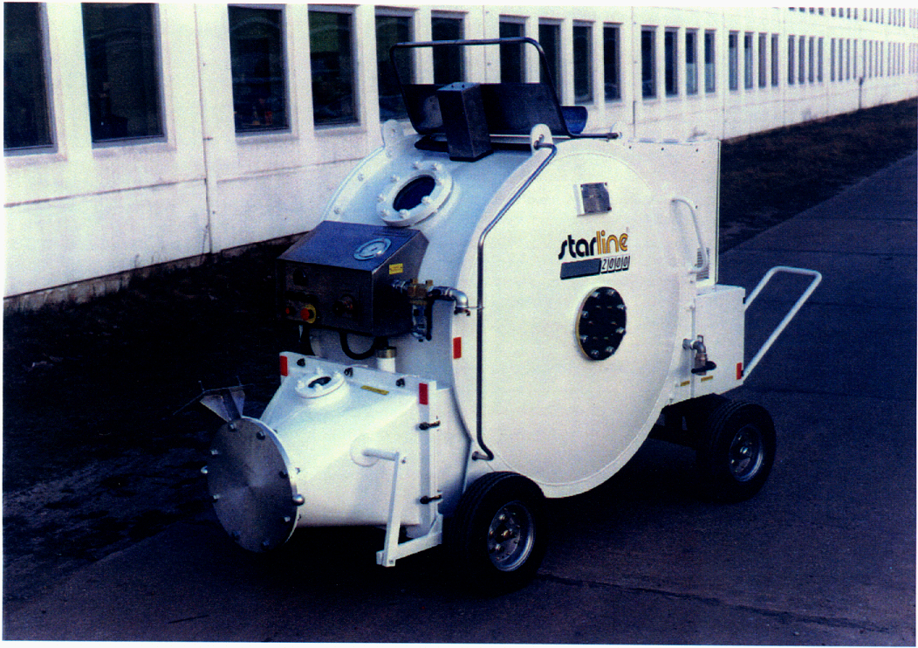
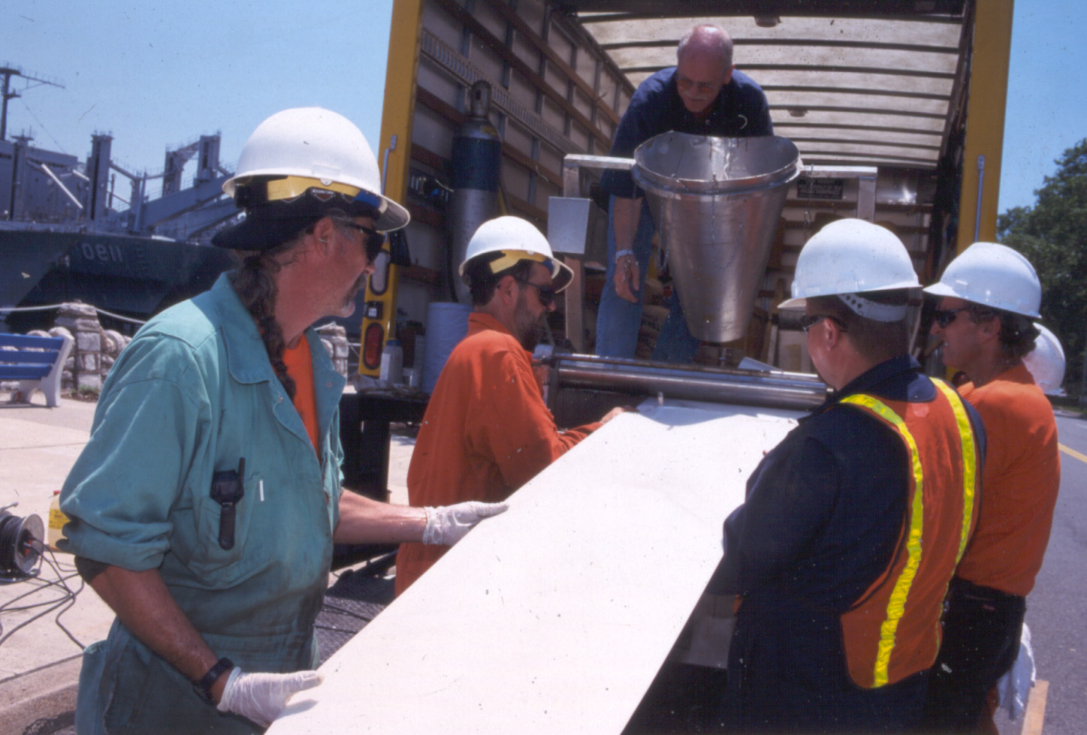
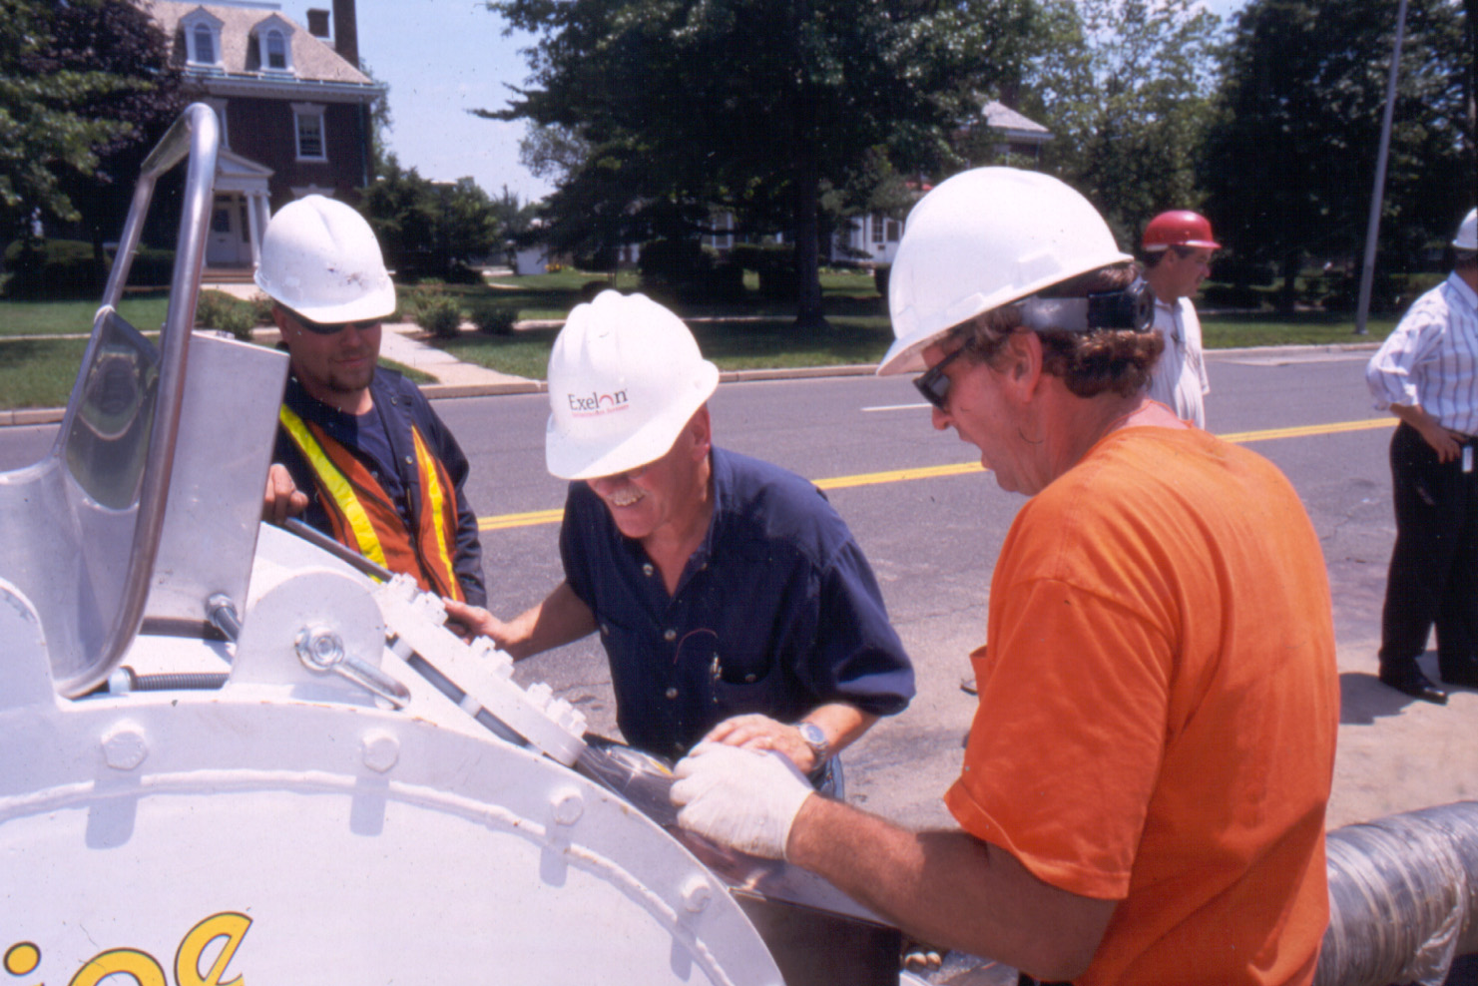
Liner is loaded into pressure drum

Slide 12
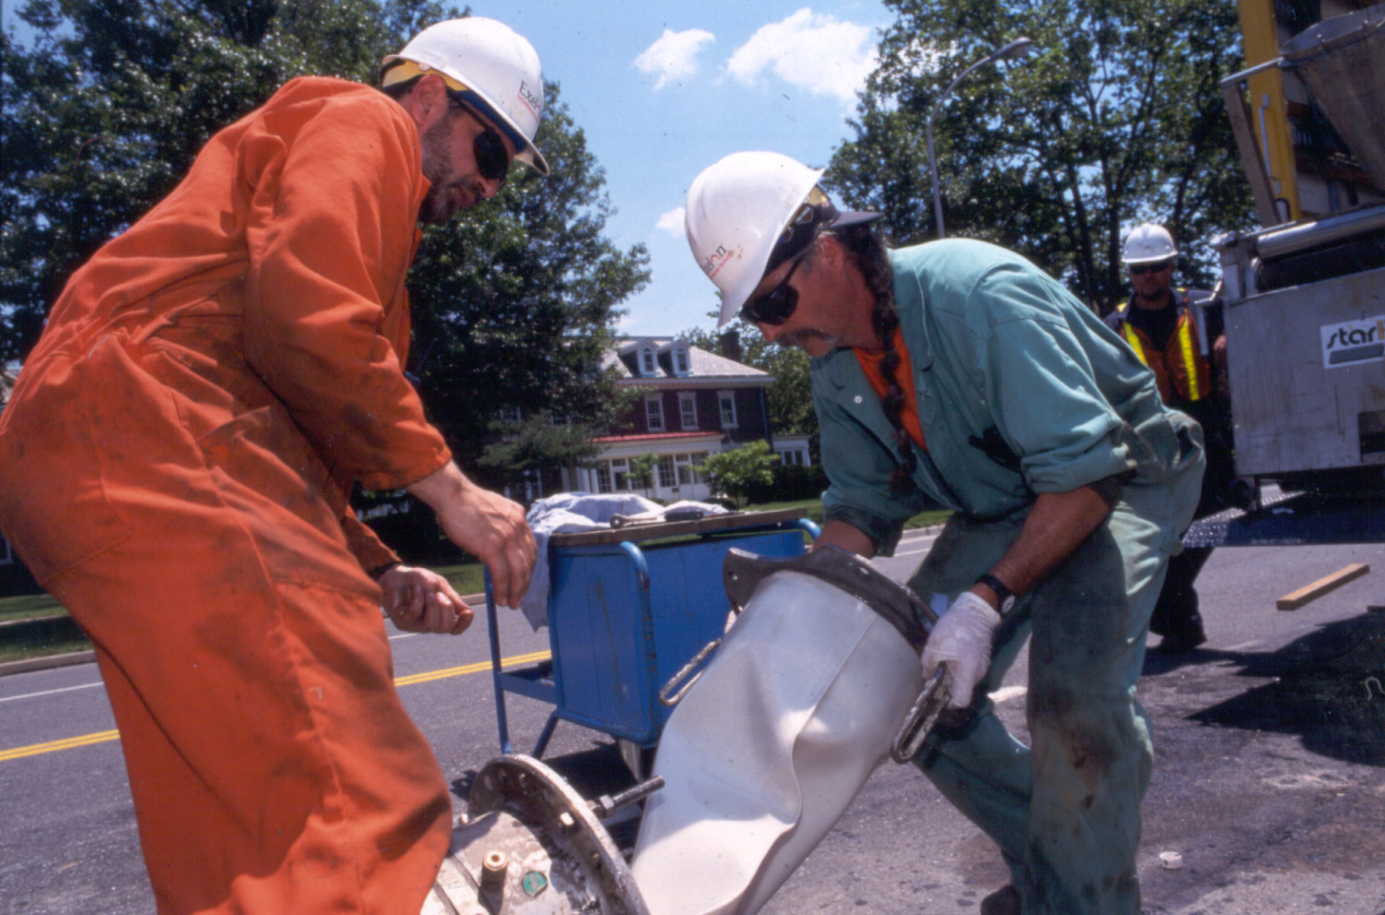
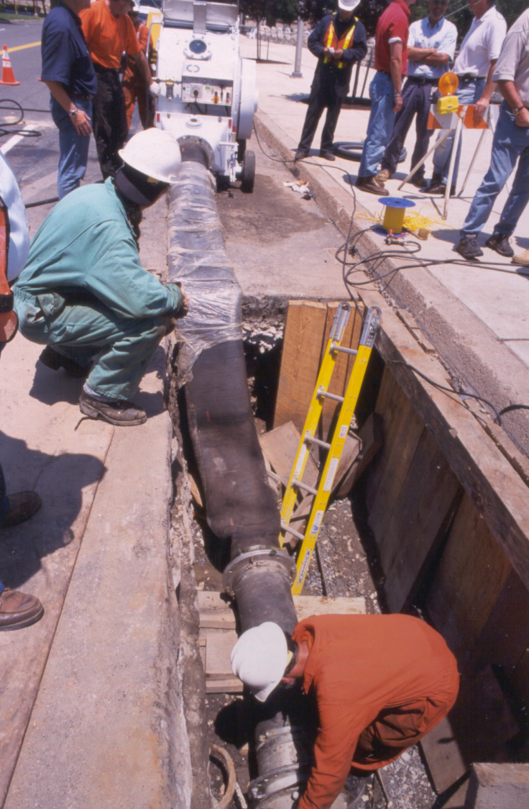
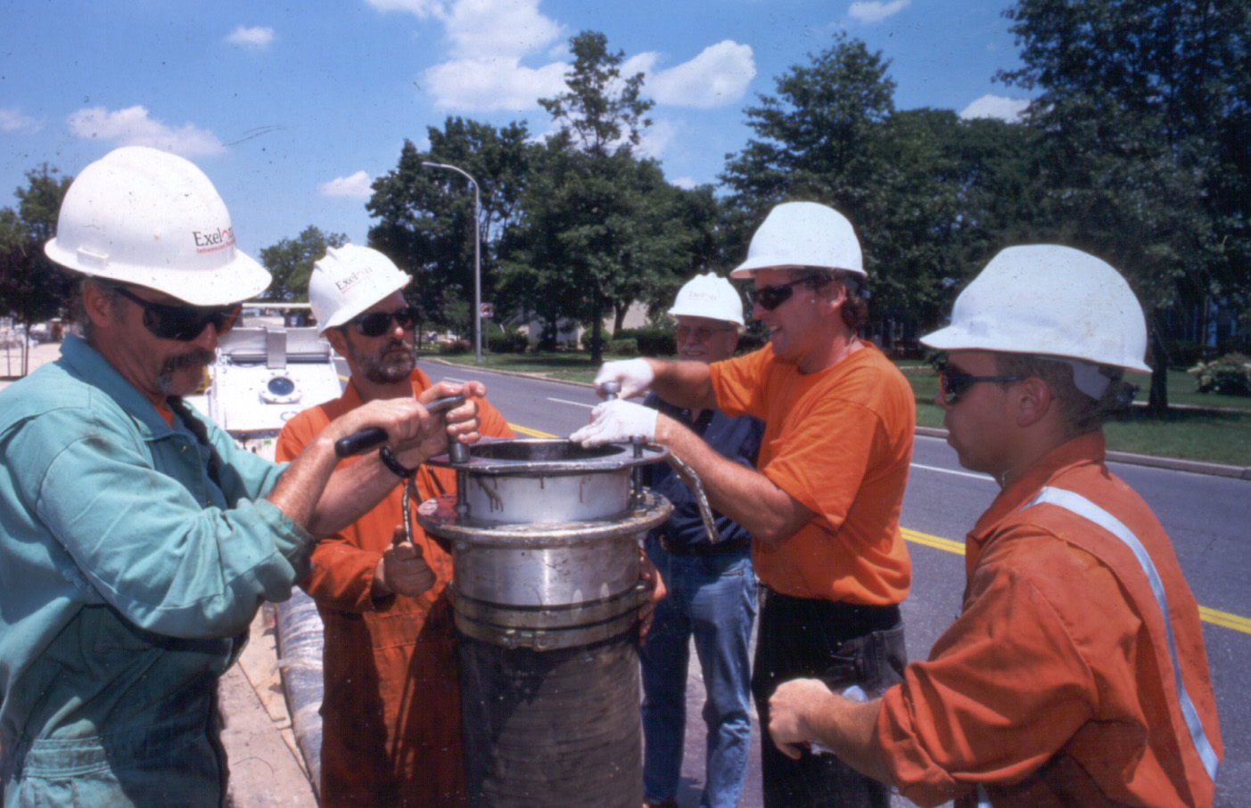
Liner attached to inversion cone which is then mounted to the main section to be lined and the inversion begins.

Slide 13
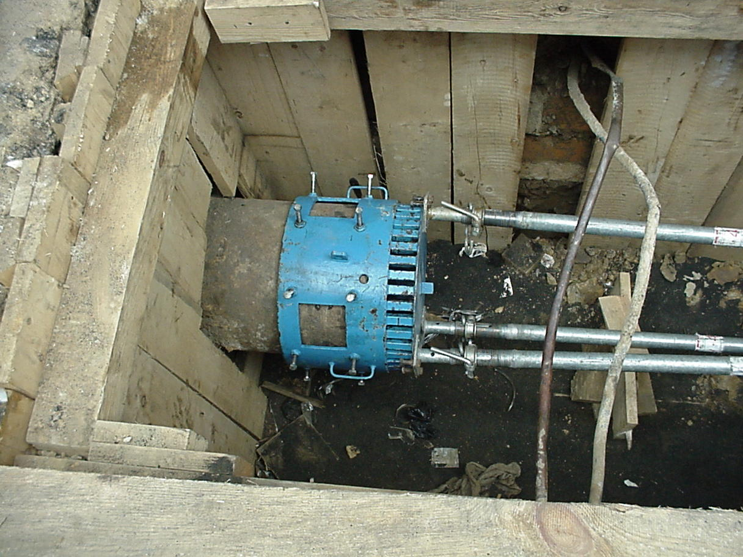
Liner inverted into catch basket

Slide 14
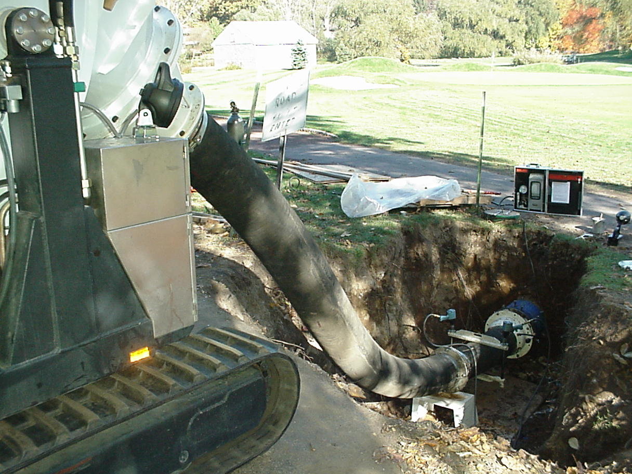
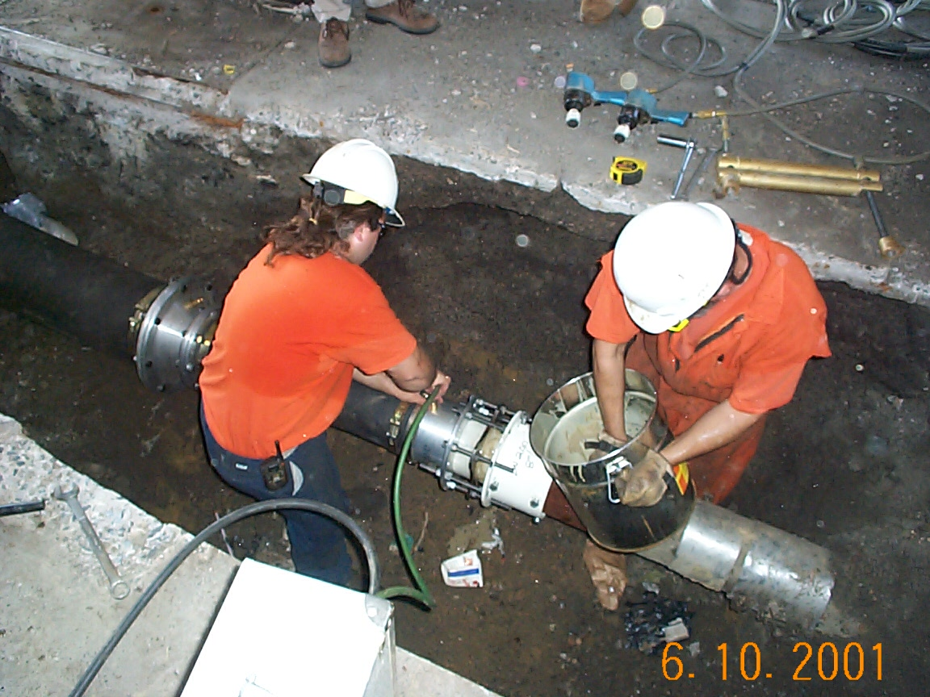
Equipment is disconnected and liner cured at ambient temperatures overnight (12 – 14 Hrs)

Slide 15
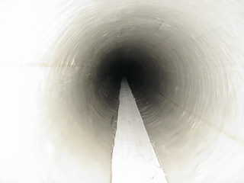
Curing Process is then followed by a final visual inspection of lined segment via the robotic camera.

Slide 16
Steps in the Process (continued)
Inversion process from mixing to beginning of curing process is completed in approximately two hours.
Main section cured using ambient temperature overnight (12-14 hrs)
Main is pressure tested and returned to service completing project.

Slide 17
Questions?
Contact Ted Fiala
Director, New Technologies
Exelon Infrastructure Services
610-690-6762
Ted.fiala@exelonis.com

